Slide 1
Module | Developing Emotional Intelligence Skills
Module Code | LCLM 5006
Student Name/ ID | simren Kaleem 2414630
Assignment Title | C1- Poster Presentation
Submission Date | 15/06/2026

Slide 2
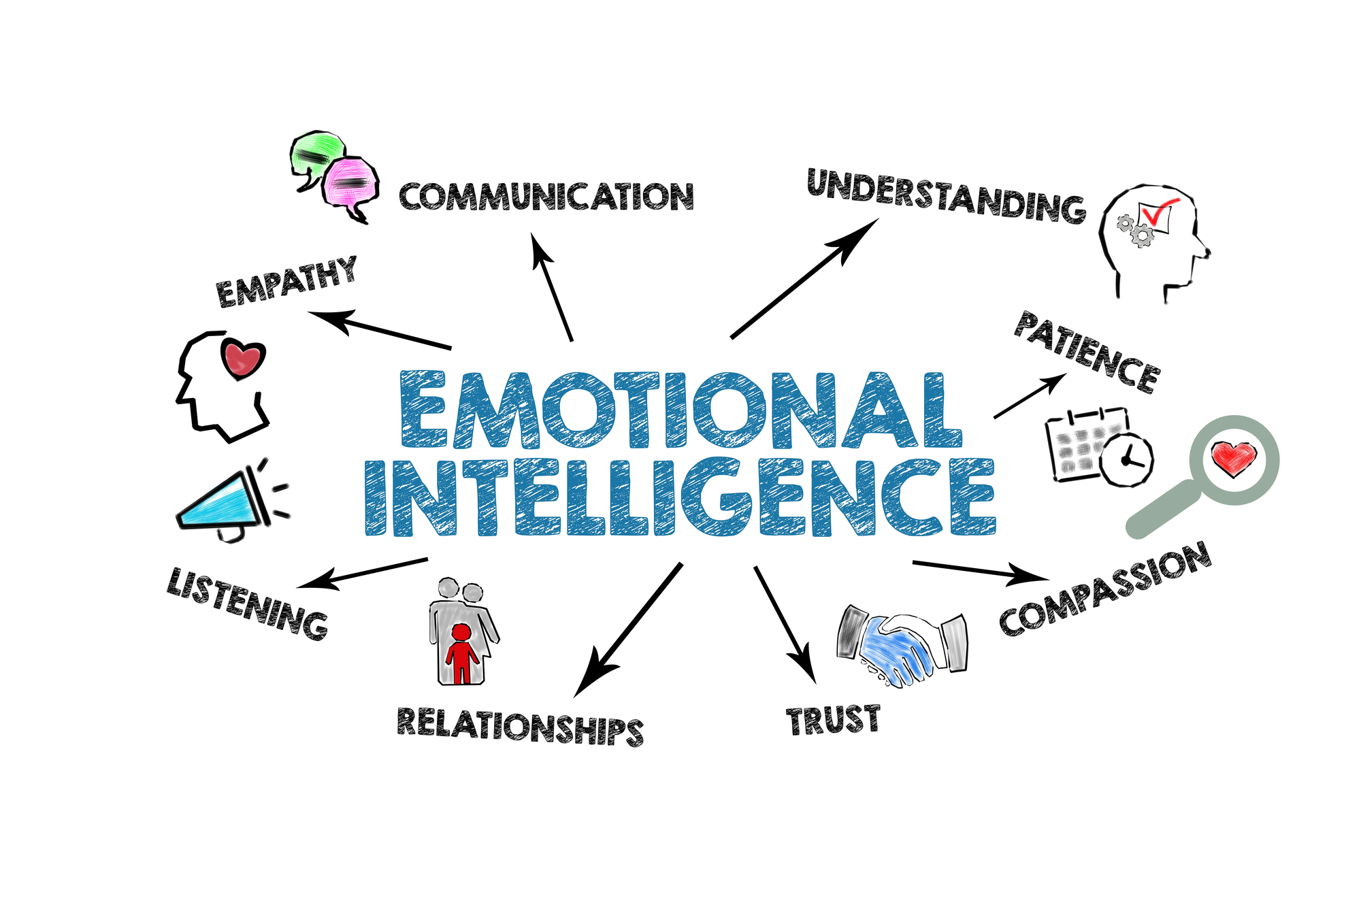
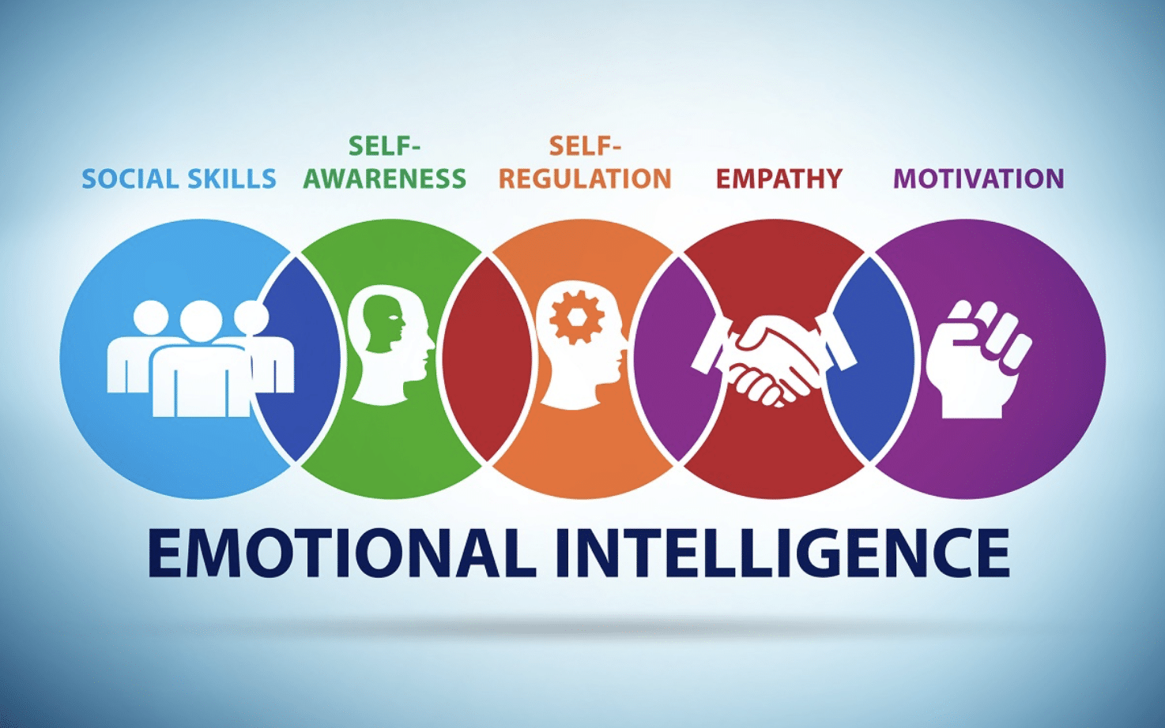
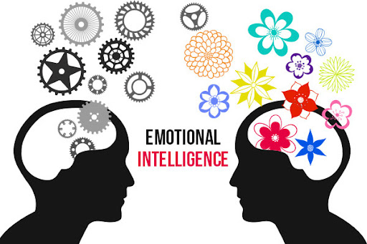
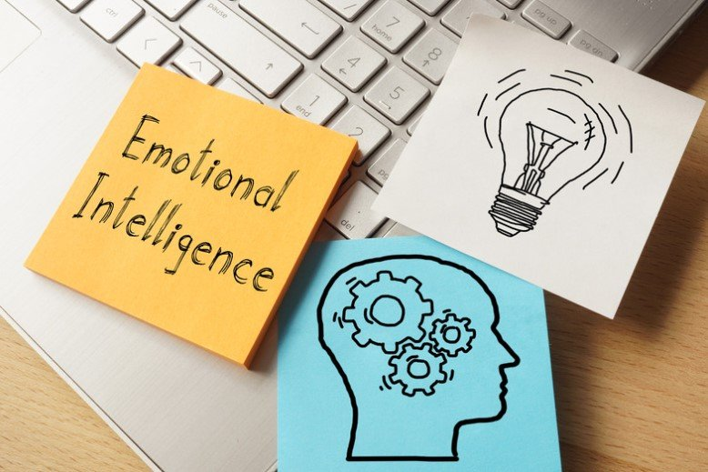
LCLM 5006 Developing Emotional Intelligence Skills
Introduction
Emotional intelligence (EI) is the ability to identify, comprehend and control personal and other people emotional state and is generally known to be a key factor in effective group performance. Some of the problems that students experience in academic group projects and will most likely have negative impacts on teamwork and performance are conflicting priorities, tight deadlines and disengagement. However, self-awareness, self-regulation and empathy provide a model of coping with these challenges through EI. Nevertheless, since the gap between the generations in terms of their communication patterns and emotional manifestations may create an obstacle to the successful application of EI, they will be forced to resort to the adaptive strategies that will be based on the nuances of the team dynamics
.
Section 2 – Managing Own Emotions
Individual feelings are essential in order to be productive and reduce stress in group work. Some of the strategies that help students manage their emotional responses, remain focused when in stressful situations, and take a moment to think before they say include mindfulness, reflective journaling, and having a moment to think (Majerová and Sokolová, 2025). Mindfulness, including breathing exercises in short intervals or guided meditation to become more self-aware and less susceptible to impulsive reactions and make better choices. The reflection also allows the students to identify the patterns in their emotional responses and this provides an indication on the source of stress/frustration. In addition, cognitive reframing and time prioritisation are strategies of stress management that aid in stress resilience in stressful academia.
However, the success of these techniques depends on such factors as personal motivation and personality. Although there has been proof of the positive impact of mindfulness on stress relief, this might become constrained due to differences in participation levels, attitudes, and the amount of pressure associated with the project itself (Kriakous et al., 2021). Similarly, reflection requires much self-control and mental effort from a person, and not all students can sustain this on a consistent basis. Nevertheless, using a few of these techniques together can lead to overcoming these limitations, and thus, provide an effective emotion regulation approach. Finally, the deliberate control of emotions is not only beneficial to individual health but also the cohesion of groups, their performance and ability to manage interpersonal issues effectively.
Section 3 – Understanding Others’ Emotions
Empathy is the key to effective group work that can enable students to recognize and respond to the feelings of others in the most sufficient manner. Some of the methods that enhance interpersonal understanding and facilitate joint problem solving are active listening, perspective taking, and providing constructive feedback. Active listening will allow students to acquire as much as possible about the opinions of the other and perspective-taking will allow the students to value the motivation, experiences, and communication style of the other (Paramole et al., 2024). Emotional awareness in the form of positively oriented feedback helps the learning process and makes everyone involved engaged, thus reducing tensions and irritations within the team.
The generational differences influence how students think about and feel emotions and might impact the EI practice. To illustrate the point, younger students may be more inclined towards digital communication and this aspect may reduce the level of emotional cue, and older students may be reliant on face-to-face communication and this affects the feeling of empathy (Stieger, Lewetz and Willinger, 2023). Notably, the over-identifying with the emotions of colleagues could be a barrier to objectivity and judgement, therefore, a moderate EI practice is required to maintain the balance between professional judgements and build a team spirit. Nevertheless, empathy construction can establish the environment of acknowledgment and acknowledgment of different perspectives, which enhances collaboration and the success of the entire project. Using empathy as a strategic tool, students can be able to solve interpersonal issues, be more trustful of one another, and maximize individual and group output.
Section 1 – EI in Teamwork
Emotional intelligence (EI) is a key component of building a successful teamwork, particularly in the case of the academic group projects, where various personalities and styles come into contact. Two of the most popular models that can offer alternative perspectives are Goleman and the four-branch model of EI by Mayer and Salovey. Goleman concentrates on social competencies and concepts such as self-awareness, self-regulation, motivation, empathy, and social skills as well as highlights practical implications of interpersonal behaviours in making teams cohesive (Brackett, Delaney and Salovey, 2025). Comparatively, Mayer and Salovey are worried about the mental processes that surround emotions like the appropriate perception of emotion, ease of thinking, meaning of emotion and control of emotion information.
Where Goleman has concentrated on social skills and motivation, Mayer and Salovey on cognitive theory, in practice, in a student project, there may be disproportionate contribution, conflict or incompatible work habits. As an example, when a team member fails to contain his/her frustration due to tight deadlines, he/she may disrupt the team activity, whereas empathy and perspective-taking may restore collaboration activities when another team member is understanding and perceptive of other team members. The inclusion of EI practices can help students to handle the feedback in a constructive way, to overcome the tension in the relationship, and to be engaged (Fteiha and Awwad, 2020). However, the successful realization of the EI concerns the understanding of individual differences and situational factors since not all team members can perceive and respond to emotional cues in a similar manner. These EI models as a combination provides a model of developing individual and team competencies which ultimately leads to a more effective team work.
References
Brackett, M., Delaney, S. and Salovey, P. (2025) Emotional Intelligence, Noba. Available at: https://nobaproject.com/modules/emotional-intelligence.
Fteiha, M. and Awwad, N. (2020) ‘Emotional intelligence and its relationship with stress coping style’, Health Psychology Open, 7(2). Available at: https://doi.org/10.1177/2055102920970416.
Kriakous, S.A., Elliott, K.A., Lamers, C. and Owen, R. (2021) ‘The effectiveness of mindfulness-based stress reduction on the psychological functioning of healthcare professionals: A systematic review’, Mindfulness, 12(1), pp. 1–28. Available at: https://doi.org/10.1007/s12671-020-01500-9.
Majerová, N. and Sokolová, L. (2025) ‘Well-being and academic stress in higher education students: interview and diary study’, International Journal of Qualitative Studies on Health and Well-being, 20(1). Available at: https://doi.org/10.1080/17482631.2025.2602369.
Maldonado, I.C. and Márquez, M.-D.B. (2023) ‘Emotional intelligence, leadership, and work teams: a hybrid literature review’, Heliyon, 9(10), pp. 1–19. Available at: https://doi.org/10.1016/j.heliyon.2023.e20356.
Paramole, O.C., Adeoye, M.A., Arowosaye, S.A. and Ibikunle, Y.A. (2024) ‘The Impact of Active Listening on Student Engagement and Learning Outcomes in Educational Settings’, International Journal of Universal Education, 2(2), pp. 77–89. Available at: https://doi.org/10.33084/ijue.v2i2.8898.
Stieger, S., Lewetz, D. and Willinger, D. (2023) ‘Face-to-face More Important than Digital Communication for Mental Health during the Pandemic’, Scientific Reports, 13(1). Available at: https://doi.org/10.1038/s41598-023-34957-4.
Conclusion / Recommendations
The main aspect of effective collaboration is EI that enables students to manage their emotions, to learn how other participants feel, and apply their social skills. Sections 1-3 demonstrates that integration of EI models such as social competency model created by Goleman and cognitive model created by Mayer and Salovey will be used to resolve conflicts, give constructive feedbacks, and work together, but mindfulness and reflection will be used to help with personal resilience. The practical suggestions are to practice self-reflection in order to determine emotional triggers, to use systematic feedback mechanisms in order to support communication, and to engage in empathy exercises to build team cohesion. Even though EI frameworks are in place, it would be significant to adapt to different behaviours of students and group behaviours in order to maximise individual and group performance.

