Slide 1



Effective Teamwork and Communication
Reflections

Slide 2

Putting your skills to the test

Slide 3





SCENARIOS
In groups you will be allocated a scenario to work through, using the knowledge and skills learnt throughout the module to answer the questions.

Slide 4



Scenario 1 – Group project
Scenario 2 – Planning
a fundraiser
Scenario 3 – Misunderstood instructions
Scenario 4 – New
team member
Scenario 5 – Solving a
community problem
Notes:
Provide handouts or signpost to Moodle.
Once the scenarios have been discussed in groups link these to models and theory covered in the module.

Slide 5
Looking Ahead: Your Personal Development Plan
As we look forward to next term, this is your opportunity to reflect on your academic journey and identify one key skill you’d like to improve.
Choose an area that you feel would make a real difference to your progress.
What went well: Briefly highlight something you’re proud of from this term.
What could be improved: Identify one specific area where you feel there’s room to grow.
How to move forward: Suggest clear, realistic steps you can take to improve in this area next term. Think about tools, habits, or support that might help.
Notes:
You can do this in pairs and only share with the wider group if you feel comfortable doing so.

Slide 6


HOW HAVE YOU FOUND THIS MODULE?

Slide 7

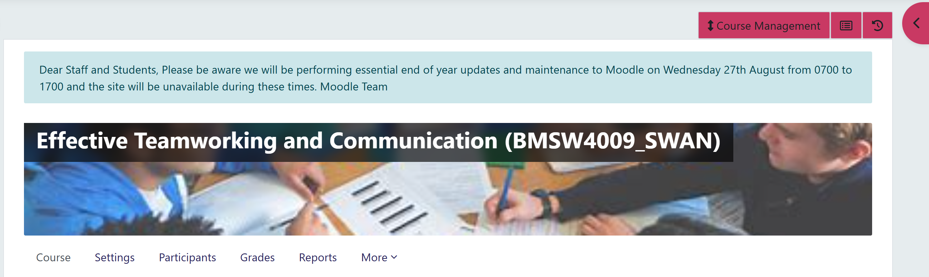
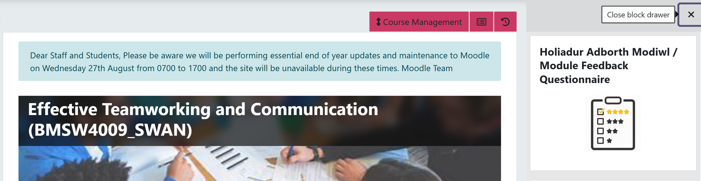
Module Evaluation Questionnaire - Provide Your Feedback!

Slide 8
Your Voice Matters: End-of-Term Feedback
As we come to the end of the term, I’d love to hear your thoughts on the module.
On the sheet of paper provided, please write down:
What you liked about the module
What you didn’t enjoy or think could be improved
Be honest, constructive, and respectful—this is your chance to help shape the future of the course. Your feedback will help me understand what worked well and what could be better next time.
You can write comments, draw diagrams, or be creative with your response—whatever helps you express your thoughts best.

Slide 9
Thank You
Keep an eye out for updates regarding online activities next week
Have a fantastic summer!
If you have any questions, please do not hesitate to reach out.
m.squire@uwtsd.ac.uk

