Slide 1


Student: Mazar Iqbal.
Lecturer: Olufemi Oluranti.
Module: Professional Development within Health and Social Care.
Hi, my name is Mazar Iqbal. In this presentation, I’ll talk about my journey into care, how my past experiance in management has helped, and the steps I’m taking to become a care home manager.
This is based on what I’ve learned from my Level 4 course and my years in supervision and warehouse management.
Notes:
Good morning. My name is Mazar Iqbal, and today I’ll share my professional development journey within Health and Social Care.
My goal is to become a Care Home Manager—a role that requires leadership, empathy, and continuous learning. Over the next few minutes,
I’ll walk you through how my background, skills, and experiences have shaped my path toward that goal.

Slide 2

My Career Goal: Care Home Manager
My goal is to manage a care home where people feel safe, supported, and respected.
I’m using my leadership background and new learning to build the right skills.
I want to lead by example, make staff feel valued, and improve care every day.
Notes:
My career goal is to lead a care home where people feel respected, valued, and safe.
I’m building on my leadership background and new learning from this module to develop strong interpersonal and management skills.
My aim is to lead by example, promote high standards of care, and create a supportive culture for both staff and residents.

Slide 3

Understanding Job Roles
Now I look at job descriptions to understand what employers want.
For a care home manager, it means leadership, safeguarding, paperwork, and good communication (NHS Jobs, 2024).
Knowing this helps me plan my steps and focus on what I need to work on.
Notes:
In understanding job roles, I researched responsibilities and expectations for Care Home Managers through NHS Jobs and Skills for Care.
This includes overseeing staff, maintaining compliance with CQC regulations, and ensuring residents’ wellbeing.
I learned that effective leaders balance administration with compassionate care—something I aspire to master.

Slide 4
Professional Applications
I’ve learned how to write a CV and cover letter that match what the job asks for.
I highlight my past leadership experience and the new care skills I’m gaining (Skills for Care, 2024).
Shortlisting tools showed me how employers pick the right candidate.
Notes:
I’ve applied professional values such as accountability, teamwork, and person-centered care in my current role.
These align with the NHS and Health Education England frameworks. I’ve also developed communication skills to handle sensitive issues,
provide feedback, and support staff growth.

Slide 5


Experience & Skills Development
I’ve worked 20 years in a Depot , 6 years as a supervisor.
That gave me team leadership, timekeeping, and problem solving skills.
Now I’m learning more about safeguarding, care planning, and reflective thinking.
This supports my CPD which means continuing professional development helping me grow through hands on experience and training.
Notes:
Through experience, I’ve strengthened my leadership, problem-solving, and adaptability.
I’ve also identified areas for growth, like conflict resolution and data-driven decision making.
I plan to gain more direct experience in care settings by observing or working alongside experienced managers in the future. Training sessions and self-study have already helped me understand what effective leadership in care looks like.

Slide 6

Leadership, Career Steps & CQC
Here are my steps to becoming a care home manager:
1. Finish Level 4 Health and Social Care
2. Get real experience in care through volunteering or entry level work
3. Shadow experienced carers and managers
4. Apply for a senior care or team leader role
5. Complete Level 5 in Care Leadership
6. Apply for a care home manager post
I’ve led teams for 20 years, but I know I need direct care experience to understand how care is delivered and how to support residents.
The CQC checks care homes to make sure they’re safe and well led. As a manager, I’ll be responsible for meeting these standards (Skills for Care, 2024).
This includes following the law on confidentiality – protecting private information about residents, and only sharing it when it’s necessary for their care.
Notes:
Understanding CQC standards has been crucial. I’ve learned that leadership isn’t just about authority—it’s about accountability, motivation,
and ensuring compliance. My next step is to gain formal management qualifications and continue mentoring others in care settings.

Slide 7
SWOT Analysis
• Strengths: Strong leadership, organisation, and communication skills gained from my experience as a warehouse manager. These are transferable to care management team coordination, responsibility, and consistent performance.
• Weaknesses: Limited hands on experience in the care sector and developing understanding of clinical and CQC compliance standards. However, my Level 4 studies in Health and Social Care are helping me bridge this gap.
• Opportunities: Mentorship, continued study, and volunteering in care environments will help me gain the practical experience I need. Networking with professionals and joining training sessions will support my career transition.
• Threats: Competition from experienced care professionals and initial lack of sector specific knowledge. I plan to reduce these threats through ongoing education, reflection, and applying my proven leadership strengths.
Notes:
This slide is the central part of my presentation: my SWOT analysis.
My strengths come from my time as a warehouse manager, where I developed leadership, organisation, and communication skills.
These strengths are fully transferable to health and social care, because managing people, maintaining standards, and creating a supportive team culture are universal leadership qualities.
My main weakness is my limited direct care experience. I’m still developing my understanding of CQC regulations, care planning, and health and safety procedures in care homes.
However, I’m actively closing that gap through my Level 4 studies, which are helping me apply theory to real-life scenarios.
My opportunities include continuing my education, seeking mentorship, and volunteering in care settings to gain sector-specific experience.
These opportunities will give me the knowledge and confidence to transition successfully into a Care Home Manager role.
As for threats, I’m aware that competition and lack of care experience could slow my progress. But by reflecting on my transferable leadership skills,
continuing my education, and learning from experienced professionals, I can turn those threats into motivation for growth and resilience.
This analysis helps me understand my professional position clearly. Now, let’s explore my strengths and areas for development in more detail, and how I plan to use them in my future role as a Care Home Manager.

Slide 8

Strengths
- Confident in managing people and tasks
- Good under pressure
- Strong communication and teamwork
- Open to learning and feedback
- Respectful and person-centred approach
Notes:
Building on my SWOT reflection, these are the strengths I rely on most in my professional journey. Reflecting on my strengths, I’m a strong communicator, empathetic, and organized.
I’m dependable and skilled in motivating others—qualities essential for a Care Home Manager. These are my key strengths.
From a SWOT perspective, I use these strengths to overcome weaknesses, such as occasional self-doubt when faced with new challenges.
For example, by drawing on feedback and focusing on positive outcomes, I build confidence.
My opportunities include further leadership training and networking within the sector, while threats—like burnout—can be minimized through self-care and effective delegation.
I also use my empathy and communication skills to create trust and collaboration among staff, which strengthens team morale and ensures continuity of care.
By reflecting on my progress and continuously seeking constructive feedback, I turn my strengths into growth tools—keeping me motivated and grounded as a leader.

Slide 9

Areas for Development
- Limited care sector experience
- Need to learn care regulations and policies (Skills for Care, 2024)
- Practice documentation and audits
- Improve confidence in safeguarding decisions (Health Education England, 2023)
- Learn to support emotional needs of residents and families
These are areas I'm actively working on as I prepare for leadership in care.
Notes:
Following from my strengths, I’ve also identified key areas for development that will help me grow further. My main areas for development include expanding my clinical knowledge and enhancing conflict management.
I plan to use my strengths—like communication and empathy—to address these gaps.
By seeking mentorship and learning from experienced managers, I’ll convert potential weaknesses into opportunities for growth.
This approach will help me stay adaptable and resilient in a demanding environment.
From the SWOT perspective, I view challenges as learning points. Opportunities such as leadership qualifications, shadowing managers,
and attending CQC-focused workshops will help me improve my management and compliance understanding.
To minimize threats such as burnout and stress, I’ll maintain a good work-life balance, seek support when needed, and delegate tasks appropriately.
Overall, using reflection and self-awareness, I can balance personal limitations with professional strengths, turning every challenge into a chance for growth.

Slide 10
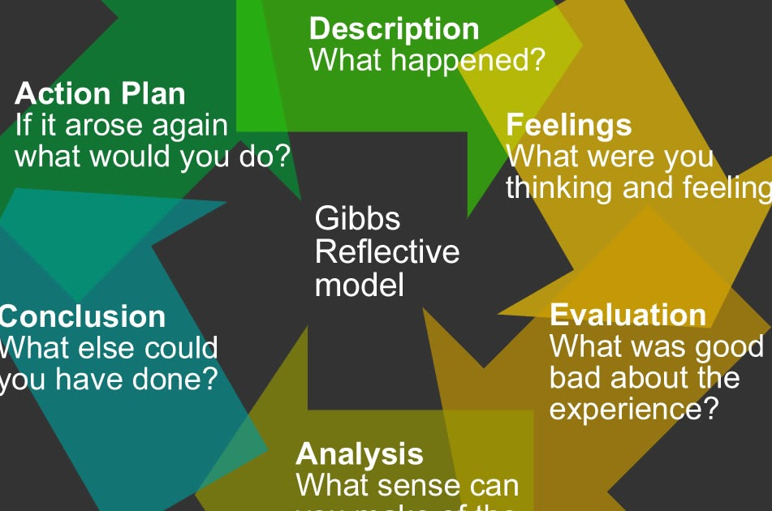

Reflection Using Gibbs’ Cycle
Gibbs' model helps me think clearly about what I’ve done, how I felt, what I learned, and what I’ll do next.
It helps me improve every time whether it’s in the classroom or care practice (Health Education England, 2023).
Notes:
Using Gibbs’ Reflective Cycle, I evaluate my experiences systematically—describing what happened, analyzing how I felt,
and identifying lessons for future improvement. Reflection helps me adapt and refine my approach, ensuring I grow both personally and professionally.

Slide 11

References & Conclusion
References:
Health Education England. (2023). Care Leadership Pathways. https://www.hee.nhs.uk
Skills for Care. (2024). Becoming a Care Manager. https://www.skillsforcare.org.uk
NHS Jobs. (2024). Care Roles and Descriptions. https://www.jobs.nhs.uk
To end, my management background gives me a strong start.
With the right care experience and learning, I believe I’ll be ready to lead a team and support people the right way.
Footnotes: Health Education England (2023), Skills for Care (2024), NHS Jobs (2024).
Notes:
To conclude, my management background and continued learning prepare me for a successful career as a Care Home Manager.
I’m committed to fostering a positive environment for staff and residents alike.
With ongoing training, reflection, and strong leadership values, I believe I’m ready to make a meaningful difference in care provision.
(References: Health Education England, 2023; Skills for Care, 2024; NHS Jobs, 2024)

