Slide 1
ROUSSEAU ON EDUCATION
LECTURE 7 – PART 2

Slide 2
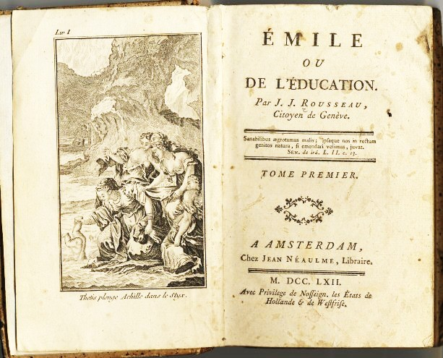
EMILE OR A NEW SYSTEM OF EDUCATION
Published 1762 and publically burned in Paris
Rousseau flees France (1766-7 in England)
Controversy centred around religious teaching in ‘Emile’

Slide 3
EMILE
Rousseau sets out his views on education
Semi-fictitious account of the early years of a young boy
Rousseau centres Emile’s education in the country, away from urban bad habits
Aim: to live righteously
Means: a guardian or guide used to put Emile through contrived experiences

Slide 4
EMILE contd...
Emile’s education divided between:
1. upto 12 years old – free of complex thinking, children allowed to run free
2. 12-16 years – reason develops
3. 16 upwards – adult development nurtured by skills requirement e.g. carpentry (the requirement of creativity and thought absent of moral compromise); also partners sought
Outcome: Emile is seen to acquire healthy living that allows him to follow his social instincts, but remain free of vices
Emile is seen to engage with society in a natural and instinctive way
He is seen to develop self worth and morals

Slide 5
EMILE contd...
Gender and Emile:
‘Emile’ is not ‘gender neutral’; Sophie (who is destined to marry Emile) enjoys a different course of education
Sophie (the ideal of womanhood) is educated ‘to be governed by her husband’, as opposed to Emile’s ‘self-governing’ life course
She is educated for the ‘private sphere’ reliant upon ‘a natural subordination of women’ for it to function

Slide 6
EMILE AND RELIGION
Controversy based upon the belief held by Rousseau that:
Man is ‘good by nature’, and:
‘There is no original perversity in the human heart’, hence:
The denying and overturning of ‘Original Sin’

