Slide 1
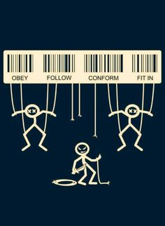
Compliance and obedience
Libertarian nation (2011)
1702538
Jason Morgan
SSAP4002

Slide 2
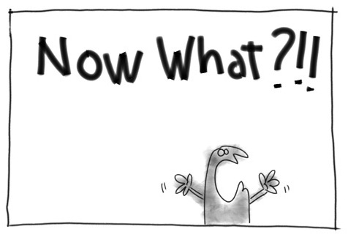
Contents
What do compliance and obedience mean?
What evidence is available?
What are the impacts of social compliance and obedience?
Conclusion
Awsomely luvvie, (2012)

Slide 3
What do Compliance and Obedience mean?
Compliance – refers to the acquiescence to a request (Cialdini, and Goldstein, 2004).
Obedience – refers to the compliance with an order, or request by authority (Milgram, and Gudehus, 1978).

Slide 4
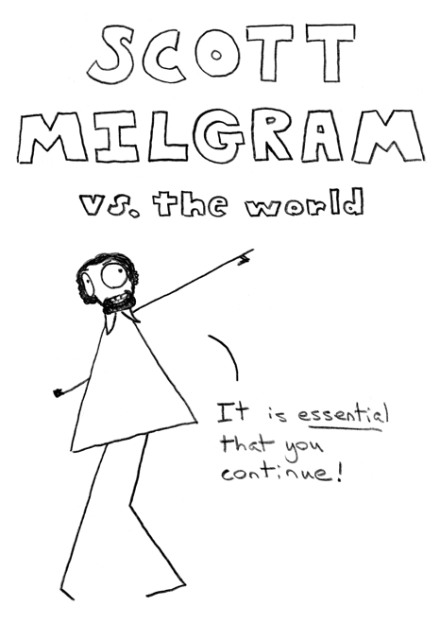
Obedience
Milgram’s (1963) study of obedience
Does gender differences matter?
Do we have the same level of obedience nowadays?
Does culture play a role?
Modern versions of Milgram's study
Doliński et al., (2017). Study of obedience
Eyeteeth (2012)

Slide 5

Compliance
  Foot in the door (Freedman & Fraser 1966).
  Door in the face (Cialdini et al., 1975).
  High ball low ball (Cialdini et al,. 1975).
  ‘that’s not all’ (Burger 1986).
Giantgeekyrobot (2014)

Slide 6
Conclusion
This essay has explained what compliance and obedience is
It has looked over some studies which delve into these subjects
Companies and adverts use compliance techniques to gain profit
Not much has changed over the past generations in accordance to compliance and obedience, as much as we think they have.
Gender and culture may not be an important factor in the level of obedience and compliance
The disappearance of a sense of responsibility is the most far-reaching consequence of submission to authority. Stanley milgram

Slide 7
References
Cialdini, R. B., & Goldstein, N. J. (2004). Social influence: Compliance and conformity. Annu. Rev. Psychol., 55, 591-621.
Doliński, D., Grzyb, Folwarczny, Grzybała, Krzyszycha, Martynowska, & Trojanowski. (2017). Would You Deliver an Electric Shock in 2015? Obedience in the Experimental Paradigm Developed by Stanley Milgram in the 50 Years Following the Original Studies. Social Psychological & Personality Science., 8(8), 927-933.
Milgram, S. (1963). Behavioral study of obedience. The Journal of abnormal and social psychology, 67(4), 371.
Milgram, S., & Gudehus, C. (1978). Obedience to authority.

