Slide 1
Global Perspectives in Education
Education for Sustainability Development and Global Citizenship
By Kat Williams

Slide 2
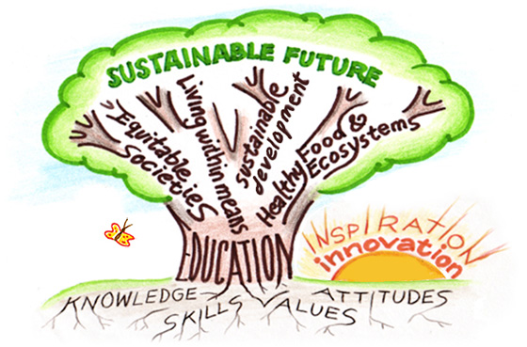



What is Education for Sustainability Development
and Global Citizenship?
Sustainability can be described as the processes or actions that humankind can satisfy it’s current economical, social and environmental needs, without compromising future generations, does not cause harm to society, locally and globally, (youmatter, 2020).
Global citizenship is being aware of and caring about the world we live in and the people within it. It is about protecting our planet for ourselves and future generations and making positive impacts and changes for a better quality of life for all, (United World Schools, no date).
Schools have a crucial role to play in helping to create citizens that understand the negative impacts that impedes on the welfare of the people and planet. ESD is alerting society to the current issues that are looming and educate possible solutions to mitigate them, (Hicks, no date).

Slide 3





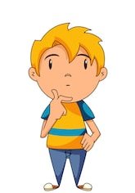
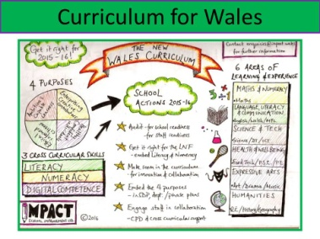

continued....
The idea of ESDGC originated from the Earth Summit 1992 to address global issues and the inability of future sustainability. This led to the UN’s Millennium Development Goals agreed in 2000 and later developed into the Sustainable Development Goals (SDG) which consists of 17 targets for global partnership and other deprivations including critical issues addressing climate change and preserving our oceans and forests in 2015, (Lefko, 2017).
The Welsh Government launched the ESDGC Common Understanding documents in July 2008 to support the implementation with hope these actions will be embedded within the school’s curriculum. The ESDGC will be compulsory in schools in Wales in 2022, although many schools have already amalgamated it within the new curriculum, (Eco School, 1994-2019).
The ESDGC enables students to:
Make links between society, economy and environment in our own lives and others around the world
Establish relationships between power, resources and human rights
Realise local and global implications we have, as individuals and organisations can cause consequences to local and global issues, (Welsh Government, 2008).

Slide 4


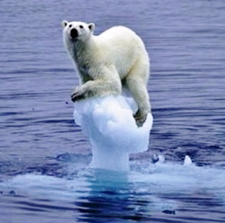
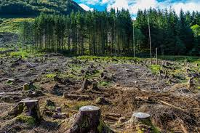
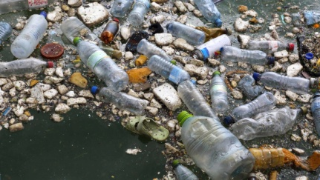
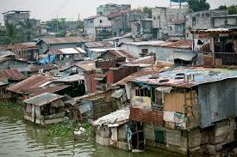

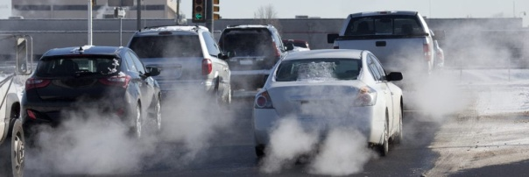


Can ESDGC Help to Promote Global Issues?
Nuclear plants
Animal’s environments
suffering
Deforestation
Plastics/rubbish in our oceans
Global warming
Poverty
Air pollution
The carbon footprint
The above illustrations are the issues the pupils within the setting are mostly concerned and care about within society and globally. They are learning that actions have consequences and repercussions on where they live and the rest of the world.
Discussing ESD, has encouraged pupil decision making skills, become more innovative and creative thinkers and enlightened them to larger critical factors that are harming our planet and is leading them to believe they can make long-lasting positive changes to help to create a sustainable world, (Eco Schools, 1994-2019).

Slide 5



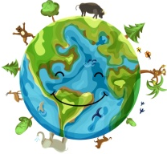







How do Schools Implement ESDGC in the Curricular?
There are 7 themes in the ESDGC that schools are to prioritise within teaching and learning, that helps students appreciate their context in the world beyond their classroom.
Identity and Culture
The Natural Environment
Wealth and Poverty
Health
Climate Change
Consumption and Waste
Choices and Decisions.
(Welsh Government, 2008).
There are 9 concepts associated with ESDGC and the themes will contribute to students understanding how to utilise them within their learning.
Interdependence
Citizenship and stewardship
Needs and rights of future generations
Diversity
Sustainable change
Quality of life
Uncertainty and precaution
Values and perceptions
Conflict resolution.
ESDGC is not a single topic or subject, it is incorporated into all Areas of Learning Experiences (AoLE) curriculum using pedagogical principles identified in the ‘Successful Futures’ (2015). Using ICT resources, whole class and group discussions, welcoming outside environmentalist organisations are all valuable and knowledgeable. Forest school leaders are a great asset to outdoor learning and most schools have Pupil Leadership Teams, which all orbit around the delivery of ESDGC and the 4 Core Purposes of education, (Estyn, 2019).

Slide 6





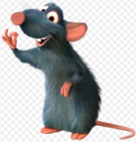









Pupil
Leadership
Teams
This group enhances pupils’ understanding of the Rights in education.
Rhodri Rangers
Sports Ambassadors
Be the school voice for PE, promote the positive values of sport, be a role model for sport and exercise.
The Eco Squad are responsible for looking after the sustainability of the setting, the pupils grow their own produce, ensure the importance of recycling and keeping the school clean and GREEN.
Digital Leaders
Eco Squad
Promote internet safety, have responsibilities of ensuring others have safety awareness and help others develop their ITC skills.
Criw Cymraeg
Healthy
Eating Squad
Helps to promote and encourage healthy eating throughout the school to become fit and active individuals.
Promotes the Welsh language throughout the school and engages others in Welsh celebrations.
(School’s website, 2019).

Slide 7












How is the Setting making Progress towards ESDGC?
“Keep our school Green”
There are compost bins around the areas of the school grounds, theses are widely used.
The school has 3 Eco-school green flags.
This year, the pupils have planted 150 trees on the school grounds.
The Eco Squad plant and harvest crops and vegetables grown in the poly tunnel.
The pupils sell home-made produce with ingredients grown on school grounds to outside community.
Regular litter picks around the grounds.
The school has a permanent Forest School Leader.
Regular discussions and stories are shared about global awareness during assembly’s .
All money raised is put into a new scheme to purchase new equipment to help the school to become sustainable.
The Eco Squad are currently raising money for a water butt.
Learners’ visit cultural venues to scaffold their outdoor learning experiences for example: St Fagan's National History Museum, National Waterfront Museum, Gower Heritage Centre and Techno Quest.
All toilets are fitted with hand dryers to avoid over-usage of paper towels.

Slide 8













continued....
“One World Week” highlights the importance of maintaining our planet, within this week there is a paper ban and Fair Trade is discussed.
The pupils work with a local community group to plant and help maintain plants and flowers in the local park and helped to build insect habitats.
The school have fitted solar panels and are monitored regularly.
Lavender is regularly grown to encourage the bee population.
The classrooms have sensors to turn off lights automatically during inactivity.
The school has a glitter ban.
The pupils learn about Victorian times and the Celtic Warriors. They compare and contrast what life was like then and now.
The setting have recycling bins accessible to all.
Outside agencies are often visiting the setting to discuss global issues and resolutions to help to tackle these issues, such as, WWF, RSPB, Dwr Cymru and other environmental organisations.
The setting supports Children in Need, Comic Relief and Save the Children Appeal.
The school has a second-hand uniform shop to help the local community.

Slide 9




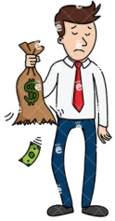



What are the Negative Aspects to ESDGC?
Some educators perceive ESDGC as an extra subject or an ‘add on’ to the curriculum, there is a lack of time and pressure for teachers to meet the criteria and teach other subjects, (Boyd, Hirst and Siraj-Blatchford, 2017).
Others feel too much emphasis is put into teaching ESDGC, pupils could misconstrued that everything man-made is destructive. There is a danger that human activity can be seen as corruptive and polluting by young children, (Grigg and Hughs, 2013).
There is scepticism on the ESDGC Framework, that the leading components are stuck in the 20th century and its contents are not teaching enough awareness of globalism, global terrorism, human rights and ecological abuses, (Zajda, 2010).
There are some concerns that young children may not be able to engage with the complexity of issues linked to ESDGC and discussing global threats facing humanity can over-burden young minds, (Tinney and Merriman, 2018).
Sustainable development will only be achieved by active participation from everyone, not only within schools, the wider society, (Tinney and Merriman, 2018).
Staff feel they may be lacking confidence and knowledge in teaching the ESDGC.
There is a lack of courses, money and time to educate the educators.
Funding can be an issue to keep up with environmental changes to become a sustainable school.
ESDGC is taking valuable teaching time away from more important core subjects, for example, literacy and numeracy, (Colley, 2009).

Slide 10

What are the benefits?
Pupils are very aware of the global issues and continuing to form solutions to tackle our future dilemmas.
By educating the children of today, we are heading towards a cleaner Wales, a happier UK and a brighter world for future generations.
The framework raises awareness that there is not enough food for everyone to eat, some live in insufficient living conditions, millions of children do not have the equal educational opportunities or rights. Students are learning the planet’s wildlife and habitats are diminishing and ‘we’ can make a difference.
The SDG’s help to raise awareness of the global issues for their next generations to come, they are increasingly helping to find solutions for sustainability.
Studies have shown ESDGC being taught in schools can improve academic skills, helps learners’ mental and moral development. This increases economic opportunities when they leave school, (Reynolds, 2016).

Slide 11

continued...
Learning about the SDG’s can engage and strengthen partnerships and relationships between parents, children, communities and local businesses.
Learners’ will understand culturally diverse experiences, critically evaluate their own values and attitudes, familiarise themselves with global citizenship, (Oxfam GB, 2019).
Welsh Government is committed to ESDGC in schools to ensure that Wales is heading towards sustainability. This has helped 90% of schools to be registered on the Eco-schools Program, (Scott et al, 2013).

Slide 12





Recommendations to increase awareness on ESDGC...
The school does not have a battery recycling bin.
A coffee morning could be a way of engaging parents and carers to be involved in sustainable development.
More bins on the school grounds and by the school gates would be benefitial, there is still an issue with littering after the school day.
There could be evening courses or a full day inset training for teaching staff to be educated on ESDGC.
There could be more advertisements around the school, on displays and outside of the setting to raise more awareness to pupils and parents.
There is a large usage on lamination sheets, this has a strain on the plastic waste, the setting is currently looking into eco-friendly plastics.
There are many staff members who are unaware of the ESDGC Framework.
The staff room does not have a food waste bin or a green tin and glass recycling bin, it has been requested.
Perhaps homework on global dangers that parents could get involved with could raise awareness.

Slide 13

Thank you for
listening. x

Slide 14

References...
*School* Primary School Policy Statement on the Curriculum (2019), Curriculum, Learning and Experiences. Available at: https://primarysite-prod-sorted.s3.amazonaws.com/clase-primary-school/UploadedDocument/5a758cdbfda845388ed94bcaa2d51e9a/curriculum-policy-2018.pdf
*school*Website (2019). Pupil Leadership Teams. Available at: https://www.claseprimaryschool.co.uk/pupil-voice-groups/ (Accessed on: 5 March 2020).
Boyd, D, Hirst, N and Siraj-Blatchford, J, (2017). Understanding Sustainability in Early Childhood Education: case studies and approaches from across the UK. Available at: https://books.google.co.uk (Accessed on: 6 March 2020).
Colley, H, (2009). Analysis of ESDGC in Welsh institutions: Barriers to the promotion of ESDG. Available at: https://www.hefcw.ac.uk/documents/news/events/2009%20Events/H%20Colley%20Presentation.pdf (Accessed on: 4 March 2020).

Slide 15
Eco Schools (1994-2019). Status for Environmental Education. Available at: https://www.academia.edu/41661936/Changing_Together_-_Eco_Schools_1994-2019_ (Accessed on: 4 March 2020).
ESTYN (2019) A school Report. Available at: https://www.estyn.gov.wales/sites/www.estyn.gov.wales/files/documents/Clase%20Primary%20School.pdf (Accessed on: 2 March 2020).
Grigg, R and Hughes, S, (2013). Teaching Primary Humanities. Available at: https://books.google.co.uk (Accessed on: 7 March 2020).
Hicks, D. (no date). Teaching for a Better World; a Sustainable Future. Available at: https://www.teaching4abetterworld.co.uk/sustainable.html (Accessed on: 5 March 2020).
Lefko, M (2017). Global Sustainability: 21 Leading CEO’s Show How to do Well by Doing Good. Available at: https://books.google.co.uk (Accessed on: 10 February 2020).
Oxfam GB (2019). The Sustainable Development Goals: A guide for teachers. Available at: https://oxfamilibrary.openrepository.com/bitstream/handle/10546/620842/edu-sustainable-development-guide-15072019-en.pdf?sequence=4 (Accessed on: 6 March 2020).

Slide 16
Reynolds, E, (2016). How to teach the UN's development goals, and why. Available at: https://www.britishcouncil.org/voices-magazine/why-teach-uns-development-goals-and-how (Accessed on: 6 March 2020).
Scott, W, Martin, S, Dillon, J, Higgins, P & Peters, C 2013, 'Divergent Evolution in Education for Sustainable Development Policy in the United Kingdom: Current Status, Best Practice, and Opportunities for the Future', Sustainability, vol. 5, no. 4, pp. 1522-1544. Available at: https://purehost.bath.ac.uk/ws/portalfiles/portal/89202884/Published_version.pdf (Accessed on: 3 March 2020).
Tinney, G and Merriman, E. Early Years Education and Education for Sustainable. Development and Global Citizenship (ESDGC) - Two Sides of the Same Coin? Wales Journal of Learning and Teaching in Higher Education (2018), Volume 1, Number 1, 71-76 pp. Available at: https://www.uwtsd.ac.uk/media/uwtsd-website/content-assets/documents/enhancement-unit/wales-journal/71-76-Tinney-and-Merriman.pdf (Accessed on: 3 March 2020).

Slide 17
United World Schools (no date). What is Global Citizenship? Available at: https://www.unitedworldschools.org/global-citizenship-award?gclid=EAIaIQobChMI4Y-d4NyG6AIVhbHtCh0U6Qk_EAAYASAAEgKxPfD_BwE (Accessed on: 7 March 2020).
Welsh Assembly Government (2008). Education for Sustainable Development and Global Citizenship in the Further Education Sector in Wales. Available at: https://gov.wales/sites/default/files/publications/2018-02/education-for-sustainable-development-and-global-citizenship-in-the-further-education-sector-in-wales_0.pdf (Accessed on: 6 March 2020).
Youmatter (2020) Sustainability – What Is It? Definition, Principles And Examples. Available at: https://youmatter.world/en/definition/definitions-sustainability-definition-examples-principles/ (Accessed on: 7 March 2020).
Zajda, J, (2010). Global Pedagogies: Schooling for the future. Available at: https://books.google.co.uk (Accessed on: 8 March 2020).

