Slide 1
INTRODUCTION TO PHYSIOLOGY
(BMHP5003)
WEEK 4 SESSION 3
THE ENDOCRINE SYSTEM
Mumtaz Goolam

Slide 2
Objective of the Session
By the end of the lesson students will be able to
Discuss the function of the endocrine system in relation to the principle of homeostasis.

Slide 3
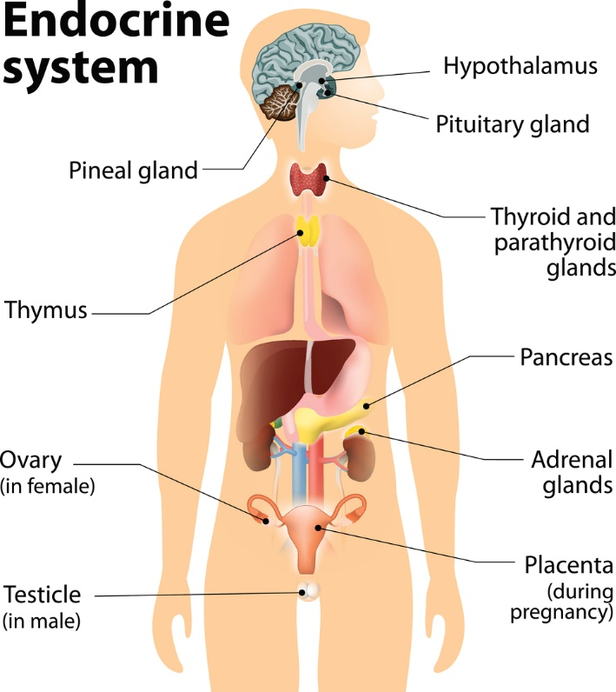

Slide 4
Endocrine system
The endocrine systems, also referred to as hormone system, comprise:
glands located throughout the body;
hormones that are made by the glands and released into the bloodstream or the fluid surrounding cells; and
receptors in various organs and tissues that recognise and respond to the hormones.

Slide 5
Location of Endocrine system
Hypothalamus - The hypothalamus links our endocrine and nervous systems together. The hypothalamus drives the endocrine system.
Pituitary gland - The pituitary gland receives signals from the hypothalamus. This gland has two lobes, the posterior and anterior lobes. The posterior lobe secretes hormones that are made by the hypothalamus. The anterior lobe produces its own hormones, several of which act on other endocrine glands.
Thyroid gland - The thyroid gland is critical to the healthy development and maturation of vertebrates and regulates metabolism.

Slide 6
Location of Endocrine system
Adrenal glands - The adrenal gland is made up of two glands: the cortex and medulla. These glands produce hormones in response to stress and regulate blood pressure, glucose metabolism, and the body's salt and water balance.
Pancreas - The pancreas is responsible for producing glucagon and insulin. Both hormones help regulate the concentration of glucose (sugar) in the blood.
Gonads - The male reproductive gonads, or testes, and female reproductive gonads, or ovaries, produce steroids that affect growth and development and also regulate reproductive cycles and behaviors. The major categories of gonadal steroids are androgens, estrogens, and progestins, all of which are found in both males and females but at different levels.

Slide 7
Endocrine system
Hormones act as chemical messengers that are released into the blood stream to act on an organ in another part of the body.
Although hormones reach all parts of the body, only target cells with compatible receptors are equipped to respond.
Over 50 hormones have been identified in humans and other vertebrates.

Slide 8
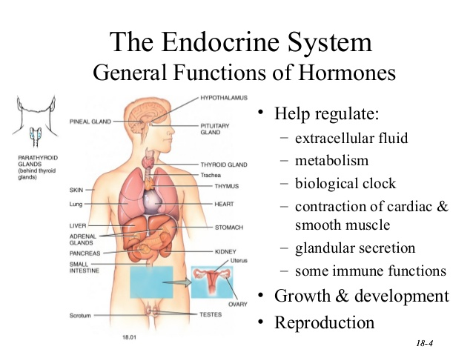

Slide 9
Endocrine system: functioning
Hormones control or regulate many biological processes and are often produced in exceptionally low amounts within the body. Examples of such processes include:
blood sugar control (insulin);
differentiation, growth, and function of reproductive organs (testosterone (T) and estradiol); and
body growth and energy production (growth hormone and thyroid hormone).

Slide 10
Endocrine system: hormones
Much like a lock and key, many hormones act by binding to receptors that are produced within cells.
When a hormone binds to a receptor, the receptor carries out the hormone's instructions, either by altering the cell's existing proteins or turning on genes that will build a new protein.
The hormone-receptor complex switches on or switches off specific biological processes in cells, tissues, and organs.

Slide 11
Endocrine system: examples
Estrogens are the group of hormones responsible for female sexual development.
They are produced primarily by the ovaries and in small amounts by the adrenal glands.
Androgens are responsible for male sex characteristics. Testosterone, the sex hormone produced by the testicles, is an androgen.

Slide 12
Endocrine system: examples
The thyroid gland secretes two main hormones, thyroxine and triiodothyronine, into the bloodstream.
These thyroid hormones stimulate all the cells in the body and control biological processes such as growth, reproduction, development, and metabolism.

Slide 13
Endocrine system: examples
The endocrine system, made up of all the body's different hormones, regulates all biological processes in the body
That is, from conception through adulthood and into old age,
This includes the development of the brain and nervous system, the growth and function of the reproductive system, as well as the metabolism and blood sugar levels.
The female ovaries, male testes, and pituitary, thyroid, and adrenal glands are major constituents of the endocrine system.

Slide 14
Insulin
Insulin is a hormone produced in the liver
Insulin is a hormone that is necessary:
  Converts glycogen (storage form of energy) to glucose from blood into cells for energy
People with type 1 diabetes do not produce insulin
Without enough insulin, high blood glucose results:
  Energy levels are low
  Dehydration
  Complications

Slide 15
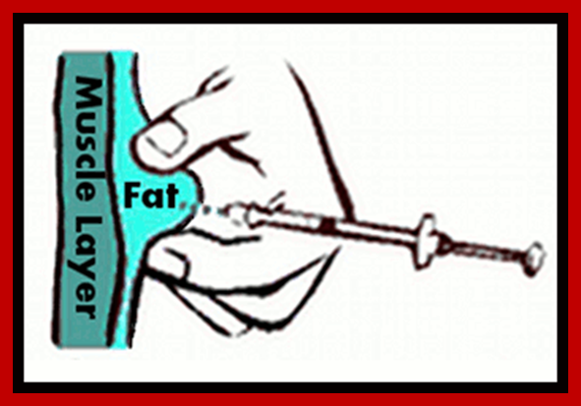
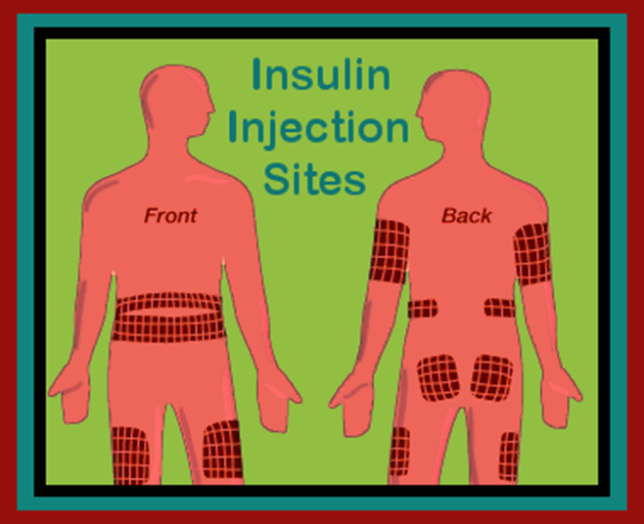
Where to Give Insulin: On Target!
Inject into fat layer under skin
Rotate sites
Student should choose site
Common sites: abdomen, thigh buttocks, upper arms

Slide 16
Physiological effects of thyroid hormone
Increases oxygen consumption and heat production
Positive chronotropic and inotropic effects on heart
Increase sensitivity to adrenergic effectors
  Up-regulates β-adrenergic receptors
Increase gut motility
Increase bone turnover

Slide 17
Physiological effects of thyroid hormone
Increases reflex response
Increase hepatic glycogenolysis and gluconeogenesis
Stimulates lipolysis
Developmental effects
  Growth
  Brain development

Slide 18
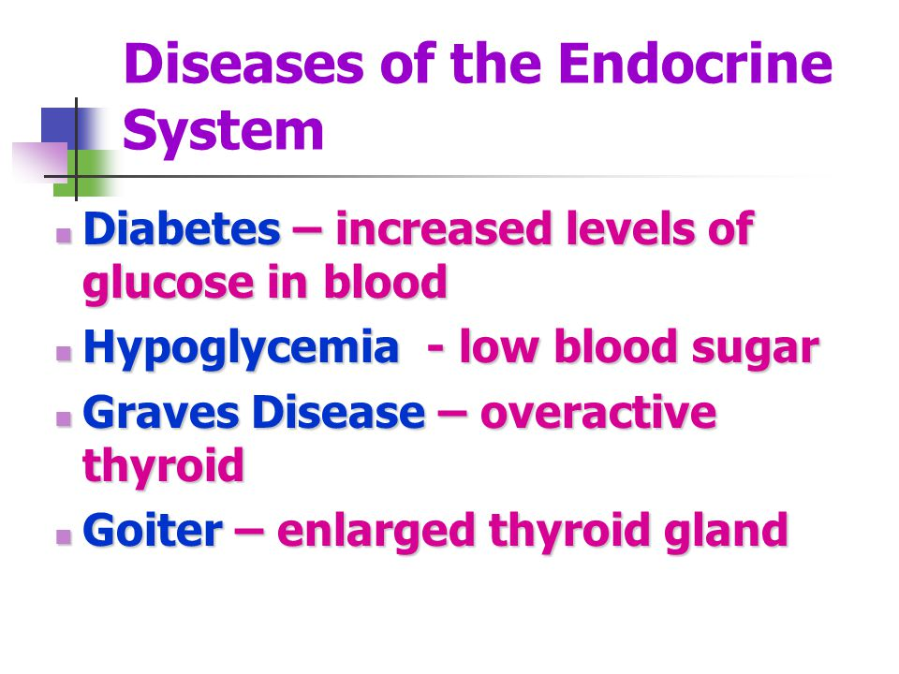
Endocrine system: dysfunction

Slide 19
VIDEO ON ENDOCRINE SYSTEM
Lets watch the video and engage in a class discussion as an overview to the lesson.
https://www.youtube.com/watch?v=-S_vQZDH9hY

