Slide 1

SUSTAINABLE PROCESSES
WELLBEING FUTURE GENERATIONS (WALES) ACT 2015
Juan A Ferriz-Papi

Slide 2

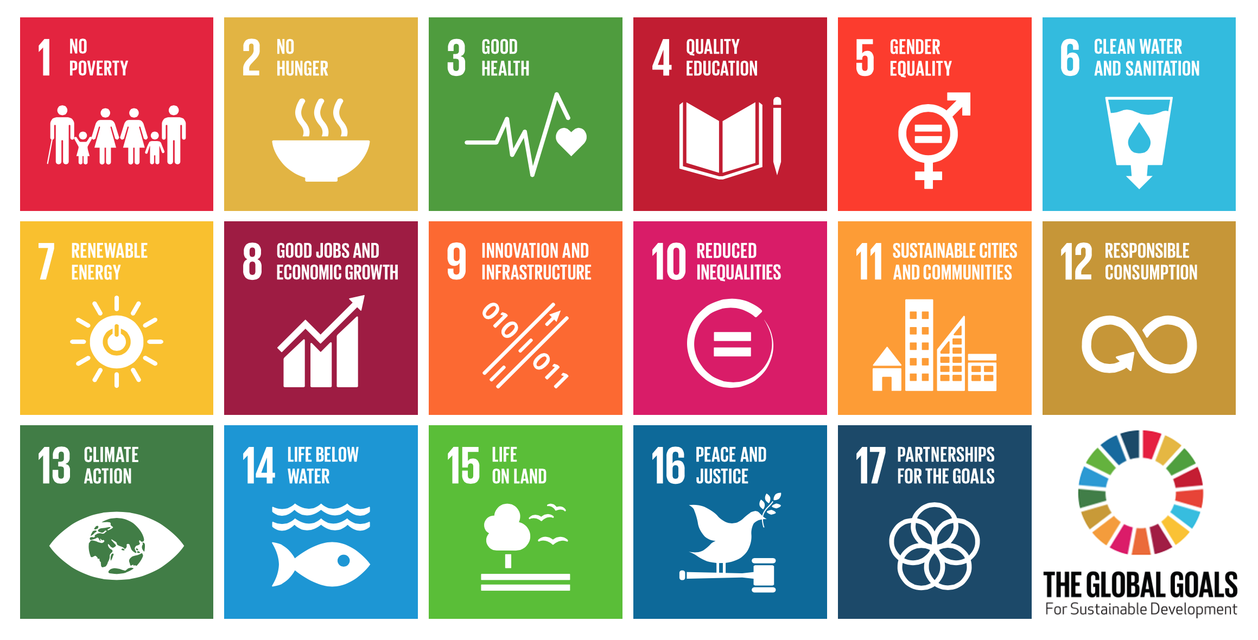
WELLBEING FUTURE GENERATIONS (WALES) ACT 2015
AGENDA 2030

Slide 3
WELLBEING FUTURE GENERATIONS (WALES) ACT 2015
You have a list with the Goals for Sustainable Development. Have a look at it and, individually, decide which ones you can contribute from your expertise and how, in this case regarding Facilities Management.
Start a discussion in class about how you think you can contribute to these goals and in what way this is complementary to other expertises and fields.

Slide 4
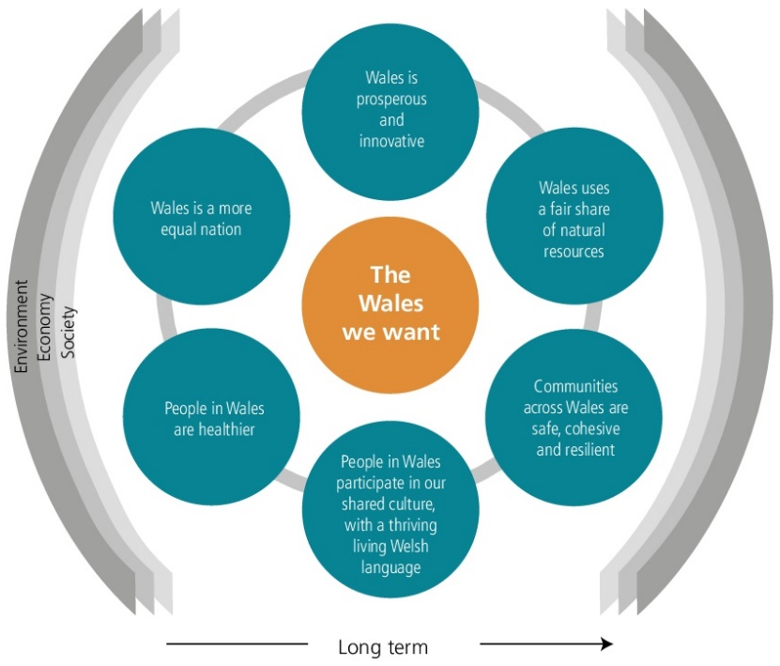
WELLBEING FUTURE GENERATIONS (WALES) ACT 2015
Implementation in Wales
The Wales we want (2014)
Proposed draft goals for debate

Slide 5
WELLBEING FUTURE GENERATIONS (WALES) ACT 2015
Implementation in Wales
Wellbeing Future Generations (Wales) Act 2015
Purpose of the Act
Shared purpose and drivers to achieve a better and lasting quality of life for us all (The Wales we Want)
7 well-being goals
Progress measured by National Indicators

Slide 6
WELLBEING FUTURE GENERATIONS (WALES) ACT 2015
Implementation in Wales
Wellbeing Future Generations (Wales) Act 2015
The basics
A duty for the public sector to pursue
A set of well-being goals
According to the “sustainable development principle”
Overseen by a statutory @Commissioner for Future Generations”
National Conversation process, Guidance Panel
The Wales Audit Office

Slide 7
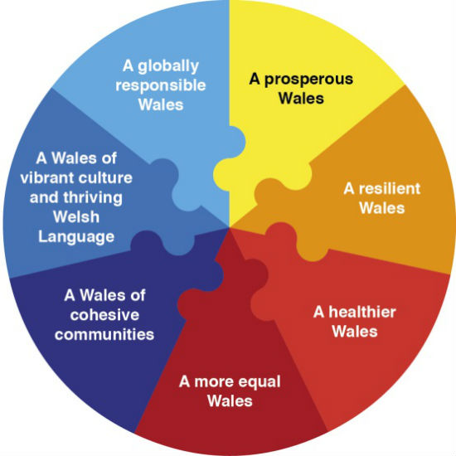
WELLBEING FUTURE GENERATIONS (WALES) ACT 2015
Implementation in Wales
Wellbeing Future Generations (Wales) Act 2015
Goals

Slide 8
WELLBEING FUTURE GENERATIONS (WALES) ACT 2015
Implementation in Wales
Wellbeing Future Generations (Wales) Act 2015
How the Act works
New way of working so we all make better decisions, transform services, tackle root problems and avoid wasting money
5 ways of working

Slide 9
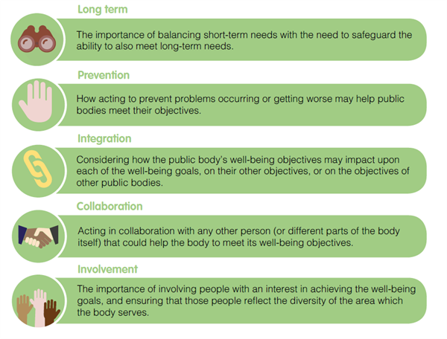
WELLBEING FUTURE GENERATIONS (WALES) ACT 2015

Slide 10
WELLBEING FUTURE GENERATIONS (WALES) ACT 2015
Implementation in Wales
Wellbeing Future Generations (Wales) Act 2015
The Commissioner for Future Generations
Act as a guardian for the interests of future generations in Wales and support the public bodies listed in the Act
Advise, encourage and promote
Research
Carry out reviews
Make recommendations
Future Generations Report
Supported by an Advisory Panel

Slide 11
WELLBEING FUTURE GENERATIONS (WALES) ACT 2015
Implementation in Wales
Wellbeing Future Generations (Wales) Act 2015
More information
http://futuregenerations.wales/about-us/future-generations-act/
VIDEO

Slide 12
WELLBEING FUTURE GENERATIONS (WALES) ACT 2015
Exercise
Take the 7 goals established in the WFGWA and list at least 2 aspects you can work from your professional activity as a Facilities Manager.

Slide 13
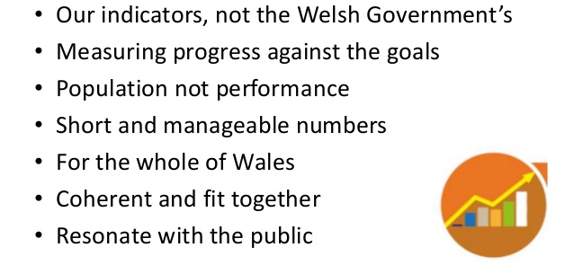
WELLBEING FUTURE GENERATIONS (WALES) ACT 2015
The National Indicators
46 indicators
https://gov.wales/topics/people-and-communities/people/future-generations-act/national-indicators/?lang=en

