Slide 1
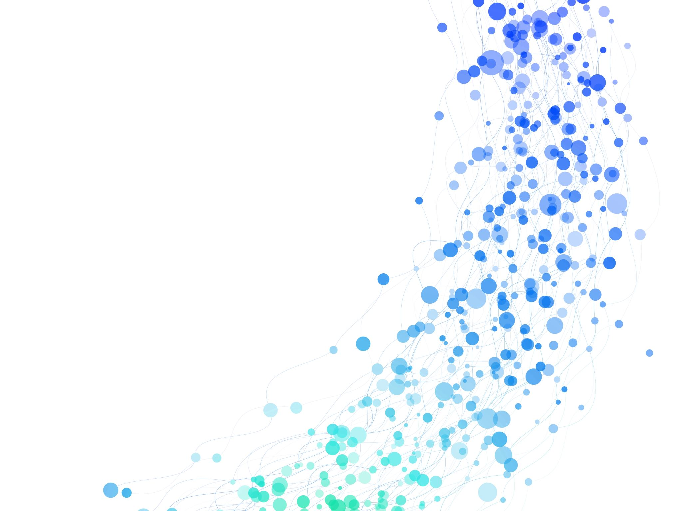
Research Methods
Lecture 6: Analysing qualitative data
Dr Badir Miftah

Slide 2
Synthesizing Qualitative Studies
When working with secondary data you should synthesize the documents you’re using.
There are two main approaches to doing this:
  A Thematic Synthesis (a thematic analysis)
  A Systematic Review (uses meta-analytic approaches)
*for the purposes of your research, we recommend you take the first option

Slide 3
Thematic Synthesis of Secondary Data
Synthesising the data involves ‘sifting’ the data, looking for key points amongst the documents and putting these together
By doing this you should be able to sense what is a ‘phenomenon’ and where there are ‘variations’
By the end of the analysis, the researcher should be able to comment on the general phenomena they find and offer insights
Phenomena may include variations, similarities, patterns, cause and effect, the performance of interventions etc.

Slide 4
Thematic Analysis of Secondary Data– Getting Started
The researcher MUST specify a clear research question
A search criteria should be established for the studies based on the research question
Eliminate those studies that do not reflect the criteria or of poor quality
Decide on your final set of documents to use

Slide 5
Matrix
You can use this for secondary data analysis
and/or
Your literature review
Sthapit, A., & Shakya, D. B. (2010) Brand Response of Cell-phone Users in Nepal: A Strategic Perspective.

Slide 6
Presenting your Results
This is the stage where you should relate your themes to theoretical ideas
You must take time to interpret the findings
You should present connections between codes
You must highlight the relationship of the codes to the research question/s and the existing literature

Slide 7
Primary Themes & Secondary themes
This table shows the overall theme (primary theme) and all of the sub-themes relating to it.
Once you have created a table like this, you can then count the number of participants or documents that mentioned the themes.
The number of participants discussing a particular code is important to note
Sam Cotton: Content Analysis Coding (You Tube)

Slide 8
Finished Example
You should end up with a table or section that looks similar to this. Here you can see:
The key theme (Primary or higher order code)
Some examples of text which give context and evidence of the theme (secondary codes or sub-codes)
The number to participants who mentioned the particular theme
Sam Cotton: Content Analysis Coding (You Tube)

Slide 9
Example
Theme 1: Mistrust (20 out of 25) | Related quotes
 | MNE Interview 4: “These are brand new relationships so trust is difficult... There’s no established trust and respect – therefore we are wary of using innovation to establish and create new relationships.”
 | SME Interview 11: “ We have a TBVA (trust based value added) relationship. However, in terms of X trusting Y, the nature of Ys organisation (i.e. reporting/analysing) means that organisations are often cautious and can be careful of what they disclose. Y knows the analyst relations team within X but wants to maintain a professional relationship due to concerns that ad hoc/personal conversations can lead to potentially confidential information being discussed on a personal level so it’s a bit of an arm’s length situation.”
 | SME Interview 13: “We are very trusting of our partner… the relationship is driven from possessing the same goals – possess technical respect for eachother with regard to what they’re achieving. There are some Commercial issues in terms of pricing disagreements and so sometimes there’s constraints in the technical aspect of their relationship but not within the working relationship”

Slide 10
Example
Theme 2: Openness to innovation (8 out of 25) | Related quotes
 | MNE Interview 1: “Our willingness to change is a top down approach driven by central organisation business hub in X… But changing culture/behaviours/mindset is a process that will take time – and the company are not quite there yet. “ X are very honourable and easy to work with – but they create markets based upon X’s requirements. And so there are cultural differences across different divisions of the company – which is a known challenge that we are attempting to address”
 | MNE Interview 12: “We always get a negative reception internally – there’s an ethos of ‘what can new partners achieve that we can’t? we can do everything ourselves’. SO the customer response is that they want organisations to be engaging in ecosystems as they recognise firms can’t do it alone. This is a problem internally as some employees are stuck in their ways and don’t want to change… the understanding of the importance of why it is necessary to co-create and collaborate is therefore lost sometimes”
 | SME Interview 8: “Like the idea of learning from partners and industry experts, but there is some non-willingness involved in terms of decisions made. Sometimes they [the company] stick to decisions that may harm partnerships but that are actually better for the company. So there’s definitely an ability to change but there is also an inherent stubbornness not to”
 | SME Interview 3: “Most large companies have employees who are accustomed to saying no, and this acts as a barrier to innovation. Change agents are necessary to move things forward but sometimes it is necessary to say no… sometimes it’s also hard to sell the idea to the ‘old guard’ – creating new work in engaging with ecosystems and people are reluctant to take on new work”

Slide 11
Example 2: A Coding Framework
Theme | Example quote | Code | Frequency
Mistrust | “These are brand new relationships so trust is difficult... There’s no established trust and respect” | T1 | 20
Relational Risk | “The commercial relationship means that there are sometimes negative outcomes… this can cause friction when they decide to pursue alternative partners” | R1 | 8
Relationship orientation | “We have to find a partner who is willing to invest time and hard work into the relationship and work flexibly to work together and achieve innovative outputs | RO1 | 11
Organisational distance | “Differences in organisational size can act as a barrier” | OD1 | 5
Miscommunication | “More could be done to generate greater clarity to see suitability” | M1 | 15
Reluctance to innovate | “There’s an ethos of ‘what can new partners achieve that we can’t? We can do everything ourselves” | I1 | 9

Slide 12

Validity and Reliability
Both qualitative and quantitative approaches need to consider the validity and reliability of the methods used.
Both validity and reliability are used to assess the quality of the research
Validity – Does the approach/measurement answer the research questions?
Reliability – Are the measurements and results consistent and repeatable?
Reliability has been highlighted by many authors as an issue in qualitative research. A better term to use is RIGOUR
Remember to discuss this in your dissertation – it is important!

Slide 13
CAQDAS and NVivo
Computer assisted qualitative data analysis software (CAQDAS)
Emerged in the 1980s
Makes the tasks of coding and retrieving data much easier
The best known CAQDAS software is Nvivo
Speak to your supervisor if this is something you wish to explore
Some Benefits of using CAQDAS
Allow the researcher to code and retrieve text in real time
Can retrieve codes across a number of sources simultaneously
Less labour intensive, the computer does the clerical work
Some Limitations of using CAQDAS
If you have a small data set, then probably pointless using it
Still reliant on the researcher’s skills to analyse, interpret and provide insights
Researcher will need to learn how to use the software effectively
Chapter 25 Bryman

Slide 14
Media Links
Overview of Qualitative Research Methods
https://youtu.be/IsAUNs-IoSQ
How to Write a Literature Review in 30 Minutes or Less
https://youtu.be/TdJxY4w9XKY
Alan Bryman’s 4 Stages of Qualitative Analysis
https://youtu.be/7X7VuQxPfpk
Part 1: Coding
https://youtu.be/B_YXR9kp1_o
Part 2: Thematic Coding
https://youtu.be/3oo8ZcBJIEY
Part 3: What codes can be about
https://youtu.be/5xM-9yuBhMc
Part 4: What codes can be about

Slide 15
Media Links
Thematic analysis - an introduction
https://youtu.be/5zFcC10vOVY
What is Thematic Analysis
https://youtu.be/4voVhTiVydc
How to Know You Are Coding Correctly: Qualitative Research Methods
https://youtu.be/iL7Ww5kpnIM
Getting Started with NVivo
https://youtu.be/Xe0NpJPLQ6k

Slide 16
Lecture Summary
Your research question will influence your choice of research design
The research design provides a framework for the collection and analysis of data
In qualitative research you are searching for understanding and insights
Qualitative data analysis requires hard work! Lots of reading and reflection
Coding, thematic analysis and matrices can be applied to both primary and secondary qualitative approaches
If you are conducting interviews, you should type the transcription and this will help you discover codes and themes as you go.
It is not enough to describe what’s going on in the text, you should offer insights, critical analysis and links/conflicting text to the existing literature
To present your findings you are attempting to build a story by showing clear structures (tables, quotes, weightings etc.) to evidence your key points.
Good organization, preparation of documents, and the ability to gain insights from your reading are key skills for this approach

