Slide 1
BMTP6018
Global Sports & Tourism
Event Management
Wales Event Strategies

Slide 2

A Major Events Strategy for Wales
2010 Set out a Vision for Wales for 2020
Aim
WALES TO BE RECOGNISED AS A CONSISTENTLY OUTSTANDING DESTINATION FOR MAJOR EVENTS

Slide 3
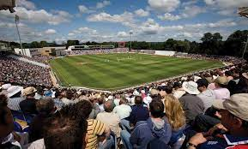
EVENTS WALES MISSION STATEMENT 2010 - 2020
DEVELOPING A BALANCED AND SUSTAINED PORTFOLIO OF MAJOR EVENTS WHICH ENHANCES WALES’ INTERNATIONAL REPUTATION AND THE WELLBEING OF IT’S PEOPLE AND COMMUNITIES (2010)

Slide 4
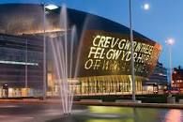
BACKGROUND INFO
EVENTS BRING US TOGETHER
EXPRESSION
BAROMETER OF PROGRESS
PRISM FOR THE REST OF THE WORLD TO VIEW WALES
STRATEGIC - ECONOMIC, SOCIAL & CULTURAL LEGACY
HOSTING RYDER CUP

Slide 5

EVENTS LED STRATEGY
GROWING REPUTATION AS WORLD CLASS EVENTS DESTINATION
POSITIVE EXTERNAL REPUTATION
BRAND IMAGE
ONE WALES AGENDA - PROACTIVE TO ACHIEVE POTENTIAL
SUSTAINABLE AND BALANCED PORTFOLIO
LONG TERM
LEGACY
ESTABLISHED MAJOR EVENTS UNIT

Slide 6
WALES EVENTS
MAJOR EVENTS GLOBAL TV, ECONOMIC IMPACTS, SIGNIFICANT VISITOR NUMBERS, INFLUENCER, MARKET SEGMENTS, CHANGING ATTITUDES & BEHAVIOUR, NO WELSH OWNERSHIP - ASHES TEST MATCHES, EUROPEAN RUGBY FINALS, VOLVO OCEAN RACE
SIGNATURE EVENTS STRONG GLOBAL FLAVOUR, RECURRING, EITHER UNIQUE TO WALES OR DISTINCTIVE WELSH FLAVOUR, CULTURAL IDENTITY, HIGH QUALITY VISITOR EXPERIENCE - IRONMAN WALES
MEGA EVENTS - PERIPATETIC EVENTS WITH GLOBAL REACH, PRECEDED BY LARGE SCALE CAPITAL PROJECTS, OFTEN NEW BUILT VENUES, INFRASTRUCTURE, MAJOR BID, HIGH LEVEL GOVT RESOURCES FROM BID TO DELIVERY, STAND ALONE ORG WITH DEDICATED BUDGET FROM START TO FINISH - RYDER CUP
GROWTH EVENTS - SMALLER EVENTS, FOOTPRINT, REGIONAL, LOCAL OR SECTOR LED, DEMONSTRATE AMBITION FOR MAJOR OR SIGNATURE EVENTS, GROWING CAPACITY, EXPERIENCE AND CREDIBILITY OF WALES AS DESTINATION, ADDED VALUE - CARDIFF HALF / EUROPEAN FOOTBALL

Slide 7
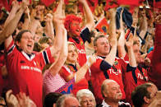
Investment
ECONOMIC BENEFITS
REPUTATION AND PROFILE OF HOST
EVENTS INSPIRE AND ENGAGE
SOCIAL, ENVIRONMENTAL & CULTURAL WELLBEING - COMMUNITY ENGAGEMENT
TOURISM - PROSPEROUS SOCIETY & SKILLS

Slide 8
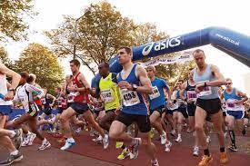
Guiding Principles
DELIVER CLEAR & MEASURABLE BENEFITS
RETURN ON PUBLIC INVESTMENT
RECOGNITION AND REPUTATION
SENSE OF PLACE
SUSTAINABLE EVENTS INDUSTRY
GEOGRAPHICAL & SEASONAL SPREAD
BALANCE OF EVENTS
EFFECTIVE & EFFICIENT USE OF RESOURCES
SUSTAINABLE MGT SYSTEMS
EXPLOIT OPPS FOR PARTNESHIPS & DEVELOPMENT

Slide 9
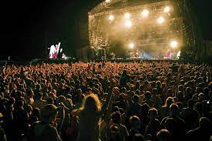

Which Events to Support
ASSESS V CRITERIA
STRATEGIC CASE FOR INVESTMENT
IMPACT & LEGACY
ASSESSMENT FRAMEWORK TO PROACTIVELY RESEARCH & IDENTIFY EVENTS WITH POTENTIAL
ASSESSMENT CRITERIA
BENEFITS - WALES POLICY AREA
BALANCED PORTFOLIO ??

Slide 10
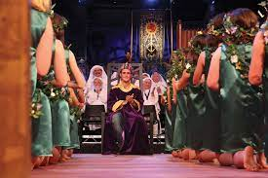
Role of Events Wales
TEAM WALES PARTNESHIPS - SPORTS WALES, VISIT WALES, LA ………
UNITY
DEVELOPMENT OF STRONG EXTERNAL RELATIONSHIPS
MEU PRIMARY ROLE TO LEAD & COORDINATE RATHER THAN DELIVER
RESEARCH
FUNDING
HARNESS EXPERTISE
SUPPORT DEVELOPMENT OF SPECIALIST EVENTS SKILLS
LEVERAGE OPPS
CREATE UK WIDE RELATIONSHIP
PROVIDE STRATEGIC ADVICE & GUIDANCE
CHAMPION EVENTS

Slide 11
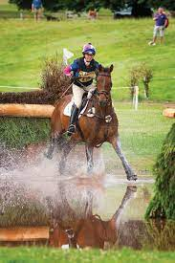
Measuring Success
MONITOR & EVALUATE
ASSESS EFFECTIVENESS
RETURN ON INVESTMENT
RESEARCH - ECONOMIC, SOCIO CULTURE, ENVIRONMENTAL AND MEDIA IMPACTS

Slide 12
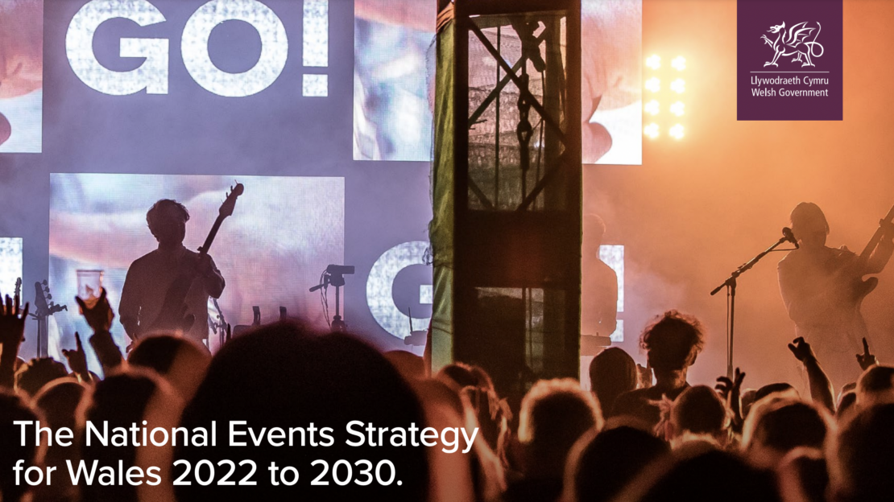

Slide 13
National Events Strategy for Wales 2022 - 2030
Align the industry. To be resilient and prosperous the industry will develop a strong voice that ensures all stakeholders are aligned and working in collaboration towards common outcomes.
Authenticity. Events in Wales will have a distinct ‘Welshness’ regardless of size, scale, or location. This will include the Welsh language, reflect the Cymru Wales Brand, and the Well-being Act criteria.
All of Wales. Our industry will maximise existing assets, spread its events across Wales and across the year and aim to achieve quality, diversity, and inclusion.

Slide 14

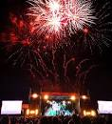
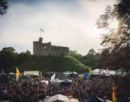
Proactive
Sport
Business Events & Meetings – Meet in Wales
Arts & Culture
Music Sector
Sport Wales
Visit Wales
Creative Wales
Local Authorities

Slide 15

Strong Foundations
Sustainability
People
Place
Planet
Future Generations Act

Slide 16
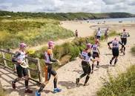
Mechanics
Roles
Responsibilities & Evaluation
Review

Slide 17
Event Wales Aims
Attract major international events which deliver a significant economic return on investment and contribute to the promotion of the Wales brand.
Identify new and innovative ways of extending their reach to new audiences both inside and outside Wales.
Work strategically with local and regional partners to identify potential Growth Events and explore opportunities for creating new events.
Support the development of a strong Welsh skills base of knowledge and experience. This is critical in the development of a sustainable events industry delivering a compelling events portfolio.

Slide 18
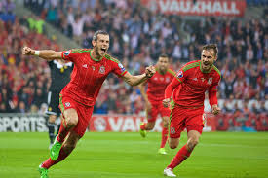
EVENT WALES ROLE
Co-ordinates
Funds
Enables
Through Partnerships
Sustainability
Skills Development
Volunteering

