Slide 1
Risk Analysis
Dr. Glenn L Jenkins
Tim Bashford
Notes:
11/17/2015
1
1

Slide 2
In this lesson
  Hazards, risks and accidents (terminology)
  Severity – consequences of malfunction
  Frequency – probability of malfunction
  Risk classification
  Acceptability of Risk
  Levels of integrity
  View of society and ethical considerations
Notes:
11/17/2015
2
2

Slide 3
From last week
  Hazard
    Present in all aspects of life
      Struck by meteorite
      Electrocuted by a incorrectly wired appliance
    Represents situations of potential danger
  Accident
    When a hazard actually results in harm
    Often defined as
      An unwanted and unexpected release of energy
        Limited as it does not include exposure to chemicals etc.
        The term mishap is often used to include these
    More general definition
      An unintended event or sequence of events that causes the death, injury, environmental or material damage
Notes:
11/17/2015
3
3

Slide 4
  Much of hazard analysis aimed at identifying sequences of events which may lead to an accident
    These are termed
      Accident sequences or
      Accident scenarios
    These must be investigated to determine hazard significance
    Information from incidents (or near-misses)
      Defined as: An incident is an unintended sequence of events which does not result in loss but under different circumstances has the potential to do so
  Importance of a hazard is related to two factors
    Potential consequences
    Frequency (or probability) of occurrence
Notes:
11/17/2015
4
4

Slide 5
Risk
  The risk associated with a hazard is defined as:
    A combination of the frequency and probability of a hazardous event and its consequence.
  This allows risk to be treated in a:
    Quantitative manner
      e.g. Component fails every 10,000 years (0.0001 fails per year)
        Would kill up to 100 people
        Risk = severity (100) x frequency (0.0001)
        = 0.01 deaths per year
        This can also be represented as a person having a 0.01 chance of dying (this is normally used for population based risks – e.g. lightning etc.
    Qualitative manner
      Divide into classes to simplify guidelines – vary by industry
Notes:
11/17/2015
5
5

Slide 6
Consequences of Malfunction - Severity
  All safety-related industries classify risks in order of their severity
    Tend to be related to the area
      Match the needs of the industry / organisation
    Vary between industries
    Examples
      Avionics
        Civil aviation standards US and Europe (RTC/EUROCAE, 1992)
          Severity defined in terms of the effects on the aircraft and crew and safety of occupants
          Military avionics are similar
Notes:
11/17/2015
6
6

Slide 7
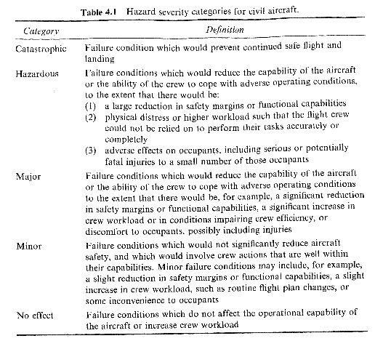
Notes:
11/17/2015
7
7

Slide 8
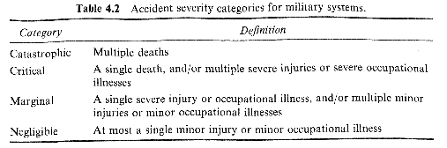
      Military Systems (MOD)
        Interim Defence Standard 00-56 defines size categories of hazard severity (termed ‘accident severity categories’)
        More generally applicable
        Emphasis on death and injury to individuals
Notes:
11/17/2015
8
8

Slide 9
Probability of Malfunction – frequency
  Probability or frequency of a hazardous event expressed either
    Qualitative
    Quantitative
    Expressed as
      A rate over some time frame (per hour / per day / etc)
      Alternative over the lifetime of the unit
      Failure on demand
        For systems used infrequently (such as emergency shut-down systems)
        Number of failures expressed as a fraction of the total number of times the system is expected to operate
Notes:
11/17/2015
9
9

Slide 10
    Common to see failure rate quoted with no units
      Huge ambiguity from which standards are not immune.
  Classification
    A number of industry specific standards for classification
    Examples
      Avionics
        Frequency / probability expressed associated with a hazard expressed in terms of occurrences per hour of flight
        Divided in to 3 main classifications
          Subdivided into five classes
Notes:
11/17/2015
10
10

Slide 11
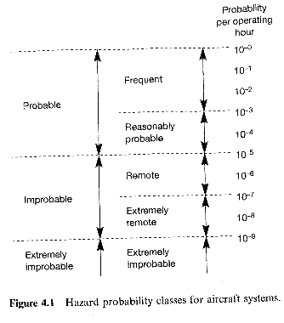
Notes:
11/17/2015
11
11

Slide 12
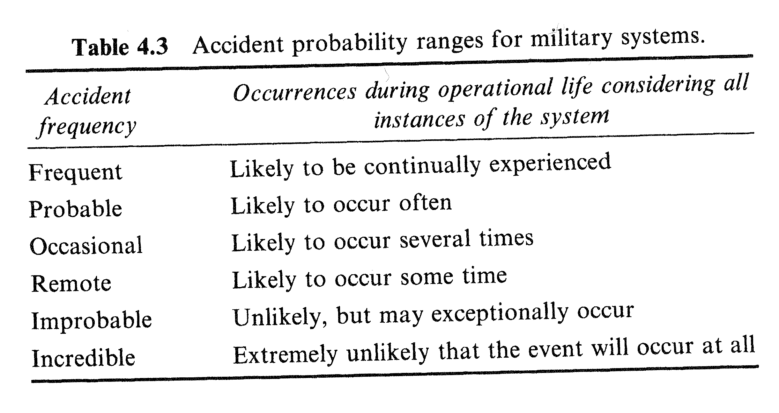
      Military Systems
        Interim Defence Standard 00-56 defines six categories
Notes:
11/17/2015
12
12

Slide 13
Risk Classification
  Cannot produce a number for risk when using qualitative measures for frequency and severity (i.e. the tables in the last few slides).
  Must be combined in a less mechanical way i.e. classification
    Also called
      Risk Class
      Risk Level
      Risk Factor
  Most standards define a number of risk classes
    Along with development and design techniques appropriate to that level of risk
Notes:
11/17/2015
13
13

Slide 14
  Examples
    Military Systems
      Interim Defence Standard 00-56 defines 4 classes (A-D)
    IEC 1508
      Similar in many ways to the MOD standards
      Represents efforts to harmonize standards worldwide
Notes:
11/17/2015
14
14

Slide 15
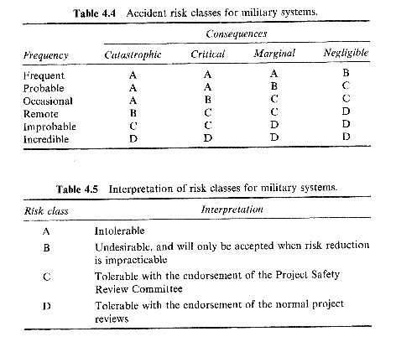
Notes:
11/17/2015
15
15

Slide 16
Acceptability of Risk
  Acceptability of risk is related to
    The benefits associated with that risk
    The effort required to reduce it
  IEC 1508 (or at least its draft)
    Divides risk into 3 ranges
      Unacceptable (shown at the top)
      Broadly acceptable (shown at the bottom)
      ALARP – As Low As Reasonably Practical
        Benefits
        Cost of further reduction
        A system with low ALARP risk which can be reduced is unacceptable
        A System with high ALARP risk which has significant benefits and a high cost of further risk reduction is acceptable
Notes:
11/17/2015
16
16

Slide 17
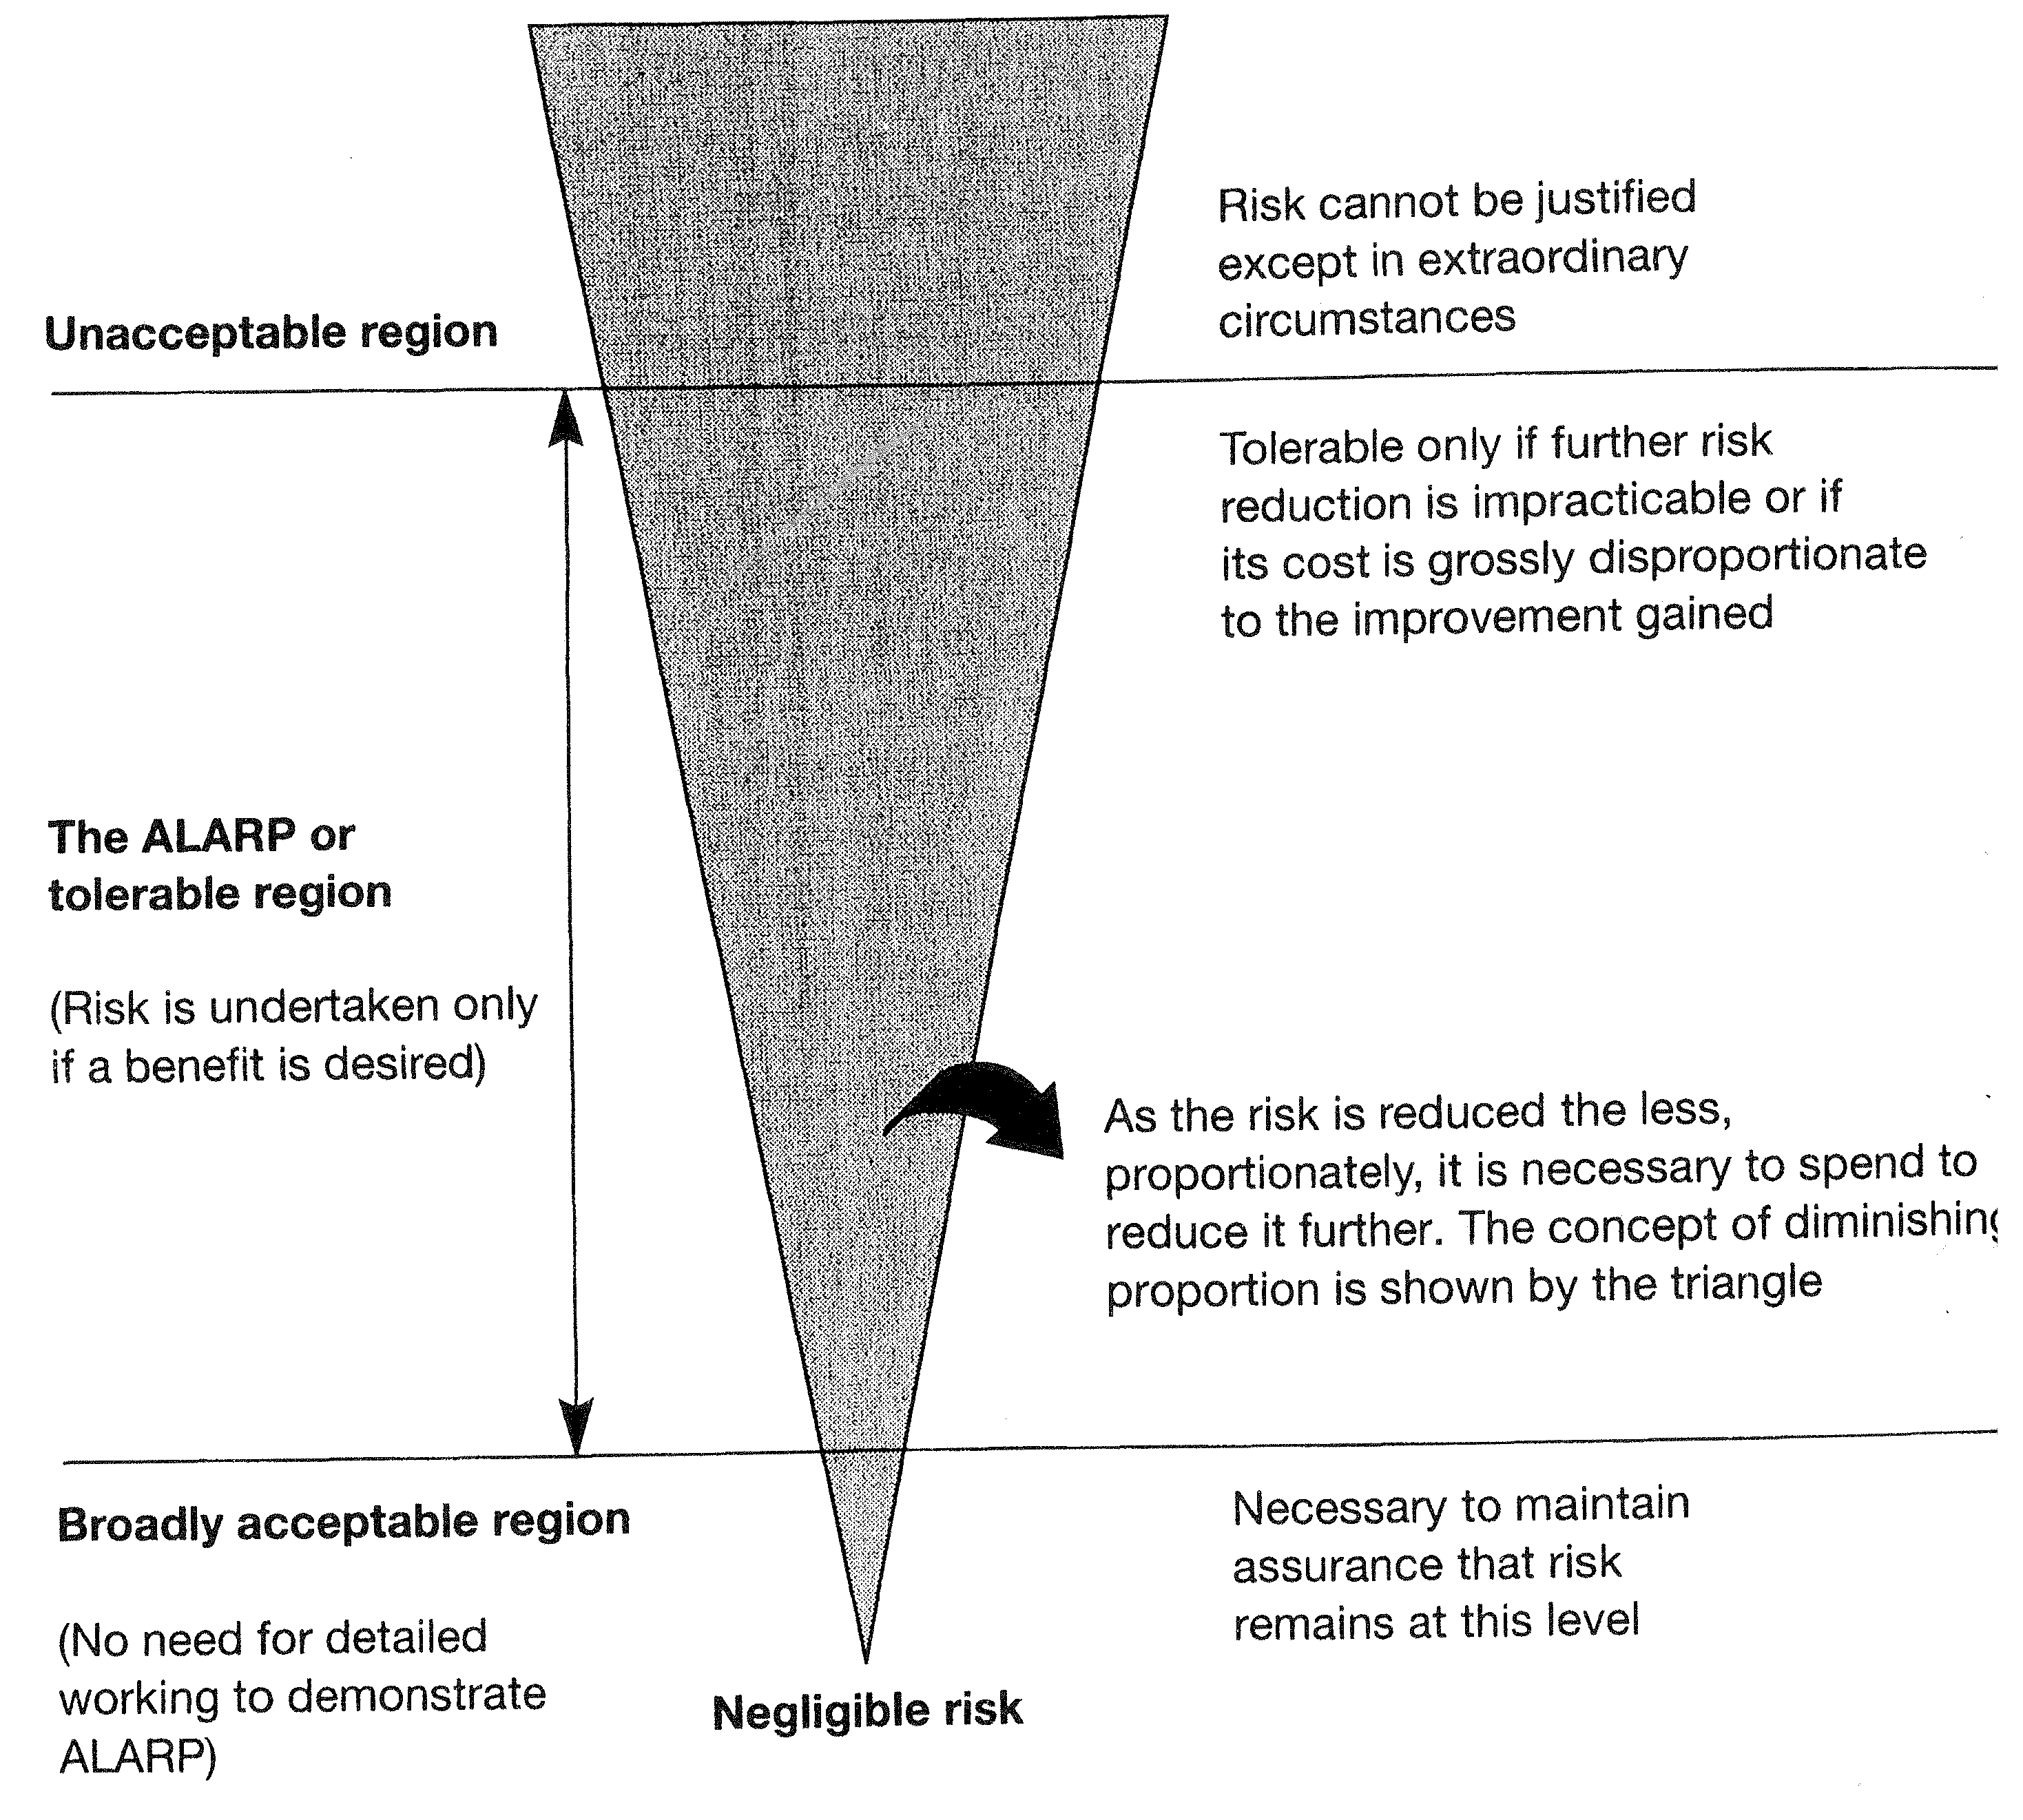
Notes:
11/17/2015
17
17

Slide 18
  ALARP region
    Can show risk is ALARP
    In most critical systems certifying authority will make this decision
      Take account of
        Standards
        Arguments of design team
      High Risk Systems
        Developers put significant effort into reducing risk
        Company puts money into reducing risk
      Low Risk Systems
        Comparatively less risk avoidance effort
        Less money spent on risk avoidance
Notes:
11/17/2015
18
18

Slide 19
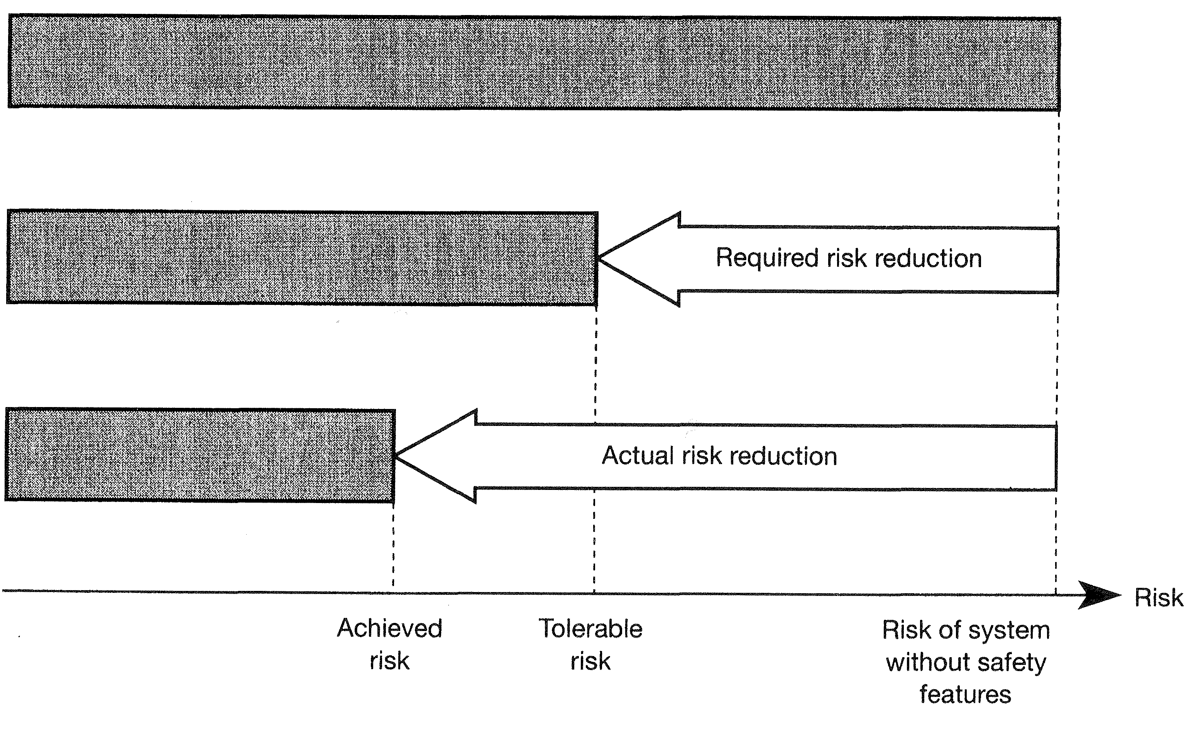
Production of Saftety-critical systems
  Requires Risk Management (aka Risk Reduction)
    Equipment under control represents a level of risk (in the absence of any protective measures taken by the designer)
      Low risk may be negligible and no action required
      If not then
        Design must incorporate safety features to reduce risk to below that considered tolerable
Notes:
11/17/2015
19
19

Slide 20
Levels of Integrity
  Variation in system safety requirements
    Toaster and nuclear power station must both be safe
  Can be viewed in terms of the risk reduction required
    Clearly to provide the required risk reduction the risk management systems must be dependable
    How dependable depends on
      The degree of risk
      Financial considerations (in low risk cases)
    This leads to the concept of integrity, interlinked with safety integrity
Notes:
11/17/2015
20
20

Slide 21
  Safety Integrity
    Definition
      The likelihood of a safety-related system satisfactorily performing the required safety functions under all the stated conditions within a stated period of time
    Most common to allocated a system one of a number of safety integrity levels expressed either
      Quantitatively
        In terms of measures
      Qualitatively
        In terms of system characteristics
    Example
      The example shown in based on the integrity levels for German nuclear reactors (and is similar to the proposed IEC 1508 standard)
        Classes have associated properties and numerical requirements
Notes:
11/17/2015
21
21

Slide 22
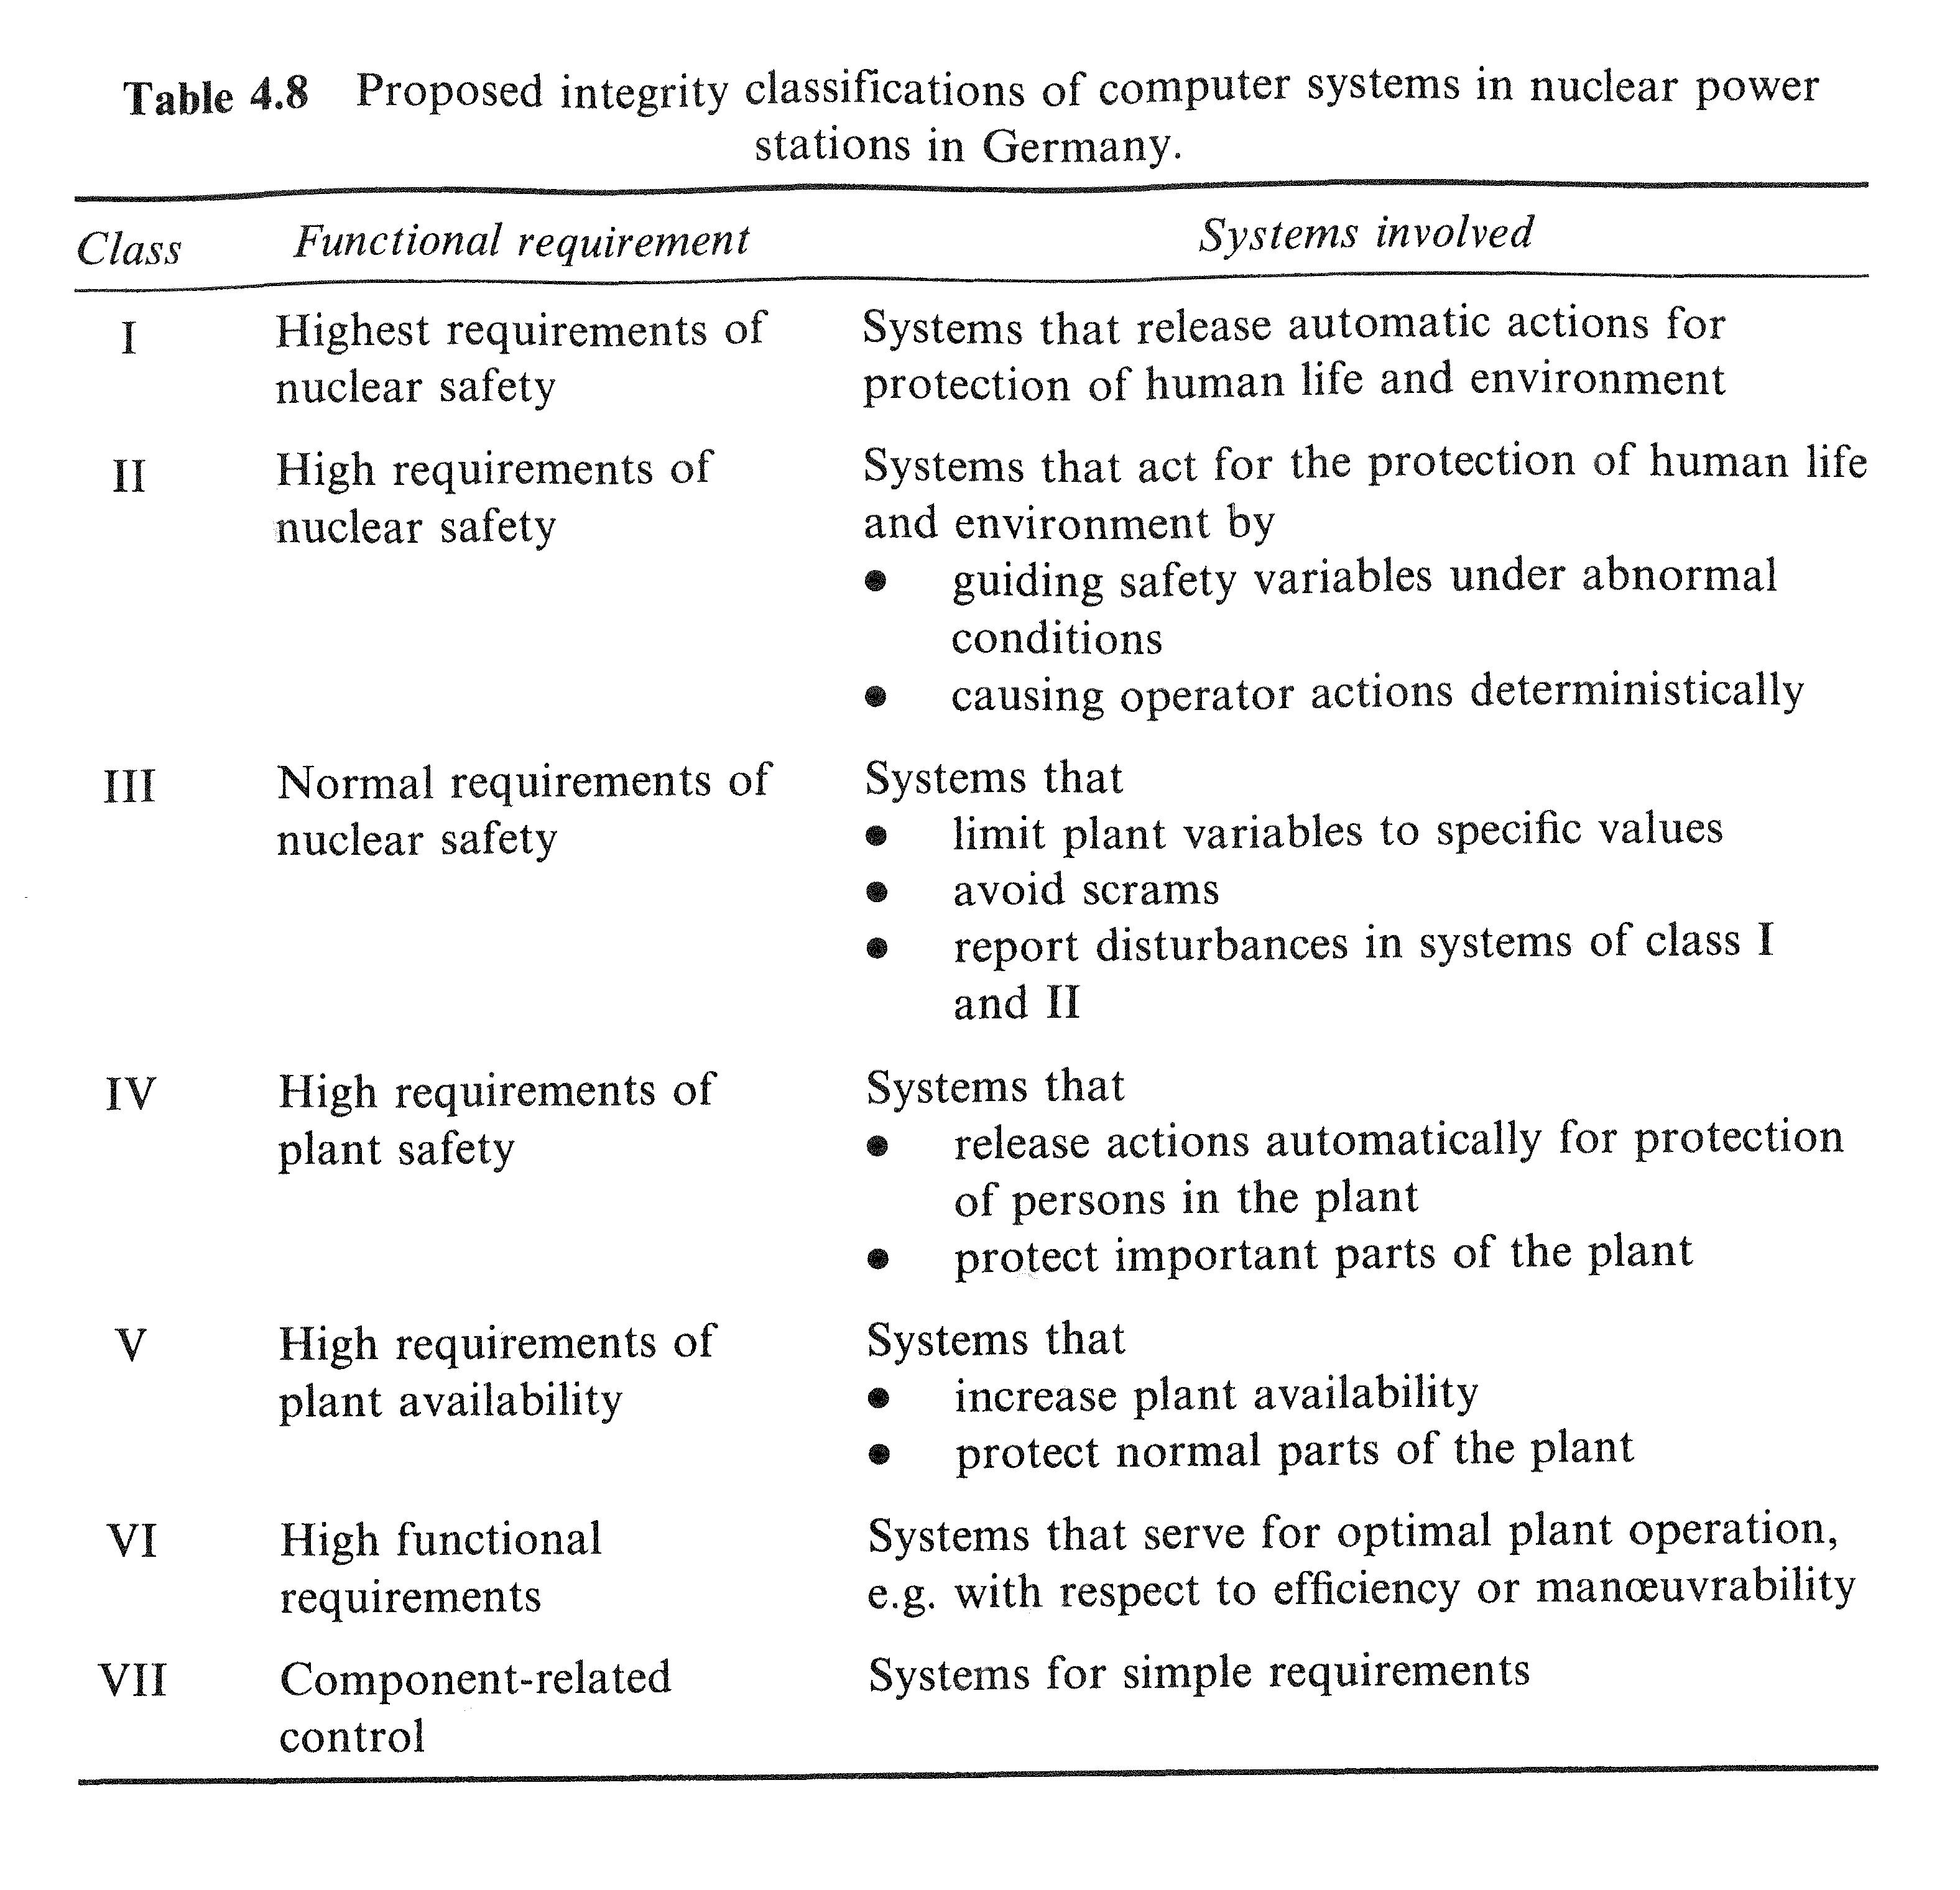
Notes:
11/17/2015
22
22

Slide 23
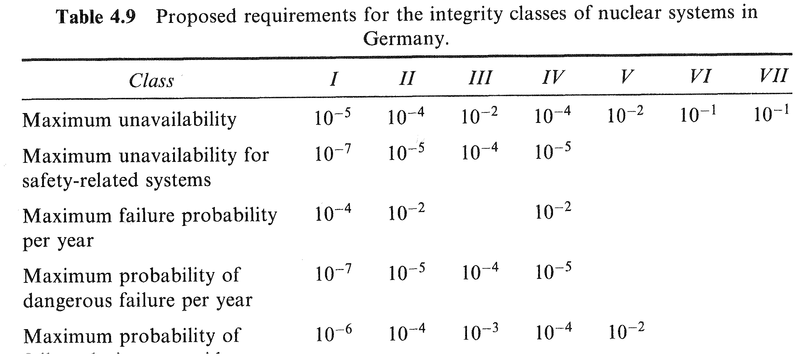
Notes:
11/17/2015
23
23

Slide 24
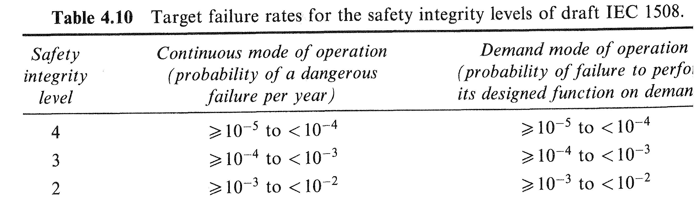
    Example 2
      IEC Standard sets out target failure rates for each of its 4 safety integrity levels
        Differentiates between continuous and on demand systems
        Note :- figures are in failures per year (though in development discussions failure per hour were considered)
Notes:
11/17/2015
24
24

Slide 25
  Production of safety critical systems = fault management
    Faults
      Random
        Random hardware failures
      Systematic
        Hardware / software design faults
  Consider integrity with respect to both these areas
    Hardware integrity
      The part of safety integrity relating to dangerous random hardware failures
    Systematic integrity
      The part of safety integrity relating to dangerous systematic failures
      This covers all aspects of design including software, however the consideration of software in isolation leads to a third classifiction
    Software integrity
      The part of safety integrity related to dangerous software failures
Notes:
11/17/2015
25
25

Slide 26
  Assginment of integrity levels
    Based on classification of the associated risks
    Following the assingment of an overall safety integrity level individual integrity levels may be assigned
      e.g. a software integrity level may be assiged to defined the importance of the correctness of the software elements
    This is related to risk, but remember the distinction
      Risk
        A measure of the likelihood and consequences of a hazardous event
      Safety
        A measure of the likelihood of the safety system performing correctly
Notes:
11/17/2015
26
26

Slide 27
  Allocation of integrity levels
    Each standard offers guidance for assigning integrity levels to systems, subsystems etc. which are critical
    This is closely related to the application area (e.g. aviation standards include 'loss of aircraft'
      Consider the allocation of integrity classifications in German nuclear reactors as discussed earlier
    Once assigned its design and method of development must be tailored to ensure this is met.
    Standards may also define
      Requirements of each level
      Development methods to be used
      Integrity levels
Notes:
11/17/2015
27
27

Slide 28
    Integrity level may also be specified directly in terms of a maximum probability of failure
      This is common practice in the aviation industry
Notes:
11/17/2015
28
28

Slide 29
  Achievable levels of integrity
    Allocating a level of integrity imposes requirements on its dependability
      Several methods exist to improve dependability
    Must
      Achieve a high level of integrity
      Show that this has been achieve
        This is incredibly difficult
    For example
      Aviation systems failure once every 100 000 years
      No way of showing that this is a case
        Yet the Paris Metro have reported failure rates 1000 times better than this
    Highest level of IEC (unachievable)
      Arguably systems which require this level of dependability are too dangerous
Notes:
11/17/2015
29
29

Slide 30
  The view of social and ethical consideration
    Involves judgement and opinion
    When a integrity level or tolerable failure rate is defined
      We define how much effort should be expended improving the safety of the system
      In doing so we place a cost monitory or otherwise on human life
    These judgements despite being illogical are none the less valid
    Values differ enormously
      Consider compensation for the families of murder victims
      Preservation of life – investment in things such as roads, decisions not to undertaken work due to cost places a maximum value on those lives lost
Notes:
11/17/2015
30
30

Slide 31
    Perception of risk affected by the number of deaths
      Plane crashes which kill hundreds in a single incident though more serious than the numbers dying in road traffic accidents
    Also affected by the control we feel we have over the situation
      People are horrified at the possibility of a nuclear explosion
      But not the much larger risk of being hit by a car
    Emotional impact
      Death of a child on camera
    Projects of national impact
      Space shuttles vs Aircraft
      Chilean miners
    Such considerations may be beyond engineering
      Guidance is provided by IEE, Royal Society, BCS etc.
Notes:
11/17/2015
31
31

Slide 32
Summary
  Absolute safety is not an option
    Failure is always an option – MB
  Our goal is to produce a system which is adequately safe, given the conditions benefits it offers
  In many industries standards are enforced by a regulatory body and set out
    Integrity levels / classifications and requirements for these levels
      Also set out methods to achieve these levels
    Risk classes
    Hazard severity classifications
    Hazard probability classifications
  Professional and moral responsibility to develop software which is as safe as reasonably possible
Notes:
11/17/2015
32
32

