Slide 1
Successes And Challenges Of Healthcare Policies
Assignment Title: Component 1: Presentation
Student Name: Rizwan Ahmed
Student Number: 2227934
Module Title: Health, Wellbeing and Sustainable Development
Module Code: BMHP6030
Lecturer’s Name: Zakiyyah Ahmed

Slide 2
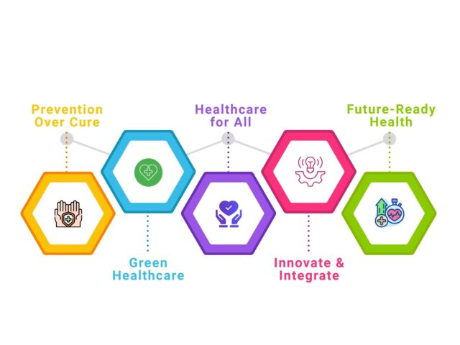
Introduction
Health outcomes in the modern era are shaped by environmental, economic and social determinants (Hudson, 2024).
Well-being is the overall state of being healthy, happy and able to cope with life physically , mentally, and socially. (WHO, 2026)
Integration of sustainability, well-being and health promotes resilient, equitable and preventive social and healthcare systems.
Effective alignment with the International infrastructure strengthens the well-being of the population in the long run while overstretching the care facilities and minimising pressures.
Notes:
Environmental, economic, and social conditions determine the modern outcomes of well-being rather than relying on biomedical care facilities. The integrated approach can efficiently address the determinants of well-being, sustainability, and health, thereby enabling system resilience, equity, and prevention. The rising burden of inequalities, ageing population and chronic diseases extends beyond the models that specifically focus on treatments. It is essential to embed sustainability across the social and health care support systems to support the long-term well-being of the population. It also focuses on enhancing resource efficiency, which is a positive aspect in this context. In addition, significant alignment with the global development and health frameworks plays a crucial role in strengthening the preventive measures while minimising avoidable demand successfully.

Slide 3
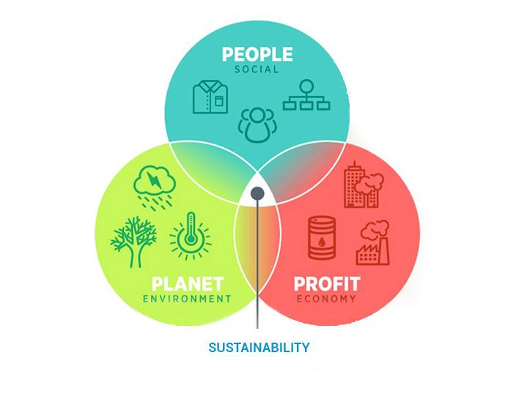
Definitions and key concepts
Health can be defined as a dynamic state of social, emotional and physical well-being of individuals, which is beyond the absence of diseases (WHO, 2026a).
Subjective health indicates self-reported perceived quality of life, emotions and satisfaction of individuals.
Objective concerns regarding the well-being of individuals are measured through employment stability, education, housing quality and income security (Roll et al., 2022).
Sustainable development is regarded as the process of satisfying the current health needs of individuals without compromising the economic, social and environmental resources for future generations.
Notes:
Apart from being free from illnesses, health can be regarded as a shifting state of social, emotional and physical well-being of individuals. The health condition of the people can be categorised into their objective and subjective well-being. Objective well-being includes a wide range of measurable elements such as stable employment, education, safe housing and income. In addition, subjective well-being includes the feelings of individuals regarding their own lives, which includes satisfaction, stress level and happiness. Sustainable development is an important concept of the presentation, which reflects the process of satisfying current health requirements without compromising resources for the upcoming generations. A community that offers clean water, stable employment, mental health assistance and affordable housing substantially improves the well-being of the people today. This action also ensures a healthy and safe environment for the children in the future, which is why it is regarded as sustainable development.

Slide 4
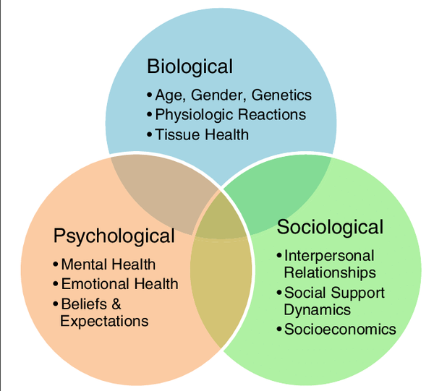
Theories: Biopsychosocial Model
The biopsychosocial model evaluates health as a significant interaction between the social environment, psychological state and biological processes (Bolton, 2023).
Integrated design of services is supported by the model, which helps in addressing social issues, behavioural challenges and mental health concerns along with providing clinical treatment.
Operationalising the biopsychosocial model is difficult because the system is extensively resource-constrained in nature (Zheng and Wang, 2025).
Notes:
Health is defined as an interaction among the social environment, mind and body of individuals by the biopsychosocial model. It indicates that biological factors are not the only responsible aspects for poor health conditions of the people, but it is also influenced by society, work, family, behaviour and emotions. This theoretical model supports the integrated approach of care and encourages facilities for addressing social support, lifestyle and mental health needs of the people along with the clinical treatment. Treating diabetes can be considered a notable example in this context, which requires managing the motivation and stress of the patients, which is a psychological element. Similarly, the contribution of family income in the treatment process can be considered as a social element, while providing medication can be regarded as a biological element.

Slide 5
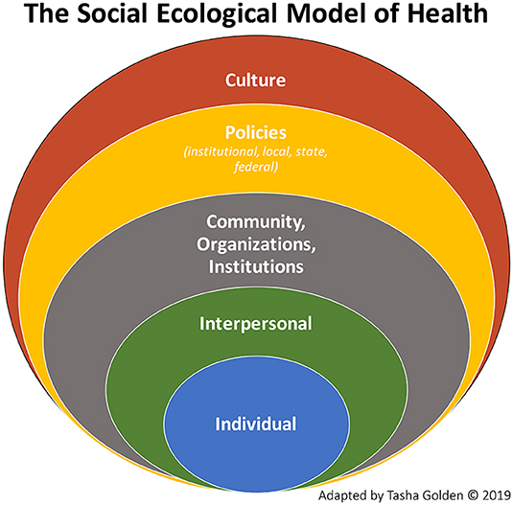
Theories: Ecological Model
The ecological model outlines that health is influenced by several levels of interaction with the policy from the individual environment (Navarro and Tudge, 2023).
Prevention is strengthened by the model, which eventually targets social and economic policy levers, the education system and community design.
However, the ecological model required for cross-sector collaboration is mostly challenging in the segmented structure of governance (Vogel et al., 2022).
Notes:
Ecological models efficiently demonstrate the health of the individuals as a significant outcome of several interconnected influences that are beyond personal choices. These factors include government policies, communities, workplaces, schools, social and personal relationships and individual behaviour. The ecological model assists prevention by acting at different levels. Minimising the rate of obesity is beyond advising people to eat better, and it is a significant example in this regard. It is also about supportive health practices, affordable pricing of food, healthy meals at schools and regular exercise. However, it is difficult to apply the ecological approaches due to the requirement of cooperation among diverse sectors such as government, housing, education and health.

Slide 6
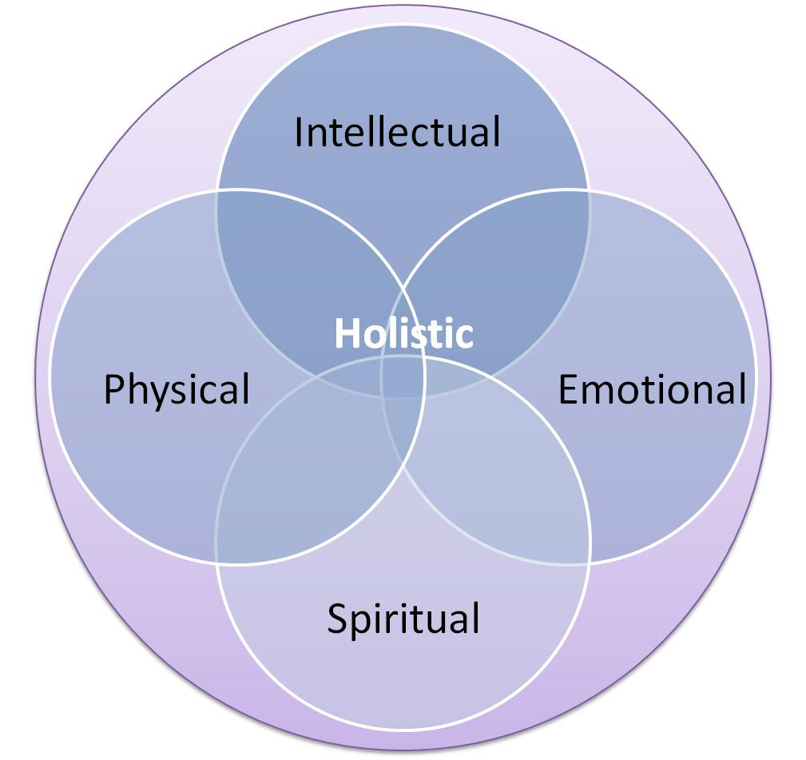
Theories: Holistic Model
The holistic model integrates social, spiritual, emotional and physical dimensions for emphasising whole person care facilities (Tavares et al., 2022).
This model ensures a strong alignment between person-centred care approaches and the agendas of well-being of the individuals in the social and healthcare sector.
Nevertheless, holistic care models include inconsistent risk because of the absence of evidence-based guidance, accountability and clear standards for implementation (Thamizhoviya, 2025).
Notes:
The holistic model focuses on caring for the whole person rather than only treating illness. It considers physical health alongside emotional, social, and spiritual needs. This approach recognises that factors such as stress, relationships, beliefs, and living conditions all influence wellbeing. Holistic care fits well with person-centred health and social care, as it encourages professionals to involve individuals in decisions and tailor support to their personal circumstances. For example, a patient with diabetes may receive medical treatment, emotional support to manage stress, advice on diet and exercise, and help accessing community groups. This can improve overall quality of life, not just physical symptoms. However, holistic care can be difficult to deliver consistently. Without clear standards, training, and evidence-based guidance, care quality may vary between services or professionals. Strong accountability and clear frameworks are therefore needed to ensure holistic care is effective, fair, and sustainable across health and social care systems.

Slide 7
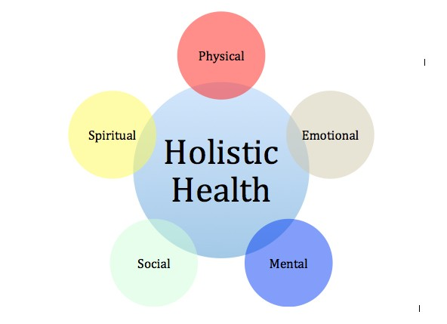
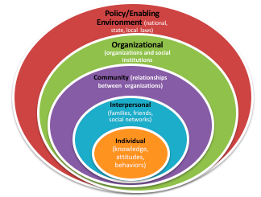
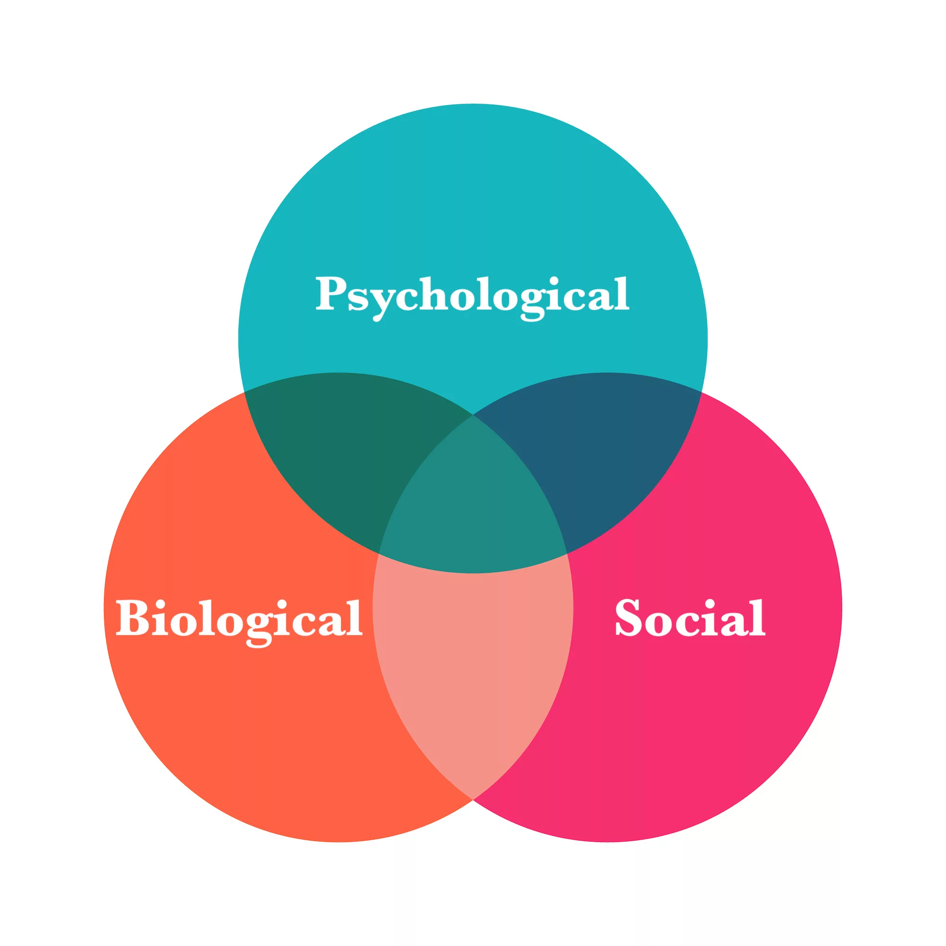
Comparative Evaluation of the Models
Combination of the models indicates sustainable design of care facilities by prioritising longitudinal well-being, integration and prevention (Symeou et al., 2025).
The application of the models supports health equity by addressing the structural determinants rather than relying only on individual behaviour.
Comparative utilisation improves system responsiveness, along with requiring critical evaluation for avoiding conceptual duplication or overlap.
Notes:
These models together help design sustainable health and social care services by focusing on prevention, integration, and long-term wellbeing rather than short-term treatment. Instead of reacting only when people become ill, services aim to stop problems early and support physical, mental, and social health across the life course. By doing this, the models promote health equity. They recognise that health is shaped by wider structural factors such as income, housing, education, and access to services, not just individual lifestyle choices. Addressing these determinants helps reduce inequalities between different population groups. Using the models in comparison also makes health systems more responsive and adaptable, as strengths from each approach can be combined. However, careful evaluation is needed to prevent overlapping concepts or duplicated interventions. For example, a community health programme might combine preventive screenings with social support services, ensuring low-income families receive early care while also addressing barriers like poor housing or limited access to transport.

Slide 8
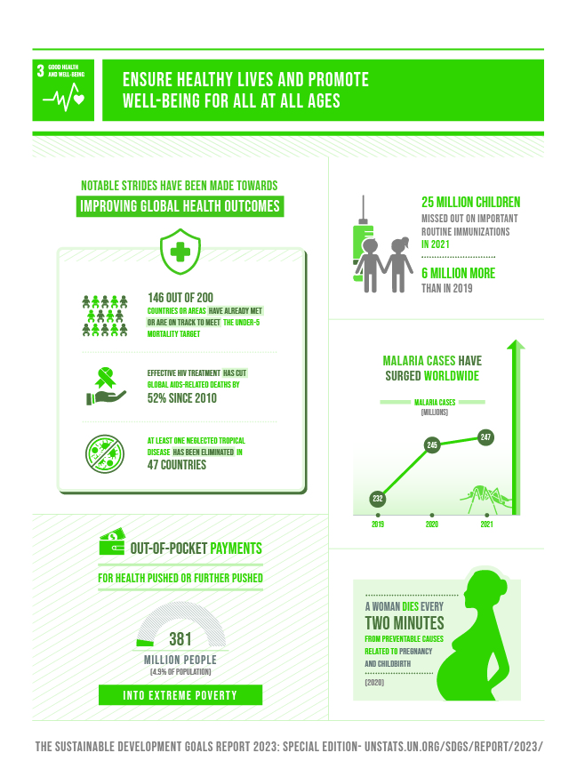
Sustainable Development Goals and SDG3
The sustainable development goals 3 establishes a strong connection between global environmental sustainability and equity with the health improvement infrastructure (UN, 2026).
The principles of sustainable development goals in the UK shape population-based and preventive health policies by addressing social determinants and lifestyle risk.
Diabetes prevention programs of the National Health Service target modifiable risk factors for reducing long-term demand for care facilities by exemplifying sustainable prevention (Mbata et al., 2024).
However, unequal uptake persists significantly, which demonstrates the requirement for improved community outrage and digital inclusion.
Notes:
The Sustainable Development Goals link better health with fairness and environmental sustainability across the world. In the United Kingdom, these ideas influence health policies that focus on prevention rather than only treatment. UK strategies aim to reduce lifestyle risks such as poor diet, inactivity, and smoking, while also addressing social factors like income, education, and housing that affect health. A clear example is the NHS Diabetes Prevention Programme, which supports people at high risk of type 2 diabetes. The programme encourages healthier eating, regular physical activity, and weight management. Reducing preventable illness, it helps lower future pressure on hospitals and long-term healthcare costs. However, not everyone benefits equally. Some groups face barriers such as limited digital access, language difficulties, or low awareness. This shows the need for better digital inclusion and stronger community outreach, for example, through local clinics or community centres, to ensure preventive health services are fair and accessible to all.

Slide 9
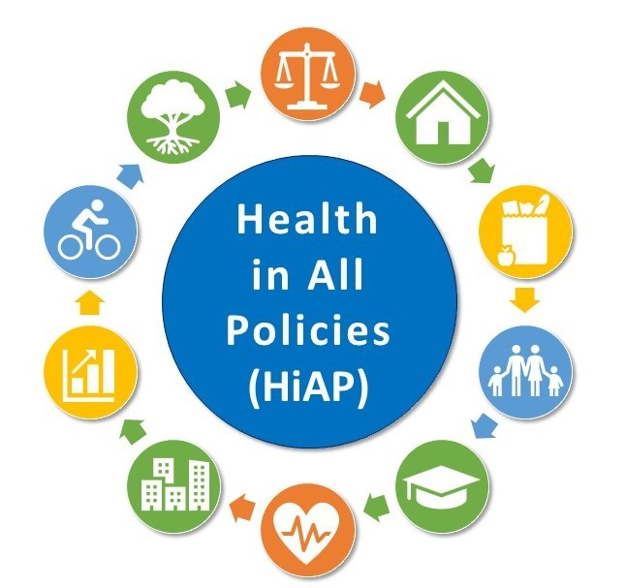

Policy and Governance: Major national and international frameworks
HiAP connects health to housing, transport, and employment (WHO, 2026).
SDG 3 supports equitable, preventive, and sustainable health systems.
NHS Long Term Plan promotes prevention and personalised health (NHS, 2019).
The Health and Care Act 2022 promotes integrated systems (Legislation.gov.uk, 2026).
Notes:
National and international frameworks develop the strategic foundations for incorporating well-being, health, and sustainable development in the UK. The WHO Health in All Policies (HiAP) promotes collaboration across sectors by establishing that health outcomes depend on employment, housing, transport, and planning along with clinical care (WHO, 2026). This aligns directly with SDG 3, which demands equitable, preventive, and sustainable approaches to the health of the population. The NHS operationalises SDG 3 through the NHS Long Term Plan. This prioritises prevention, personalised care, and investment in mental health, followed by community-based support (NHS, 2019). The plan has produced structural changes like the expansion of integrated care systems and the rollout of social prescribing networks. Additionally, it aligns with sustainability factors through commitments to reduce waste, improve care pathways and move resources towards early intervention. The Health and Care Act 2022 replaced competitive commissioning with collaboration, reinforced duties and service integration, and legally established ICS for population health improvement (Legislation.gov.uk, 2026). This provides the statutory basis for sustainable care planning and coordination among teams. Hence, it supports SDG 3 by incorporating prevention, long-term well-being of the population and partnership working in the legal requirements.

Slide 10
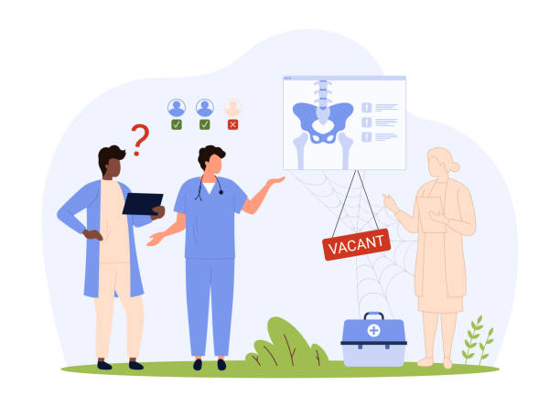
Policy and Governance
Austerity restricts HiAP and intersectoral planning.
Staff shortages undermine the NHS Long Term Plan (NHS, 2024).
Diabetes Prevention Programme demonstrates poor referral outcomes (Ravindrarajah et al., 2023).
Fragmented governance increases inequalities and avoidable deaths (Hughes et al., 2020).
Notes:
Policies and frameworks have a significant impact on healthcare, yet are often influenced by governance ideology and social inequalities. The HiAP approach is not completely established in the UK, as fragmented local authorities and austerity budgets have limited capacity for health planning across sectors. For instance, poor quality housing is still harming health, with 15 million people living in damp houses with mould or cold (Health Equals, 2025). This contradicts the emphasis of SDG 3 on the social determinants of health. The NHS Long Term plan has improved prevention, especially through social prescribing and expanded mental health funding. However, there are major systemic constraints with over 112,000 workforce vacancies in the NHS despite increasing demand (NHS, 2024). Preventive programmes like the NHS Diabetes Prevention Programme are not complete successes, as around 51331 patients were not referred in the main analysis, resulting in a smaller association with risk reduction (Ravindrarajah et al., 2023). This revealed a significant gap between policy ambition and structural capacity. The Health and Care Act 2022 aimed to reduce fragmentation caused by market reforms. However, integrated care services can increase collaboration, whereas Hughes, Shaw, and Greenhalgh (2020) state that increasing outsourcing and a lack of persistent local governance impact care delivery. Social processes further increase disparities as avoidable mortality is significantly higher in deprived regions, which contradicts the equity objective of SDG 3.

Slide 11

Initiative: NHS Health Check
NHS Health Check focus on the early prevention of NCDs for adults aged 40-74 years (NHS, 2026).
The initiative supports the achievement of SDG 3 by screening and providing lifestyle advice (NHS, 2020).
It aims to lower long-term hospitalisation and treatment expenses through prevention.
Participants showed higher levels of motivation and self-control regarding health (Atkins et al., 2020).
Notes:
The NHS Health Check Programme is a national cardiovascular risk assessment strategy for adults aged between 40 and 74 (NHS, 2026). It is designed to prevent the risks of stroke, heart disease, diabetes, and kidney issues. This programme is strongly aligned with SDG 3 as it emphasises early detection, prevention, and the reduction of non-communicable diseases (NCDs). The programme also effectively integrates health and well-being by combining screening with lifestyle counselling for physical activity, reduction of smoking support, weight management, and community health pathways (NHS, 2020). It also follows sustainable development principles by aiming to reduce hospital admissions in the future, followed by long-term treatment costs through early intervention. Qualitative evaluations of the Health Check Programme demonstrate that participants reported increased motivation with improved knowledge and a strong sense of control of their well-being after a check-up (Atkins et al., 2020). Thus, the programme theoretically improves population health by reducing risks, supporting local preventive services, and offering comprehensive assessment along with biomedical markers. Thus, NHS Health Checks provide useful points for well-being, health, and education of sustainability, yet face significant implementation challenges.

Slide 12
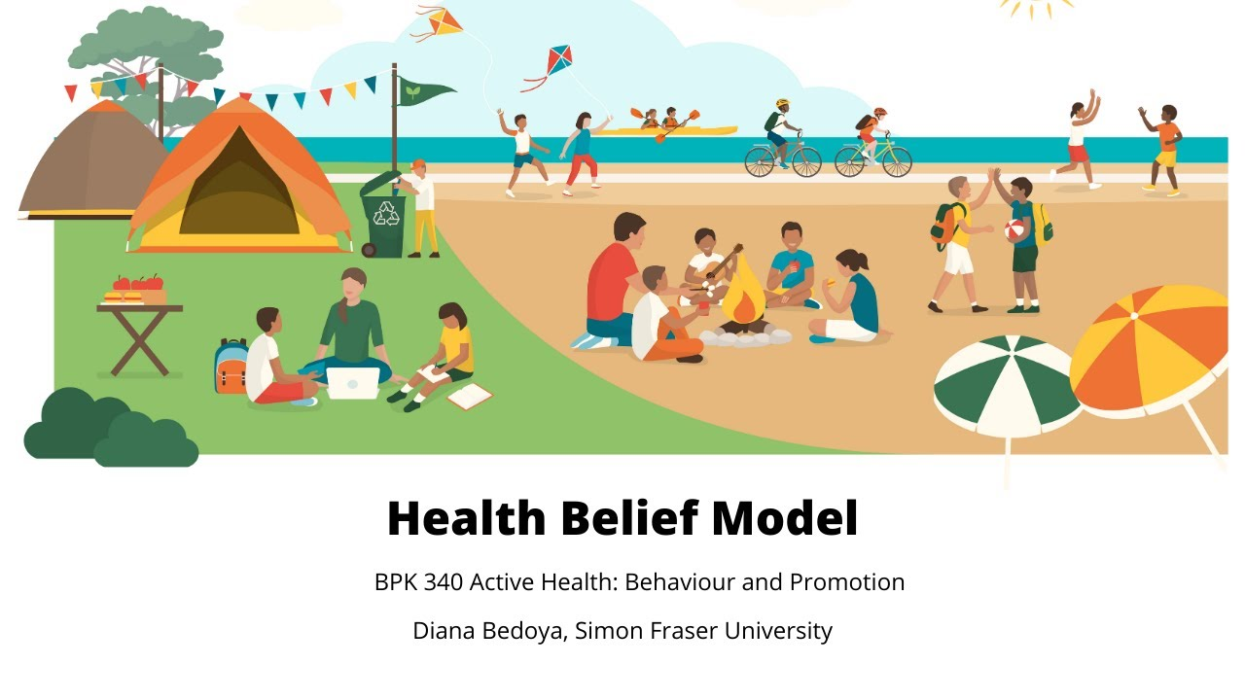
The Health Belief Model (HBM) to Explain Programme Planning
HBM theory is used to develop interventions based on severity, benefits, barriers, and cues (Anuar et al., 2020).
Cardiovascular risk scores in Health checks enhance perceived susceptibility and severity of illness.
Interventions support embracing perceived benefits like lifestyle guidance, early detection, and reduced morbidity.
However, self-efficacy is still low, and brief advice is not followed up (Su et al., 2025).
Notes:
The design of the NHS health checks closely aligns with the health belief model (HBM). This model has four major parts in the form of perceived severity, perceived benefits, perceived barriers, and cues to action (Anuar et al., 2020). The programme aims to increase perceived susceptibility by providing cardiovascular risk scores to individuals, thereby helping them to understand the seriousness or perceived severity of their illness. The model often identifies the goal of the programme in embracing perceived benefits like lifestyle guidance, early detection, and reduced morbidity. Local authorities have also introduced flexible delivery models like community venues, pharmacies, digital booking, and mobile clinics to combat perceived barriers. Cues to action include reminder systems, an invitation to general practitioners, and targeted outreach. However, the NHS Health Check Programme struggles to build self-efficacy as many participants felt unsure about maintaining lifestyle changes after the appointment. Additionally, brief advice is also not sufficient without a structured follow-up, indicating that assumptions of HBM about rational decision making may not identify the complexity of behaviour in deprived communities (Su et al., 2025). This increases tension between theoretical planning and implementation.

Slide 13
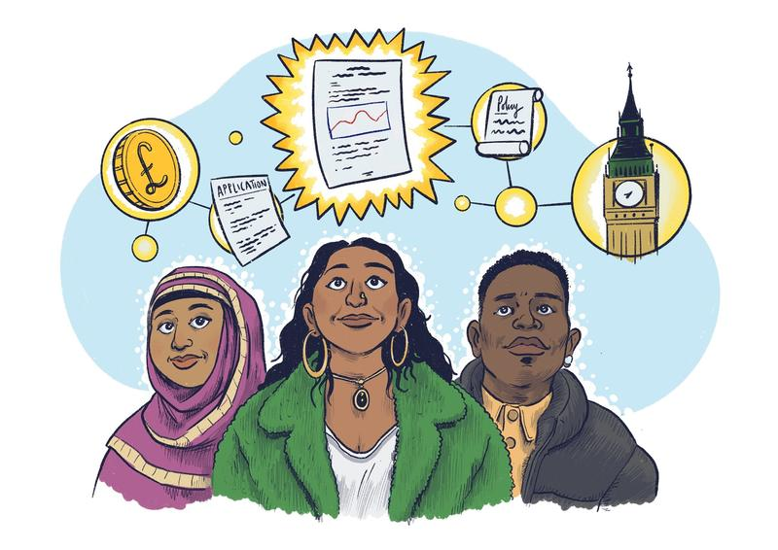
Critical Evaluation
NHS Health Checks enhanced early detection and helped meet SDG 3 prevention objectives.
However, national participation dropped to 39%, which is well below the target of 75% (Salway et al., 2024).
There was lower attendance in ethnic minorities and deprived communities (NHS, 2020).
Staff shortages and poor follow-up capacity undermine behavioural change outcomes.
Notes:
NHS Health Checks increased early detection of hypertension and diabetes and supported SDG 3 through preventive action. Several local authorities also demonstrated strong outcomes with increasing uptake among individuals. Several systematic challenges result in the national uptake of health checks declining to 39% in 2023, significantly below the target of 75%, with a large geographical variation (Salway et al., 2024). Additionally, people from ethnic groups and people from underserved areas were less likely to attend when compared to those in affluent areas. Despite completion of the checks, there is very little data available on behavioural change or referrals to lifestyle services (NHS, 2020). Many participants felt overwhelmed by lifestyle advice, resulting in a lack of trust in the preventive problems of the emphasis of HBM on individual decision-making. Workforce shortages also result in fragmented delivery of services, which illustrates the issues of integrated well-being, health, and sustainable development in the UK.

Slide 14

Equity and Access
South Asian adults in the UK have six times the risk of diabetes (Hanif and Susarla, 2018).
Deprived areas have double the preventable admissions because of a lack of access (Enard et al., 2023).
5.4 million have poor digital skills, restricting access to digital services in the NHS (Gov.uk, 2019).
Universal services maintain inequalities without specific equity strategies.
Notes:
Equity in health and social care in the UK remains constrained by existing structural inequalities. Ethnic minorities still face the burden of chronic illness with less access to preventive services. For instance, adults of South Asian origin living in the UK are six times more likely to suffer from diabetes, yet the referral rates to prevention are significantly lower than those of white British groups (Hanif and Susarla, 2018). Deprivation of access to care is a powerful barrier, as people living in deprived regions have double the rate of preventable hospital admissions, which reflect poor access to care with fragmented primary care coverage (Enard et al., 2023). Digital exclusion also presents inequity, as around 5.4 million adults in the UK do not have basic digital skills, which undermines participation in digital services (Gov.uk, 2019). This renders remote consultations of the NHS and behavioural change programmes useless. The disparities denote that universal services do not guarantee equal uptake, as inequalities can be reproduced if services fail to protect every individual.

Slide 15
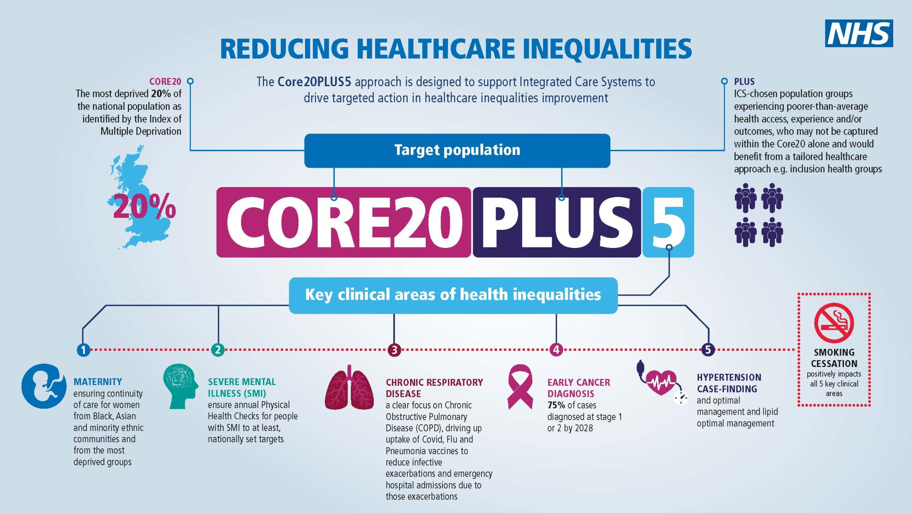
Equity and Access: Recommendations
Core20PLUS5 is unevenly delivered in the ICS, reducing effectiveness (Gov.uk, 2022).
Digital strategies increase exclusion without matching investment in digital literacy (NHS, 2026a).
Co-produced interventions increase engagement with marginalised communities (Litchfield et al., 2025).
Future policy changes require equity audits and community screening.
Notes:
National strategies at present introduce disparities, yet the effectiveness is often uneven across the UK. The Core20PLUS5 framework aims to prioritise the most deprived 20% and underserved groups (Gov.uk, 2022). However, there is variable implementation across integrated care systems, which limits impact on conditions like cardiovascular disease and diabetes. Similarly, the Long Term plan of the NHS promotes digital access (NHS, 2026a). However, a lack of parallel investment in digital literacy enhanced the service of excluding older adults and low-income individuals. Hence, equitable service delivery demands shifting from these models to proactive outrage especially in the case of high deprivation areas. Evidence states that co-produced health interventions can increase engagement and non-marginalised groups, which demonstrates the effectiveness of participatory systems (Litchfield et al., 2025). Thus, future reforms should include casually adapted health information, mandatory equity audits, and targeted screening in the community to address the symptoms of inequality.

Slide 16

Conclusion
Frameworks in the UK are supportive of SDG 3, but there are still some gaps in the implementation of the goal.
Health Checks demonstrate the application of HBM, but there is low uptake.
Ethnic inequalities, including diabetes risk, still exist.
Equity needs co-produced and proactive community interventions.
Notes:
In summary, integration of well-being, health, and sustainability in the UK is significantly supported by structures like the Health and Care Act 2022, the NHS Long Term plan, and SDG 3. However, there are significant gaps in implementation which hinders delivery of care. The NHS Health Check Programme demonstrates the theoretical application of the Health Belief Model to prevent NCDs, yet its impact is affected by workforce shortages and low uptake rates. Additionally, systemic inequity demonstrated by the disproportionate diabetes risk in several ethnic communities and digital exclusion also identifies that universal policies can fail in vulnerable situations. Hence achievement of genuine health equity demands a change from passive clinical models to co-produced and proactive community-based interventions.

Slide 17
References
Anuar, H., Shah, S.A., Gafor, H., Mahmood, M.I. and Ghazi, H.F. (2020). Usage of Health Belief Model (HBM) in health behaviour: A systematic review. Malaysian Journal of Medicine and Health Sciences, 16(11), pp.2636-9346. http://medic.upm.edu.my/upload/dokumen/2021010809001826_2020_0366_.pdf
Atkins, L., Stefanidou, C., Chadborn, T., Thompson, K., Michie, S. and Lorencatto, F. (2020). Influences on NHS Health Check behaviours: a systematic review. BMC Public Health, 20(1), p.1359. https://doi.org/10.1186/s12889-020-09365-2
Bolton, D. (2023) ‘A revitalized biopsychosocial model: core theory, research paradigms, and clinical implications’, Psychological medicine, 53(16), pp.7504-7511. https://www.cambridge.org/core/services/aop-cambridge-core/content/view/8FC915C01228857ED6B5E123536E8994/S0033291723002660a.pdf/div-class-title-a-revitalized-biopsychosocial-model-core-theory-research-paradigms-and-clinical-implications-div.pdf
Enard, K.R., Coleman, A.M., Yakubu, R.A., Butcher, B.C., Tao, D. and Hauptman, P.J. (2023). Influence of social determinants of health on heart failure outcomes: a systematic review. Journal of the American Heart Association, 12(3), p.e026590. https://www.ahajournals.org/doi/pdf/10.1161/JAHA.122.026590
Gov.uk (2019) Essential digital skills framework. Available at: https://www.gov.uk/government/publications/essential-digital-skills-framework/essential-digital-skills-framework (Accessed: 13 February 2026).
Gov.uk (2022) Health disparities and health inequalities: applying All Our Health. Available at: https://www.gov.uk/government/publications/health-disparities-and-health-inequalities-applying-all-our-health/health-disparities-and-health-inequalities-applying-all-our-health (Accessed: 13 February 2026).
Hanif, W. and Susarla, R. (2018) Diabetes and cardiovascular risk in UK South Asians: an overview. Br. J. Cardiol, 25(Suppl 2), pp.S8-S13. http://dx.doi.org/10.5837/bjc.2018.s08
Notes:
Health Equals (2025) New data shows more than 1 in 4 of us live in homes that could harm our health. Available at: https://healthequals.org.uk/data_insights/homes-that-harm-health/ (Accessed: 13 February 2026).
Hudson, S. (2024) ‘The role of social determinants in shaping public health policies’, Global Perspectives in Health, Medicine, and Nursing, 3(1), pp.23-33. https://forthworthjournals.org/journals/index.php/GPHMN/article/download/99/98
Hughes, G., Shaw, S.E. and Greenhalgh, T. (2020). Rethinking integrated care: a systematic hermeneutic review of the literature on integrated care strategies and concepts. The Milbank Quarterly, 98(2), pp.446-492. https://onlinelibrary.wiley.com/doi/abs/10.1111/1468-0009.12459
Jane Osareme, O., Muonde, M., Maduka, C.P., Olorunsogo, T.O. and Omotayo, O. (2024) ‘Demographic shifts and healthcare: A review of aging populations and systemic challenges’, Int. J. Sci. Res. Arch, 11, pp.383-395. https://pdfs.semanticscholar.org/65f3/36ed8bac5d284f94d935fb8b373344ff0011.pdf
Legislation.gov.uk (2026) Health and Care Act 2022. Available at: https://www.legislation.gov.uk/ukpga/2022/31/contents (Accessed: 13 February 2026).
Litchfield, I., Delanerolle, G., Juffs, H., Bloxham, S., Dunning, S. and Harper, L. (2025). Increasing the inclusivity of digital health co-production: an integrative review. Frontiers in digital health, 7, p.1636469. https://doi.org/10.3389/fdgth.2025.1636469
Mbata, A.O., Soyege, O.S., Nwokedi, C.N., Tomoh, B.O., Mustapha, A.Y., Balogun, O.D., Forkuo, A.Y. and Iguma, D.R. (2024) ‘Preventative medicine and chronic disease management: reducing healthcare costs and improving long-term public health’, International Journal of Multidisciplinary Research and Growth Evaluation, 5(06), pp.1584-1600. https://www.researchgate.net/profile/Olakunle-Soyege/publication/390694904_Preventative_Medicine_and_Chronic_Disease_Management_Reducing_Healthcare_Costs_and_Improving_Long-Term_Public_Health/links/67fb28eadf0e3f544f4102e5/Preventative-Medicine-and-Chronic-Disease-Management-Reducing-Healthcare-Costs-and-Improving-Long-Term-Public-Health.pdf
Navarro, J.L. and Tudge, J.R. (2023) ‘Technologizing Bronfenbrenner: neo-ecological theory’, Current Psychology, 42(22), pp.19338-19354. https://pmc.ncbi.nlm.nih.gov/articles/PMC8782219/pdf/12144_2022_Article_2738.pdf
NHS (2019) NHS Long Term Plan to tackle major killer conditions and save up to half a million lives. Available at: https://www.england.nhs.uk/2019/01/long-term-plan/ (Accessed: 13 February 2026).
NHS (2020) NHS Health Check programme standards: a framework for quality improvement. Available at: https://www.healthcheck.nhs.uk/seecmsfile/?id=1507 (Accessed: 13 February 2026).
NHS (2023) NHS Long Term Workforce Plan. Available at: https://www.england.nhs.uk/long-read/nhs-long-term-workforce-plan-2/ (Accessed: 13 February 2026).
NHS (2026) NHS Health Check. Available at: https://www.nhs.uk/tests-and-treatments/nhs-health-check/ (Accessed: 13 February 2026).
NHS (2026a) Digital and technology. Available at: https://www.england.nhs.uk/mat-transformation/matrons-handbook/digital-and-technology/ (Accessed: 13 February 2026).
Ravindrarajah, R., Sutton, M., Reeves, D., Cotterill, S., Mcmanus, E., Meacock, R., Whittaker, W., Soiland-Reyes, C., Heller, S., Bower, P. and Kontopantelis, E. (2023). Referral to the NHS Diabetes Prevention Programme and conversion from nondiabetic hyperglycaemia to type 2 diabetes mellitus in England: A matched cohort analysis. PLoS medicine, 20(2), p.e1004177. https://doi.org/10.1371/journal.pmed.1004177
Roll, S., Kondratjeva, O., Bufe, S., Grinstein-Weiss, M. and Skees, S. (2022) ‘Assessing the short-term stability of financial well-being in low-and moderate-income households’, Journal of Family and Economic Issues, 43(1), pp.100-127. https://openscholarship.wustl.edu/cgi/viewcontent.cgi?article=1018&context=spi_research
Salway, R., Sillero-Rejon, C., Forte, C., Grey, E., Jessiman, P., McLeod, H., Harkes, R., Stokes, P., De Vocht, F., Campbell, R. and Jago, R. (2024). A service evaluation of the uptake and effectiveness of a digital delivery of the NHS health check service. BMJ open, 14(11), p.e091417. https://doi.org/10.1136/bmjopen-2024-091417
Su, Z., Yang, D., Wang, C., Xiao, Z. and Cai, S. (2025) Structural assessment of family and educational influences on student health behaviours: Insights from a public health perspective. Plos one, 20(9), p.e0333086. https://journals.plos.org/plosone/article?id=10.1371/journal.pone.0333086
Symeou, L., Louca, L., Kavadella, A., Mackay, J., Danidou, Y. and Raffay, V. (2025) ‘Development of Evidence‐Based Guidelines for the Integration of Generative AI in University Education Through a Multidisciplinary, Consensus‐Based Approach’, European Journal of Dental Education, 29(2), pp.285-303. https://onlinelibrary.wiley.com/doi/pdf/10.1111/eje.13069
Tavares, A.P., Martins, H., Pinto, S., Caldeira, S., Pontífice Sousa, P. and Rodgers, B. (2022, November) ‘Spiritual comfort, spiritual support, and spiritual care: A simultaneous concept analysis’, In Nursing forum (Vol. 57, No. 6, pp. 1559-1566). https://onlinelibrary.wiley.com/doi/pdf/10.1111/nuf.12845
Thamizhoviya, G. (2025) ‘Global Integration of Traditional and Modern Medicine: Policy Developments, Regulatory Frameworks, and Clinical Integration Model’, Future Integrative Medicine, 4(3), pp.180-190. https://www.xiahepublishing.com/m/2835-6357/FIM-2025-00033
UN (2026) Ensure healthy lives and promote well-being for all at all ages. Available at: https://sdgs.un.org/goals/goal3 (Accessed: 13 February 2026).
Vogel, R., Göbel, M., Grewe‐Salfeld, M., Herbert, B., Matsuo, Y. and Weber, C. (2022) ‘Cross‐sector partnerships: Mapping the field and advancing an institutional approach’, International Journal of Management Reviews, 24(3), pp.394-414. https://onlinelibrary.wiley.com/doi/pdfdirect/10.1111/ijmr.12283
WHO (2026a) Health and Well-Being. Available at: https://www.who.int/data/gho/data/major-themes/health-and-well-being (Accessed: 13 February 2026).
WHO (2026b) Promoting Health in All Policies and intersectoral action capacities. Available at: https://www.who.int/activities/promoting-health-in-all-policies-and-intersectoral-action-capacities (Accessed: 13 February 2026).
Zheng, X. and Wang, A. (2025) ‘Optimizing Nursing Communication for Symptom Management in Hemodialysis: Development of an Artificial Intelligence–Based Web Predictive Model for Burden Classification and Evidence Navigation’, Journal of Nursing Management, 2025(1), pp.1-21. https://onlinelibrary.wiley.com/doi/pdf/10.1155/jonm/4579091

Slide 18
References
Health Equals (2025) New data shows more than 1 in 4 of us live in homes that could harm our health. Available at: https://healthequals.org.uk/data_insights/homes-that-harm-health/ (Accessed: 13 February 2026).
Hudson, S. (2024) ‘The role of social determinants in shaping public health policies’, Global Perspectives in Health, Medicine, and Nursing, 3(1), pp.23-33. https://forthworthjournals.org/journals/index.php/GPHMN/article/download/99/98
Hughes, G., Shaw, S.E. and Greenhalgh, T. (2020). Rethinking integrated care: a systematic hermeneutic review of the literature on integrated care strategies and concepts. The Milbank Quarterly, 98(2), pp.446-492. https://onlinelibrary.wiley.com/doi/abs/10.1111/1468-0009.12459
Jane Osareme, O., Muonde, M., Maduka, C.P., Olorunsogo, T.O. and Omotayo, O. (2024) ‘Demographic shifts and healthcare: A review of aging populations and systemic challenges’, Int. J. Sci. Res. Arch, 11, pp.383-395. https://pdfs.semanticscholar.org/65f3/36ed8bac5d284f94d935fb8b373344ff0011.pdf
Legislation.gov.uk (2026) Health and Care Act 2022. Available at: https://www.legislation.gov.uk/ukpga/2022/31/contents (Accessed: 13 February 2026).
Litchfield, I., Delanerolle, G., Juffs, H., Bloxham, S., Dunning, S. and Harper, L. (2025). Increasing the inclusivity of digital health co-production: an integrative review. Frontiers in digital health, 7, p.1636469. https://doi.org/10.3389/fdgth.2025.1636469
Mbata, A.O., Soyege, O.S., Nwokedi, C.N., Tomoh, B.O., Mustapha, A.Y., Balogun, O.D., Forkuo, A.Y. and Iguma, D.R. (2024) ‘Preventative medicine and chronic disease management: reducing healthcare costs and improving long-term public health’, International Journal of Multidisciplinary Research and Growth Evaluation, 5(06), pp.1584-1600. https://www.researchgate.net/profile/Olakunle-Soyege/publication/390694904_Preventative_Medicine_and_Chronic_Disease_Management_Reducing_Healthcare_Costs_and_Improving_Long-Term_Public_Health/links/67fb28eadf0e3f544f4102e5/Preventative-Medicine-and-Chronic-Disease-Management-Reducing-Healthcare-Costs-and-Improving-Long-Term-Public-Health.pdf
Notes:
Legislation.gov.uk (2026) Health and Care Act 2022. Available at: https://www.legislation.gov.uk/ukpga/2022/31/contents (Accessed: 13 February 2026).
Litchfield, I., Delanerolle, G., Juffs, H., Bloxham, S., Dunning, S. and Harper, L. (2025). Increasing the inclusivity of digital health co-production: an integrative review. Frontiers in digital health, 7, p.1636469. https://doi.org/10.3389/fdgth.2025.1636469
Mbata, A.O., Soyege, O.S., Nwokedi, C.N., Tomoh, B.O., Mustapha, A.Y., Balogun, O.D., Forkuo, A.Y. and Iguma, D.R. (2024) ‘Preventative medicine and chronic disease management: reducing healthcare costs and improving long-term public health’, International Journal of Multidisciplinary Research and Growth Evaluation, 5(06), pp.1584-1600. https://www.researchgate.net/profile/Olakunle-Soyege/publication/390694904_Preventative_Medicine_and_Chronic_Disease_Management_Reducing_Healthcare_Costs_and_Improving_Long-Term_Public_Health/links/67fb28eadf0e3f544f4102e5/Preventative-Medicine-and-Chronic-Disease-Management-Reducing-Healthcare-Costs-and-Improving-Long-Term-Public-Health.pdf
Navarro, J.L. and Tudge, J.R. (2023) ‘Technologizing Bronfenbrenner: neo-ecological theory’, Current Psychology, 42(22), pp.19338-19354. https://pmc.ncbi.nlm.nih.gov/articles/PMC8782219/pdf/12144_2022_Article_2738.pdf
NHS (2019) NHS Long Term Plan to tackle major killer conditions and save up to half a million lives. Available at: https://www.england.nhs.uk/2019/01/long-term-plan/ (Accessed: 13 February 2026).
NHS (2020) NHS Health Check programme standards: a framework for quality improvement. Available at: https://www.healthcheck.nhs.uk/seecmsfile/?id=1507 (Accessed: 13 February 2026).
NHS (2023) NHS Long Term Workforce Plan. Available at: https://www.england.nhs.uk/long-read/nhs-long-term-workforce-plan-2/ (Accessed: 13 February 2026).
NHS (2026) NHS Health Check. Available at: https://www.nhs.uk/tests-and-treatments/nhs-health-check/ (Accessed: 13 February 2026).
NHS (2026a) Digital and technology. Available at: https://www.england.nhs.uk/mat-transformation/matrons-handbook/digital-and-technology/ (Accessed: 13 February 2026).
Ravindrarajah, R., Sutton, M., Reeves, D., Cotterill, S., Mcmanus, E., Meacock, R., Whittaker, W., Soiland-Reyes, C., Heller, S., Bower, P. and Kontopantelis, E. (2023). Referral to the NHS Diabetes Prevention Programme and conversion from nondiabetic hyperglycaemia to type 2 diabetes mellitus in England: A matched cohort analysis. PLoS medicine, 20(2), p.e1004177. https://doi.org/10.1371/journal.pmed.1004177
Roll, S., Kondratjeva, O., Bufe, S., Grinstein-Weiss, M. and Skees, S. (2022) ‘Assessing the short-term stability of financial well-being in low-and moderate-income households’, Journal of Family and Economic Issues, 43(1), pp.100-127. https://openscholarship.wustl.edu/cgi/viewcontent.cgi?article=1018&context=spi_research
Salway, R., Sillero-Rejon, C., Forte, C., Grey, E., Jessiman, P., McLeod, H., Harkes, R., Stokes, P., De Vocht, F., Campbell, R. and Jago, R. (2024). A service evaluation of the uptake and effectiveness of a digital delivery of the NHS health check service. BMJ open, 14(11), p.e091417. https://doi.org/10.1136/bmjopen-2024-091417
Su, Z., Yang, D., Wang, C., Xiao, Z. and Cai, S. (2025) Structural assessment of family and educational influences on student health behaviours: Insights from a public health perspective. Plos one, 20(9), p.e0333086. https://journals.plos.org/plosone/article?id=10.1371/journal.pone.0333086
Symeou, L., Louca, L., Kavadella, A., Mackay, J., Danidou, Y. and Raffay, V. (2025) ‘Development of Evidence‐Based Guidelines for the Integration of Generative AI in University Education Through a Multidisciplinary, Consensus‐Based Approach’, European Journal of Dental Education, 29(2), pp.285-303. https://onlinelibrary.wiley.com/doi/pdf/10.1111/eje.13069
Tavares, A.P., Martins, H., Pinto, S., Caldeira, S., Pontífice Sousa, P. and Rodgers, B. (2022, November) ‘Spiritual comfort, spiritual support, and spiritual care: A simultaneous concept analysis’, In Nursing forum (Vol. 57, No. 6, pp. 1559-1566). https://onlinelibrary.wiley.com/doi/pdf/10.1111/nuf.12845
Thamizhoviya, G. (2025) ‘Global Integration of Traditional and Modern Medicine: Policy Developments, Regulatory Frameworks, and Clinical Integration Model’, Future Integrative Medicine, 4(3), pp.180-190. https://www.xiahepublishing.com/m/2835-6357/FIM-2025-00033
UN (2026) Ensure healthy lives and promote well-being for all at all ages. Available at: https://sdgs.un.org/goals/goal3 (Accessed: 13 February 2026).
Vogel, R., Göbel, M., Grewe‐Salfeld, M., Herbert, B., Matsuo, Y. and Weber, C. (2022) ‘Cross‐sector partnerships: Mapping the field and advancing an institutional approach’, International Journal of Management Reviews, 24(3), pp.394-414. https://onlinelibrary.wiley.com/doi/pdfdirect/10.1111/ijmr.12283
WHO (2026a) Health and Well-Being. Available at: https://www.who.int/data/gho/data/major-themes/health-and-well-being (Accessed: 13 February 2026).
WHO (2026b) Promoting Health in All Policies and intersectoral action capacities. Available at: https://www.who.int/activities/promoting-health-in-all-policies-and-intersectoral-action-capacities (Accessed: 13 February 2026).
Zheng, X. and Wang, A. (2025) ‘Optimizing Nursing Communication for Symptom Management in Hemodialysis: Development of an Artificial Intelligence–Based Web Predictive Model for Burden Classification and Evidence Navigation’, Journal of Nursing Management, 2025(1), pp.1-21. https://onlinelibrary.wiley.com/doi/pdf/10.1155/jonm/4579091

Slide 19


