Slide 1
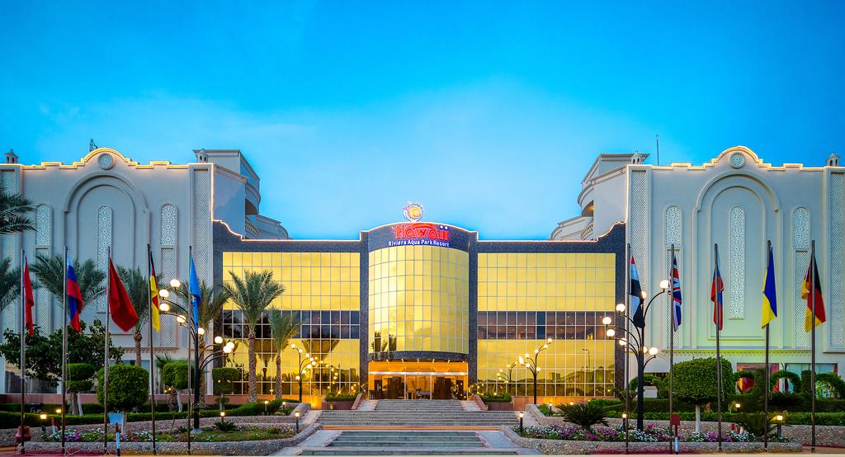
An Appraisal of a Guest Service Experience
Students: Georgeta Antoche - 1816337
Andreea Sandru - 1815220
Maria Vrincianu - 1815243
Emilia Zelin – 1815221
Lecturer: Dr. Oluwaseun Adegbite

Slide 2

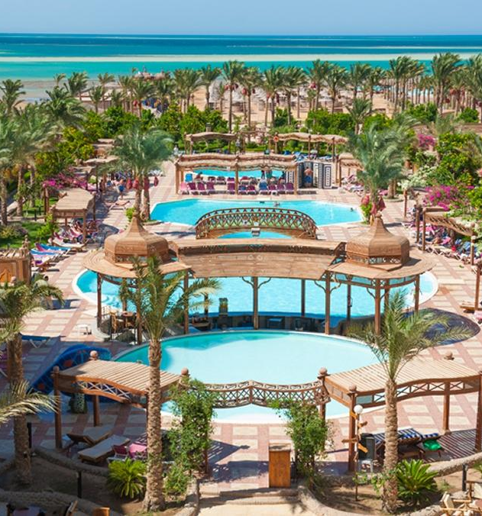
Hawaii Riviera Aqua Park Resort
The 4-star resort
Is located under 10 miles north of the popular Egyptian resort, Hurghada
Is a resort ideal for families and couples
With plenty of activities suitable for children
Adult activities, including a spa and a fitness and wellness centre
Restaurant with both outdoor an indoor seating available
Different entertainment background

Slide 3

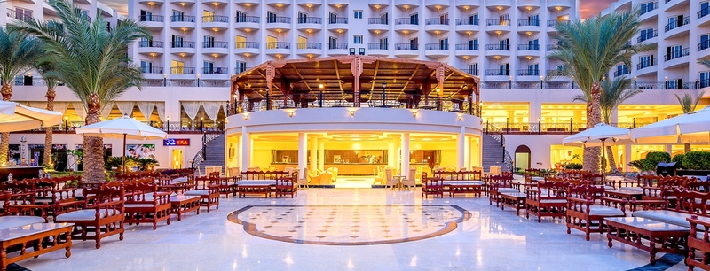
Hawaii Riviera Aqua Park Resort
Hotel built in 2005 (last complete renovation 2016)
Multilingual staff on hand 24 hours a day
All-inclusive hotel
Spend a relaxing time at the Hawaii Riviera Aqua Park Resort "Couples & Families Only“
A little paradise for the holidaymakers looking to spend some time with family and friends.

Slide 4


Slide 5

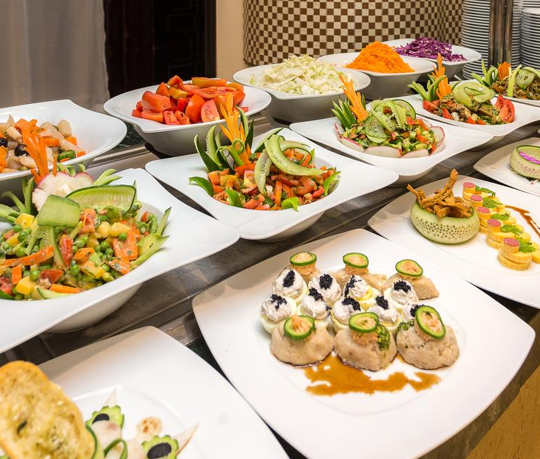



Large buffet meals, also Asian and Italian cuisines
Free wi-fi
Pool-side bar and beach bar
Entertainment (tennis, karaoke, darts, water park, windsurfing
ATM cash machine – 24 h
24 h Reception
Healthy suits( Turkish/steam bath, massage, hot but/jacuzzi, sauna
Fitness centre
9. Medical Centre
10. Trips ( additional charge )

Slide 6

Only all inclusive
Trips
Special cuisine
Each room contains balcony as smoking area
Presents an exotic beachscape view on Red Sea
Reasonable price
Diversification entertainment/ cultural diversity
Water park free of charge
Kids pool, a playground and kids club
Diet meals (customer demand) and BBQ facilities

Slide 7

New town, new hotel ( 2005)
Improve by listening our guests
Training for our employees periodically
Variety of languages spoken in the hotel
Design in a way that makes it hard to believe you are in Egypt
Motivating the staff with discounts The place and history gives a plus to the hotel

Slide 8
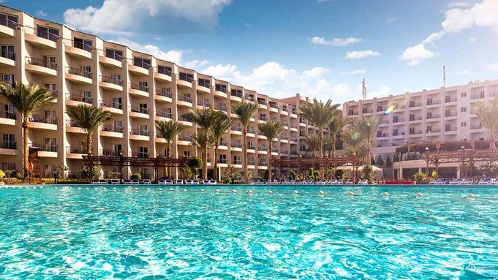
Bullet points:
All Inclusive
Entertainment everywhere
Dazzlingly marine life
Trained staff
Every guest -> a VIP
Hygienic
Diversity

Slide 9

- It has a astonishing reception room with an Egyptian design.
- Particular cuisines every night.
Different trips every day .
-Various recipes of cocktails enjoyed by the pool bar.
-Mobile coffee next to the sea with original smoothies.
SETTING
- In the resort are 3 hotels . In all of them the quality of the services is the major factor due to relationship between quality and customer satisfaction.
-Treating every guest as a VIP. Increase hotel efforts to facilitate an unforgettable guest experience, in a high competitive marketplace.
-Targeting first-rate customer service it documents every preference of customers.
QUALITY
- the resort is one of the most appreciate from the region as a result of the trained workers that deliver the best customers service.
-”Do it right the first time” or the service will fail.
DELIVERY

Slide 10
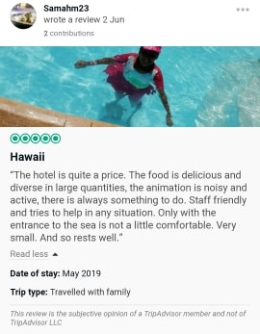
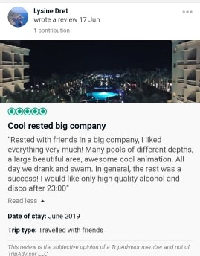

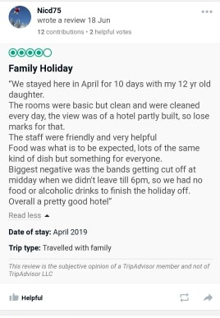
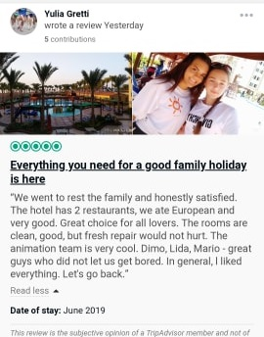
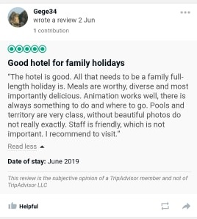

Slide 11
Hawaii Aqua Park Resort
COMPARE
Villamarin Spain
Quality
Treat every guest as an VIP Friendly workers
Quality
managers are trying to intimidate customers, invading personal space -unfriendly workers
Setting
-small rooms, paying for remote 10 £, bathrooms small, the washbasin is in bedroom, the balconies are too small food banal -2 singles bed No English channels Bad location ( Salou ) Entertainment awful (2 singers, boys, that were a disaster )
Setting
big rooms, 2 double beds, big balconies with lovely views -different cuisine every day -very good location Very nice entertainment Different activities every day for adults and kids
Delivery
motivated staff by helping customers with everything that they need
Delivery
staff not implicated in helping guests, they don't have training

Slide 12
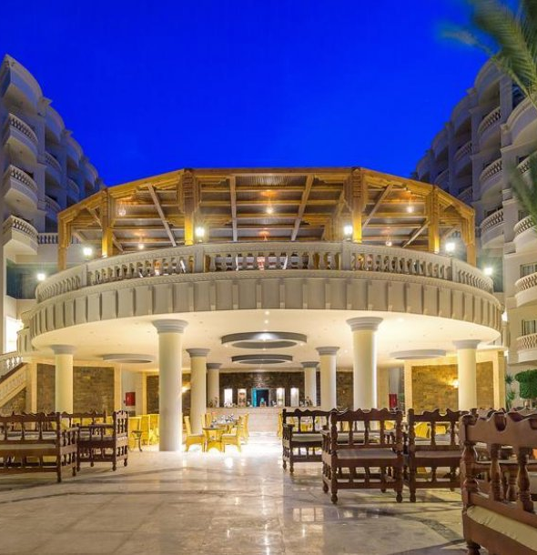
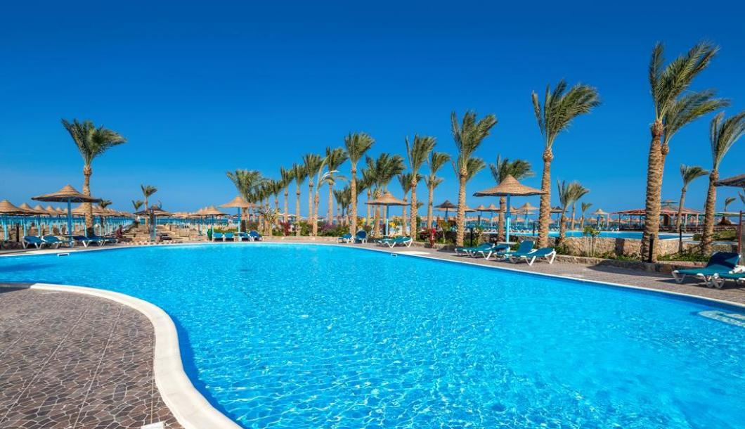
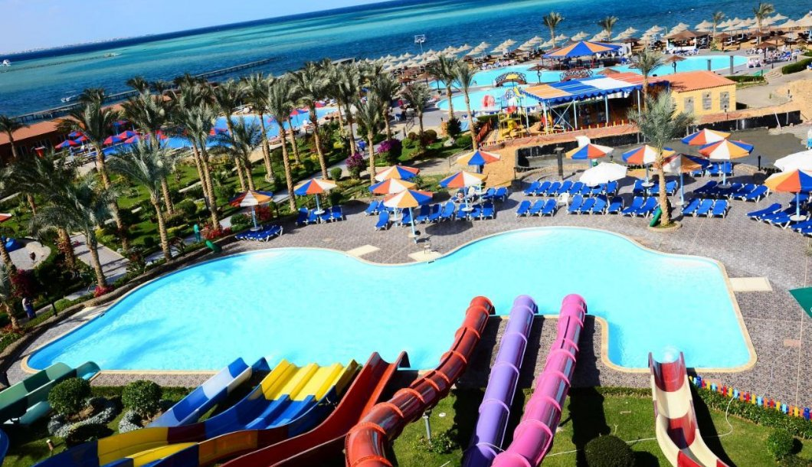
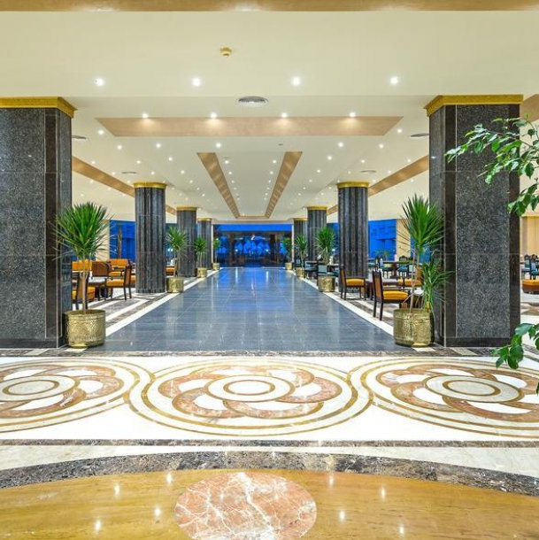
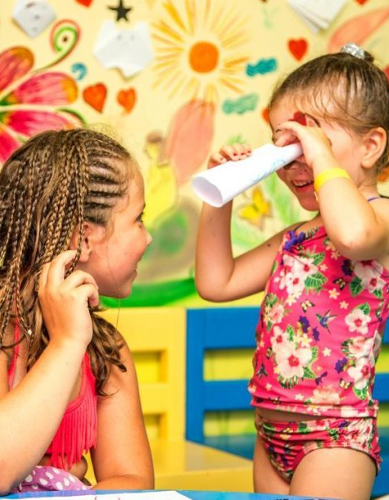
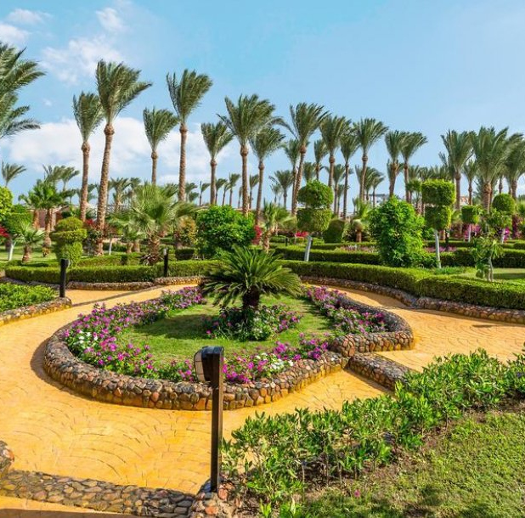

Aqua Park
and pool
Inside and outside restaurants
Kid friendly
Amazing gardens

Slide 13
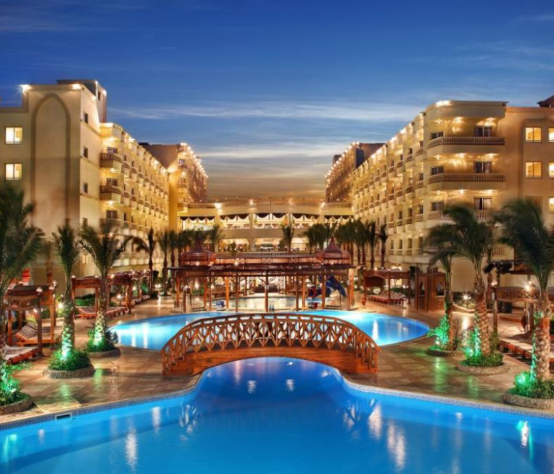

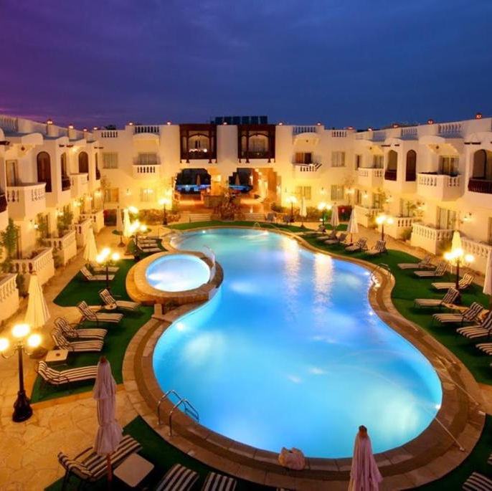
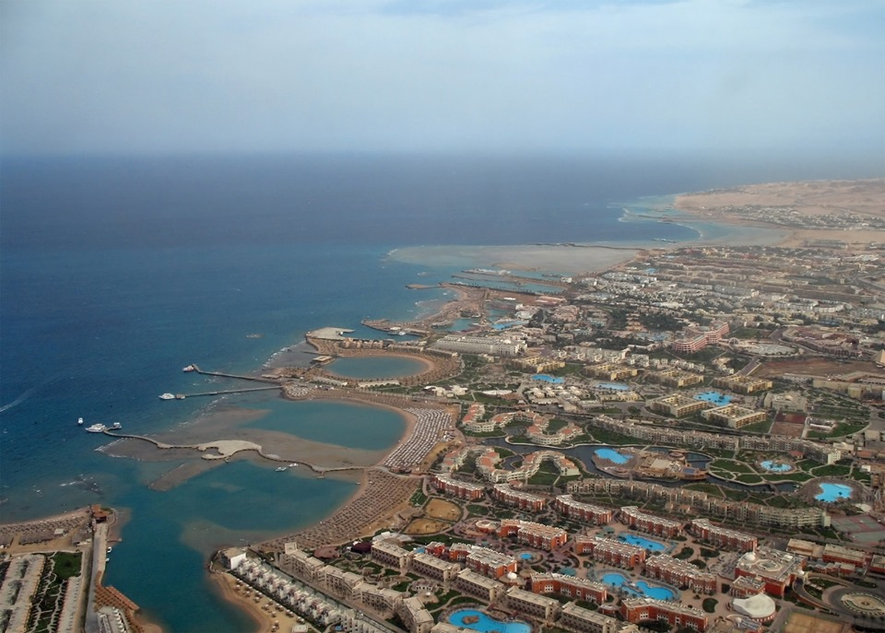
A resort full of activities
Restaurants made special for every type of guest
Kid-friendly
You are a family and don’t know where to go to have fun with the kids? Give this resort a chance.
You want to relax somewhere with an amazing view? This is the best place.
Have an awesome experience at Hawaii Riviera Aqua Park Resort.

Slide 14

Copper, B. (2002). Feedback. Bath: Camden.
Ford, R., Sturman, M. and Heaton, C. (2012). Managing quality service in hospitality. Clifton Park, N.Y.: Delmar, Cengage Learning.
Ive, J. (2000). Achieving excellence in guest service. Melbourne, Vic.: Hospitality Press.
Meric, T. and Oxford Brookes University. (2012). Business to business marketing communication mix. Oxford: Oxford Brookes University.
Nickels, W., McHugh, J. and McHugh, S. (n.d.). Understanding business.
Overton, R. (2007). Customer Service. Murwillumbah: Martin Books.
Rajpal, N. (2013). Guest service management. New Delhi: Anmol Publications.
www.booking.com

