Slide 1
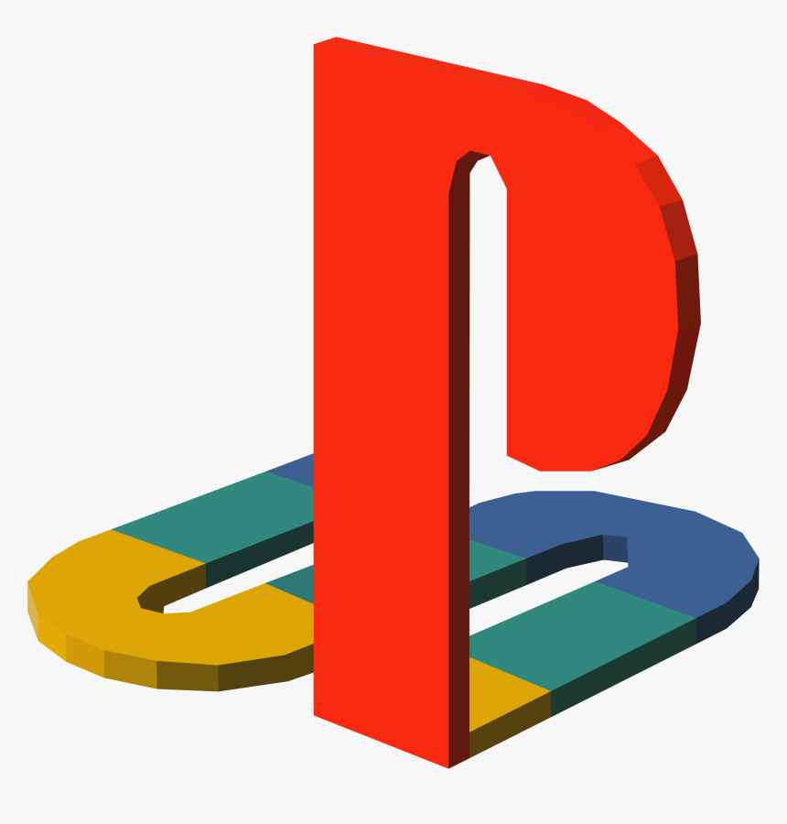
PLAYSTATION
"FEEL THE POWER"
University of Wales Trinity Saint David
LCBB4000 (ACADEMIC SKILLS)
Group 4
Student name: DENISA NEAGU
Student name: FRANCESCA LUCESCU
Student name: ANDREEA MAGOS
Lecturer: CHIJIOKE UBA

Slide 2
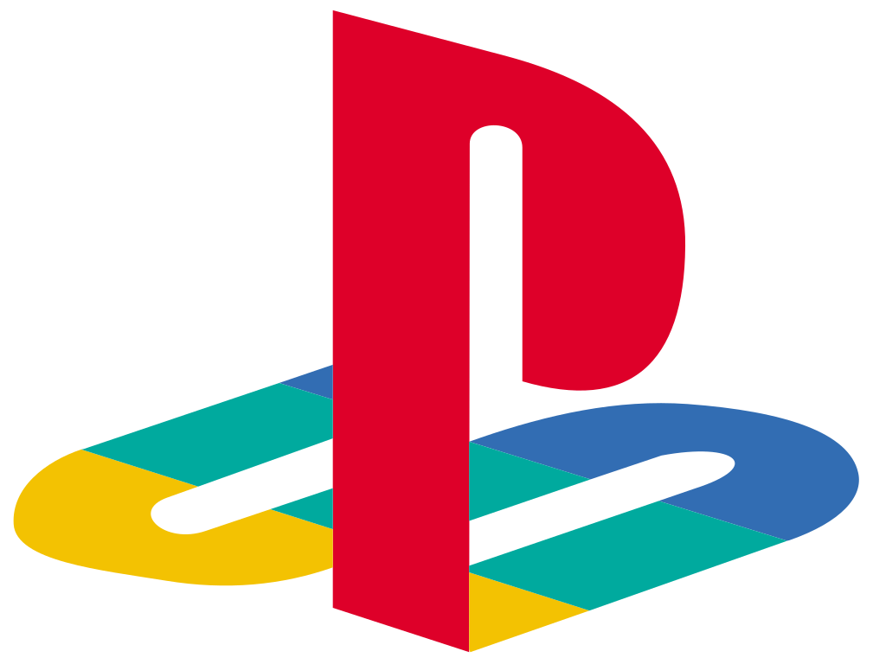
Appendix
Company information
From playground to PlayStation
Competitors on the market
Primary Data
Secondary Data
Information from primary and secondary data
Improvement
Conclusion
References

Slide 3

Company Information
PlayStation is the brand name of the gaming console created by Sony.
The first PlayStation was launched in 1994.
PlayStation 4 is the most powerful and advanced gaming console until this date.
Popular game titles include: God of War, Dark Souls 3,Dead Redemption 2

Slide 4

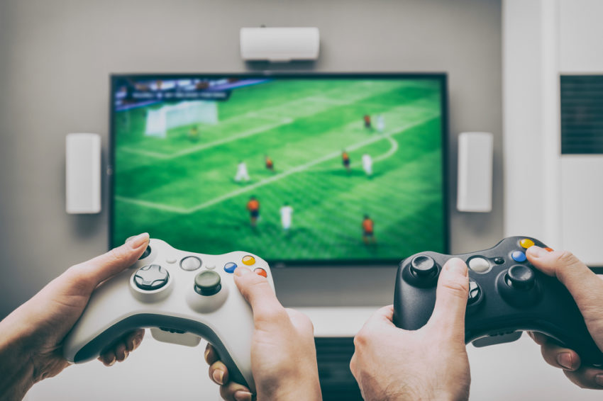
From playgrounds to PlayStation
From Playgrounds to PlayStation explores how play reflects and drives the evolution of American culture.
Notes:
In this book, Carroll Pursell examines the ways in which technology affects play and play shapes people .The objects that children and adults play with and play on along with their games and hobbies they pursue and it can reinforce and challenge gender roles and cultural norms. Pursell shows readers how technology enables the forms, equipment and devices of play to evolve constantly ,both reflecting on consumer choices and driving innovators and manufacturers to promote toys that involve entirely new kinds of play, from Lego to beading kits and videogames

Slide 5
COMPETITORS ON THE GAMING MARKET
Soon after Sony released the new prototype of PS5, his biggest competitor, XBOX announced their new addition to their collection, X SERIERS ,which will be released in the same period as PlayStation 5-Holiday 2020. (xbox.com)
Second competitor, Nintendo, released his latest console in 2019 (Nintendo SWITCH),with no current updates on any other future product on the market. (nintendo.com)

Slide 6
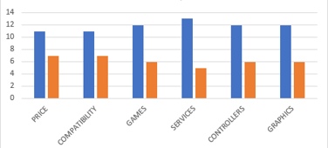
Primary Data: Comparison between PlayStation and XBoX Consoles
Sources: A. Magos & F. Lucescu, University of Wales,2020
Notes:
According to a recent survey created by our group ,majority of customers prefer PlayStation .

Slide 7
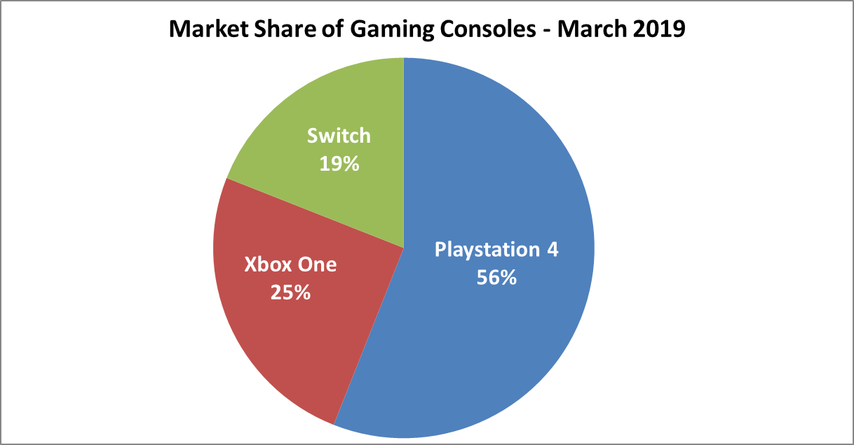
MARKET SHARES OF GAMING CONSOLES
SECONDARY DATA
Source: VGChartz,2019
Notes:
As we can see in this diagram, the market shares in 2019,were beneficial to PlayStation, with a massive 56% market share over 6 years. In comparison Xbox One had 25% and Nintendo,19%.

Slide 8
INFORMATION FROM PRIMARY AND SECONDARY DATA
PlayStation proved that is the most powerful product on the market leading the survey regarding : price ,compatibility, services ,controllers' games and graphics;
We can notice that he is leading the market shares in 2019,with a massive 56% market share over 6 years. In comparison Xbox One had 25% and Nintendo,19%.
Notes:
In summary PS is leading the market without any signs of slowdown.

Slide 9
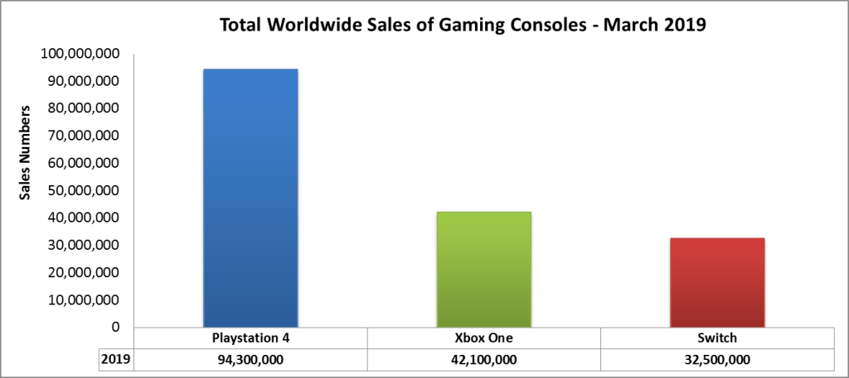
PLAYSTATION SALES NUMBERS
Source:
VGChartzS,2019
Notes:
Although their services can be improved, we can notice in this slide that PS is still leading the sales market crossing the 94-mil mark while Xbox and Nintendo together are not surpassing PS.

Slide 10
Conclusion
Since Sony has released PlayStation on the market; it has been considered the best gaming console.
Playground to PlayStation describes how technology evolved and transported games played on playground into virtual space.
Primary and secondary data were a main factor for the confirmation of Sony consoles leadership on the market.
Notes:
Using the survey that me and my group colleagues created on Microsoft Forms we could notice that PlayStation was the customers favorite gaming console regarding the not only the price and services but also the hardware and features.
According to the charts collected from credible sources we can observe PlayStation position on market shares and sales in the precedent year.

Slide 11
Recommendations on how to improve PlayStation Consoles
Continue improving quality of products and adapting to new technologies they could lead the market many years from now
Improving their online store
Updating their game engine
Hardware updates
Notes:
We can continue with other improvements that can be made such as:
-developing more features with who you can have game control (keyboards, mousses, etc.) by improving that the new CrossPlay feature(CrossPlay is simply the ability to play the same game, for example Fortnite, with other people that own different formats. So if you’ve got friends that only have an Xbox One or Nintendo Switch, but you have a PlayStation 4, CrossPlay allows you to all play together in the same match.).
To back up our findings about improvements we found on gaming forums and created a quiz with multiple choices and a suggestion question, on Forms and the results are presented in the next slide
https://metro.co.uk/2019/10/03/ps4-crossplay-games-use-10855264/?ito=cbshare

Slide 12
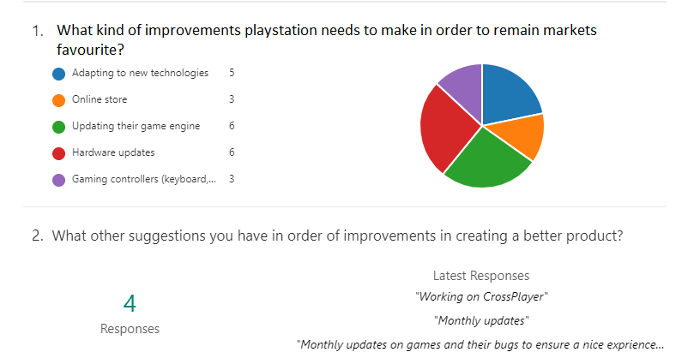
Source: A. Magos, University of Wales,2020

Slide 13
References
Kordas, Ann. "Carroll Pursell. From Playgrounds to PlayStation: The Interaction of Technology and Play." (2016): 612-612.
S. Conrad, G. Dorn and P. Craiger, 2011.Forensic analysis of a PlayStation 3 console in Advances in Digital Forensics VI, Springer, pp. 65-76
Wolf, M.J. ed., 2008. The video game explosion: a history from PONG to PlayStation and beyond. ABC-CLIO.
https://www.playstation.com
https://hookedontech.com/ps4-vs-xbox-one-vs-switch-console-and-game-sales-numbers-2019/
https://www.vgchartz.com/
https://www.pushsquare.com/forums/ps4
https://www.nintendo.com/
https://www.xbox.com/

