Slide 1
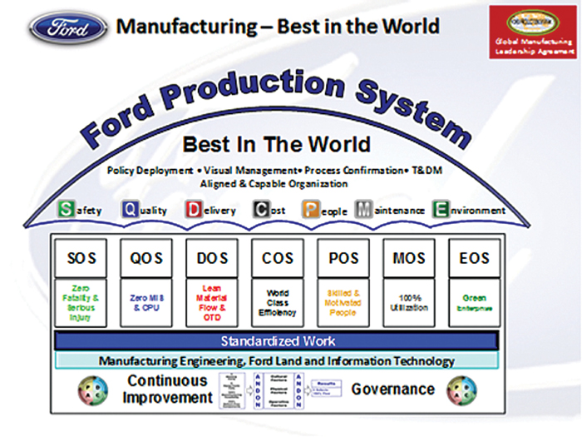

  Compare and contrast the lean manufacturing system and the agile manufacturing system.
Xu, (2013)
Notes:
Explain the topic
I have chosen to make a comparison between lean and agile manufacturing systems.
Why?
As I work in a manufacturing environment and being a work related topic, the FPS follows the basic principle of lean and agile.
The added benefit is that I can expand my knowledge and apply what I have learnt straight into industry.

Slide 2
Power Point Overview
Summary of Lean and Agile Manufacturing
Interesting Facts
Research Challenges and Limitations
What I Enjoyed
The Effects on my Employment
Changes to my research journey
Notes:
Why should the audience listen?
This PPT will cover a brief overview of the knowledge gained, aiming to answer the topic question.
You will learn about my experiences through my research journey, looking at what I found interesting, research I enjoyed and the challenges faced.
Linking back to the reasons why I choose this topic and the effects on my employment and personal life.

Slide 3
Purpose of Lean and Agile Manufacturing Systems
Competitive Industry.
Continuous improvement.
Customer requirements.
Integrated together to improve manufacturing strategies.
Khan & Dalu, (2015) and Snee & Hoerl, (2017)
Notes:
Competitive Industry.
As a competitive and ever changing industry, continuous improvement helps manufactures become the best within their sector.
Continuous improvement.
Small reduction in product delivery can have a huge long term impact.
Customer requirements.
High customer expectations:
* For quality products
* At lower prices
Integrated together to improve manufacturing strategies.
Lean and agile is used to respond to customer needs and wants.

Slide 4
Lean Manufacturing System
Lean Principles and Standardised Methods:
  ‘JIT’
  Eliminate Waste
  Quality Strategies
  Cell Production and Working Triangles.
‘Response to competitive pressures’
Khan & Dalu, (2015)
Notes:
Lean looks at effective use of resources to respond to competitive pressures.
Provides standardised structure to an organisation to increase efficiency and productivity, reduce cost and lead times as well as to improve product quality.
Integrated systems such as:
‘Just in time’ is used to produce products at quantities to meet customer demands, minimising transport, inventory, and over production.
Likewise, 7 Wastes
Transport
Inventory
Motion
Waiting
Over processing
Overproduction
Defects

Slide 5

Agile Manufacturing System
Innovative processes and tools.
  Visual Management
  Multitasking
  Kanban
Maximum Flexibility.
Responds to challenges from ‘change and uncertainty’.
‘Response to complexity due to constant change’
Newman, (2017)
Khan & Dalu, (2015)
Notes:
Agile is a strategy to be adaptable to everchanging environment.
Includes innovative processes to meet demands:
Manufactures utilises the ‘origination, people and technology’ for maximum flexibility to quickly adapt and respond to customer demands and market changes.
Using provided skillsets and employee training

Slide 6
Interesting Information and Facts
‘Work smarter, not harder’.
Improves Safety.
Maximised Profits.
Everyone has to ‘buy in’.
Environmental Impacts.
Production Increase:
    Three Years = 20% Increase
Lean and Agile does not just apply to Manufacturing:
    One Year = 17% improvement
Apple Rubber, (2015) and Marmol, (2017)
Notes:
‘Work smarter, not harder’
Improves work efficiency so that employees are more productive.
Improves Safety
Its not just about being lean and agile, Visual Management helps identify an unsafe practices.
Maximised Profits
Increased up time and lowering costs increases profits without performing more work.
Everyone has to ‘buy in’
For the process to work, includes everyone doing their part, from shop floor to management.
Environmental Impacts
Similar to the ‘ONE FORD’ process, Nike has a reduced their CO2 emissions by 3%.
Production Increase
Likewise, in the same 3 Years, production has increased by 20%.
Lean and Agile does not just apply to Manufacturing
A non manufacturing example, proving the principles are universal. In one year, a lean approach enabled a hospital in California to see more patients than ever with 17% reduced waiting time.

Slide 7

What did I enjoy?
Linking the principles to my personal life.
Study in the USA, (2018)
Notes:
Linking the principles to my personal life.
Whilst researching, I enjoyed reflecting and reviewing where I have used and could have used these principle, not just in my employment but in every day to day situations. For example: Cooking, studying and utilising my time to be more efficient and effective.

Slide 8
The Effects on my employment and Education
Integration into my job role.
How can I be part of the lean and agile strategy?
ONE Ford Culture.
Work part as a team.
Notes:
Integration into my job role.
Use 5’s (Sort, Set Shine, Standardise and Sustain).
Understand the wastes (7 Wastes: TIMWOOD).
Have a greater understanding for why there is a frequent increase and decrease in production volumes; emphasising the importance of being flexible.
As an individual, I plan to continue to maximise uptime and ensure as a team Ford stay competitive against the emerging competition, which are cash rich technology firms such as Google, Apple and Tesla; making it even more important than ever to be lean, to deliver quality products on time and at the right price for our customers.
An improved understanding of the ‘ONE Ford’ culture which is a lean and disciplined manufacturing environment; helping me identify what I can do to help achieve business success globally.
Work part as a team.
Improved understanding of how a team can be more effective.

Slide 9

Research Challenges and Future Changes
Time Management.
Reliability of Sources.
Brooks, (no date)
Notes:
Time Management
As a part time student, like yourselves, I found managing time between Work, College, University, and Social aspect difficult at times.
Reflecting back, I would have written a realistic schedule that I would enable me to keep track and maintain an equal balance between them.
If I applied the lean principles to my research, I would have achieved a broader and more in-depth understanding within the same period.
Reliability of Sources
There were lots of information regarding lean and agile on the internet, using books and websites.
Looking back, Ford has an extensive archive of literature as its what we do day in day out. At the time, I did not think of utilising this resource.

Slide 10
Summary
Comparison of Lean and Agile Manufacturing.
What I enjoyed.
What I learnt.
Challenges faced.
Changes I would have made.

Slide 11
Questions?

Slide 12
References
Apple Rubber. (2015), 7 Big Things You Can Count on With Lean Manufacturing, [online] https://www.applerubber.com. Accessed 3rd January 2019.
Brooks, W. (no date), 7 Must-Have Time Management Tips for Salespeople, [online] https://brooksgroup.com. Accessed 17th January 2019.
Khan, J. & Dalu, R. (2015), Lean and Agile Manufacturing as productivity enhancement techniques, Shegaon: IOSR.
Marmol, L. (2017), 2 Impactful Examples of Worldwide Companies Using Lean Management, [online] https://leansixsigmabelgium.com/. Accessed 3rd January 2019.
Newman, T. (2017). Multitasking brain mechanism examined, [online] https://www.medicalnewstoday.com. Accessed 17th January 2019.
Snee, R. & Hoerl, R. (2017), Time for Lean Six Sigma 2.0?, [online] http://asq.org/. Accessed 4th January 2019.
Study in the USA. (2018), How to survive the First Year of Studying in the US, [online] https://www.studyusa.com. Accessed 17th January 2019.
Wheeler, C. (2014), 3 Biggest Myths in Lean Manufacturing, [online] https://www.newcastlesys.com/. Accessed 4th January 2019.
Xu, Z. (2013), Ford Production System, [online] http://cmuscm.blogspot.com/. Accessed 6th January 2019.

