Slide 1
Notice: Extending Batch commands with switches
I answered a student question recently. I think the answer would be useful for all:
Options are used to alter bat commands and are sometimes known as options/switches/parameters.
Single basic commands are absolutely fine for the assignment, and you can receive a very good mark. For the full set of marks available (Excellent/Exceptional), use a few commands with an additional switch:
  E.g. dir /?. /? Can be used to see help information and other switches to use with any command.
  E.g. dir /p displays the directory one screen/page at a time, press any key to continue.
For other dir switches see the list here: dir | Microsoft Learn.
For additional Batch switch examples, click here: Windows Batch Switch examples.
  Full list here: Windows commands | Microsoft Learn.
This information can also be found under the ‘OS3 – Batch commands’ deck on Moodle.

Slide 2


OS Fundamentals
6: Introduction to Bash Scripting.
This Photo by Unknown Author is licensed under CC BY-SA

Slide 3
Deck structure:
Section 1: Lecture slides
Section 2: Tutorial slides

Slide 4
Section 1:
OS Lecture

Slide 5


Topics
This Photo by Unknown Author is licensed under CC BY-SA
Introduction to Bash
Executing Bash scripts
Bash syntax
Example Scripts
Useful commands
Reference sources
  Raise a hand or Chat box not viewed during slides. Save any Qs for the tutorial.

Slide 6
Lecture and tutorial
The Lecture introduces the Bash script syntax we will be using in the tutorial session.
In this deck we will cover the key syntax areas before putting them together to create a complete script/program.
There will be time to practice and test the code in the tutorial session.
However, if you have a laptop with you in the Lecture, you can start to test some of the code.
Download the slides from Moodle: OS 6 - Bash Scripting.
All code is located in the ‘Notes’ section of the slides and zip file in Moodle.
We will be covering the practical areas in the tutorial session. If you’d like to, you can just listen and make some notes for now and try the practical/code in the tutorial session.
Notes:
Even noting the key syntax on a tablet/smartphone/notepad is initially helpful for learning. Until we can get hands on in the tutorial.

Slide 7
Shell scripting with Bash
This session introduces Bash scripting aka Shell scripting.
Bash is a command script language and stands for
‘Bourne Again SHell’.
Bash was written by Brian Fox and released in 1989 as a free software replacement and improvement of the original Unix Bourne shell.
Bash is the interpreter program that executes our bash commands and scripts.
Bash scripts are used for many purposes, typically for System / Server / Network / Cloud monitoring and management. And for fun Creativity & Games.
Notes:
The Terminal/Shell is part of the OS that provides a CLI interface to the Computer System.
The Shell receives input from the user in the form of commands or program code/scripts, executes them and displays the programs output.

Slide 8
Bg. Bash: Terminal, Shell & interpreter?
Bash is the default CLI shell interpreter in Linux OSs.
  The Terminal is the GUI window we see on the screen.
  The Shell is the CLI where we type and run our commands and scripts.
  The interpreter is a program that interprets/processes the commands & scripts we type into the Shell.
Notes:
The Terminal/Shell is part of the OS that provides a CLI interface to the Computer System.
The Shell receives input from the user in the form of commands or program code/scripts, executes them and displays the programs output.

Slide 9
Show: Options for executing Bash scripts
We can run Bash scripts on any Linux OS, on a Windows OS and in the browser:
By using a text editor such as Nano/Vi/VIM in a browser-based console such as Bellard Alpine Linux console or Google Cloud Shell.
Via a browser-based Coding environment such as OnlineGDB.com.
By installing Git for Windows on a Windows PC.
  Show: Right click Git BASH HERE in file explorer (OS 6 - Bash Scripts folder) and run bash script file (e.g. ./1HelloWorld.sh) from Git-Bash console.
WSL: Since 2016, we can use Bash on a Windows 10+ PC by enabling ‘Windows Subsystem for Linux’. Full instructions located on the next slide.
  After WSL is enabled we can use bash commands in CMD & PowerShell. Enabled in the VM.

Slide 10

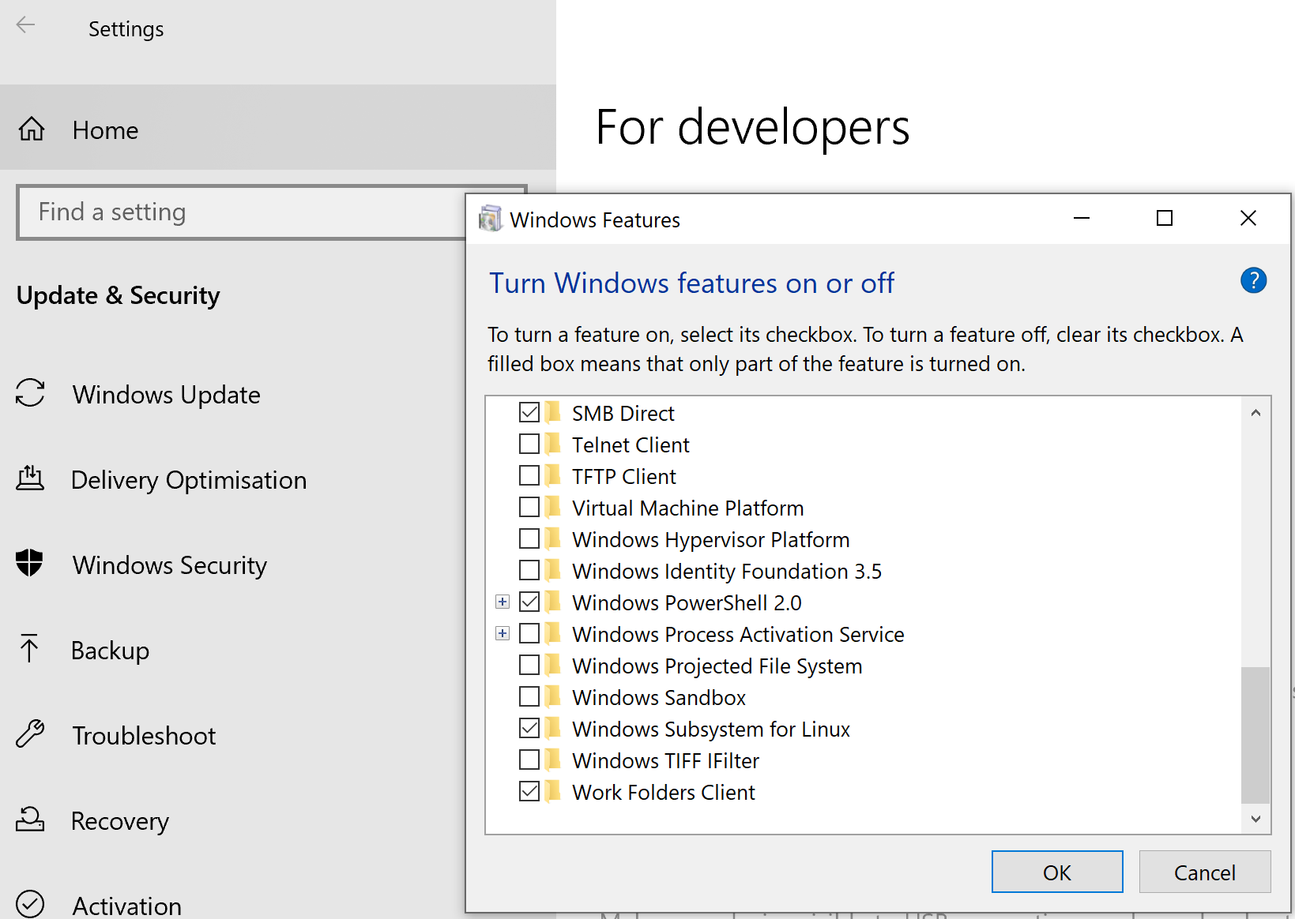
Bg. To install WSL/Linux on Windows:
Start icon > Settings icon > Update & Security > For Developers.
Check the Developer Mode radio button.
Search for “Turn Windows Features on/off”.
Check “Windows Subsystem for Linux”.
Press OK.
After a system restart. Goto Windows Store from the start menu
and install a Linux OS such as Ubuntu, Kali, alpine or
After the installation you can start the WSL console/CLI by either clicking the Linux distro icon such as Ubunto/Debian in the start menu or by typing the distro name such as ‘ubunto’ (to go to you user’s Ubuntu home directory) or ‘bash’ (to go to your User home directory in the Windows file system) in cmd or powershell, to run Bash commands and scripts in cmd.
Type: cd ~ to go to your user home directory. Here you will automatically have permission to start creating directories and files.
Try using the touch command to create a file: touch test1.sh
Then use the nano text editor to create a script file: nano test1.sh – to open the file.
For more information on using the Nano text editor, please click-here & here. And for the Vi text editor here.
This Photo by Unknown Author is licensed under CC BY-SA

Slide 11
Bg. To install WSL/Linux on Windows
Or open CMD or PowerShell and enter the following command:
wsl --install --distribution Ubuntu-22.04
You will be prompted to set a Username and Password.
  Type ‘exit’ to exit Ubuntu and return to cmd.

Slide 12

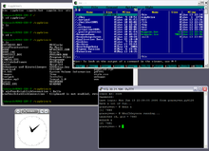
Show: Cygwin
Cygwin is free and open-source software.
That offers a Linux-like experience in Windows.
And allows us to interact with Windows using bash.
We can use Bash commands much like we would on a Linux OS.
Try it out - Install Cygwin Terminal from: Cygwin.com
  Video: How to install Nano text editor with Cygwin: Install nano editor in Cygwin.
Note: Git Bash has more Linux tools pre-installed. With Cygwin we need to manually install more Linux tools.

Slide 13
Show: Nano
Use either Bellard Alpine Linux CLI or Google Cloud Shell to create a new Bash file in Nano:
  Nano test.sh
  Type code:
#!/bin/bash
echo “Hello world”
  CTRL+S to save the file.
    Note: CTRL+O to ‘save as’ a new file name. ENTER to save.
  CTRL+X to exit nano.
  ls –l command to view file permissions.
  ./test.sh – to run the script file.
  chmod +x test.sh – to add execute permission to run the script file.
  ls –l command to view file permissions.
  ./test.sh – to run the script file.
Notes:
Bg. Additional Nano commands:
CTRL+G to display nano help page.
CTRL+K: To Cut
CTRL+U: To paste the text.
CTRL+^ (6 for hat ^): A start of text we want to copy. Use cursor to select text. Upto and not including where the cursor is. Alt+^ (6) to copy text to the clipboard.

Slide 14
Bg. Linux & Python
Python comes preinstalled on most Linux distributions.
To code in python using a Linux Terminal:
Open a terminal window and type python. This opens python in interactive mode. This is good for initial learning, but we can also use a text editor such as Nano.
Create a new python file by typing: Nano test.py. Insert code such as:
print (“Hello World”)
x=5
print(x)
Type: exit() to exit python.
In the terminal type: python test.py to run the script file.
Type: python3 --version to check which version is on the system.
To update the python version on your system, use the following commands:
  sudo apt-get update – command is used to download and refresh the local package index and to provide the system with the most recent information about available packages from the repositories.
  sudo apt-get install – command will retrieve the packages from the authenticated sources for installation and upgrade.

Slide 15

Additional ways of using the Bash language.
Enable WSL ‘Windows Subsystem for Linux’ in Windows 10/11: Since Window 10, we can now run Bash in Windows. Some minor system configuration changes are needed for this, but it is easy to set-up Bash in Windows 10. For CLI use only. To view a step-by-step guide see the following slide, or click here or here.
Git for Windows: Git for Windows provides a BASH emulator to run Git version control and bash files on windows OS. You can use Gitbash with your favourite text/code editor e.g. Notepad++ or Visual Studio Code.
Use Linux CLI Shell in the Web browser: These options allow you to test Linux commands/sripts in your web browser. There are many options (see here and here). Note: some network commands do not typically work in the browser based CLIs.
Install Linux on your OS using a Virtual Machine: Using a VM such as Wine or VirtualBox allows you to install Linux without making any changes to your system. It’s a great way to initially experiment and you can use Linux just like an App. within your existing OS. To view step by step tutorials click-here or here.
Create a dual-boot system: A Dual-boot Linux & Windows system allows you to have both Windows/Mac and Linux on the same system and you can choose which one to load into at start-up. For this option you will need to create a partition on your HD for Linux as it has a different file system. To view step by step tutorials to help you click-here or here.
FOR THE FULL LINUX EXPERIENCE: Use an old Computer: Create your own Linux PC. Download Linux and create a bootable USB stick and install Linux onto an old system. To view step by step tutorials to help you click-here or here.
Notes:
VM install Tip: Create a Virtual HD hard disk during install.

Slide 16
Sha-bang
The first line of a bash script file, begins with a hash symbol (aka sha) and exclamation mark (aka bang). #! = sha-bang.
#!/ sha-bang is followed by the /bin/bash directory path where the bash shell interpreter is located: #!/bin/bash
THIS ONLY NEEDS TO BE INCLUDED ONCE AT THE TOP OF THE SCRIPT FILE.
The path tells the OS the location of the bash interpreter that will process the commands/scripts we use.
Notes:
Bg. If the path was: #!/bin/sh, this tells the OS to use the original UNIX Bourne shell interpreter to process the commands.

Slide 17
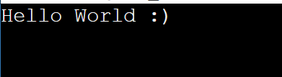
Show: Online script editor & Echo: Hello World
To demonstrate another way we can run bash scripts, this time I’m going to use an Online script editor: https://www.onlinegdb.com/online_bash_shell
Let’s try a simple script and echo out ‘Hello World :)’. Copy and paste:
The ‘#’ hash symbol allows us to include comments in our code.
#!/bin/bash
# Single line comment
echo 'Hello World :)'
Notes:
Bg. For echo options such as –n, –e, \a, \b, \c, etc… click-here and here.

Slide 18
Code comments
The ‘#’ symbol allows us to include single line comments in our code.
We can write multi-line comments by enclosing text comments between the commands: <<COMMENTS and COMMENTS.
Or we can write multi-line comments using the colon and single quote symbols at the start of the comment block : ‘and the single quote ‘ symbol at the end of the block.
<<COMMENTS The following script enables the user to input their username and password and upon submit takes them to the registration page. COMMENTS | : ' The following script enables the user to input their username and password and upon submit takes them to the registration page. '

Slide 19
Bash: Variables
Variables are created in bash when we create a variable name and assign it a value using the assignment operator i.e. the equal symbol =
Bash variables are not strongly data typed. We do not need to specify if a variable is a string, integer or other data type.
Bash variables are character strings, but it will automatically consider the data type we use, and if we assign a numeric value to the variable, it will work as integer.
We do not need to use single or double quotes around a string. But it is good practice to put our string variable values inside double quotes.
var1="Tommy"
echo $var1
Notes:
Special characters (e.g. @, #, £, $, ! etc…) are escaped using the backslash ‘\’ symbol in bash.
For more information about Variables and Special Variables click here: https://www.tutorialspoint.com/unix/unix-using-variables.htm and here: https://www.tutorialspoint.com/unix/unix-special-variables.htm.

Slide 20
Naming & Accessing Variables
Names of variables can only contain a string of characters, numbers and the underscore _ symbol.
Variable names in bash are case sensitive.
No spaces are permitted on either side of the equal=symbol when initializing variables.
To access the variable value in our code, we precede the variable name with a dollar symbol ‘$’.
var1="Tommy"
echo $var1
Notes:
Special characters (e.g. @, #, £, $, ! etc…) are escaped using the backslash ‘\’ symbol in bash.
For more information about Variables and Special Variables click here: https://www.tutorialspoint.com/unix/unix-using-variables.htm and here: https://www.tutorialspoint.com/unix/unix-special-variables.htm.

Slide 21
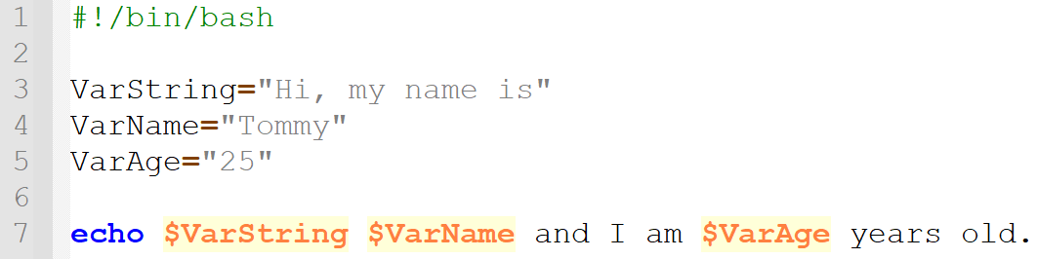
Show: Accessing Variables
As mentioned, to access a variable and output it’s value we place a dollar symbol before the variable name.
Show: Right click Git BASH HERE in File Explorer (OS 6 - Bash Scripts) folder
File: ./2Variables.sh
Code | Output
Notes:
#!/bin/bash
VarString="Hi, my name is"
VarName="Tommy"
VarAge="25"
echo $VarString $VarName and I am $VarAge years old.

Slide 22
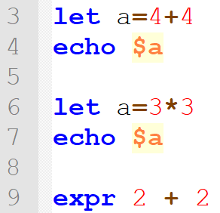
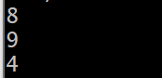
Bash: Arithmetic
This Photo by Unknown Author is licensed under CC BY-SA
In case needed, Bash’s built-in ‘let’ function allows us to do math.
Following the let keyword we create a variable name to store the result.
Another useful function is ‘expr’ which outputs the math result directly to the terminal. There is no need to save the result to a variable. With expr there must be spaces between the numbers and operators.
Output

Slide 23
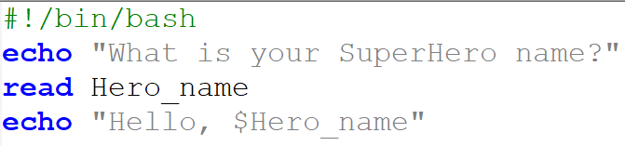

Show: User input
The read command takes user input from the keyboard and assigns it as a value to the variable name we declare after the read command: Hero_name.
Bash will pause and wait for the user to enter input.
We echo out the user input by using the variable name.
Commonly used to ask users to enter their Usernames and passwords.
Syntax: read variable_name. File: ./3Input.sh
Notes:
#!/bin/bash
echo "What is your SuperHero name?"
read Hero_name
echo "Hello, $Hero_name“
-
Note: In bash you can use the read command as the equivalent to the Bat pause command to pause the output e.g. ‘read -p “Press any key to continue ...”.

Slide 24
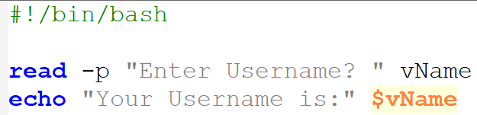

Bg. User input –p option
In this example we use the –p option to allow user input on the same prompt line as the read command. Instead of on the next line.
Code | Output
User input
Notes:
#!/bin/bash
read -p "Enter Username? " vName
echo "Your Username is:" $vName

Slide 25
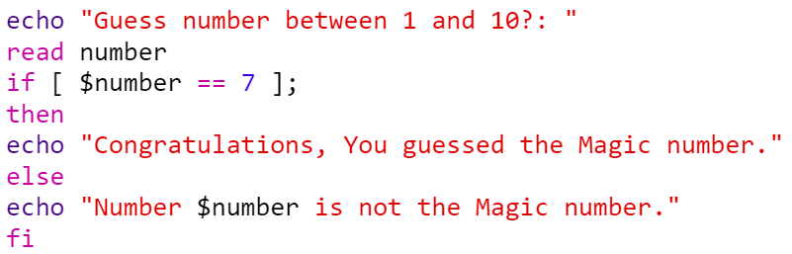
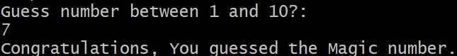

Show: if then else statements
In this example, we ask a user to input a value between 1 and 10 which is stored in the ‘number’ variable that we declare after the read command.
We then use an if statement to check if the value is equal to 7 i.e. The Magic Number. IF true “Congratulations” is echod out, if false however, the ‘else’ statement outputs the false echo string: Number is not the Magic number.
File: ./4if_statement.sh
Notes:
#!/bin/bash
echo "Guess number between 1 and 10?: "
read number
if [ $number == 7 ];
then
echo "Congratulations, You guessed the Magic number."
else
echo "Number $number is not the Magic number."
Fi
-
Bg. Tips:
== or -eq can be used for the ‘equal to’ operator.
if statements and if-else statements can be nested inside other if or if-else statements.

Slide 26
Bg. Bash: If then statements
This Photo by Unknown Author is licensed under CC BY-SA
if statements are used to make decisions and execute code based on whether certain conditions are met. If the if condition/expression is true, code is executed, but if the condition is not true, the code is not executed.
The two spaces within the if square bracket [ ] either side of the condition/expression, need to be included.
The code statements between then and fi is only executed if the expression after ‘if’ is true. Fi: If backwards is used to signify the end the if statement.
Syntax:
if [ expression ];
then
statements
fi
Bg. Tips:
if statements and if-else statements can be nested inside other if or if-else statements.

Slide 27
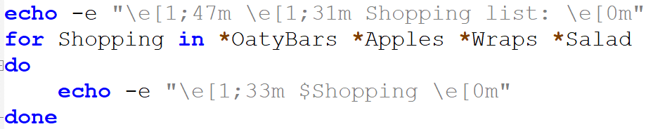
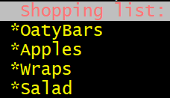
Show: For Loop example
In this example, we use a for loop with a variable called ‘Shopping’ which contains each item ‘in’ the loops list i.e. *OatyBars *Apples *Wraps *Salad
The loop use the keyword ‘do’ to start and execute the ‘echo’ code on in each item in the loops list.
Colour codes are used to set the ‘Shopping list’ background to white & text red: \e[1;47m & \e[1;31m.
Another colour code is used to set each list item text to bold yellow: e[1;33m.
Another colour code is used to remove text formatting: \e[0m. The -e flag is used to output colour.
Finally, we use the ‘done’ keyword to end our code statements and end the loop.
File: ./5forloop.sh
Notes:
#!/bin/bash
echo -e "\e[1;47m\e[1;31mShopping list: \e[0m"
for Shopping in *OatyBars *Apples *Wraps *Salad
do
echo -e "\e[1;33m $Shopping \e[0m"
done

Slide 28
Bg. Bash: For Loop
This Photo by Unknown Author is licensed under CC BY-SA
Loops are useful to perform repetitive tasks, to iterate and repeat code statements multiple times.
There are 3 loop constructs in Bash: a for loop, a while loop, and an until loop.
We start a for loop using the word ‘for’, after this we create a variable name to store the values in the loops list.
The 'for loop' will iterate through and execute it’s code on each value/item declared in the list.
List items need to be separated by spaces and can contain strings or numbers.
The 'do' keyword is used to start the code statements and the 'done’ keyword is used to end them.
After the 'done' keyword, the loop goes back to the top and executes the code on the next item in the list.
Syntax:
for variable in list
do
code statements
done
Notes:
#!/bin/bash
echo "Shopping list:"
for Shopping in *OatyBars *Apples *Wraps *Salad
do
echo "$Shopping"
done

Slide 29
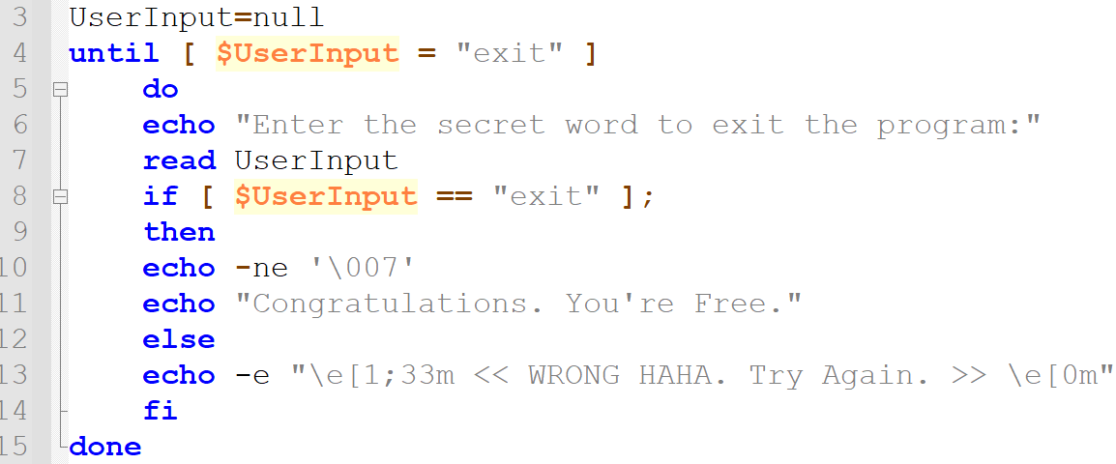
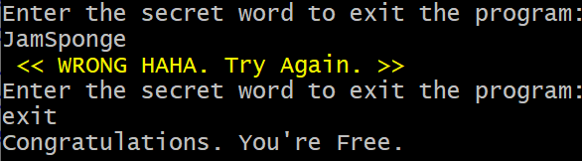
Show: Until Loop
In this game-like script, we use an Until loop to ask the user to guess the secret word to exit the program. If the User enters the secret word ‘exit’ the script echo’s out ‘Congratulations’.
If the User does not input the secret word, the script echo’s out: WRONG HAHA. Try Again.
-ne \007 is a method for producing a beep sound fx in a shell script.
Colour codes:\e[1;33m is the code that sets the colour to bold yellow and \e[0m resets the colour back. Replace 1;33 with the colour code you want. See next page for colour codes.
File: ./6UntilLoop.sh
Notes:
The value null means that no value exists.
Inside square [[ ]] brackets, == is a pattern matching operator for strings, and = is a straight equality comparison.
The -e flag is used to output colour. The -n flag returns true when a string is not null and –e is used to interpret the \007 ASCII bell character. Both are required to produce the beep in the script.
For more information click here: https://thecodingbot.com/what-is-ne-in-a-bashshell-script/.
Tips: /n = newline in bash.
A backslash \ is the escape character in bash that preserves the literal value of the next character.
#!/bin/bash
UserInput=null
until [ $UserInput = "exit" ]
do
echo "Enter the secret word to exit the program:"
read UserInput
if [ $UserInput == "exit" ];
then
echo -ne '\007'
echo "Congratulations. You're Free."
else
echo -e "\e[1;47m \e[1;31m << WRONG HAHA. Try Again. >> \e[0m"
fi
done

Slide 30
Bg. Some additional Colour codes
This Photo by Unknown Author is licensed under CC BY-SA
Red 0;31 or Green 0;32
Blue 0;34 or Black 0;30
Yellow 0;33 or Agenta 0;35
Cyan 0;36 or White 0;37.
There are many more colours, to see more google ‘Bash Colour palette’.
To make your colour bold use the numeric value 1 instead of 0 e.g. 1;31 = bold red or 1;33 = bold Yellow.
To colour the background use: red = 41, black = 40, green = 42, yellow = 43, blue = 44, cyan = 46, magenta = 45, white=47 or to reset = 0. To output the background with a colour, use the following command: echo -e "\e[1;47m ...
For more information click-here.

Slide 31
Bash: Arrays
To create an Array in Bash we use the declare keyword, followed by a name for the array and the assignment operator ‘=’, followed by the list of array elements in parentheses ‘( )’, separated by spaces:
declare Array1=(element1 element2 element3)
Bash supports numerically indexed arrays and Associative Arrays.
In bash we use the lowercase -a option to create a numerically indexed Array:
declare -a ArrayName=([1]=element1 [2]=element2)
And an uppercase -A option to create an Associative array:
declare -A ArrayName=([Wales]="Sunny“ [Scotland]="Snowy“)
Associative arrays use words instead of numbers as the keys to access values.
To echo out an element of an Array, we wrap the array name up in curly braces and include the array element in square brackets: echo ${Array1[2]}
Notes:
Bg. As we learned recently with Batch, Arrays are variables that can hold multiple values at the same time.
An array is a collection of elements, each element has it’s own value.
declare -a ArrayName=(
[1]="element1"
[2]="element2"
)
echo ${ArrayName[2]}

Slide 32

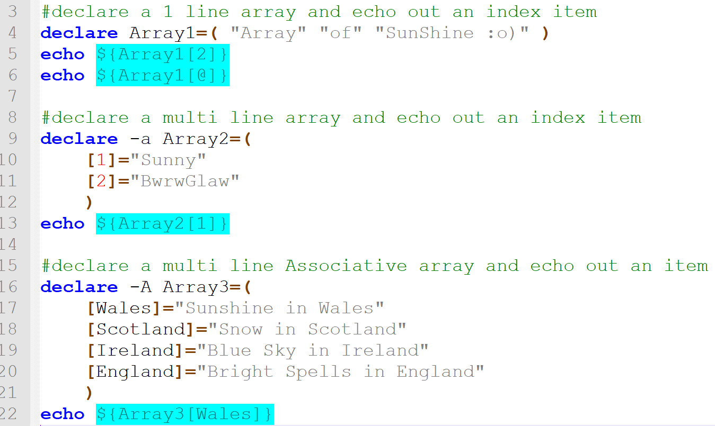
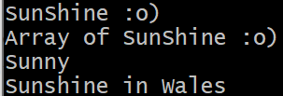
Show: Array example
Tip: Use the ‘@’ or ‘*’ symbol in the index to print out all array elements.
File: ./7Array.sh
Notes:
#!/bin/bash
#declare a 1 line array and echo out an index item
declare Array1=( "Array" "of" "SunShine :o)" )
echo ${Array1[2]}
echo ${Array1[@]}
#declare a multi-line array and echo out an index item
declare -a Array2=(
[1]="Sunny"
[2]="Bwrwglaw"
)
echo ${Array2[1]}
#declare a multi-line Associative array and echo out an item
declare -A Array3=(
[Wales]="Sunshine in Wales"
[Scotland]="Snow in Scotland"
[Ireland]="Blue Sky in Ireland"
[England]="Bright Spells in England"
)
echo ${Array3[Wales]}

Slide 33
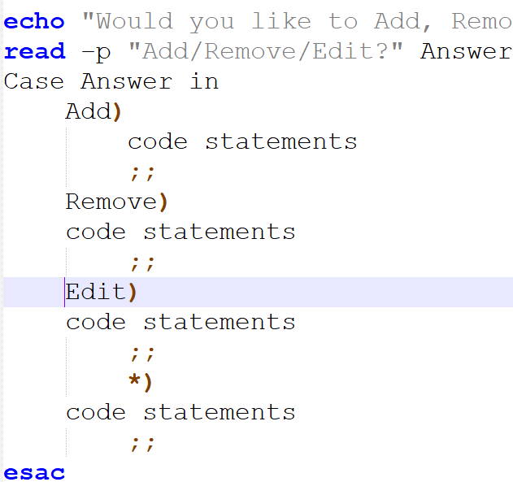
Case statement
As we have learned, the read command takes user input and assigns it as a value to the variable we declare after the read command.
The –p option allow us to receive user input on the same prompt line.
A Case statement takes a value & tests that value against multiple conditions until it finds that value, and then executes the code associated with it.
We can use the read command and a Case statement to match a user’s input with a Case pattern.
In this example if the user types in ‘Add’, the code after ‘Add’ is executed.
Let’s look at a working example on the next slide.
Notes:
As we have learned, the read command takes user input from the keyboard and assigns it as a value to the variable name we declare after the read command.
Echo “Would you like to Add, Remove or Edit a User?”
read –p “Add/Remove/Edit?” Answer
Case Answer in
Add)
code statements
;;
Remove)
code statements
;;
Edit)
code statements
;;
*)
code statements
;;
esac

Slide 34
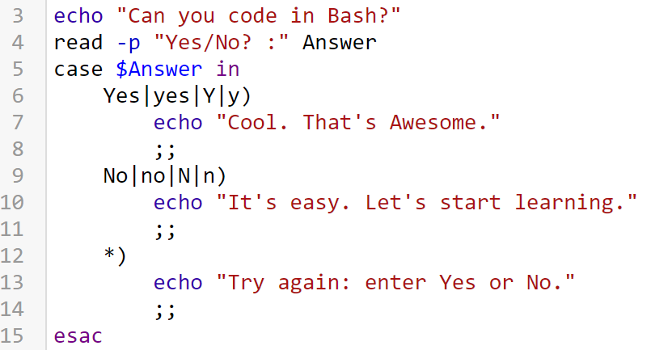



Show: Case statement example
In this example, the user is asked if they can code in bash. If the input matches the Yes|yes|Y|y pattern the program outputs “Cool. That’s Awesome”. If the input is ‘No’ the program outputs “It’s easy. Let’s start learning”, if no match is found, the default * exit case outputs: “Try again, enter Yes or No?”.
Output:
Or
Or
File: ./8Case.sh
Notes:
#!/bin/bash
echo "Can you code in Bash?"
read -p "Yes/No?" Answer
case $Answer in
Yes|yes|Y|y)
echo "Cool. That's Awesome."
;;
No|no|N|n)
echo "It's easy. Let's start learning."
;;
*)
echo "Try again: enter Yes or No."
;;
esac

Slide 35
Bg. Case statements
A Case statement takes a value & tests that value against multiple conditions until it finds that value, and then executes the code associated with it.
A Case statement starts with the keyword 'case' and is followed by the case variable/expression and 'in' keyword.
The ‘in’ keyword is followed by the case test ‘pattern’.
The | pipe symbol is used to include multiple patterns.
A closing bracket ) is used to end a pattern list.
A Case statement pattern is ended with a double semicolon ‘;;’.
If no pattern is matched, the ‘*’ asterisk symbol is used to define and execute an ‘exit case’, a last resort / final default case pattern.
The case statement is then closed with the 'esac' keyword.
A case statement tries to match a value with each of the stated patterns, until it finds a match, it then executes the code statements up to the double semicolon ‘;;’. And then terminates.
Syntax:
case variable/expression in
pattern1)
code statements
;;
pattern2|pattern3)
code statements
;;
pattern4)
code statements
;;
*)
code statements
;;
esac
Notes:
Bg. An expression consists of variables, operators, values and calls to functions, which are arranged according to the rules of the language.

Slide 36

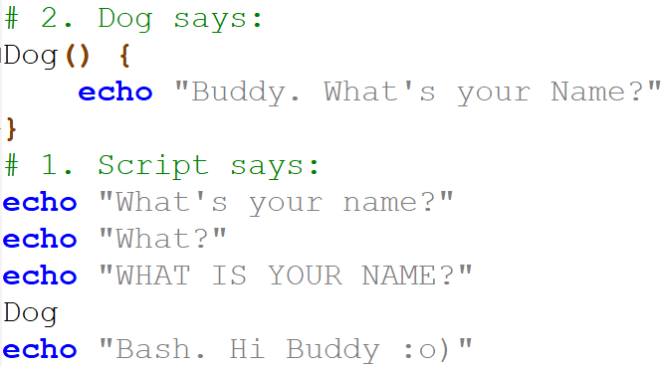
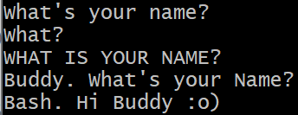
Show: Function
As we recently learned with Batch, Functions allow us to create self-contained blocks of code that we can call and reuse whenever needed. Bash also support the use of functions.
In this example, we create a function named ‘Dog’, who woof’s out his name ‘Buddy’.
The main script underneath uses some echo commands and calls the function. Parenthesis are not used when calling functions in Bash.
2.
Output:
1.
File:./9Function.sh
Notes:
#!/bin/bash
# 2. Dog says:
Dog() {
echo "Buddy. What's your Name?"
}
# 1. Script says:
echo "What's your name?"
echo "What?"
echo "WHAT IS YOUR NAME?"
Dog
echo "Bash. Hi Buddy :o)"

Slide 37
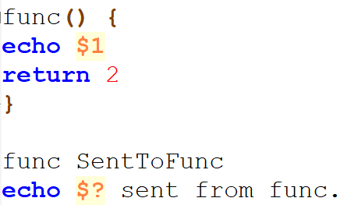

Receive and Return values from a function
As we learned with Batch, Bash functions can also receive and return values back to the main script.
Bash functions can also receive and return values back to the main script.
In this example we send a string “SentToFunc” to the function to print out. The value is accessed inside the function by using the $ dollar symbol followed by the number of the value being passed to the function.
And we use the 'return' keyword, to return a numeric value ‘2’ back to the main script. To be echoed out. $? returns the value from the last executed function.
2.
Output:
3.
1.
4.
Notes:
Functions can return values back to the main program after it has been called. In bash, we do this by using the 'return' keyword. Most programming languages can return a value from a function. Bash functions don't do this in the usual way. Bash allows us to set a return status.
When a function is successfully complete in bash, it’s return status value is set to the last code executed in the function (or by default 0 for success). We can use the return keyword to return a ‘status value’ back to the main script. The return keyword also acts as an exit status and terminates the function.
The only value we can return from a function using bash’s return statement is a numeric value.
The status value is stored in the $? variable. $? In bash returns the value from the last executed command / function. It doesn't have to be hardcoded as in this example, it can be a variable.
Tip: $0 is the name of the shell script itself (e.g. myscript.sh), $1 is the first command-line argument passed to the shell script and $2 is the second argument. These are automatically assigned.
#!/bin/bash
func() {
echo $1
return 2
}
func SentToFunc
echo $? sent from func.

Slide 38
Bg. Bash Functions
Syntax: function_name(){
code statements
}
Functions make our code cleaner, more organised and modular. They prevent us from having to re-write the same code over and over again. Functions allow us to break down our aim/code/problem into smaller parts, allowing us to focus on one area/requirement at a time.
Functions are usually written/declared at the top of the script.
We can pass strings or number values to functions for processing (Arguments), they are accessed inside a function by using the $ dollar symbol followed by the positional number of the value being passed to the function.
Local variables can be defined within a function using the ‘local’ keyword & the scope of those variables exists only within the function. Bg. For more info. see ‘Variable Scope’ at the end of this deck.
Libraries: Functions can be written in a separate file from the main script file, known as a library (e.g. functions.lib). This file can then be referenced at the top of the script files. Very useful for calling functions from multiple scripts without having to re-write or include them multiple times.
  Bg. For an example please click-here.
To declare a function in bash, we start by declaring the function name, followed by brackets called parentheses ( ) and finally our code statements exist within curly brackets { }.

Slide 39
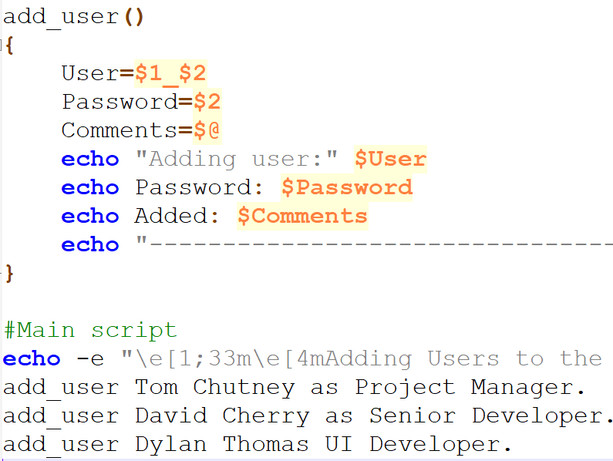
Bg. Example: Passing values to a function
2.
In this example we call the add_user function and send it some values.
In the function, we assign those values to variable names User, Password and Comments.
The first value passed is the firstname and is assigned to the User variable, the second value is the surname and is assigned to the Password variable and the entire sentence is assigned to the Comments variable.
Next we echo out the variables from within the function.
1.
Notes:
#!/bin/bash
add_user()
{
User=$1_$2
Password=$2
Comments=$@
echo "Adding user:" $User
echo Password: $Password
echo Added: $Comments
echo "---------------------------------------"
}
#Main script
echo -e "\e[1;33m\e[4mAdding Users to the Development Group:\e[0m"
add_user Tom Chutney as Project Manager.
add_user David Cherry as Senior Developer.
add_user Dylan Thomas UI Developer.

Slide 40
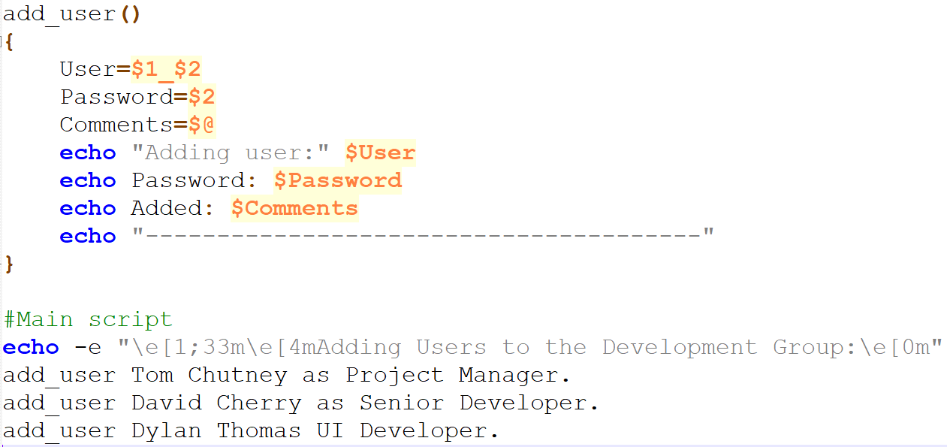
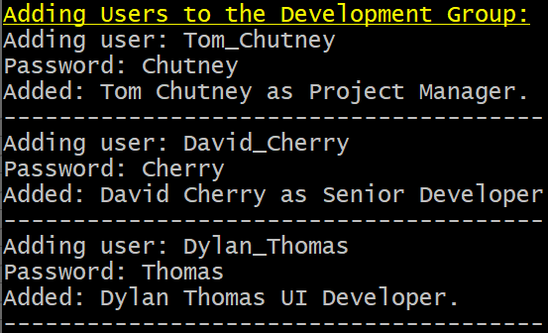
Bg. Example: Code and Output
Output:
Notes:
#!/bin/bash
add_user()
{
User=$1_$2
Password=$2
Comments=$@
echo "Adding user:" $User
echo Password: $Password
echo Added: $Comments
echo "---------------------------------------"
}
#Main script
echo -e "\e[1;33m\e[4mAdding Users to the Development Group:\e[0m"
add_user Tom Chutney as Project Manager.
add_user David Cherry as Senior Developer.
add_user Dylan Thomas UI Developer.

Slide 41
Show: A Multiple-choice Menu
If you are a System Administrator, it can be useful to create a menu to help you quickly execute frequently needed scripts.
The following script provides an Admin menu that allows you to easily check the system’s current:
  Memory load usage
  CPU load usage
  TCP connections
  System information and
  Who is logged onto the server and what they are doing.
To try the following script with Google Cloud Shell or OnlineGDB.com (Select BASH language) or VM. Not Git Bash. As some Linux commands are not installed in Git Bash.
File:./10MenuScript.sh
Notes:
#!/bin/bash
function memory_usage() {
echo "Memory usage on Server is:"
free
}
function proc_and_cpu() {
echo "Process list and CPU usgae:"
htop
}
function tcp_usage() {
echo "TCP connections:"
cat /proc/net/tcp
}
function kernel_usage() {
echo "System name & Kernel version:"
uname -s -v -r
}
function WhoWhyWhat() {
echo "WhoWhyWhat:"
w
}
Menu(){
echo -e "\e[1;33m\e[4mSystem Admin. Menu:\e[0m"
echo "1) Memory usage:
2) Process list & CPU usage:
3) Number of TCP connections:
4) System & Kernel version:
5) WhoWhyWhat:
0) Exit."
echo -e "\e[1;33m Choose an option: \e[0m"
read choice
case $choice in
1) memory_usage ; Menu ;;
2) proc_and_cpu ; Menu ;;
3) tcp_usage ; Menu ;;
4) kernel_usage ; Menu ;;
5) WhoWhyWhat ; Menu ;;
0) exit 0 ;;
esac
}
# Call Menu function
Menu

Slide 42
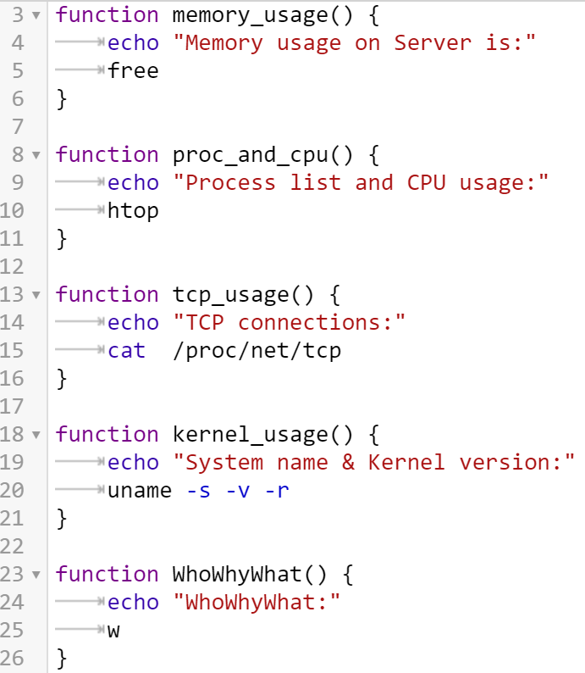
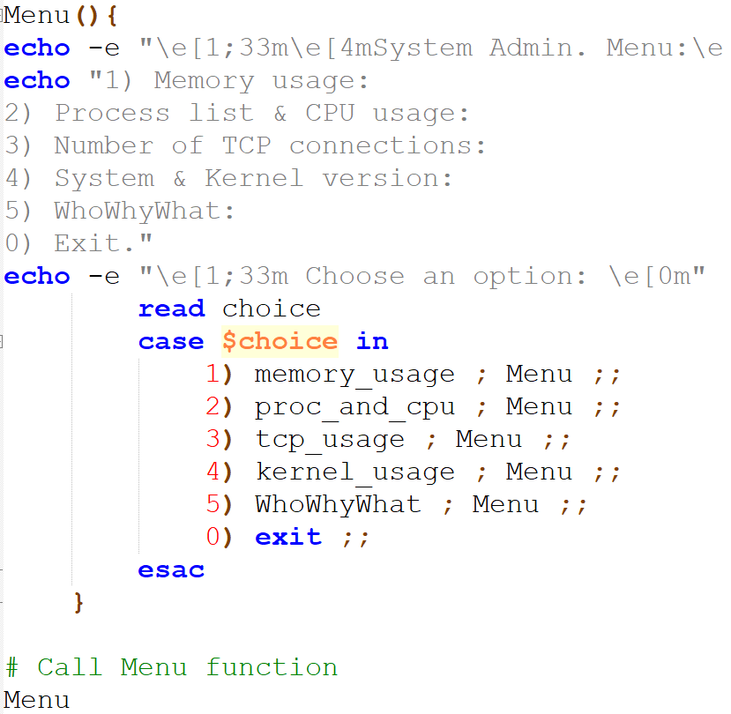
Functions: A Multiple-choice Menu.
3.
2.
This Photo by Unknown Author is licensed under CC BY-SA
1.
File:./10MenuScript.sh
Notes:
First, the main script will call the Menu function (located right at the end of the script) to echo out the Menu options to the user.
The Menu function uses a read command to accept User input and a case statement to identity the number typed in by the user. The user’s option choice is stored in the $choice variable.
The case statement then executes the corresponding function call.
Finally, the case code statements call the Menu function again to output the Menu options to choose from.
The last option uses the ‘exit’ command to exit the program and return to the prompt. We don’t really NEED to hard code the exit ‘0’ value, but it is good practice to use. 0 signals successful execution of the script. An exit code of 0 means success. So we know the script ran successfully to that point. We could use an echo to output the value.
Tip: Each command we use on Linux (like all other Unix and Unix-like OSs) is a system program that can be found in the Linux directory, usually bin or sbin.
#!/bin/bash
function memory_usage() {
echo "Memory usage on Server is:"
free
}
function proc_and_cpu() {
echo "Process list and CPU usgae:"
htop
}
function tcp_usage() {
echo "TCP connections:"
cat /proc/net/tcp
}
function kernel_usage() {
echo "System name & Kernel version:"
uname -s -v -r
}
function WhoWhyWhat() {
echo "WhoWhyWhat:"
w
}
Menu(){
echo -e "\e[1;33m \e[1m \e[4m System Admin. Menu:\e[0m"
echo "1) Memory usage:
2) Process list & CPU usage:
3) Number of TCP connections:
4) System & Kernel version:
5) WhoWhyWhat:
0) Exit."
echo -e "\e[1;33m Choose an option: \e[0m"
read choice
case $choice in
1) memory_usage ; Menu ;;
2) proc_and_cpu ; Menu ;;
3) tcp_usage ; Menu ;;
4) kernel_usage ; Menu ;;
5) WhoWhyWhat ; Menu ;;
0) exit ;;
esac
}
# Call Menu function
Menu

Slide 43
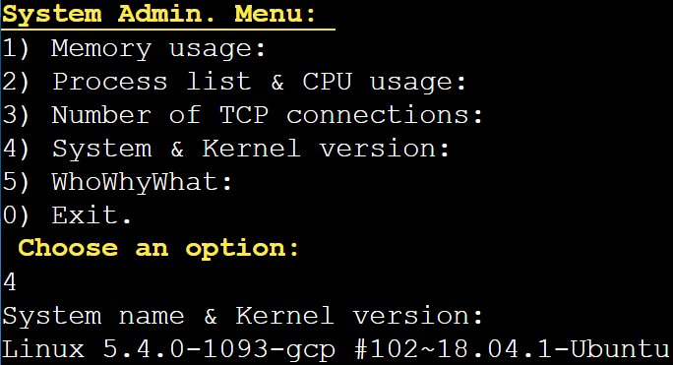
Output: Sys. Admin Menu
Bg.
\e[1;33m = Sets the text colour to bold Yellow.
\e[1m = Bolds the text.
\e[4m = Underlines the text.
\e[0m = is used to remove text formatting.
For further formatting options, please click-here.

Slide 44
Bg. Script description: Multiple-choice Menu
First, the main script calls the Menu function (located right at the end of the script) to echo out the Menu options to the user.
The Menu function uses a read command to accept User input and a case statement to identity the number typed in by the user. The user’s option choice is stored in the $choice variable.
The case then executes the corresponding function call.
Finally, the case code statements call the Menu function again to output the Menu options to choose from.
Notes:
The function called depends on the user’s choice and the value of the $choice variable.

Slide 45
Menu commands description
The free command in the memory_usage() function checks the memory usage on a linux system.
We use the htop command in the proc_and_cpu() function to show system activity including CPU & Memory usage and a list of the processes running.
We use the cat /proc/net/tcp command in the tcp_usage() function to output the current TCP connections from the /proc/net/tcp file.
We use the uname command (short for Unix name) in the kernel_usage() function to output the name & version of the computer and OS.
We use the w command in the WhoWhyWhat() function to provide a summary of each user who is logged into the system, what each user is doing, and what load their activity is putting on the system.
Notes:
We could also use the cat command to output the /proc/meminfo file to check memory usage.
We could also use the ps command to view all processes from the current logged in user, or ‘ps aux’ to view all processes from all users (au) and processes not executed from the terminal (x).
We can use the xclip command to copy command output to the clipboard.
CoCalc.com is a very good online IDE. That we can use for Bash scripting projects.

Slide 46


The End.
REGISTER

Slide 47
Section 2:
OS Tutorial

Slide 48

OS Assignment: Task 5
5. Use of Bash scripts in a Linux OS.
Demonstrate key features of a Linux OS scripting language by documenting the use of Bash scripts, with screenshots and accompanying narration.
Approx. 350 words.
Cite several reference sources.
This Photo by Unknown Author is licensed under CC BY-SA

Slide 49

Task 5: Assignment tips
Demonstrate the use of each key aspect of the language e.g. Use of Variables, User Input, if statement, Loop, Array, Case statement and Function.
The type of scripts you write for the Assignment will depend on your ability. There is flexibility here.
Students who are new to coding/Bash might create 7 small test scripts to demonstrate they understand the core constructs of the language.
Students who are more experienced may create 1/2 larger scripts combining the core constructs.
Either option would gain the same marks in the assignment.
This Photo by Unknown Author is licensed under CC BY-NC-ND

Slide 50
Task 5: Assignment task 5 checklist
Demonstrate the use of each key aspect of the language:
  Variables
  User Input
  if statement
  A Loop (one type)
  Array
  Case statement
  Function
This Photo by Unknown Author is licensed under CC BY-NC-ND

Slide 51


Be careful when Scripting with Bash
Knowledge is Powerful.
This Photo by Unknown Author is licensed under CC BY-SA
Please be careful how you use Bash scripts.
Especially when using your own device.
Use the VM provided to safeguard your machine and the University’s systems.
Until you are more experienced be careful with the commands and scripts you use.
Bash is a simple but powerful language.
It can damage your and others’ systems, network or websites.
Bash is used for white and black hat hacking.
As a mature Higher Education student, please use your growing knowledge safely, ethically & responsibly, with careful consideration for your system and that of others.
Note: All script examples in this deck are safe to use, you will find in many online sources. Be careful if using scripts from system administration/security/hacking sites. Do not use these if you are new to the subject area and wait until you are more experienced.

Slide 52
Bash: Reference tutorials
This Photo by Unknown Author is licensed under CC BY-SA
Online Bash tutorials:
  https://www.tutorialspoint.com/unix/unix-what-is-shell.htm
  https://www.guru99.com/introduction-to-shell-scripting.html
  https://linuxhint.com/bash_scripting_tutorial_beginners/#b1
  https://www.learnshell.org/
  https://www.javatpoint.com/bash
  https://tldp.org/LDP/Bash-Beginners-Guide/html/
Shell Scripting Tutorial for Beginners: Click here to view the Video series, or here to view the whole series in one Video.
Bash Shell command reference manual – Bash commands to use with your scripts.

Slide 53
Peer / pair programming
We encourage students to work together in pairs or small teams of 3 to help each other to debug and solve any code problems.
This is called Pair/Peer programming to support professional learning, where the code of a program is written in pairs.
In tutorials, you can work on your own PCs independently, but you can also help each other to solve any problems and debug your code. You can also ask a module tutor for help and support.
Outside of tutorials, make use of Tech Community Q&A Networks such as StackOverflow.co. Document this in the assignment (GAC cat.5: Demonstrate independent learning & Professional Practice).
Notes:
* Bg.
Each person looks at the code the other member is writing / written and they help each other debug the code.
In industry, pair / peer programming is a software development technique where two programmers work together on one device. One person who writes the code is called the driver, while the other person is called the observer who reviews each the code being typed. Both review the code for errors after and help each other to solve problems. They can switch roles intermittently when needed.

Slide 54




Bg. Support forums:
There are more, but here are some commonly used coding support sites:
Stackoverflow.com - Programming Community support.
Coderanch.com - Friendly Programming Community & support for newbie’s / Greenhorns.
Codeproject.com - Checkout the Quick Answers section.
Superuser.com - Hardware, Software & Superuser Community support.
Github.community - Application Dev. Community support.
This Photo by Unknown Author is licensed under CC BY-SA
This Photo by Unknown Author is licensed under CC BY-SA-NC
This Photo by Unknown Author is licensed under CC BY-SA
This Photo by Unknown Author is licensed under CC BY

Slide 55
Options for executing Bash scripts
We can run Bash scripts in the Computer lab by using:
A text editor such as Nano in a browser-based console such as Bellard Alpine Linux console or Google Cloud Shell.
Via a browser-based Coding environment such as OnlineGDB.com.
On your own device with WSL activated you can use any editor or console.
Git for Windows on a Windows PC. Right click Git BASH HERE in file explorer.
Azure VM Virtual Machine. Introduction on following slides.
https://labs.azure.com/virtualmachines
The Windows login details for every machine:
Username: soac-azure
Password: AzuR3L@85ErviCe5
and for Ubuntu (as part of WSL)
Username: l4soac
Password: 5o@cUser
Remember to ‘STOP’ the VM after use, to save your hours.

Slide 56
Bg. Azure Cloud VM instructions
You will receive an invitation to open your Virtual Machine (VM) via your student email from the UWTSD Computing technician ‘Lee.Cobley@uwtsd.ac.uk’ from Microsoft Azure.
Click the button/link to ‘Sign in’ when you receive the email(you may need to enter your student email address and Moodle password).
You will see a splash screen with a PC, you'll notice a little slider button (bottom left) just next to a small PC icon (which at first will be greyed out). Slide the button and give it 1-3 mins while the VM powers on.
It should now show a little blue PC icon (if not, Refresh the webpage, and try again).
If you click on the little blue PC icon it should download a RDP file. If it doesn't work first time give it another go, it will put the .rdp file in the Downloads folder or, it may attempt to open it directly, at which point you'll be prompted for logon details:
Username: soac-azure
Password: AzuR3L@85ErviCe5
Linux Ubuntu (through WSL) is installed. And can be used via the CMD prompt. If it asks for the Ubuntu login, use: Username: l4soac Password: 5o@cUser
This link to access the VM will work after initial sign-in: My virtual machines - Azure Lab Services.
Usage time: VM time is limited. Remember to ‘STOP’ the VM after use. Email Lee for more hours if needed.

Slide 57
Tutorial Activity: Bash Scripting
Experiment with the following Bash scripts to familiarise yourself with the syntax, customise the code to create your own scripts.
  Research and discover some additional Bash scripting sources to enhance your scripts and cite them in your Assignment task answer.
    Research to discover some example scripts related to your programme area / area of interest. E.g. System/Network diagnostics using Bash scripts, Automation using Bash scripts, How to create a game using Bash, how to create an Animation using Bash.
Save your experiments with screenshots of both code and output with brief text description to include in your Assignment for task 5.

Slide 58
Getting stared: Creating a Bash file
Download the slides from Moodle: OS 6 - Bash Scripting.
Open a Bash Shell console such as Bellard/Google-Shell/OnlineGDB/Git-Bash/VM & text editor of your choice.
Experiment with the following Bash scripts to familiarise yourself with the syntax and start to create your own scripts.
The code is in the Notes section of the slides or in the .zip file in Moodle.
Use the following slide as a checklist to practice using each key area of the syntax.
As students on the courses have varying skill levels. We will let you progress through the examples at your own pace. Experiment research and enhance at your own pace. If you have any Questions please let us know.

Slide 59
Task 5: Assignment task 5 checklist
Demonstrate the use of each key aspect of the Bash script syntax:
  Variables
  User Input
  if statement
  A Loop (one type)
  Array
  Case statement
  Function
This Photo by Unknown Author is licensed under CC BY-NC-ND

Slide 60
Try: Nano text editor
Use either Google Cloud Shell or Bellard Alpine console To create a new bash file using Nano, type:
  Nano test.sh
  Type code:
#!/bin/bash
echo “Hello world”
  CTRL+S to save the file.
    Note: CTRL+O to ‘save as’ a new file name. ENTER to save.
  CTRL+X to exit nano.
  Ls –l command to view file permissions.
  ./test.sh – to run the script file.
  chmod +x test.sh – to add execute permission to run the script file.
  ls –l command to view file permissions.
  ./test.sh – to run the script file.
CTRL+G to display nano help page.
CTRL+K: To Cut
CTRL+U: To paste the text.
CTRL+^ (6 for hat ^): A start of text we want to copy. Use cursor to select text. Upto and not including where the cursor is. Alt+^ (6) to copy text to the clipboard.

Slide 61

TEE - Try Edit Experiment: Echo: Hello World
Using an Online script editor: https://www.onlinegdb.com/online_bash_shell
Let’s try a simple script and echo out ‘Hello World’. Copy and paste:
The ‘#’ symbol allows us to include comments in our code.
#!/bin/bash
# Comment: Test 1.
echo 'Hello World.'
Notes:
Bg. For echo options such as –n, –e, \a, \b, \c, etc… click-here and here.

Slide 62
TEE: Basic Variable example
This Photo by Unknown Author is licensed under CC BY-SA
Code | Output
Notes:
#!/bin/bash
VarString="Hi, my name is"
VarName="Tommy"
VarAge="25"
echo $VarString $VarName and I am $VarAge years old.

Slide 63

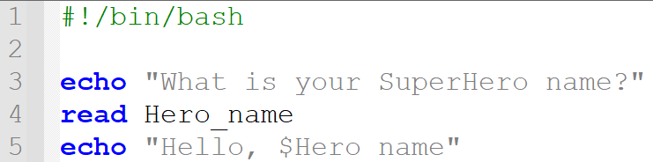

Try: User input
This Photo by Unknown Author is licensed under CC BY-SA
The read command takes user input from the keyboard and assigns it as a value to the variable name we declare after the read command: Hero_name.
Bash will pause and wait for the user to enter input.
We then echo out the user input by using the variable name.
Commonly used to ask users to enter their Usernames and passwords.
Syntax: read variable_name
Notes:
#!/bin/bash
echo "What is your SuperHero name?"
read Hero_name
echo "Hello, $Hero_name“
-
Note: In bash you can use the read command as the equivalent to the Bat pause command to pause the output e.g. ‘read -p “Press any key to continue ...”.

Slide 64
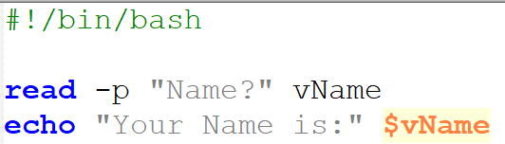

Try: User input –p option
In this example we use the –p option to allow user input on the same prompt line as the read command.
Code | Output
Notes:
#!/bin/bash
read -p "Name?" vName
echo "Your Name is:" $vName

Slide 65
Try: if then else statements
This Photo by Unknown Author is licensed under CC BY-SA
In this example, we ask a user to input a value between 1 and 10 which is stored in the ‘number’ variable that we declare after the read command.
We then use an if statement to check if the value is equal to 7 i.e. The Magic Number. IF true “Congratulations” is echoed out, if false however, the ‘else’ statement outputs the false echo string: Number is not the Magic number.
Notes:
#!/bin/bash
echo "Guess number between 1 and 10?: "
read number
if [ $number == 7 ];
then
echo "Congratulations, You guessed the Magic number."
else
echo "Number $number is not the Magic number."
Fi
-
Bg. Tips:
== or -eq can be used for the ‘equal to’ operator.
if statements and if-else statements can be nested inside other if or if-else statements.

Slide 66
Try: For Loop example
This Photo by Unknown Author is licensed under CC BY-SA
In this example, the for loop contains a variable called ‘Shopping’ which contains each item ‘in’ the loops list i.e. *OatyBars *Apples etc…
The loop executes the ‘echo’ code on in each item in the loops list.
Colour codes are used to set the ‘Shopping list’ background to white & text red: \e[1;47m & \e[1;31m.
Another colour code is used to set the list item text to bold yellow: e[1;33m.
Another colour code is used to remove text formatting: \e[0m. The -e flag is used to output colour.
Notes:
#!/bin/bash
echo -e "\e[1;47m\e[1;31mShopping list: \e[0m"
for Shopping in *OatyBars *Apples *Wraps *Salad
do
echo -e "\e[1;33m $Shopping \e[0m"
done

Slide 67
Try: Until Loop
In this game-like script, we use an Until loop to ask the user to guess the secret word to exit the program. If the User enters the secret word ‘exit’ the script echo’s out ‘Congratulations’.
If the User does not input the secret word, the script echo’s out: WRONG HAHA. Try Again.
-ne \007 is a method for producing a beep sound fx in a shell script.
Colour codes:\e[1;33m is the code that sets the colour to bold yellow and \e[0m resets the colour back. Replace 1;33 with the colour code you want. See next page for colour codes.
Notes:
#!/bin/bash
UserInput=null
until [ $UserInput = "exit" ]
do
echo "Enter the secret word to exit the program:"
read UserInput
if [ $UserInput == "exit" ];
then
echo -ne '\007'
echo "Congratulations. You're Free."
else
echo -e "\e[1;47m \e[1;31m << WRONG HAHA. Try Again. >> \e[0m"
fi
done

Slide 68
Try: Array
Tip: Use the ‘@’ or ‘*’ symbol in the index to print out all array elements.
Notes:
#!/bin/bash
#declare a 1 line array and echo out an index item
declare Array1=( "Array" "of" "SunShine :o)" )
echo ${Array1[2]}
echo ${Array1[@]}
#declare a multi-line array and echo out an index item
declare -a Array2=(
[1]="Sunny"
[2]="Bwrwglaw"
)
echo ${Array2[1]}
#declare a multi-line Associative array and echo out an item
declare -A Array3=(
[Wales]="Sunshine in Wales"
[Scotland]="Snow in Scotland"
[Ireland]="Blue Sky in Ireland"
[England]="Bright Spells in England"
)
echo ${Array3[Wales]}

Slide 69
Try: Case statement example
In this example, the user is asked if they can code in bash. If the input matches the Yes|yes|Y|y pattern the program outputs “Cool. That’s Awesome”. If the input is ‘No’ the program outputs “It’s easy. Let’s start learning”, if no match is found, the default * exit case outputs: “Try again, enter Yes or No?”.
Output:
Or
Or
Notes:
#!/bin/bash
echo "Can you code in Bash?"
read -p "Yes/No?" Answer
case $Answer in
Yes|yes|Y|y)
echo "Cool. That's Awesome."
;;
No|no|N|n)
echo "It's easy. Let's start learning."
;;
*)
echo "Try again: enter Yes or No."
;;
esac

Slide 70
Try: Function
As we recently learned with Batch, Functions allow us to create self-contained blocks of code that we can call and reuse whenever needed. Bash also support the use of functions.
In this example, we create a function named ‘Dog’, who woof’s out his name ‘Buddy’. When the the main script underneath uses some echo commands and calls the function. Parenthesis are not used when calling functions in Bash.
2.
Output:
1.
Notes:
#!/bin/bash
# 2. Dog says:
Dog() {
echo "Buddy. What's your Name?"
}
# 1. Script says:
echo "What's your name?"
echo "What?"
echo "WHAT IS YOUR NAME?"
Dog
echo "Bash. Hi Buddy :o)"

Slide 71
Try: A Multiple-choice Menu
This Photo by Unknown Author is licensed under CC BY-SA
If you are managing a Linux Server, it can be useful to create a menu to help you quickly execute frequently needed scripts.
The script in the Notes section below, provides an Admin menu example that allows you to easily check some system settings. You can customise it to create your own menu of usual commands.
  Memory load usage
  CPU load usage
  TCP connections
  System information and
  Who is logged onto the server and what they are doing.
To try the script using either a Linux Terminal, nano in Google Cloud Shell Nano text editor, Azure VM, or OnlineGDB.com (Select BASH) some commands may not work with OnlineGDB.
Notes:
#!/bin/bash
function memory_usage() {
echo "Memory usage on Server is:"
free
}
function proc_and_cpu() {
echo "Process list and CPU usgae:"
htop
}
function tcp_usage() {
echo "TCP connections:"
cat /proc/net/tcp
}
function kernel_usage() {
echo "System name & Kernel version:"
uname -s -v -r
}
function WhoWhyWhat() {
echo "WhoWhyWhat:"
w
}
Menu(){
echo -e "\e[1;33m\e[4mSystem Admin. Menu:\e[0m"
echo "1) Memory usage:
2) Process list & CPU usage:
3) Number of TCP connections:
4) System & Kernel version:
5) WhoWhyWhat:
0) Exit."
echo -e "\e[1;33m Choose an option: \e[0m"
read choice
case $choice in
1) memory_usage ; Menu ;;
2) proc_and_cpu ; Menu ;;
3) tcp_usage ; Menu ;;
4) kernel_usage ; Menu ;;
5) WhoWhyWhat ; Menu ;;
0) exit 0 ;;
esac
}
# Call Menu function
Menu

Slide 72
Functions: A Multiple-choice Menu.
3.
2.
This Photo by Unknown Author is licensed under CC BY-SA
1.
File:./10MenuScript.sh
Notes:
First, the main script will call the Menu function (located right at the end of the script) to echo out the Menu options to the user.
The Menu function uses a read command to accept User input and a case statement to identity the number typed in by the user. The user’s option choice is stored in the $choice variable.
The case statement then executes the corresponding function call.
Finally, the case code statements call the Menu function again to output the Menu options to choose from.
The last option uses the ‘exit’ command to exit the program and return to the prompt. We don’t really NEED to hard code the exit ‘0’ value, but it is good practice to use. 0 signals successful execution of the script. An exit code of 0 means success. So we know the script ran successfully to that point. We could use an echo to output the value.
Tip: Each command we use on Linux (like all other Unix and Unix-like OSs) is a system program that can be found in the Linux directory, usually bin or sbin.
#!/bin/bash
function memory_usage() {
echo "Memory usage on Server is:"
free
}
function proc_and_cpu() {
echo "Process list and CPU usgae:"
htop
}
function tcp_usage() {
echo "TCP connections:"
cat /proc/net/tcp
}
function kernel_usage() {
echo "System name & Kernel version:"
uname -s -v -r
}
function WhoWhyWhat() {
echo "WhoWhyWhat:"
w
}
Menu(){
echo -e "\e[1;33m \e[1m \e[4m System Admin. Menu:\e[0m"
echo "1) Memory usage:
2) Process list & CPU usage:
3) Number of TCP connections:
4) System & Kernel version:
5) WhoWhyWhat:
0) Exit."
echo -e "\e[1;33m Choose an option: \e[0m"
read choice
case $choice in
1) memory_usage ; Menu ;;
2) proc_and_cpu ; Menu ;;
3) tcp_usage ; Menu ;;
4) kernel_usage ; Menu ;;
5) WhoWhyWhat ; Menu ;;
0) exit ;;
esac
}
# Call Menu function
Menu

Slide 73
Bg. Menu commands description
The free command in the memory_usage() function is a simple and easy to use command to check memory usage on linux. Tip: Another way to check memory usage is to use the cat command to output the /proc/meminfo file.
We use the htop command in the proc_and_cpu() function to show a list of the processes running, ordered by the amount of their CPU usage. Tip: You could use ps to view all processes from the current logged in user or ‘pa aux’ to view all processes from all users (au) and processes not executed from the terminal (x).
We use the cat command in the tcp_usage() function to output the current TCP connections from the /proc/net/tcp file.
We use the uname command (short for Unix name) in the kernel_usage() function to output the name and version of the computer and operating system.
We use the ‘w’ command in the WhoWhyWhat() function to provide a quick summary of each user logged into the system, what each user is doing, and what load the activity is imposing on the system.
Notes:
Note: In case you are not running a Linux system and are using a Windows OS, I recommend using an online Bash IDE such as cocalc.com for this example.

Slide 74
Bg. Uname command options.
This Photo by Unknown Author is licensed under CC BY-SA
Here are some additional options to use with the uname command (short for Unix name) in the kernel_usage() function.
-s option: It prints the kernel name.
-n option: It prints the name of the computer.
-r option: It prints the kernel release date.
-v option: It prints the version of the current kernel.
-m option: It prints the machine hardware name.

Slide 75
Bg. Some useful System command options
Here are some additional commands to try in your menu.
ps > file.txt - to output all processes running into a file.
df – to show the disk space remaining in the file system.
  df –h - df command followed with the -h for an easier to read version.
top - will display a list of processes and how much resources each process is using from the machine.
vmstat command shows a statistically detailed report of the virtual memory that is currently in use. Virtual memory uses both hardware and software to enable a computer to compensate for physical memory shortages, temporarily transferring data from random access memory (RAM) to disk storage.
htop - just like Task Manager in Windows, htop allows you to interactively monitor the system’s resources and processes in real time. htop is a newer program to the top command. htop uses color, supports mouse operation, and provides visual information about processor, memory and swap usage. Click Crtl+C to go back to the prompt.
Note: If htop does not work, try using the apt – Advanced Package Tool command, To install the program: sudo apt install htop
For more information please click-here for a video overview and here for text-based overview.

Slide 76
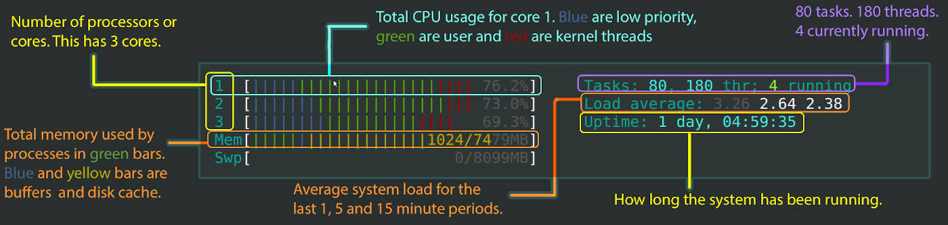
Bg. htop command overview
htop allows us to interactively monitor a system’s resources and processes in real time.
htop is a newer program to the top command.
htop uses colour, supports mouse operation, and provides visual information about processor, memory and swap (Virtual/Physical) memory usage.
For more information and overview of the htop command, please click-here.
Tip: If htop does not work, use the apt command (apt = Advanced Package Tool) to install the program: sudo apt install htop
This Photo by Unknown Author is licensed under CC BY-NC

Slide 77
Bg. Some Additional Network & Sys.Admin commands
For some additional commands to use in your scripts to configure, monitor, and secure a system and network, try the following. If any commands do not work, try using the apt – Advanced Package Tool command to install the tools:
sudo apt install net-tools.
ifconfig - to check the IP address assigned to the system.
ip link show - is for configuring, adding, and deleting network interfaces.
ip address show - to display IP addresses. Command can also be used to bind new addresses or delete old ones
IP route show - to print or display the routing table.
Nslookup insert_web_address – Nslookup or Name Server Lookup tool is used to query the Domain Name System (DNS) to obtain the IP address
dig insert_ip_address - Domain Information Getter, is a DNS (Domain Name Server) lookup and display program that looksup/checks and displays the Domain names that are returned from the name servers.
Nmap insert_IP_address – the Network Mapper tool is used for network discovery, security auditing, and administration. The default scan shows the ports, their state (open/closed), and protocols.
ping insert_ip/web_address - to see if a host is alive.
iPerf – to analyse and measure network performance between two hosts.
traceroute - to see what route the packets are taking.
Netstat –i - command is used to examine network connections, routing tables, and various network settings and statistics. Use -i flag to list the network interfaces on your system.
ss –t –a - use ss command with -t and -a flags to list all TCP sockets. Displays both listening and non-listening sockets.
Sudo tcpdump insert_ip/web_address - is a packet sniffing tool, you can examine all packets sent to or from a particular host.
ssh insert_ip_address – Secure Shell, allows you to securely connect with remote hosts over the internet.
Notes:
For more information on using the apt command please click here, here and here.

Slide 78
Student Activity: Complete the checklist below:
In your own time, complete the checklist below:
  Variables
  User Input
  if statement
  A Loop (one type)
  Array
  Case statement
  Function
This Photo by Unknown Author is licensed under CC BY-NC-ND

Slide 79
OS Assignment: Task 5
5. Use of Bash scripts in a Linux OS.
Demonstrate key features of a Linux OS scripting language by documenting the use of Bash scripts, with screenshots and accompanying narration.
Approx. 350 words.
Cite several reference sources.
This Photo by Unknown Author is licensed under CC BY-SA

Slide 80
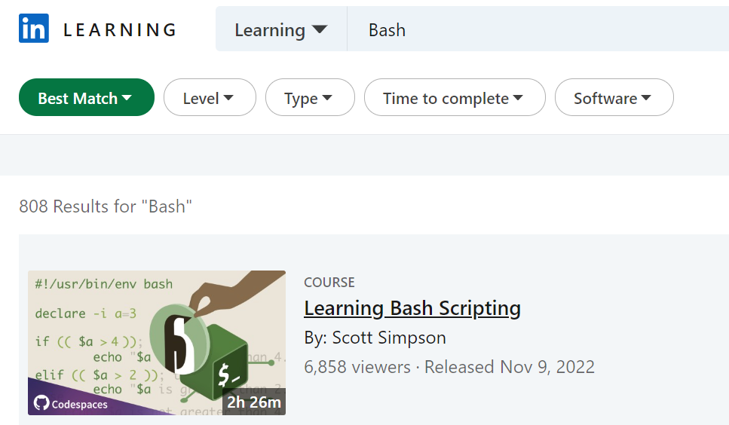


Bash Scripting: Linkedin Learning courses
If you haven’t engaged with an online Certified course yet, to get the extra 5 marks. Consider one of these courses.

Slide 81


Linux from a USB stick
We can run Linux e.g. Ubuntu directly from a USB stick, it’s an easy way to use Linux on your device.
It doesn’t alter your system’s configuration, and a simple restart without the USB stick will start and restore your machine to its normal state.
Instructions here: Try Ubuntu before you install it | Ubuntu
Others slide: 15.

Slide 82
Register reminder.

Slide 83
The End.

Slide 84

Learning Bash Apps (Play store)
Example Play store Apps for learning Bash on your phone:
Terminal emulator
Bash 5 Manual *****
Bash by Example *****
Andronix - Allows you to install Linux distros on android devices such as smartphones. Be careful, watch video first, to learn how to install, open and close properly so you can access your normal phone OS and Apps.

