Slide 1
Racial Discrimination
in Education
ECDE 7017 Yi Wang

Slide 2

Racial Discrimination
In Education
Differential treatment
Differential access to quality education
Differential outcomes of seemingly neutral policies
> based on race, ethnicity, or national origin
> based on other factors that produce a racial effect
(2004; The Annie E. Casey Foundation, 2024)

Slide 3

Racial Discrimination
The Aim of My Presentation
Explain why this issue matters
Introduce one policy response
Evaluate that policy through text, context, and consequences
Examine how the media, academic literature, and international community treat my issue

Slide 4

The Issue
Why “Racial Discrimnation”?
The chosen country: America, because it is an immigrant society (Arendt, 2006)
The chosen issue: policies respond to it, news still covers it, and the current U.S. president has neglected it, yet it remains historically significant:
U.S. discrimination ranges
  from the anti-literacy laws of 1740 to 1865, which barred Black learning
  to recent data: in 2017 African American students faced harsher punishment
  and in 2022 more non-white than white students missed reading and math goals
🌸 (The Annie E. Casey Foundation, 2024)
Notes:
(Arendt, 2006)

Slide 5
The Policy
Title VI of the Civil Rights Act of 1964
    “SEC. 601. No person in the United States shall, on the ground of race, color, or national origin, be excluded from participation in, be denied the benefits of, or be subjected to discrimination under any program or activity receiving Federal financial assistance” – the policy statement 1
It has five sections
    Section 1 states its aim: schools or programs, public and private, that receive U.S. government funding must not discriminate on the basis of race, color, or national origin
    (Civil Rights Act (1964) 2022)

Slide 6
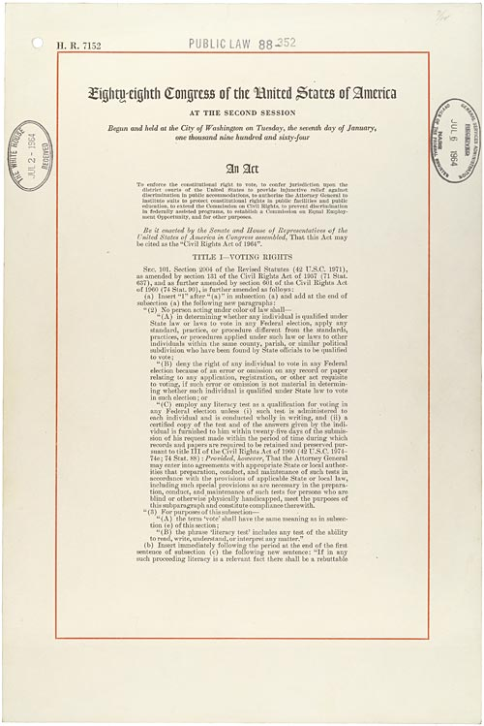
Government Policy
TITLE VI - NONDISCRIMINATION IN FEDERALLY ASSISTED PROGRAMS
SEC. 601. - a major statement of the resolution to the issue; aim of the policy
SEC. 602. - says that on violation the government first seeks voluntary correction and may then cut funding, but only with the approval of Congress
SEC. 603. - lets recipients challenge funding cuts in court
SEC. 604. - sets boundaries: employment issues fall under Title VII, not Title VI
SEC. 605. - sets boundaries: programs backed by federal insurance or guaranty contracts are excluded
(Civil Rights Act (1964) 2022)

Slide 7
Government Policy
TITLE VI - My Evaluation of The Policy
Textually, Title VI lets agencies like the Education Department set rules to ban racial discrimination in federally funded programs, that is, programs funded through grants, loans, and contracts, but not insurance or guaranty contracts, so funded programs must avoid hostile environments, racial harassment, differential treatment, and segregation 🌸:
  Not cover: sex/gender, disability, age, or socioeconomic discrimination
  Not guide: non-funded institutions
  (Civil Rights Act (1964) 2022; Robinson & Herbert, 2024; Impact of the Civil Rights Laws 2025; Discrimination in education 2026; Singh, 2026)

Slide 8
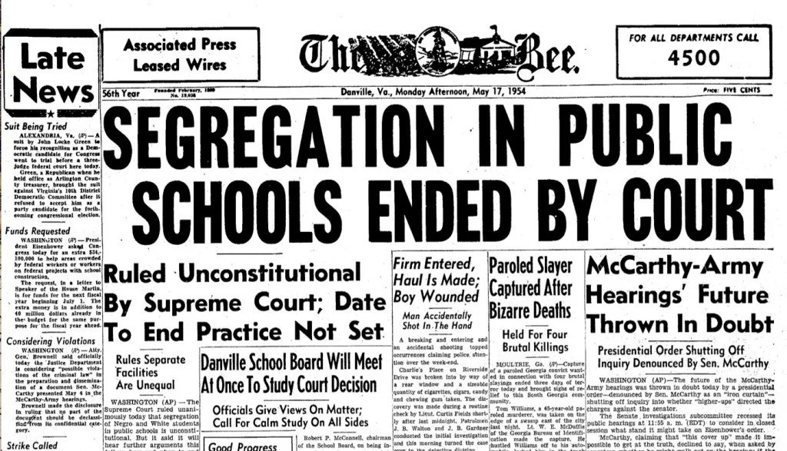
Government Policy
TITLE VI - My Evaluation of The Policy
The context traces back to
  ➡️ the 1865 Reconstruction, when laws first gave African Americans equal rights
  ➡️ only to meet rejection: Jim Crow imposed a “segregated-but-equal” principle that was never equal
  ➡️ in 1954 Brown v. Board of Education ended segregation
  ➡️ afterward Kennedy introduced Title VI to enforce desegregation, protecting all people in America rather than only African Americans. After Kennedy was killed in 1963, Johnson signed Title VI in 1964 🌸
  (Civil Rights Act (1964) 2022; Robinson & Herbert, 2024;
  Impact of the Civil Rights Laws 2025; Discrimination in education 2026; Singh, 2026)

Slide 9

Government Policy
TITLE VI - My Evaluation of The Policy
Central to implementation and interpretation is deciding what counts as a discriminatory act. The Education Department read Title VI as covering both intentional discrimination and discriminatory effect, the latter judging the outcomes of neutral policies
  But in 2025 the Department removed certain discriminatory-effect regulations, arguing they prevent punishing minority students for bad behavior. The Department simply deleted these regulations instead of distinguishing punishment from discrimination
  Trump opposed diversity acts, at the same time, as reverse discrimination against whites and men, therefore, sixty civil rights and education groups denounced these changes as threats to long-standing protections 🌸
(Civil Rights Act (1964) 2022; Robinson & Herbert, 2024; Impact of the Civil Rights Laws 2025;
Discrimination in education 2026; Singh, 2026)

Slide 10
Government Policy
TITLE VI - My Evaluation of The Policy
Title VI matters also because the values of Title VI rest on people’s understanding of three concepts: according to the Education Rights Institute
  Race means inherited physical and behavioral differences used to classify people
  Color means physical appearance such as skin color
  National origin means birthplace, ancestry, culture, or language 🌸
(Robinson & Herbert, 2024)

Slide 11

Media Treatment
October 5th, 2026
The news I stress, published on October 5, 2026, reported the Justice Department accusing UCLA School of Law of discriminating against white applicants
noting that in 2025 African American applicants were seven times and Hispanic applicants twice as likely to be admitted as similar white applicants
(Hill, 2026)
Such coverage shows the crisis has shifted the emphasis in diversity cases, especially under Trump, from protecting non-white students to protecting white students
The University of California at Los Angeles School of Law

Slide 12
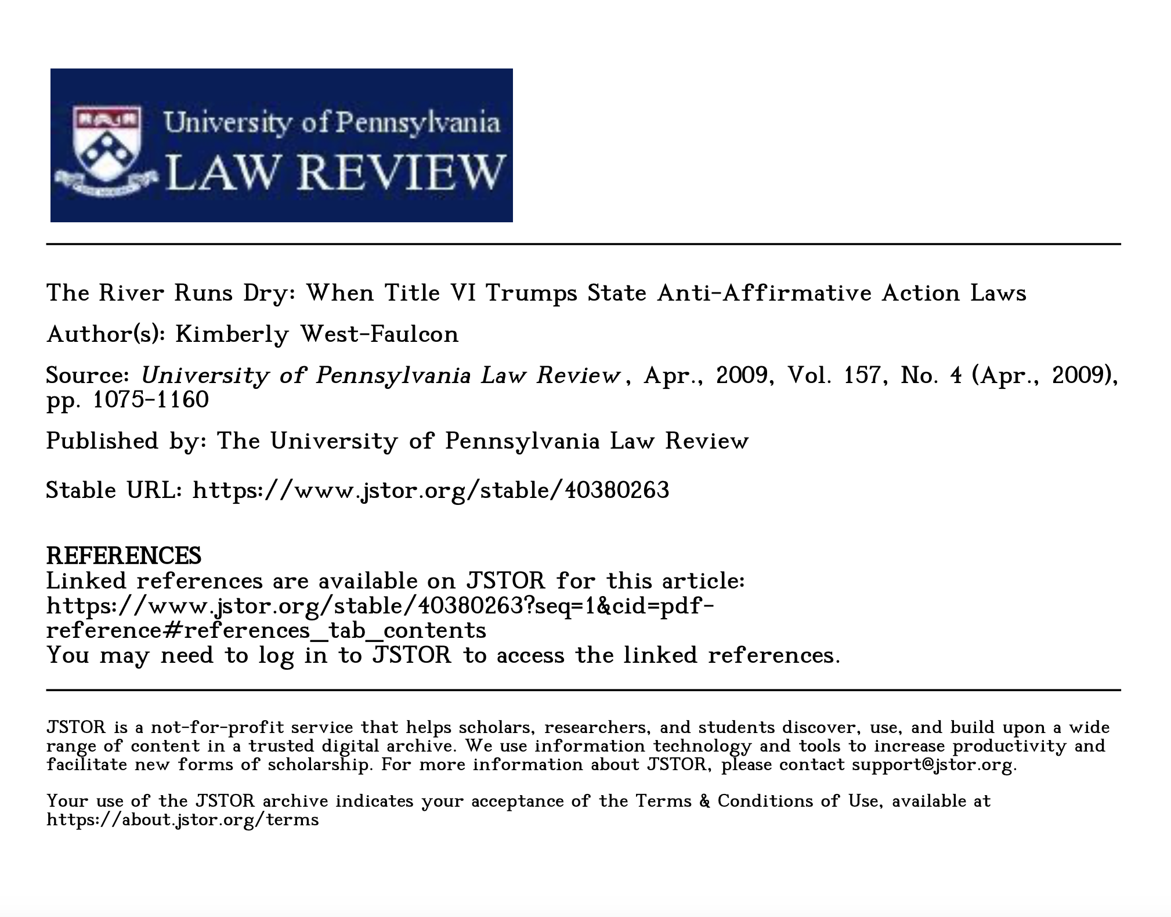
Literature Treatment
The River Runs Dry: When Title VI Trumps State Anti-Affirmative Action Laws (April 2009)
  🌸
Minority students, especially African American and Latino applicants, with lower SAT scores observed Title VI aided minority admissions until state bans
Higher-scoring White and Asian applicants, for decades, used Title VI to call race-conscious admissions discriminatory
Universities receiving federal funds: balanced federal and state laws by stressing that the SATs are necessary and race-conscious remedies
The article concludes that Title VI prevails over ‘state laws that oppose racial equality’
(West-Faulcon, 2009)
by blocking biased SATs unless their use is proven necessary
and by prompting universities to override state laws for fear of losing federal funding, restoring minority enrollment and reopening equal access

Slide 13



International Treatment
United Nations Human Rights
🌸 The United Nations’ De-cla-ration on the Elimination of All Forms of Racial Discrimination (of November 20th, 1963) which likewise counters discrimination by race, color, or national origin
And holds that “the existence of racial barriers is repugnant to the ideals of any human society” (December the 21st, 1965)
The United Nations hopes that everyone will profoundly and immediately reflect on and react to manifestations of racial discrimination

Slide 14





Conclusion
Racial Discrimination in Education
  Racial discrimination in U.S. education has long been a problem, and Title VI was a breakthrough
    [the policy’s] text reminds one whose interests are at stake
    Its context shows the history of the government’s legal action against racial discrimination and demonstrates that anti-discrimination efforts are always essential to equal rights
    And the policy’s implementation reveals the changes a policy may undergo, which may worsen or mitigate discrimination and sometimes even reverse progress

Slide 15
Conclusion
Racial Discrimination in Education
By my readings, a policy against racial discrimination should benefit everyone who suffers from it and everyone who has benefited from it, yet it often seems to help only the previously disadvantaged, while others who once enjoyed excessive privilege now resent the new landscape of equality
So, should white people protest the loss of their sense of superiority when competitors saved by anti-discrimination laws now stand before opportunities that once belonged to whites, or should they join non-whites for equality across races? I believe cross-racial cooperation is essential
and only through this can good nondiscrimination policies become effective and be reasonably revised. A final question remains: does action come before policy, or vice versa? Both are indispensable, methinks

Slide 16
References
Arendt, H. (2006) ‘The crisis in Education’, in Between Past and Future. Penguin Publishing Group.
‘Chapter: 3 defining discrimination’ (2004) in Measuring Racial Discrimination . Washington, DC: The National Academies Press.
Civil Rights Act (1964) (2022) National Archives and Records Administration. Available at: https://www.archives.gov/milestone-documents/civil-rights-act (Accessed: 07 October 2026).
Discrimination in education (2026) What is Discrimination in education? Meaning, Definition. Available at: https://www.unesco.org/en/query-list/d/discrimination-education#term-definition (Accessed: 07 October 2026).
Hill, J. (2026) DOJ accuses UCLA School of Law of Racial Discrimination, ABA Journal. Available at: https://www.abajournal.com/news/article/doj-accuses-ucla-law-of-racial-discrimination (Accessed: 09 October 2026).
Impact of the Civil Rights Laws (2025) U.S. Department of Education. Available at: https://www.ed.gov/laws-and-policy/civil-rights-laws/civil-rights-act-of-1964/impact-of-the-civil-rights-laws (Accessed: 07 October 2026).
International convention on the elimination of all forms of racial discrimination | OHCHR (1965) United Nations. Available at: https://www.ohchr.org/en/instruments-mechanisms/instruments/international-convention-elimination-all-forms-racial (Accessed: 08 October 2026).
Robinson, K.J. and Herbert, G.J. (2024) A primer on Title VI of the Civil Rights Act of 1964, University of Virginia School of Law. Available at: https://www.law.virginia.edu/document/title-vi-primer/view (Accessed: 07 October 2026).
Singh, K. (2026) US Education Department removes key rules against ..., Reuters. Available at: https://www.reuters.com/legal/government/us-education-department-removes-key-rules-against-discrimination-2026-07-23/ (Accessed: 08 October 2026).
The Annie E. Casey Foundation (2024) Racial inequality in Education, The Annie E. Casey Foundation. Available at: https://www.aecf.org/blog/racial-inequality-in-education (Accessed: 08 October 2026).
West-Faulcon, K. (2009) 'The River Runs Dry: When Title VI Trumps State Anti-Affirmative Action Laws', University of Pennsylvania Law Review, 157(4), pp. 1075–1160. Available at: http://www.jstor.org/stable/40380263 (Accessed: 9 October 2026).

