Slide 1

(Image 1)
Student Name: Siantel Nikita Brierley.
Student Number: 2235698.
Module Name: Community Care and Management of Longer-Term Conditions.
Module Code: LCHS7003.
Lecturer Name: Aishat Bakre.
Assignment Title: Component 2 – Individual Presentation.

Slide 2
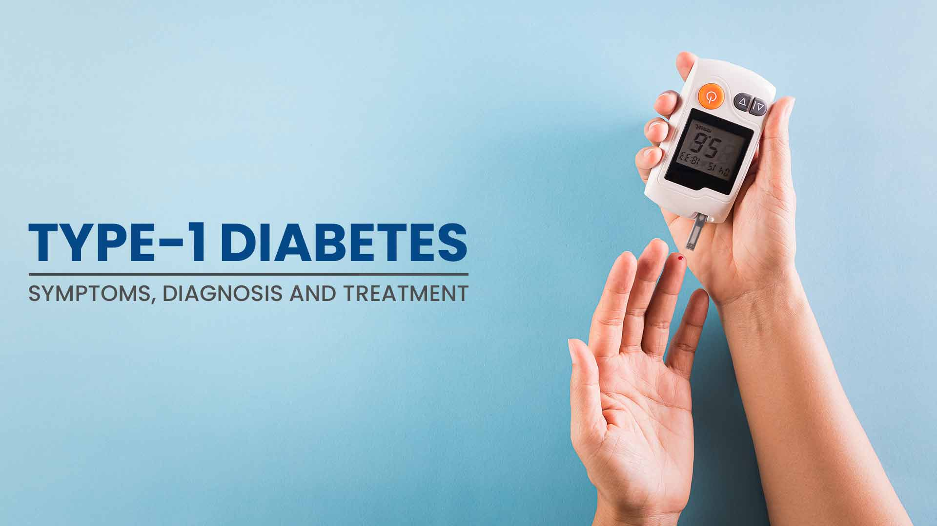
(Image 2)
Diabetes Type 1

Slide 3
What is Diabetes Type 1?

Slide 4
Overview:
Type 1diabetes is a long-term condition where an individual's immune system in the body is being weakened as insulin producing cells that are in the pancreas are being attacked and killed. Insulin aids the body to use glucose (sugar) for energy, without insulin in the body the glucose level in the body increases, leading to an individual taking insulin daily to manage these sugar levels. (NHS, 2024)
Diabetes Type 1 often develops in children and young adults but can happen at any age. With there being no cure for this long-term condition, it can be managed by daily tracking and insulin administration. Diabetes UK (2023) explains fewer than 10 people in the UK have this condition, with the exact causes not known and there's nothing to do to prevent it, the main treatment is administering insulin.

Slide 5
Causes of this long-term condition:

Slide 6
Causes:
Caused by a problem with an individual's immune system (the autoimmune system)
The body not making enough or any insulin/or it not working properly.
Individual s can be at a higher risk because; ethnicity, age, or weight. (NHS, 2023)
The exact root cause depends on what type of diabetes the individual has.

Slide 7
Symptoms of Diabetes Type 1

Slide 8
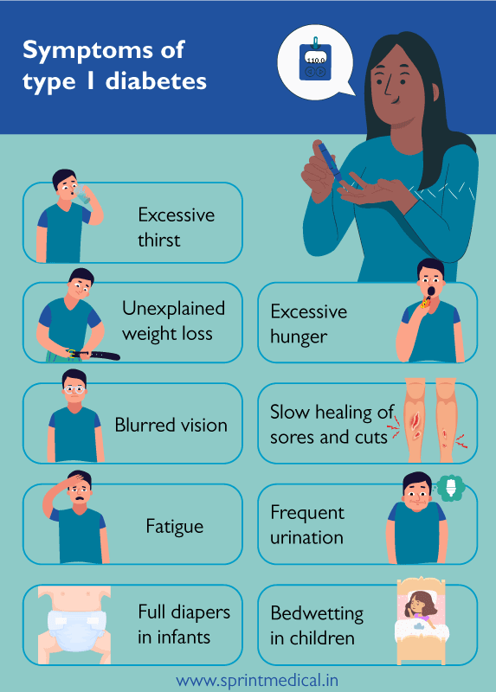
Persistent use of the toilet – using more frequently especially in the nighttime.
Constant Tiredness – feeling tired and fatigued more than usual.
Constant Thirst – craving a drink or being thirsty all the time
Weight Changes – gaining or losing weight without trying to.
Genital thrush or itching.
Wounds or cuts that take a longer time to heal.
Increased hunger, wanting to eat more.
Having blurred vision.
There being behavioral changes (irritability/annoyance)
Physical:
(Image 3)

Slide 9
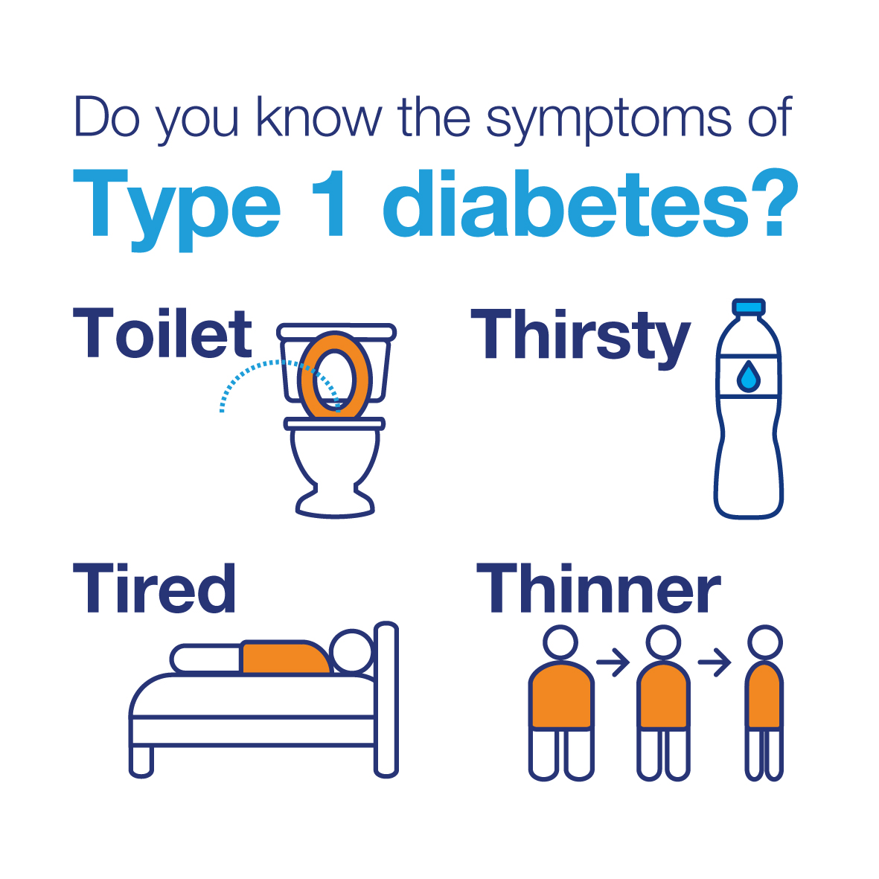
Individuals that have been diagnosed with Diabetes Type 1 can experience a psychological impact that can affect their quality of life.
People with diabetes have a heightened risk of experiencing anxiety and/or depression. (National Diabetes Support Team,2006)
Breakthrough T1D (2024)states constant testing and targets lead to stress and feeling overwhelmed, and having type 1 diabetes can affect one's mood.
Psychological:
(Image 4)

Slide 10
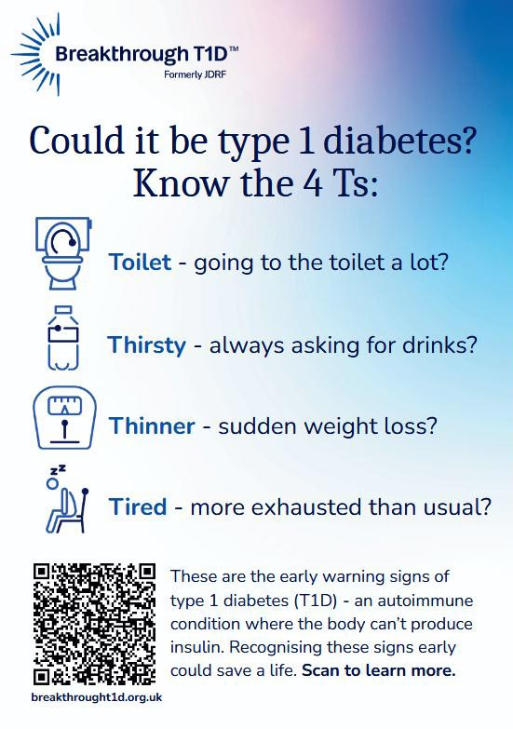
An individual may experience having mood swings and feeling agitated leasing to astrain or a feeling in tension in a friendship or relationship.
Wanting to avoid being social and social gatherings as having certain diet restrictions can leave an individual feeling fatigued or tired quickly.
The people living with diabetes explain that it has a significant impact on their social, mental and psychological quality of life, stresses such as the management, the acceptance and the diagnosis of the condition and these contribution ultimately affect one's social life. (Mohammed N.A et al, 2024)
Social:
(Image 5)

Slide 11
Prevalence of Diabetes Type 1 (UK & Worldwide)

Slide 12
UK:
In the UK it is estimation that there is around 6 million individuals living with diabetes, this being at its all-time high. With around 4.7 million individuals being diagnosed with this long-term condition, and around 1.3 million individuals living with this condition but have not yet been diagnosed.
Around 8% of this figure has Type 1 Diabetes and around 90% having Type 2 Diabetes, and statistics show that there is a higher proportion of men in the UK with diabetes accounting to 56% and women accounting for 44%. (Diabetes UK, 2023)
Conor Seery (2019) explains that 1 in 6 individuals will have diabetes being diagnosed or undiagnosed.
With type 1 diabetes it can appear at any given time in an individual's life, and this is caused by the destruction of the pancreas cells that produce insulin, this could be triggered by an infection of some kind (not for certain).
This long-term condition is the 5th most common reason for deaths with around 1 in 8 individuals aged 20 – 79 years passing away due to diabetes.
Life expectancy is reduced for people who have diabetes (Type 1 & Type 2) with individuals with type 1 diabetes living 20 years less and individuals with type 2 diabetes living 10 years less.
With this condition costing the NHS around 10% of their yearly budget towards the treatment of the disease equating to around £9 billion per year. (Diabetes UK, 2023)
In England between the years 2017- 2018 and 2021 – 2022 the prevalence of diabetes Type 1 risen from 248,240 to 270,935. (NHS England, 2023)

Slide 13
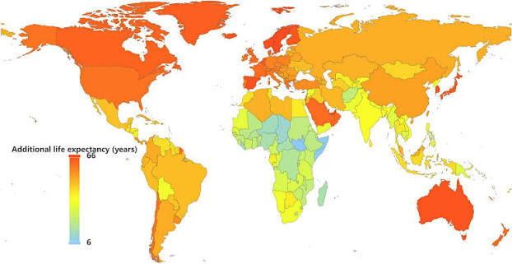
(Image 6)
In the world there are 8.3 billion people on planet earth and out of this number 9.5 million individuals are living with type 1 diabetes. The top 5 number of countries (Finland, Canada, Sweden, Kuwait, and Saudia Arabia) have the highest prevalence of this condition with around 500,000+ cases being reviewed annually, mostly being adolescence and children. (Liv Hospital, 2026)
According to International Diabetes Federation (2025) 4 in 5 individuals with diabetes (about 81%) live in low- and middle-income countries and it causing 3.4 million deaths in the year 2024 (1 person every 9 seconds). There is an estimate that there is 252 million individuals that live with diabetes but are undiagnosed.
In 2024, diabetes was responsible for around 1.015 trillion USD in global health expenditure, representing a 338% increase in the past 17 years.
Worldwide:

Slide 14
Economic & Social Burden of diabetes type 1

Slide 15
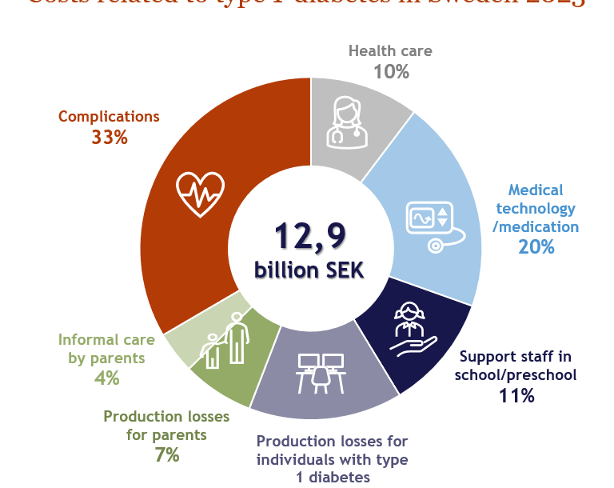
(Image 7)
Economic Burden:
The economic burden of diabetes type 1 can vary across countries, and this is dependent on having access to specific technologies and insulin. In higher income countries there is frequently higher healthcare costs and this is due to the extensive use of advanced technologies such as the Continuous Glucose Montor (CGM), and the Flash Glucose Monitor (FGM) whereas in lower income countries there is limited access to these advanced technologies, the insulin needed, and the support and care for diabetes. All these factors contribute to experiencing more challenges, a higher rate of hospitalizations and the mortality rate. (WHO, 2024; International Diabetes Foundation, 2025: Gregory, G, A., et al 2022)
With the regular upkeeping of diabetes type 1 requiring persistent monitoring, and insulin injections, it can create a lifelong cost and time spilling over into other factors of life causing economic impacts such as buying CGM, FGM, insulin, supplies, and hospital admissions, and emergency treatment. (international Diabetes Foundation, 2025)

Slide 16
Social burden:
There is a social burden that is faced in living with diabetes type 1, and this can be on individuals diagnosed, families, and on communities, as the continuous monitoring, the therapy, and the daily routines, and meal planning can impact relationships, employment, and being involved in social situations. (ElSayed, N,. A et al, 2025)
Children diagnosed with diabetes type 1 face challenges at school as monitoring glucose levels regular, injecting themselves, and managing episodes can cause the individual to feel on the outskirts because of their condition (IDF, 2025)
In adults with diabetes type 1, challenges in the work as continuous management, therapy appointments during work hours, and thr risk of hypoglemic episodes when working physical jobs, leading to reduced hours and not wanting to socialise.
While affecting the individuals with this long-term condition it ultimately affects families and care providers involved as, they can endure anxiety and depression, exhaustion (mentally), and this reduces their quality of life as the worry for the family member and the constant monitoring and life adjustments can cause burnout affecting their lives socially as tiredness and monitoring takes over (Chiang, J, L, et al, 2018)

Slide 17
Diagnosis & Initial assessment of diabetes type 1

Slide 18
Initial assessment &Diagnosis:
In order to check is diabetes is present in a individual, the GP will firstly conduct a finger prick test, and this will be to check for high blood glucose.
The next step is, when the finger prick test is done, and there is a conformation of high blood glucose, it will be recommended by the GP to see a specialist doctor in a hospital to start the treatment needed, and to conduct more tests and this will usually be done on the same day.
Then the specialist will they will be able to confirm whether the individual has type1 diabetes, or another type of diabetes and this will be based on weight, symptoms, and age (if type of diabetes isn't confirmed, more blood tests will be needed). (NHS, 2024)
The GP, doctors will always look out for the 4 T's, and they are:
Toilet.
Thirsty.
Tired.
Thinner.

Slide 19
THE MANAGEMENT OF DIABETES TYPE 1

Slide 20
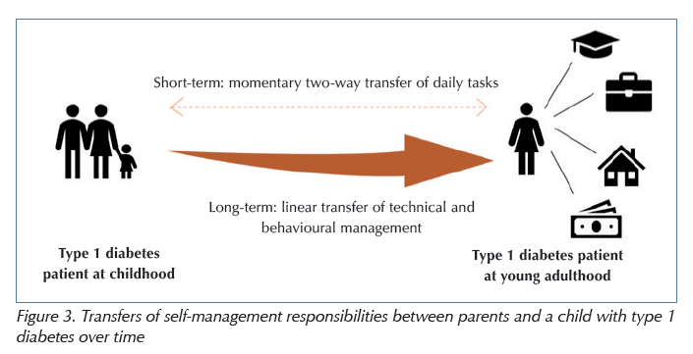
UK Guidance:
In order to manage diabetes type 1 effectively in the UK there are specific guidelines an individuals, family members and carers can follow as guidance. These guidelines are mainly set by the National Institute for Health and Care Excellence (NICE) and their guideline covers care and treatments for adults aged over 18+ diagnosed with diabetes type 1 and it consists of support, advice, education, blood glucose management, cardiovascular risk, and identifying and managing long term complications (NICE, 2022), and the NHS providing support, advice, management skills, reviews, treatment, they will also provide equipment for diabetes type 1 and provide regular tests and check-ups (NHS, 2024)
(Image 8)

Slide 21
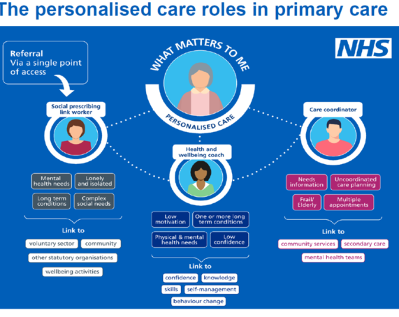
The comprehensive model of personalized care:
This model of care is one of the core frameworks that are used in current practice in improving diabetes type 1. this framework being designed by the NHS England to establish a whole population approach to support people of all ages and their carers to manage their physical and mental health and wellbeing, and to build community resilience and making informed decisions when their health changes. Also to empower individuals to have better choice and control over the care received.
There are Six evidence-based components in this framework with each of them being defined by a standard set of practices, these consist of:
Shared decision making.
Personalised care and support planning.
Enabling choice, including legal right to choice.
Social prescribing and community-based support.
Supported self-management.
Personal health and integrated personal budgets.
(NHS England, 2021)
(Image 9)

Slide 22
Treatment for diabetes type 1:

Slide 23
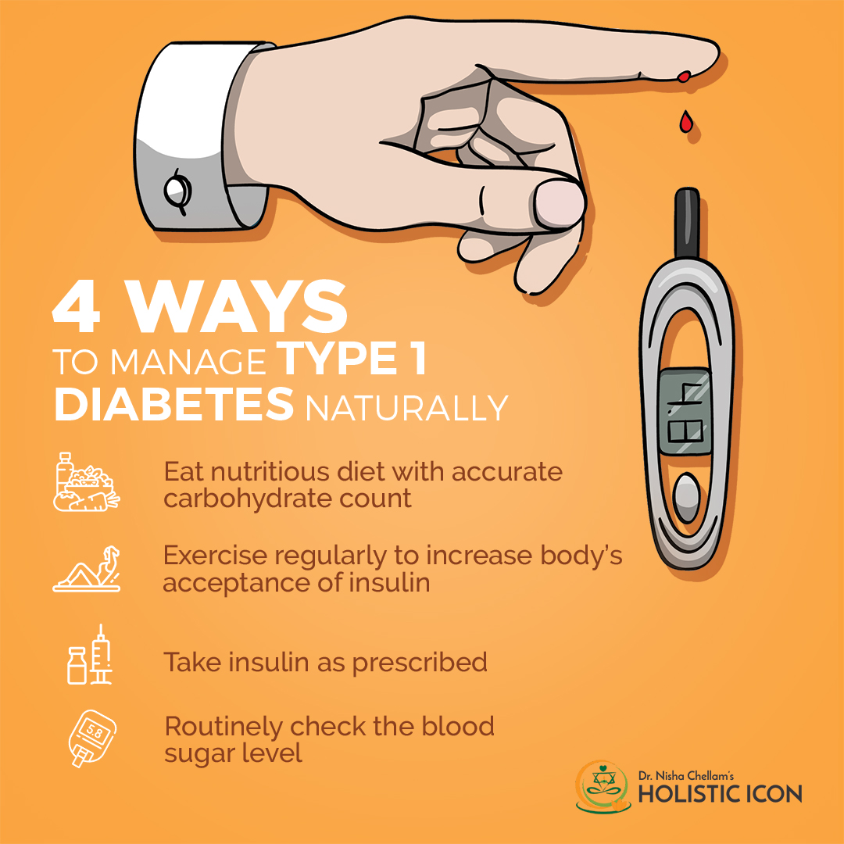
Treatment options available for diabetes type 1
The management of diabetes type 1 is a continuous process, as the body doesn’t produce insulin. As an individual diagnosed has to inject insulin daily, and have to continuously monitor their blood glucose levels but theres also factors such as watching their diet and what they eat, and maintaining weight to be able to stabilize their blood sugar levels. Treatment options available for diabetes, this reducing the risk of developing any challenges (Diabetes UK, 2023), these include:
Insulin Replacement Therapy
Blood Glucose Monitoring
Diet, Exercise, and lifestyle
Upcoming Treatments, and Early Intervention Programmes
(Image 11)

Slide 24
comorbidity

Slide 25
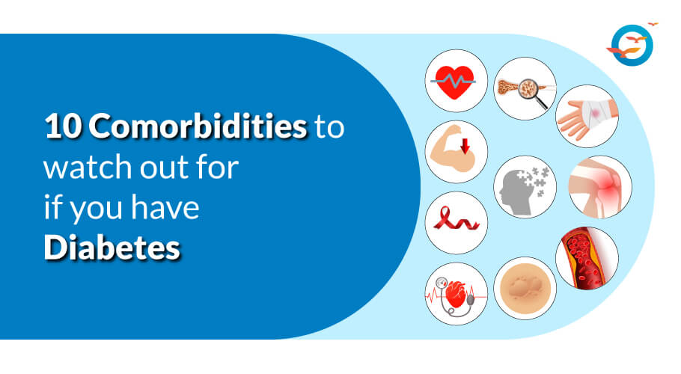
Cormorbidity that accompany diabetes type 1:
(Image 12)
Diabetes type 1, is a long term condition that happens to co-occur with other health challenges. Having type 1 diabetes can put an individual at a higher risk of developing other autoimmune diseases such as Coeliac Disease or Thyroid Disease, this long term condition (Diabetes T1) can also create a higher risk of developing certain cancers (Liver, Pancreas, Kidney, or Stomach cancer). But with this said it is known that diabetes type 1 can reduce the risk of other cancers such as breast cancer or prostate cancer. (Diabetes UK, 2017)
Caharia, O, P, et al (2022) did a study with the aim of assessing the prevalence of cardiovascular risk factors and diabetes related complications in recent onset adult type 1 diabetes and it was found out that the further need for multidisciplinary interventions focusing on groups at higher risk for hyperglycaemic crises in order to prevent ketoacidotic events. Diabetic ketoacidosis remains a serious endocrine emergency, associated with morbidity and mortality.

Slide 26
Skills, values, and behaviours for co productive care:

Slide 27
Skills, values, and behaviours required to provide co productive care for an individual diagnosed with diabetes type 1:
Effective Communication -
By using clear, concise language to create an understanding of how insulin therapy, diabetes management, and glucose monitoring work and how to adapt.
Shared Decision Making – by allowing the individual to be involved in decisions about their care, allows them to be able to be apart and help them to manage their condition.
Compassion & Empathy – being able to have empathy and compassion in what an individual with type 1 diabetes allows for be able to provide more supportive care.
Professional Behaviour -
Being able to show you are professional, taking accountability, always being honest, and abiding to the guidelines to ensure professionalism.

Slide 28
Recommendations:

Slide 29
How the comprehensive model of personalized care & self management support can be used in the management of diabetes type 1
Shared decision making -
By conversing with the individual diagnosed on the risks and benefits of treatments available in order for them to support choices that exhibit their lifestyle and choices.
Personalised Care and Support Planning -
Being able to create a personalised care plan for the diagnosed individual for their needs, routines, and their goals can be helped regarding the management.
Enabling Choice -
By being able to let the diagnosed individual make their own decisions and respecting that choice, as it should being a higher rate of adherence and their engagement.
Social Prescribing and Community Based Support -
By providing an individual diagnosed with diabetes type 1, access to support groups, mental health services, and charities to stop an individual from self-isolation because of their condition.
Supported Self-Management -
Promoting individuals to goal set and to be active on their self-monitoring can create a sense of empowerment and confidence allowing for better self-management of their condition.
Personal Health Budgets & Integrated Personal Budgets -
Allowing an individual to consider a personal health budget will allow them to be able to access services and support that are the best for themselves.

Slide 30
References:
annette (2025). Health Economic Aspects of Screening for Type 1 Diabetes - IHE. [online] IHE. Available at: https://ihe.se/en/insight-health-economic-aspects-of-screening-the-case-of-type-1-diabetes/ [Accessed 10 July 2026].
Image 7
Breakthrough T1D (2024). Emotional wellbeing | Breakthrough T1D UK. [online] Breakthrough T1D UK. Available at: https://breakthrought1d.org.uk/knowledge-support/living-with-type-1-diabetes/health-and-wellbeing/emotional-wellbeing/ [Accessed 2 July 2026].
Breakthrough TD1 (2025). Signs and symptoms poster | Breakthrough T1D UK. [online] Breakthrough T1D UK. Available at: https://breakthrought1d.org.uk/resources/signs-and-symptoms-poster/ [Accessed 7 July 2026].
Image 5
Chellam, D.N. (2021). Guide to Managing Type 1 Diabetes Naturally. [online] Holistic ICON | Functional & Integrative Medicine | Novi, MI. Available at: https://holisticicon.com/guide-managing-type-1-diabetes-naturally/ [Accessed 11 July 2026].
Image 11
Chiang, J.L., Maahs, D.M., Garvey, K.C., Hood, K.K., Laffel, L.M., Weinzimer, S.A., Wolfsdorf, J.I. and Schatz, D. (2018). Type 1 Diabetes in Children and Adolescents: A Position Statement by the American Diabetes Association. Diabetes Care, [online] 41(9), pp.2026–2044. doi:10.2337/dci18-0023.
Cmthub.co.uk. (2025). Personalised Care Roles – Cheshire & Merseyside Training Hub. [online] Available at: https://cmthub.co.uk/personalised-care-roles-2/ [Accessed 11 July 2026].
Image 9

Slide 31
Conor Seery (2019). How Many People Have Diabetes - Diabetes Prevalence Numbers. [online] Diabetes.co.uk. Available at: https://www.diabetes.co.uk/diabetes-prevalence.html [Accessed 8 July 2026].
Diabetes on the net (2019). Transferring self-management responsibilities in type 1 diabetes families: Initial assessment of individual and family self-management theory - DiabetesontheNet. [online] Diabetes on the net. Available at: https://diabetesonthenet.com/diabetes-care-children-young-people/transferring-self-management-responsibilities-type-1-diabetes-families/ [Accessed 11 July 2026].
Diabetes UK (2017). What are the signs and symptoms of diabetes? [online] Diabetes UK. Available at: https://www.diabetes.org.uk/about-diabetes/symptoms [Accessed 1 July 2026].
Diabetes UK (2023a). How Many People in the UK Have diabetes? [online] Diabetes UK. Available at: https://www.diabetes.org.uk/about-us/about-the-charity/our-strategy/statistics [Accessed 8 July 2026a].
Diabetes UK (2023b). Type 1 diabetes. [online] Diabetes UK. Available at: https://www.diabetes.org.uk/about-diabetes/type-1-diabetes [Accessed 1 July 2026b].
Diabetes uk (2023). Type 1 diabetes treatments. [online] Diabetes UK. Available at: https://www.diabetes.org.uk/about-diabetes/type-1-diabetes/treatments [Accessed 11 July 2026].
Dr. Ambrish Mithal (2021). Type 1 Diabetes: Symptoms, Diagnosis and Treatment. [online] Maxhealthcare.in. Available at: https://www.maxhealthcare.in/blogs/type-1-diabetes-causes-symptoms-and-diagnosis [Accessed 1 July 2026].
Image 2
Early years Wales (2024). Blog: Know the 4Ts of Type 1 Diabetes. [online] Early Years Wales. Available at: https://www.earlyyears.wales/en/news/blog-know-4ts-type-1-diabetes [Accessed 7 July 2026].
image 4

Slide 32
ElSayed, N.A., McCoy, R.G., Aleppo, G., Bajaj, M., Balapattabi, K., Callaghan, B.C., Cusi, K., Beverly, E.A., Briggs Early, K., Bruemmer, D., Das, S.R., Ebekozien, O., Echouffo-Tcheugui, J.B., Eichorst, B., Ekhlaspour, L., Fleming, T.K., Frykberg, R.G., Gaglia, J.L., Galindo, R.J., Garg, R., Garg, S.J., Girotra, M., Giurini, J.M., Hassanein, M., Khunti, K., Kosiborod, M.N., Kushner, R.F., Lal, R., Levin, S.R., Lingvay, I., Matfin, G., Middelbeek, R.J.W., Murdock, L., Napoli, N., Neumiller, J.J., Pandya, N., Parish, S.J., Pekas, E.J., Pilla, S.J., Pirih, F.Q., Polsky, S., Segal, A.R., Seley, J.J., Selvin, E., Srinivasan, S., Stanton, R.C., Tanenbaum, M.L., Urbanski, P., Verduzco-Gutierrez, M., Woodward, C.C., Younossi, Z.M. and Bannuru, R.R. (2024). Introduction and Methodology: Standards of Care in Diabetes—2025. Diabetes Care, [online] 48(Supplement_1), pp.S1-S5. doi:10.2337/dc25-sint.
Gregory, G.A., Robinson, T.I.G., Linklater, S.E., Wang, F., Colagiuri, S., Beaufort, C. de, Donaghue, K.C., Magliano, D.J., Maniam, J., Orchard, T.J., Rai, P. and Ogle, G.D. (2022). Global incidence, prevalence, and Mortality of Type 1 Diabetes in 2021 with Projection to 2040: A Modelling Study. The Lancet Diabetes & Endocrinology, [online] 10(10), pp.741–760. doi:10.1016/S2213-8587(22)00218-2.
International Diabetes Federation (2025a). Diabetes around the World in 2025. [online] IDF Diabetes Atlas. Available at: https://diabetesatlas.org/ [Accessed 10 July 2026a].
International Diabetes Federation (2025b). Global. [online] Diabetes Atlas. Available at: https://diabetesatlas.org/data-by-location/global/ [Accessed 10 July 2026b].
Liv Hospital (2026). How Many People Have Diabetes Type 1 Worldwide. [online] Liv Hospital. Available at: https://int.livhospital.com/how-many-people-have-type-1-diabetes-worldwide/ [Accessed 10 July 2026].
Mohammed Najeeb Ashraf, Cheng, A. and Robinson, D.J. (2024). Emotional, Psychological, and Social Well-being Experience of Long-Term Living with Type 1 Diabetes Mellitus: A Patient–Psychiatrist–Endocrinologist Perspective. Diabetes Therapy, 15(2). doi:10.1007/s13300-023-01527-w.
National Diabetes Support Team (2006). National Diabetes Support Team Factsheet No. 18 The Psychological Impact of Diabetes. [online] Available at: https://www.england.nhs.uk/improvement-hub/wp-content/uploads/sites/44/2017/11/Factsheet_Psychological_Impact.pdf [Accessed 2 July 2026].

Slide 33
National Institute for Health and Care Excellence (2022). Overview | Type 1 Diabetes in adults: Diagnosis and Management | Guidance | NICE. [online] Nice.org.uk. Available at: https://www.nice.org.uk/guidance/ng17 [Accessed 11 July 2026].
NHS (2023). Diabetes. [online] NHS. Available at: https://www.nhs.uk/conditions/diabetes/ [Accessed 1 July 2026].
NHS (2024a). Symptoms of type 1 diabetes and how it’s diagnosed. [online] Nhs.uk. Available at: https://www.nhs.uk/conditions/type-1-diabetes/symptoms/ [Accessed 10 July 2026a].
NHS (2024b). Treatment for type 1 diabetes. [online] Nhs.uk. Available at: https://www.nhs.uk/conditions/type-1-diabetes/treatment/ [Accessed 11 July 2026b].
NHS (2024c). What is type 1 diabetes? [online] nhs.uk. Available at: https://www.nhs.uk/conditions/type-1-diabetes/what-is-type-1-diabetes/ [Accessed 1 July 2026c].
NHS England (2021). Comprehensive model of personalised care. [online] NHS England. Available at: https://www.england.nhs.uk/personalisedcare/comprehensive-model-of-personalised-care/ [Accessed 11 July 2026].
NHS England (2023). Incidence and prevalence of diabetes, 2017-18 to 2021-22. [online] NHS Digital. Available at: https://digital.nhs.uk/data-and-information/publications/statistical/national-diabetes-audit/report-1-care-processes-and-treatment-targets-2021-22-full-report/section-1---incidence-and-prevalence-17-18---21-22-copy [Accessed 8 July 2026].
Ogle, G. D, Wang, F., Haynes, A., Gregory, G.A., King, T.W., Deng, K., Dabelea, D., James, S., Jenkins, A.J., Li, X., Ma, R.C.W., Maahs, D.M., Oram, R.A., Pihoker, C., Svensson, J., Zhou, Z., Magliano, D.J. and Jayanthi Maniam (2025). Global type 1 diabetes prevalence, incidence, and mortality estimates 2025: Results from the International diabetes Federation Atlas, 11th Edition, and the T1D Index Version 3.0. Diabetes Research and Clinical Practice, 225(112277), pp.112277–112277. doi:10.1016/j.diabres.2025.112277.
Image 6

Slide 34
Sprint Medical (2020). Type 1 diabetes: How to tackle the disease in children. [online] Sprint Medical. Available at: https://sprintmedical.in/blog/type-1-diabetes-how-to-tackle-the-disease-in-children [Accessed 7 July 2026].
Image 3
Tao, B., Pietropaolo, M., Atkinson, M., Schatz, D. and Taylor, D. (2010). Estimating the Cost of Type 1 Diabetes in the U.S.: A Propensity Score Matching Method. PLoS ONE, 5(7), p.e11501. doi:10.1371/journal.pone.0011501.
University of Wales Trinity Saint David (2024). Study. [online] University of Wales Trinity Saint David. Available at: https://www.uwtsd.ac.uk/study [Accessed 1 July 2026].
Image 1
World Health Organization (2024). Diabetes. [online] World Health Organization. Available at: https://www.who.int/news-room/fact-sheets/detail/diabetes [Accessed 10 July 2026].
Zaharia, O.P., Lanzinger, S., Rosenbauer, J., Karges, W., Müssig, K., Meyhöfer, S.M., Burkart, V., Hummel, M., Raddatz, D., Roden, M., Szendroedi, J. and Holl, R.W. (2022). Comorbidities in Recent-Onset Adult Type 1 Diabetes: A Comparison of German Cohorts. Frontiers in Endocrinology, 13. doi:10.3389/fendo.2022.760778.
(2017). Diabetes related conditions. [online] Diabetes UK. Available at: https://www.diabetes.org.uk/about-diabetes/looking-after-diabetes/related-conditions#Type1diabetesandrelatedconditions [Accessed 11 July 2026].
(2024). What Are the 10 Common Comorbidities of Diabetes and How Do They Affect You? - Freedom from Diabetes. [online] Www.freedomfromdiabetes.org. Available at: https://www.freedomfromdiabetes.org/blog/post/10-common-comorbidities-of-diabetes/2959 [Accessed 11 July 2026].

