Slide 1

Effective Team Working and Communication
Members:
Dre Steele
Florin Coluneanu
Ionut Humulescu
Iustina Rusei

Slide 2
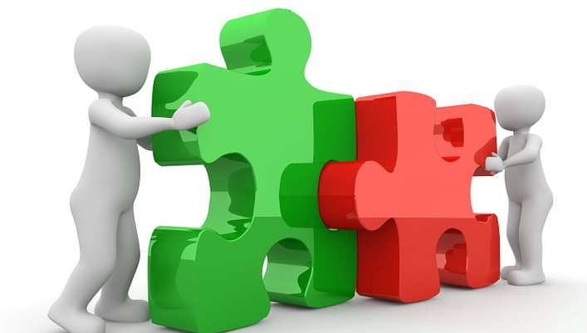
What we have Learnt about Effective Teams?
"Coming together is a beginning, staying together is progress, and working together is success."
— Henry Ford
ThePhoto by PhotoAuthor is licensed under CCYYSA.
ThePhoto by PhotoAuthor is licensed under CCYYSA.

Slide 3

OVERVIEW
TEAM BUILDING
REFLECTIONS ON RELATIONSHIPS
RELATIONSHIPS: BUILD AND MAINTAINING
REFLECTIONS ON DYNAMICS OF TEAMS AND ROLES

Slide 4
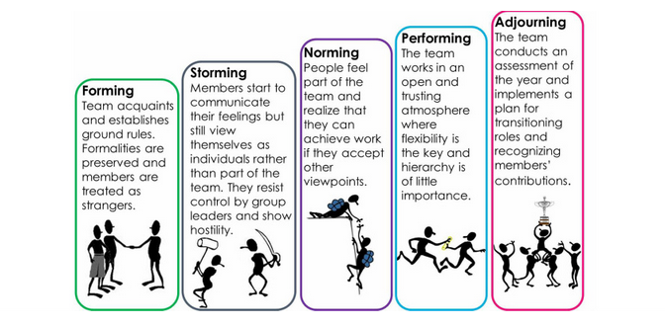
The Importance of Team Development
Bruce Tuckman identified four stages of development – forming, storming, norming and performing
A team will not be fully effective unless it reaches the stage of performing/interdependence. Many teams accept storming as a normal way of operating, while a number of teams may never get beyond forming.
Unless the process of norming is fully completed, teams may degenerate into storming.
The amount of time taken to complete the cycle will vary tremendously between teams
Teams go through phases of uncertainty, conflict, and alignment before reaching peak performance (Tuckman, 1965).

Slide 5

Trust as the Foundation of Teams
Academi Wales (2018) highlights that trust fosters open dialogue, encouraging honest and constructive communication.
Importance of Trust:
Trust is essential for collaboration, effective communication, and team commitment.
Without trust, team dynamics weaken, and progress stalls.
Trust Creates a Safe Environment:
Teams with trust support innovation and risk-taking without fear of judgment or reprisal.
Benefits of Trust in Teams:
Builds psychological safety, where members feel valued and respected.
Enhances accountability, transparency, and willingness to share ideas.
Strengthens relationships, making conflict resolution and goal alignment easier.
Challenges Without Trust:
Miscommunication, conflict, and disengagement may arise.
Lack of trust inhibits collaboration and weakens team morale.
Trust as a Building Block for Success:
Strong trust leads to higher performance and resilience in challenging situations.
Teams that prioritize trust create a foundation for long-term success and adaptability.

Slide 6
Leadership and Team Development - Adair (2015) emphasizes that effective leaders facilitate team building by recognising and addressing individual and collective needs.
Leadership is essential for fostering team union and aligning goals.
Effective leaders address conflicts constructively, turning them into growth opportunities.
Leaders must recognize and meet both individual and collective needs.
Successful leadership involves creating an environment where all team members feel valued and motivated.

Slide 7
The Seven Drivers of Team Effectiveness -Tannenbaum and Salas (2021) identify key drivers of team effectiveness, including goal alignment, resource availability, and performance monitoring.
Ensuring all team members are working toward clear, shared objectives.
Providing the tools, training, and support needed for success.
Regularly evaluating progress to maintain accountability and adapt as needed.
Clear roles and responsibilities to avoid confusion.
Ensuring flexibility to navigate challenges and sustain collaboration.
Principles of Synergy and Collaboration - (Covey, 2010) describes how effective collaboration maximizes collective strengths and mitigates weaknesses.
Power of Synergy:
Synergy enables teams to achieve results greater than individual efforts combined.
Collaboration enhances creativity, innovation, and problem-solving by leveraging diverse perspectives.
Key Benefits:
Builds stronger team cohesion and mutual trust.
Promotes efficiency by aligning skills with tasks.
Encourages continuous learning and adaptability.
Application of Synergy:
Create an environment of trust and open communication.
Encourage diverse contributions and embrace differing viewpoints.
Focus on shared goals to align efforts and maximize impact.

Slide 8
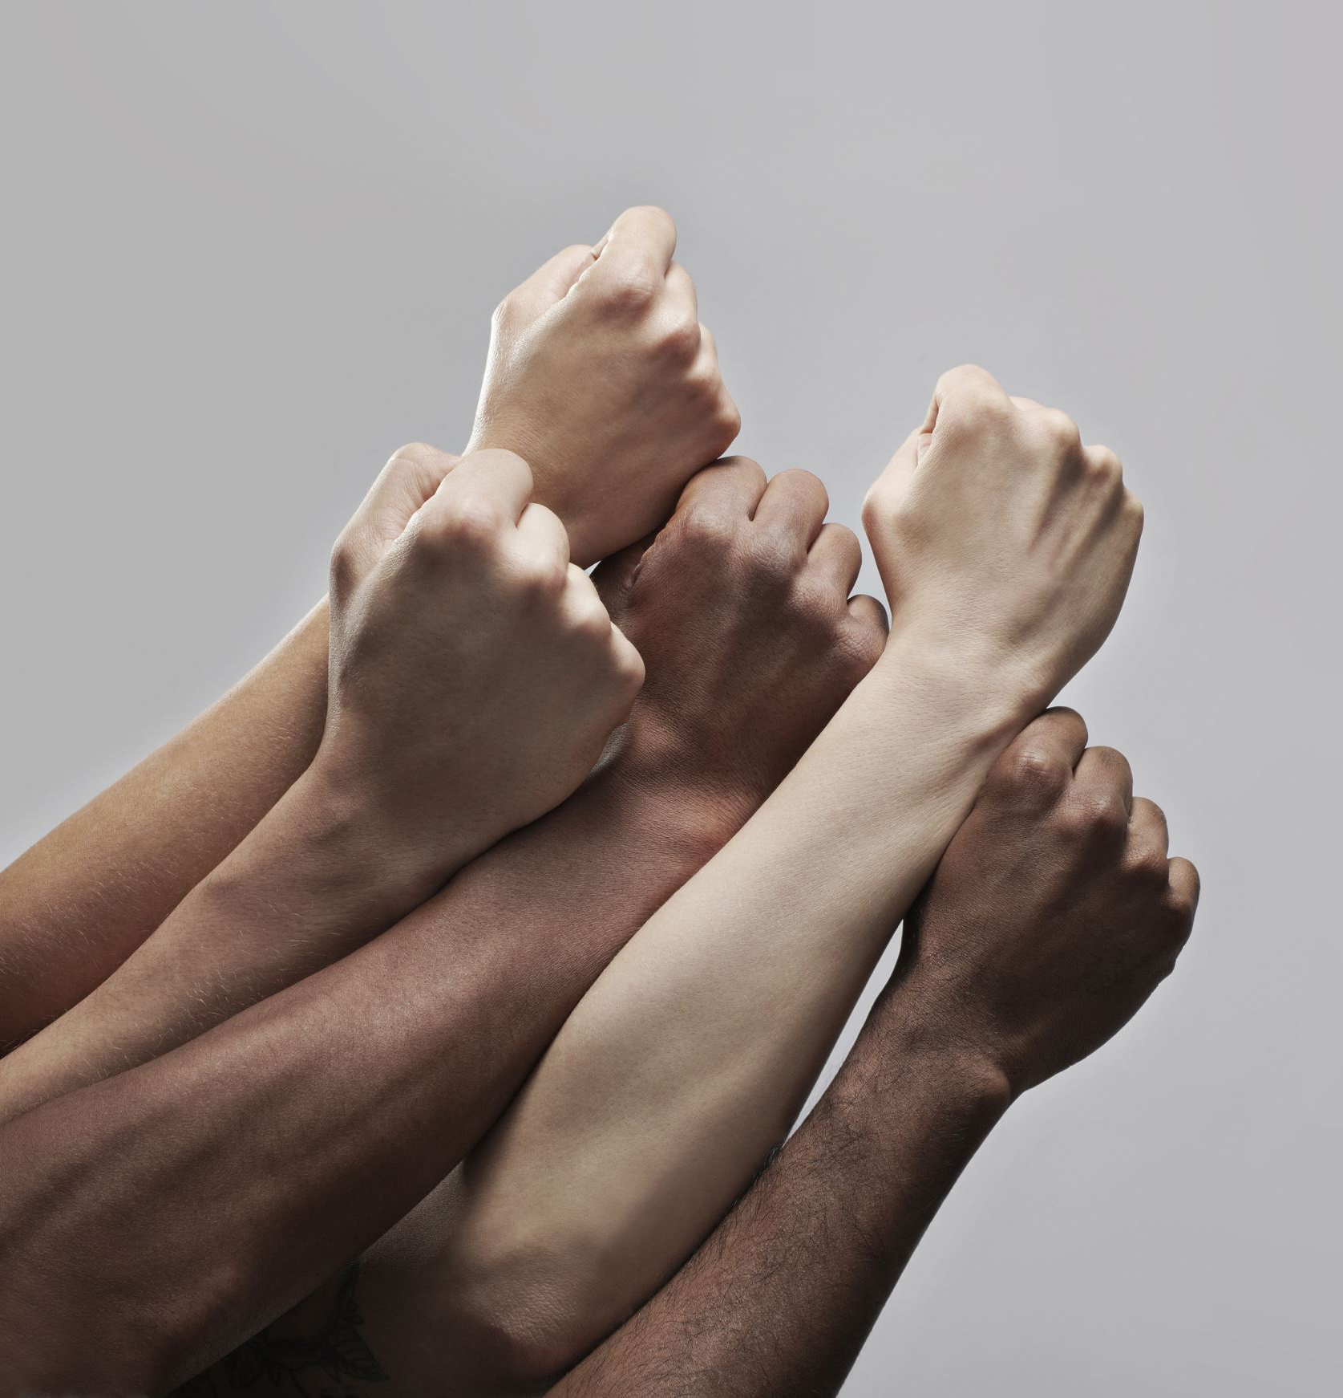
Reflection On Relationships
CONFLICT - effective resolution
Healthy relationships within teams are vital, but conflict is inevitable and can be constructive if managed well.
Effective conflict resolution requires understanding interpersonal dynamics and fostering open communication. As (Tannenbaum and Salas, 2021) highlight, successful teams embrace constructive disagreements to enhance decision-making.
Strategies like active listening where all voices are been hear, reframing conflict as an opportunity for growth are critical and collaborative problem-solving to find solutions by working togheter for the beenfit of the team (Duck & McMahan, 2021).

Slide 9
Reflection On Relationships
COMMUNICATION : The Foundation of Team
Communication is the keys of all team interactions, from conflict resolution to decision-making.
Listening is a vital communication skill. According to (Kline, 2002), "listening to ignite the human mind" fosters trust, creativity, and collaboration.
Use techniques from (Quintanilla and Wah, 2020).
Know Yourself: Understand your communication style and how it affects others.
Evaluate the Context: Adapt your communication to the specific situation and team dynamics.
Your Communication Interaction: Engage with clarity, purpose, and active listening.
Step Back and Reflect: Review your interactions to identify strengths and areas for improvement

Slide 10
Building Engagement and Motivation
Engaged teams perform better because they feel connected and invested in their goals. Motivation grows where team members feel valued and trusted as noted by (Tannenbaum and Salas, 2021) Psychological safety enables effective teamwork.
Actions Taken:
Adopted principles of active listening (Kline, 2002) to ensure team members felt heard and valued.
Improved trust led to greater openness in sharing ideas and feedback.
Collaboration and innovation within the team noticeably increased.
Encouraged inclusivity and acknowledged individual contributions to boost engagement and morale.
Trust as the foundation for open dialogue aligns with (Academi Wales, 2018).

Slide 11

Relationships: How to Build and Maintain Them
Building
Relationships are essential for teamwork and collaboration.
They foster trust, mutual respect, and a sense of belonging.
Practice active listening to validate and empower others.
Show genuine interest in team members’ perspectives and contributions.
Invest time in understanding individual strengths, needs, and motivations.
Maintaining
Regularly engage with team members to reinforce connections.
Acknowledge contributions and show appreciation for efforts.
Address conflicts constructively to prevent strain on relationships.
Provide ongoing feedback and encourage open communication.
Celebrate team successes to strengthen bonds and motivation.
Ensure transparency and honesty in interactions.

Slide 12
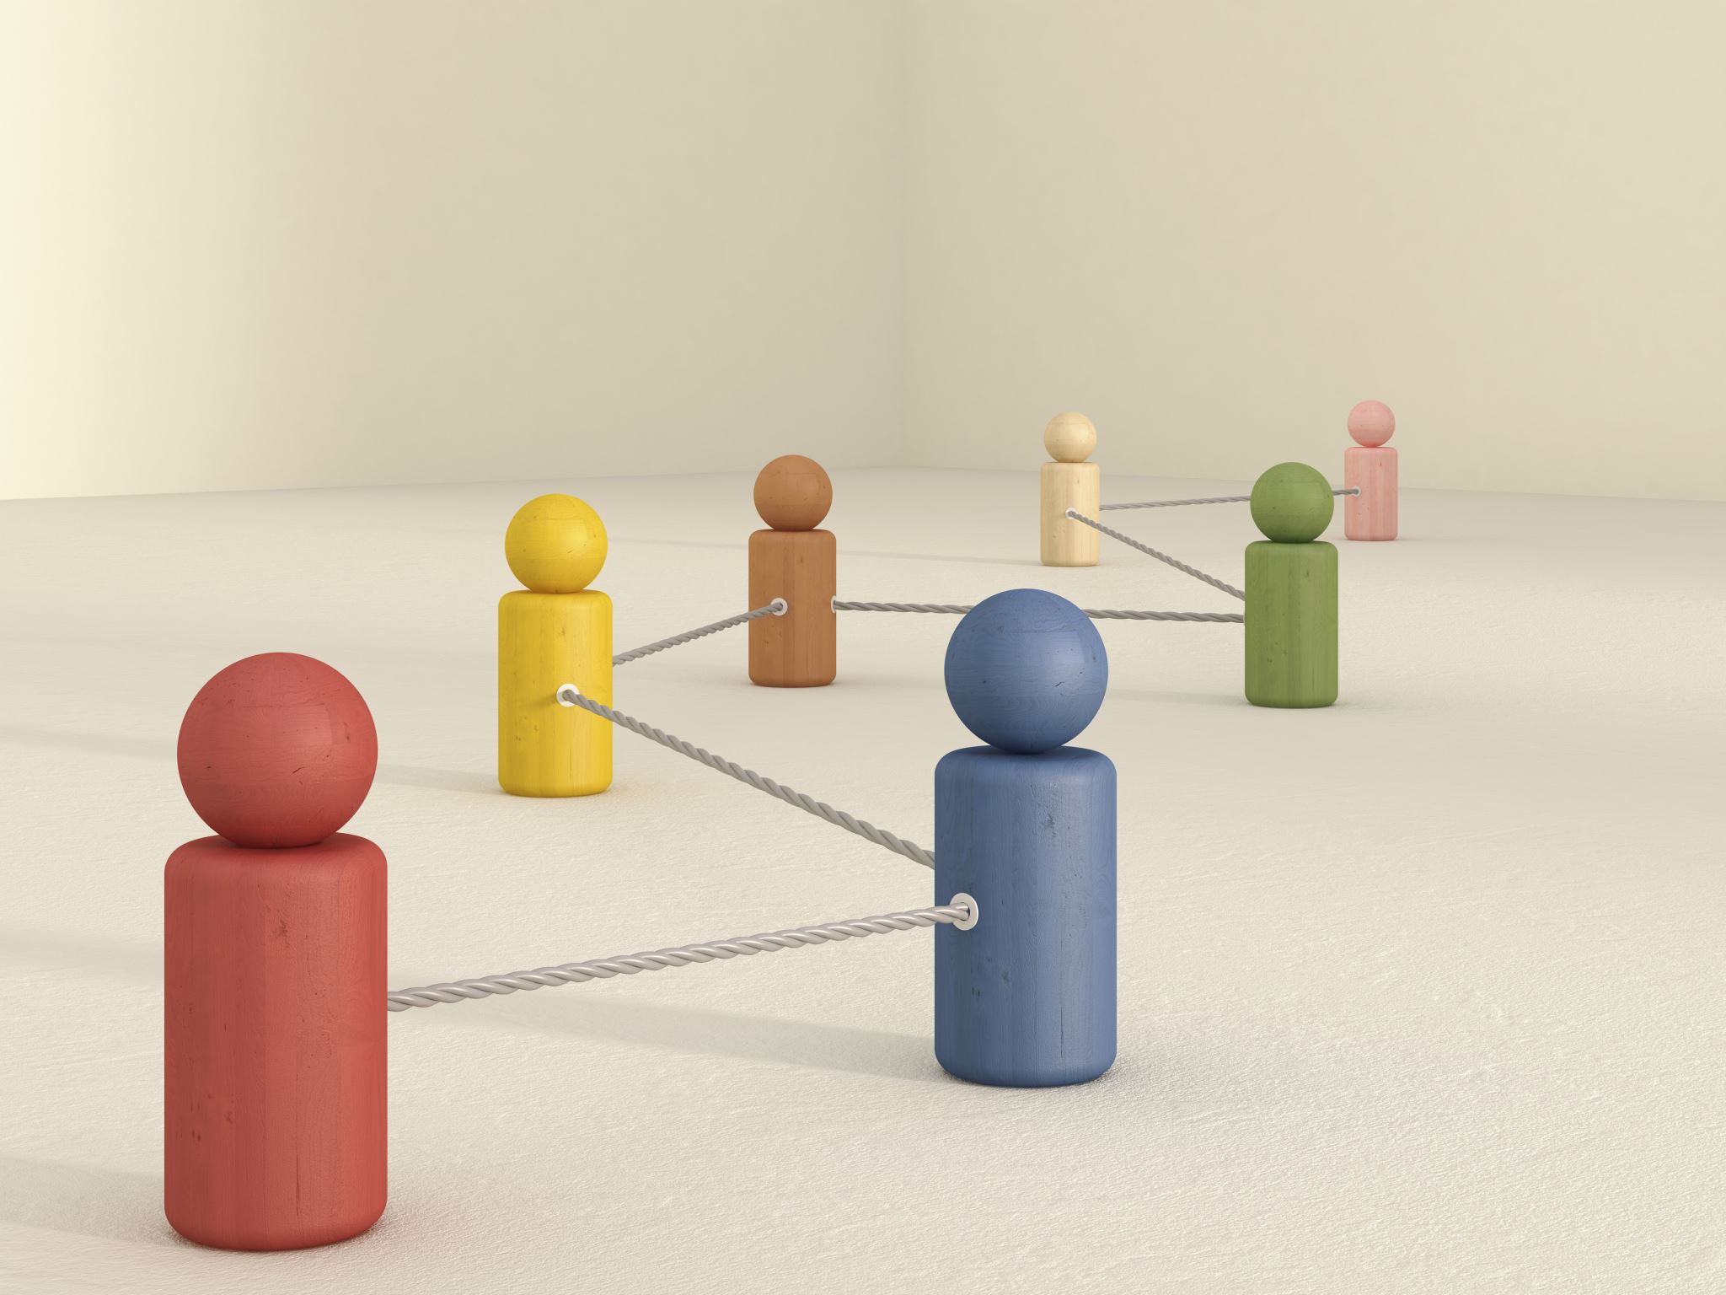
The "Know-Like-Trust" Model
Progressive Relationship Building:
Relationships develop through three stages: Know (awareness), Like (mutual respect), and Trust (reliability).
Trust is the ultimate goal and foundation of strong relationships.
Building Connections:
Understand each other’s strengths, weaknesses, and values (Duck & McMahan, 2021).
Foster connections by appreciating individual contributions and aligning on shared goals.
Fostering Likability:
Positive interactions create rapport and mutual respect.
Emotional intelligence, including empathy and self-awareness, is key to likability (Academi Wales, 2018).
Developing Trust:
Trust forms through consistent reliability, authenticity, and clear communication.
Consistency in actions and words strengthens trust over time (Academi Wales, 2016).
Key Outcome:
The Know-Like-Trust model builds a strong relational foundation for effective teamwork and collaboration.

Slide 13
Benefits of Collaboration -
  Collaboration fosters innovation by bringing together diverse perspectives and ideas (Quintanilla & Wahl, 2020).
  Collaboration aligns individual and team objectives, ensuring everyone works toward shared outcomes (Tannenbaum & Salas, 2021).
Enhanced Creativity
Increased Productivity
Goal Alignment
Mutual Accountability
Stronger Relationships
Adaptability and Learning

Slide 14

Relationship Building and Positive Psychology in Team Relationships
Aligning Strengths with Tasks
Key Roles Supporting Relationships
Relationship Benefits:
Strategies for Team Dynamics
Positive Reinforcement
Coaching
Emotional Support
Impact on Relationships:
  (Belbin & Belbin, 2010)
  (Academi Wales, 2018)

Slide 15
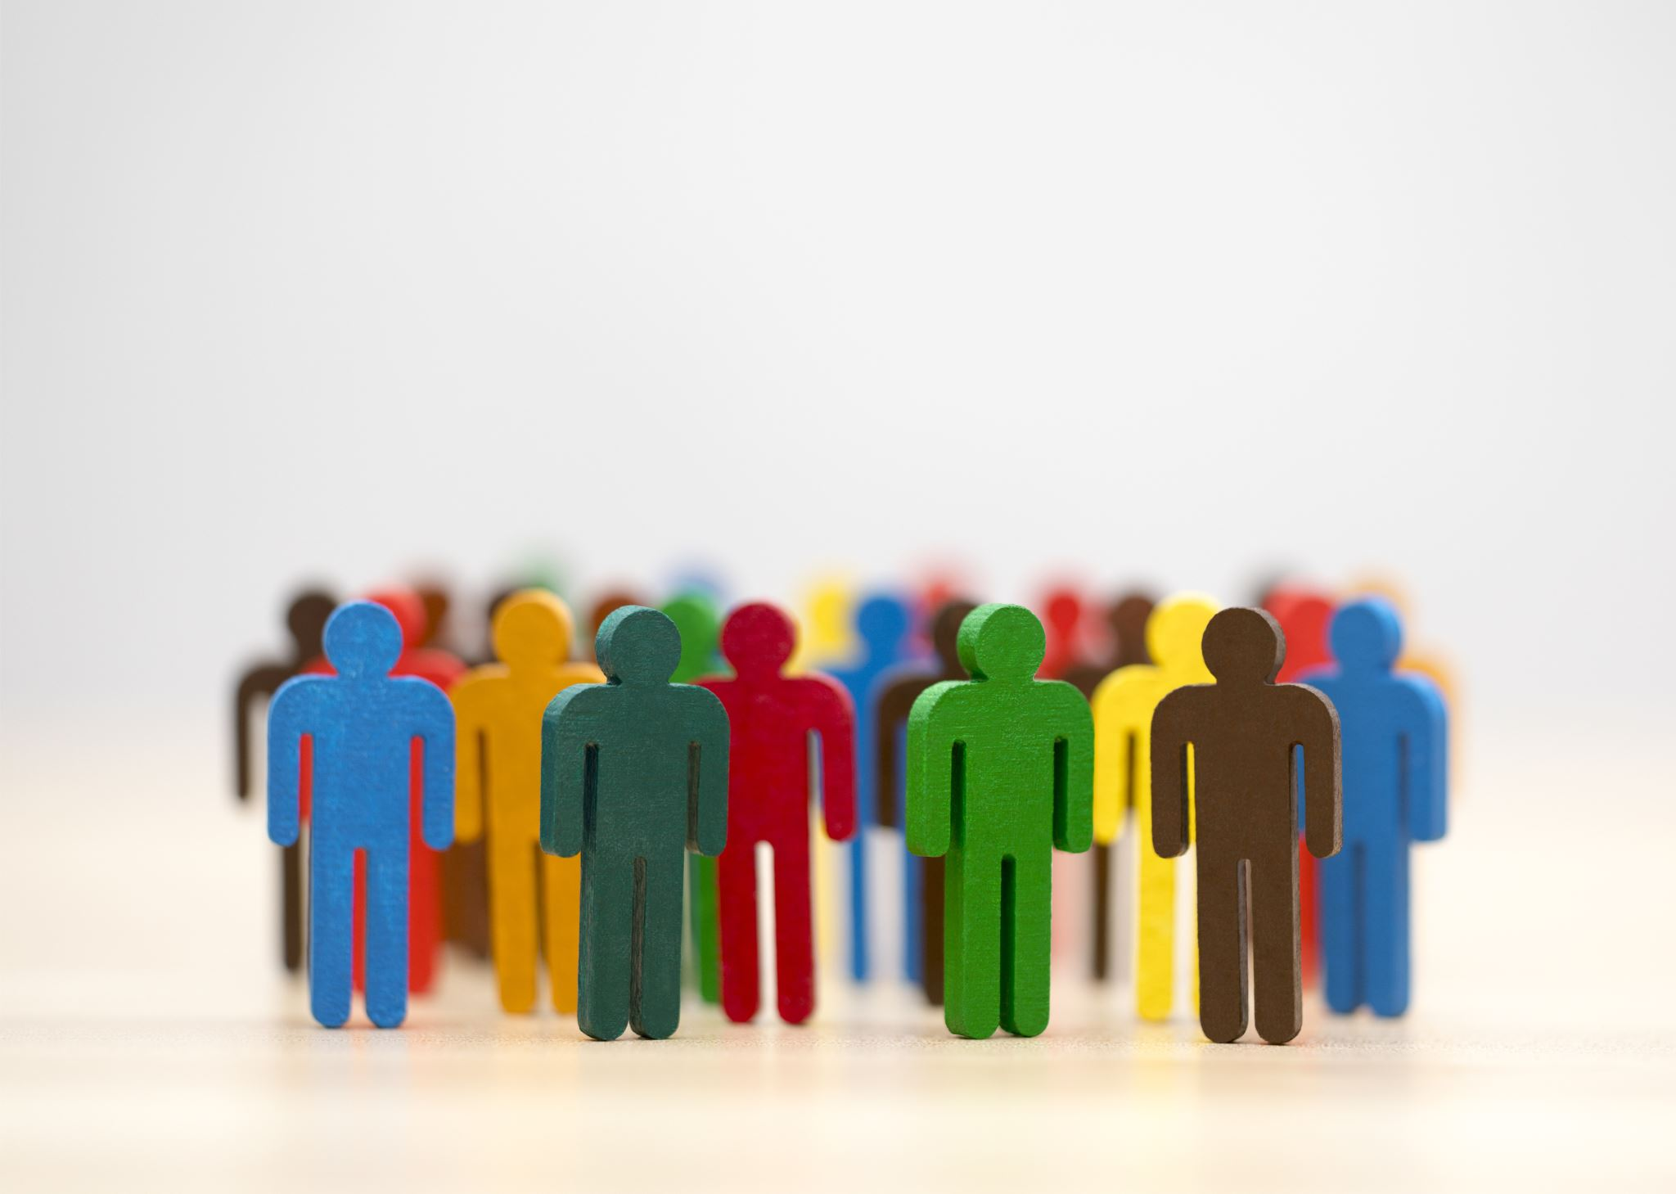
Reflections on the Dynamics of Teams and Roles
Dynamics of Teams and Roles
Teams succeed when members understand and embrace their roles (Belbin, 2010), identified nine roles that contribute to effective teams.
Enhances teamwork by leveraging individual strengths.
Balances team dynamics and reduces overlapping responsibilities.
Improves adaptability to challenges and complex tasks
Teams vs. Groups - Quintanilla and Wahl (2020) highlight that teams are more structured and goal-oriented
Advantages of Teams Over Groups:
Teams achieve outcomes beyond individual capabilities.
Stronger relationships and collaboration drive higher performance.
Teams align efforts toward common goals, enhancing efficiency.

Slide 16
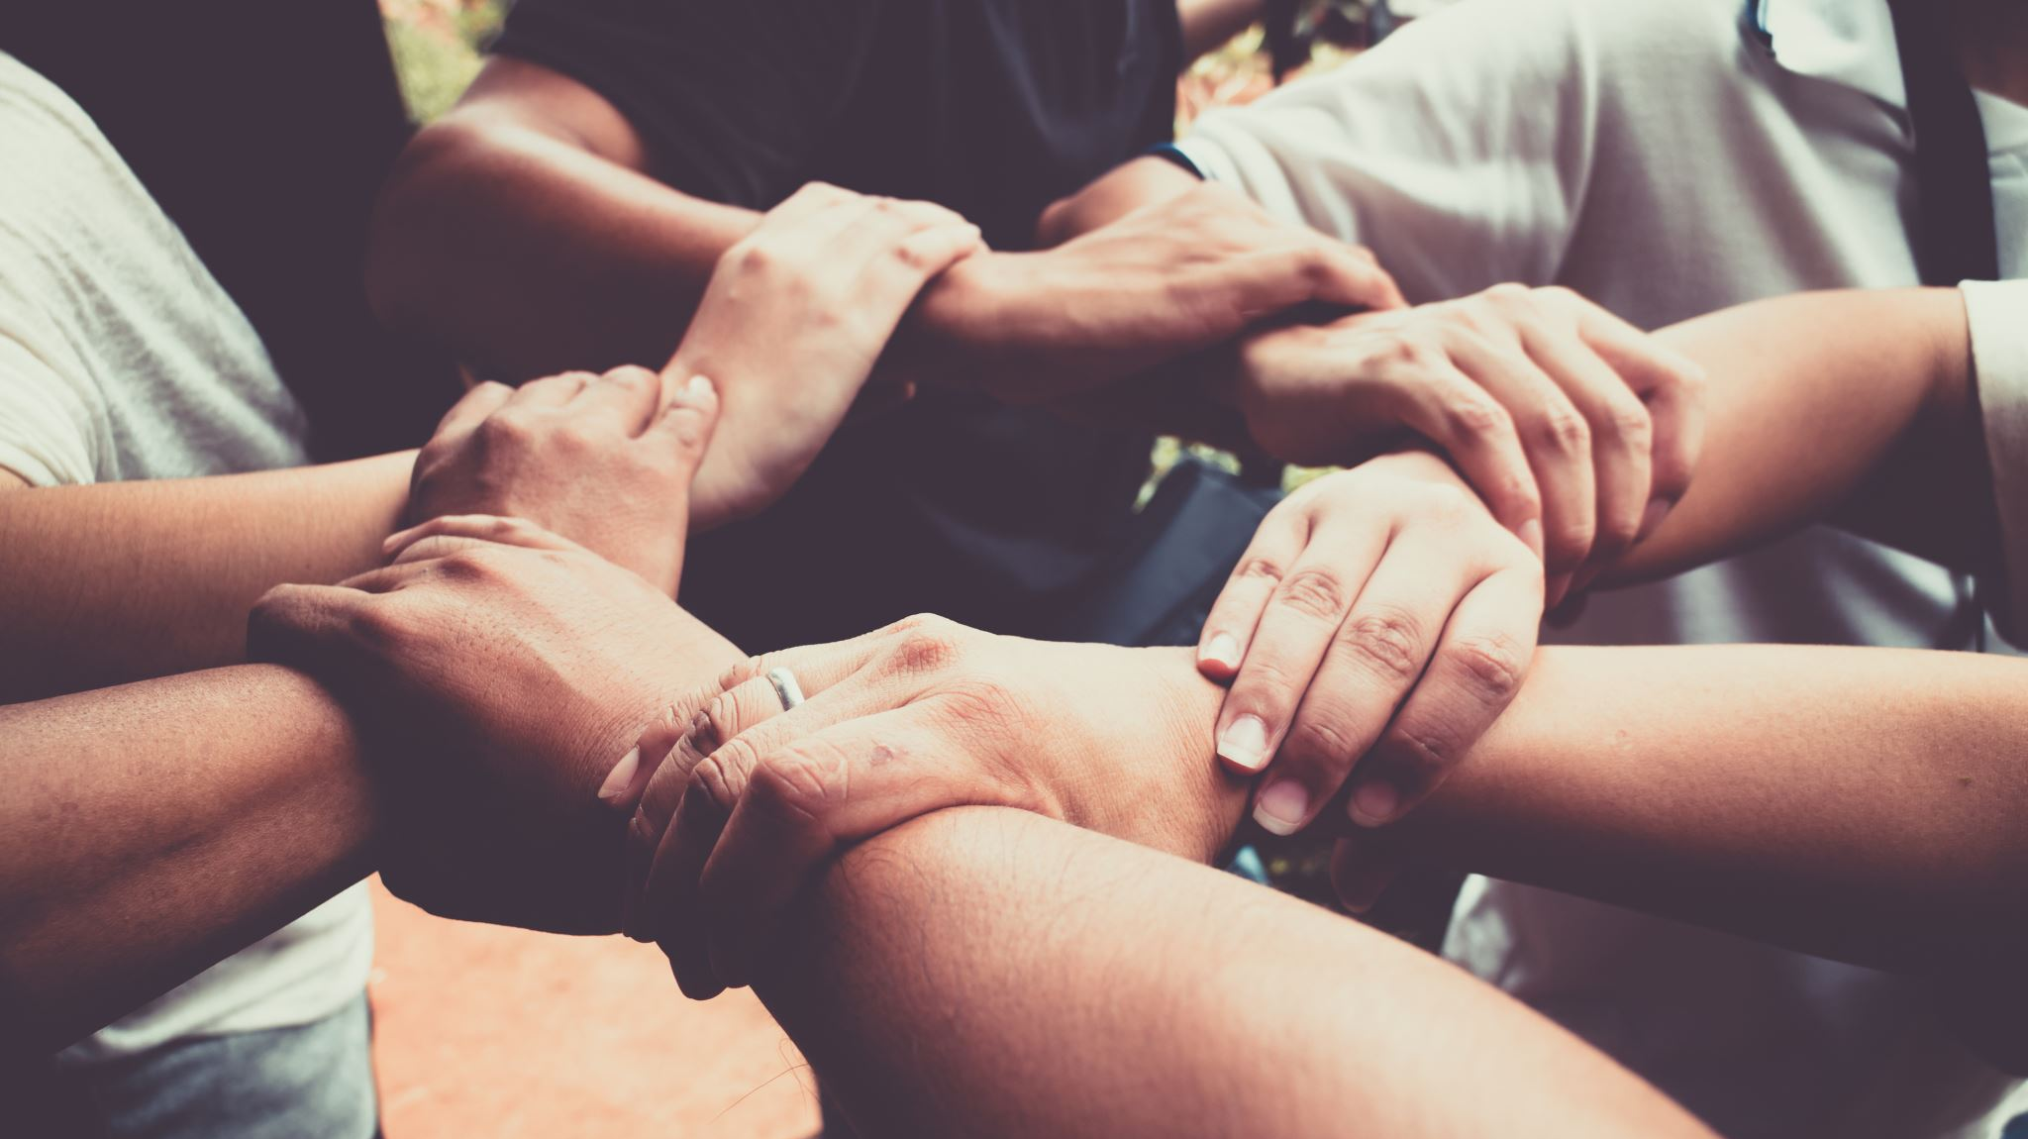
Tuckman’s Theory of Team Development
Overview of Tuckman’s Model (1965):
Forming: Team members get acquainted, define roles, and set objectives.
Storming: Conflict arises as individuals assert themselves and work through differences.
Norming: Collaboration improves as the team establishes trust and resolves conflicts.
Performing: The team becomes highly productive and goal-oriented.
Adjourning: The team disbands after achieving its objectives.
Open communication and trust are critical to navigating team challenges and achieving peak performance.
Drivers of Team Effectiveness:The clarity of purpose and mutual respect are essential for team cohesion, (Tannenbaum and Salas, 2021).
Shared goals implement alignment and collaboration within the team.
Trust and accountability create a strong foundation for performance.
Clearly defined objectives enhance team focus and cohesion.
Mutual Respect among members strengthens relationships and reduces conflicts.
Assigning tasks based on individual strengths improves efficiency.
Clear delegation minimizes role overlap and prevents misunderstandings.

Slide 17

The Role of Communication in Team Dynamics
Effective listening and communication drive team success.
Nancy Kline (2002) highlights the importance of creating environments, "a thinking enviroment" where every team member feels heard and valued.
Encourages open dialogue and equal participation.
Promotes innovative problem-solving by leveraging diverse perspectives.
Strengthens team relationships through mutual respect and understanding.

Slide 18
REFERENCES LIST
Academi Wales (2018). Trust: The Foundation of Successful Teams. Available at: https://academiwales.gov.wales/repository/resource/a3ea75b8-48af-4dd7-b70b-f3ef9bad08e7/overview [Accessed 25 Nov. 2024].
Academi Wales, 2018. Applied Positive Psychology. Available at: https://academiwales.gov.wales [Accessed 24 Nov. 2024]
Belbin, R.M. (2010). Team Roles at Work. 2nd ed. London: Routledge.
Belbin, R.M. and Belbin, R. Meredith, 2010. Management Teams: Why They Succeed or Fail. 3rd ed. Amsterdam: Butterworth-Heinemann.
Duck, S. and McMahan, D.T., 2021. Communication in Everyday Life: A Survey of Communication. 4th ed. Los Angeles: SAGE.
Heffernan, M. (2019). Dare to Disagree. TED. Available at: https://www.ted.com/talks/margaret_heffernan_dare_to_disagree [Accessed 25 Nov. 2024].

Slide 19
REFERENCES LIST
Kline, N. (2002). Time to Think: Listening to Ignite the Human Mind. London: Cassel.
Kline, N. (2010). More Time to Think: The Power of Independent Thinking. Fisher King Publishing.
Kline, N., (2015). More Time to Think: The Power of Independent Thinking. Fisher King.
Quintanilla, K.M. and Wahl, S.T., (2020). Business and Professional Communication: KEYS for Workplace Excellence. 4th ed. Los Angeles: SAGE.
Sinek, S. (2023). Trust: the Basis of High Performing Teams
Tannenbaum, S.I. & Salas, E. (2021). Teams That Work: The Seven Drivers of Team Effectiveness. Oxford University Press.
Tuckman, B.W. and Harper, B.E., (2012). Conducting Educational Research. 6th ed. United States: Rowman & Littlefield Publishers.

