Slide 1
An Evidence-Based Care Plan For a Fictional Patient
BMHP5023
Asfia Akhtar
2432708
Rizwan Nadim
Date:

Slide 2
contents

Slide 3
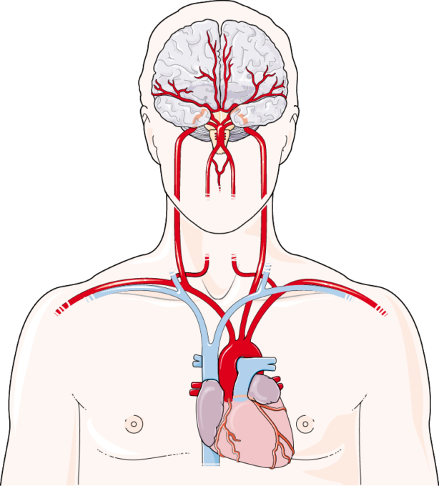
Introduction to Stroke
What is a Stroke?
A stroke is a medical emergency caused by an interruption of blood flow to the brain or the rupture of a cerebral blood vessel (National Clinical Guidelines for Stroke, 2023).
Around 85% of strokes are ischaemic, caused by a blood clot, while 15% are haemorrhagic, caused by bleeding in the brain (Feigin et al., 2021).
Without oxygen and glucose, brain cells begin to die within minutes, leading to neurological impairment (Waugh and Grant, 2022).
Prompt recognition using FAST assessment enables rapid intervention and improves patient outcomes (National Clinical Guidelines for Stroke, 2023; NHS England, 2024).
Stroke remains one of the leading causes of long-term disability worldwide, highlighting the importance of timely diagnosis, evidence-based management and multidisciplinary rehabilitation to improve patient outcomes (Feigin et al., 2021).
Source: Servier Medical Art (2025), CC BY 4.0

Slide 4
Fictional Patient Profile
Patient Demographics
Mr John Williams (Fictional Patient)
Age: 69 years
Sex: Male
Ethnicity: White British
Occupation: Retired electrician
Living situation: Lives with his wife in a two-storey home
Marital status: Married
BMI: 31 kg/m² (Obese Class I)
Medical History
Hypertension (diagnosed 12 years ago)
Atrial fibrillation
Hypercholesterolaemia
Former smoker (35 pack-year history)
No previous history of stroke
Presenting Symptoms
Sudden left-sided weakness
Facial drooping
Slurred speech (dysarthria)
Reduced balance
Difficulty walking
Diagnosis: Acute ischaemic stroke affecting the right
middle cerebral artery (MCA).
Patient-Centred Goals
Regain independent mobility
Return to daily activities
Reduce the risk of recurrent stroke
Improve quality of life
(NICE, 2023); (National Clinical Guideline for Stroke, 2023)

Slide 5
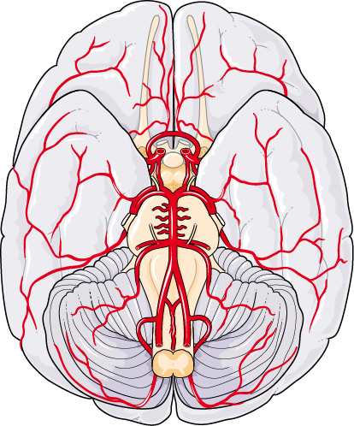
Application of Stroke to the Nervous System
Normal Anatomy and Physiology
The brain is the body's control centre, regulating movement, sensation, memory and communication (Waugh and Grant, 2022).
Neurons depend on a continuous supply of oxygen and glucose delivered through the cerebral circulation to function effectively (Tortora and Derrickson, 2021).
The middle cerebral artery (MCA) supplies regions responsible for voluntary movement, sensory perception and language (Waugh and Grant, 2022).
Effects of Stroke on the Nervous System
An ischaemic stroke blocks cerebral blood flow, depriving brain tissue of oxygen and nutrients (Intercollegiate Stroke Working Party, 2023).
Reduced cerebral perfusion leads to neuronal dysfunction, resulting in neurological deficits that vary according to the affected brain region (Feigin et al., 2021).
In Mr John Williams, occlusion of the right MCA caused left-sided weakness, facial droop and impaired mobility (Intercollegiate Stroke Working Party, 2023).
Source: Servier Medical Art (2025), CC BY 4.0.

Slide 6
Application of Stroke to the Musculoskeletal System
Normal Anatomy and Physiology
The musculoskeletal system consists of bones, skeletal muscles and joints that work together to enable movement and maintain posture (Waugh and Grant, 2022).
Skeletal muscles rely on nerve impulses from the brain to produce voluntary movement and coordinate balance (Waugh and Grant, 2022).
Normal muscle function depends on an intact nervous system to transmit signals efficiently (Tortora and Derrickson, 2021).
Application of Stroke
Damage to the right cerebral hemisphere disrupted neural pathways controlling the left side of the body (Intercollegiate Stroke Working Party, 2023).
Mr John Williams developed left-sided weakness (hemiparesis), impaired balance and reduced mobility following his stroke (NICE, 2023).
Reduced movement increases the risk of muscle wasting, joint stiffness and falls, highlighting the need for early rehabilitation (Langhorne et al., 2020).
Brain
Damaged nerve signals
Muscles receive fewer signals
Weakness (Hemiparesis)
Reduced mobility

Slide 7
Pathophysiology of Ischaemic Stroke
Ischaemic stroke occurs when a cerebral artery becomes blocked, restricting blood flow to the brain (Intercollegiate Stroke Working Party, 2023).
Reduced cerebral perfusion deprives neurons of oxygen and glucose, impairing normal cellular metabolism (Tortora and Derrickson, 2021).
ATP depletion disrupts neuronal function and leads to irreversible brain cell injury if cerebral blood flow is not restored promptly (Grefkes and Fink, 2020).
An inflammatory response and cerebral oedema develop, increasing pressure within the affected brain tissue (Intercollegiate Stroke Working Party, 2023).
In Mr John Williams, occlusion of the right middle cerebral artery resulted in neurological deficits affecting movement and coordination (Intercollegiate Stroke Working Party, 2023).
🩸 Blood clot blocks MCA
🧠 Reduced cerebral blood flow
⚡ Reduced oxygen and glucose supply
💀 Neuronal cell death
🚶 Stroke symptoms
Adapted from: Intercollegiate Stroke Working Party (2023);
Grefkes and Fink (2020).

Slide 8
Risk Factors for Stroke
Non-modifiable Risk Factors
Age: Stroke risk increases significantly after 55 years (Feigin et al., 2021).
Sex: Males have a higher lifetime risk of stroke than females (World Stroke Organization, 2022).
Ethnicity and genetics: Family history and genetic predisposition may increase stroke susceptibility (Intercollegiate Stroke Working Party, 2023).
Modifiable Risk Factors
Hypertension: The strongest modifiable risk factor, contributing to arterial damage and reduced vascular integrity (NICE, 2023).
Atrial fibrillation: Increases the risk of embolic stroke due to thrombus formation within the atria (NICE, 2021).
Obesity (BMI 31 kg/m²): Associated with hypertension, dyslipidaemia and increased cardiovascular risk (WHO, 2024).
Former smoker: Long-term smoking damages blood vessels and accelerates atherosclerosis (NHS England, 2024).
Hypercholesterolaemia: Promotes plaque formation within arteries, increasing the risk of ischaemic stroke (Feigin et al., 2021).
Application to Mr John Williams
Mr John Williams presented with multiple modifiable cardiovascular risk factors, highlighting the importance of prevention through lifestyle modification, medication adherence and regular clinical monitoring (Intercollegiate Stroke Working Party, 2023).

Slide 9
Diagnosis and Assessment Stroke
Initial Assessment
Stroke is rapidly identified using the FAST assessment to recognise facial weakness, arm weakness and speech difficulties (NHS England, 2024).
The NIH Stroke Scale (NIHSS) is used to assess stroke severity and guide treatment decisions (Powers et al., 2019).
Diagnostic Investigations
CT brain scan: Differentiates between ischaemic and haemorrhagic stroke before treatment (Intercollegiate Stroke Working Party, 2023).
MRI scan: Detects early brain tissue damage and confirms the affected area (NICE, 2023).
ECG: Identifies atrial fibrillation as a potential cause of embolic stroke (NICE, 2021).
Blood tests: Assess glucose, clotting profile, renal function and cholesterol levels (Intercollegiate Stroke Working Party, 2023).
Application to Mr John Williams
Mr John Williams underwent an urgent CT scan, ECG and blood tests, confirming an acute ischaemic stroke affecting the right middle cerebral artery, allowing timely evidence-based treatment (Intercollegiate Stroke Working Party, 2023).

Slide 10
Personalised Care Plan
Care Need | Evidence-Based Intervention | Expected Outcome
Acute treatment | Assess eligibility for thrombolysis (NICE, 2023) | Restore cerebral blood flow...
Neurological monitoring | Monitor neurological observations... (Intercollegiate Stroke Working Party, 2023) | Detect deterioration...
Swallow assessment | Complete swallow assessment (NICE, 2023) | Reduce aspiration risk.
Rehabilitation | Begin physiotherapy and occupational therapy (Langhorne et al., 2020) | Improve mobility...
Medication | Optimise antihypertensive, anticoagulant and lipid-lowering therapy (NICE, 2021) | Reduce recurrent stroke risk.
Lifestyle | Smoking cessation, diet and exercise (NHS England, 2024) | Improve long-term cardiovascular health.
Application to Mr John Williams
Mr John Williams requires an individualised care plan focused on restoring mobility, preventing complications and supporting a safe return home with his wife (Intercollegiate Stroke Working Party, 2023).

Slide 11
Multidisciplinary Team (MDT)
Key Healthcare Professionals
Stroke consultant: Diagnoses stroke, leads treatment decisions and monitors recovery (Intercollegiate Stroke Working Party, 2023).
Stroke nurse: Monitors neurological status, administers medication and provides patient education (NICE, 2023).
Physiotherapist: Improves mobility, muscle strength and balance through rehabilitation (Langhorne et al., 2020).
Occupational therapist: Supports independence with daily living activities and home adaptations (NICE, 2023).
Speech and language therapist (SALT): Assesses swallowing difficulties and communication problems (Intercollegiate Stroke Working Party, 2023).
Dietitian: Provides nutritional support and advises on dietary changes to reduce future cardiovascular risk (NHS England, 2024).
Application to Mr John Williams
A coordinated MDT approach will help Mr John Williams regain independence, reduce complications and support a safe discharge home with his wife (NICE, 2023).

Slide 12
Evidence-Based Recommendations
Evidence-Based Recommendations
Rapid thrombolysis within 4.5 hours significantly improves functional outcomes in eligible patients with acute ischaemic stroke (Powers et al., 2019).
Early multidisciplinary rehabilitation improves mobility, independence and quality of life following stroke (Langhorne et al., 2020).
Blood pressure control reduces the risk of recurrent stroke and should be optimised after the acute phase (NICE, 2023).
Anticoagulation therapy is recommended for patients with atrial fibrillation to prevent future embolic strokes (NICE, 2021).
Lifestyle interventions, including smoking cessation, healthy diet and regular physical activity, reduce long-term cardiovascular risk (World Health Organization, 2024).
Application to Mr John Williams
Implementing these evidence-based interventions will support Mr John Williams' recovery, reduce complications and minimise the risk of recurrent stroke through person-centred rehabilitation (Intercollegiate Stroke Working Party, 2023).

Slide 13
Ethical, Legal and Professional Considerations
Person-centred care: Mr John Williams should be actively involved in decisions regarding his treatment and rehabilitation (NICE, 2023).
Mental Capacity Act (2005): Capacity should be assessed if stroke affects decision-making or communication (Mental Capacity Act, 2005).
Informed consent: Healthcare professionals must provide clear information before treatment and interventions (NMC, 2018).
Confidentiality: Patient information must be protected in accordance with the UK GDPR and Data Protection Act 2018 (Data Protection Act, 2018).
Equality and dignity: Care should be delivered without discrimination and adapted to meet the patient's individual needs (Equality Act, 2010).
Application to Mr John Williams
Mr John Williams' care should promote autonomy, respect his preferences and involve his wife in decision-making where appropriate, while ensuring confidentiality and valid consent are maintained (NMC, 2018).

Slide 14
Conclusion
Stroke is a life-threatening condition that requires rapid recognition, diagnosis and evidence-based treatment to improve patient outcomes (Intercollegiate Stroke Working Party, 2023).
Damage to the nervous and musculoskeletal systems can significantly affect mobility, independence and quality of life (Feigin et al., 2021).
Early assessment, multidisciplinary rehabilitation and person-centred care are essential to maximise recovery and reduce the risk of recurrent stroke (NICE, 2023).
Applying evidence-based practice to the care of Mr John Williams demonstrates the importance of holistic, individualised management in improving long-term outcomes (Langhorne et al., 2020).

Slide 15
References
Data Protection Act 2018. London: The Stationery Office.
Equality Act 2010. London: The Stationery Office.
Feigin, V.L., Stark, B.A., Johnson, C.O., et al. (2021) 'Global, regional, and national burden of stroke and its risk factors, 1990–2019: A systematic analysis for the Global Burden of Disease Study 2019', The Lancet Neurology, 20(10), pp. 795–820.
Grefkes, C. and Fink, G.R. (2020) 'Recovery from stroke: Current concepts and future perspectives', Neurological Research and Practice, 2(17), pp. 1–10.
Intercollegiate Stroke Working Party (2023) National Clinical Guideline for Stroke. 6th edn. London: Royal College of Physicians. Available at: https://www.strokeguideline.org (Accessed: 7 July 2026).
Langhorne, P., Bernhardt, J. and Kwakkel, G. (2020) 'Stroke rehabilitation', The Lancet, 396(10267), pp. 129–142.
Mental Capacity Act 2005. London: The Stationery Office.
National Institute for Health and Care Excellence (2021) Atrial fibrillation: Diagnosis and management (NG196). Available at: https://www.nice.org.uk/guidance/ng196 (Accessed: 7 July 2026).
National Institute for Health and Care Excellence (2023) Stroke rehabilitation in adults. Available at: https://www.nice.org.uk (Accessed: 1 July 2026).
NHS England (2024) Stroke. Available at: https://www.nhs.uk/conditions/stroke/ (Accessed: 1 July 2026).
Nursing and Midwifery Council (2018) The Code: Professional standards of practice and behaviour for nurses, midwives and nursing associates. London: NMC.
Powers, W.J., Rabinstein, A.A., Ackerson, T., et al. (2019) 'Guidelines for the early management of patients with acute ischaemic stroke', Stroke, 50(12), pp. e344–e418.
Servier Medical Art (2025) Brain arteries. Available at: https://smart.servier.com/smart_image/brain-arteries/ (Accessed: 9 July 2026).
Tortora, G.J. and Derrickson, B. (2021) Principles of Anatomy and Physiology. 16th edn. Hoboken, NJ: Wiley.
Waugh, A. and Grant, A. (2022) Ross & Wilson Anatomy and Physiology in Health and Illness. 14th edn. Edinburgh: Elsevier.
World Health Organization (2024) Cardiovascular diseases. Available at: https://www.who.int (Accessed: 9 July 2026).
World Stroke Organization (2022) Global Stroke Fact Sheet 2022. Available at: https://www.world-stroke.org (Accessed: 5 July 2026).

