Slide 1


Dodgeball
Presentation by Elisa Storch

Slide 2

Aim of this Presentation
The history and rules of dodgeball
My dodgeball story
Dodgeball and professional skills development
Sports with skills development and importance
Summary

Slide 3
History of Dodgeball and Rules
Plenty of evidence suggesting it begun in Africa over 200 years ago
Played with rocks to strengthen and improve endurance
It was a game play to the death
Thankfully, today dodgeball is played with 3 types of balls.
Which are cloth, foam and non-sting balls.
Here is a quick breakdown of the rules:

Slide 4
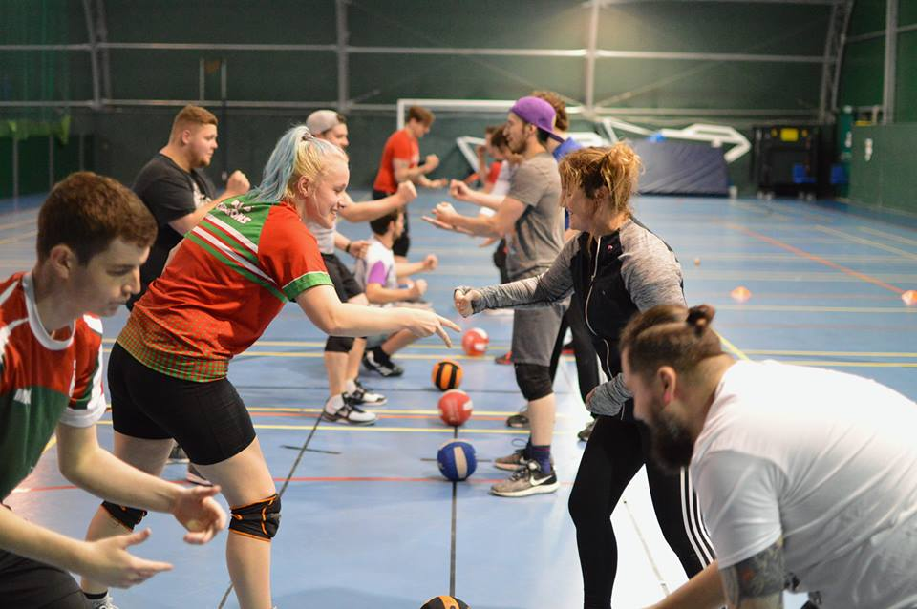
Rules and example
There are 5 balls in a game.
6 players on each team and 2 teams play against each other.
Aim of the game is to eliminate the opponent or have the most players on the court when the time is up.
Ways to get your opponent out?

Slide 5
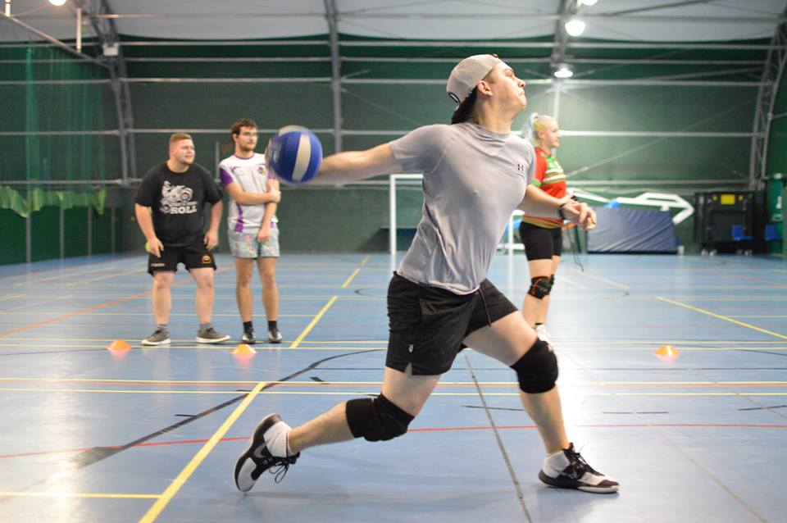
Rules and example
You can throw the ball to hit them.
Anywhere you hit them counts as a hit. (Even your shoe lace)
You can throw the ball anyway you like, just as long as you hit them.

Slide 6
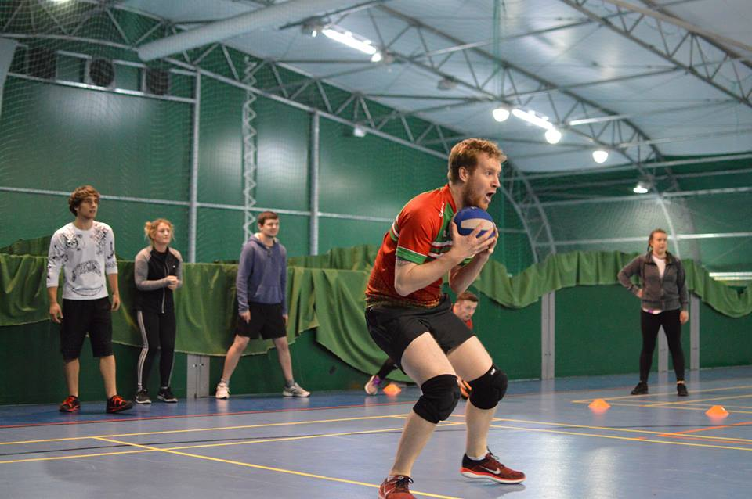
Rules and example
Making a catch.
This means, when a ball is thrown by the opponent and you catch the ball.
You have gotten your opponent out and also brought a player from your team back in.

Slide 7


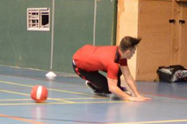
Rules and example
Dodging is a massive part of dodgeball as you have to avoid oncoming balls from hitting you.
There are many different ways of dodging such as, jumping, diving, ducking and many more.

Slide 8

My dodgeball story so far
Start playing for Carmarthen Wizards in December 2016
Playing for 2 years
Playing for Wales since January 2017
Played in 3 international tournaments – European Championships twice
Played in Northern European Championship once
Received MVP for women's in the Italian Euros (2018)

Slide 9
Dodgeball and professional skills development
Professional skills are often not taught through coursework required to earn a degree or masters but are skills such as leadership, mentoring, project management and conflict resolution which are vital skills to any career according to University of Nebraska-Lincoln (2018).
Within dodgeball many of these skills are needed to be a successful dodgeball player.
For example:
Communication
Problem Solving
Coaching others
Leadership skills
Critical thinking

Slide 10
Sports with skills development and importance
Any sport with the same skills needed in dodgeball are important for gaining skills that may be required for different career choices.
Also, sport has been suggested to be able to reduce stress and that physical activity is healthy not only physically but for the mind as well. This was found in a survey done by American Psychological Association in 2007 and 2008.
Being less stressed is important to be living a healthier lifestyle and be able to focus on your career aspects.
Physical activity and sports are being reduced in certain countries like the USA and are even completely eradicated due to budget concerns (Robert Wood Johnson Foundation, 2007).

Slide 11
Summary
Dodgeball, sports and physical activity are vital for keeping a healthy lifestyle in regards to physical health, mental health and requiring important skills.
Dodgeball is a super fun form of learning new skills and keeping fit at the same time.
Personally, dodgeball has done wonders in helping me gain these important skills that I have already used in my current job and different life situations.

Slide 12
Reference list
Anxiety and Depression Association of America. (2010-2018). Physical activity reduces stress. Retrieved from https://adaa.org/understanding-anxiety/related-illnesses/other-related-conditions/stress/physical-activity-reduces-st
Rebounderz.(2017, May 15th).Where did dodgeball start? A brief history. Retreived from https://www.rebounderz.com/lansdale/where-did-dodgeball-start-a-brief-history-lesson/
Robert Wood Johnson Foundation. (2007). Active Education. Retrieved from https://folio.iupui.edu/bitstream/handle/10244/587/Active_Ed.pdf?sequence=2
University of Nebraska-Lincoln. (2018). Professional Skills. Retrieved from https://www.unl.edu/gradstudies/current/development/professional-skills-building-your-vita-0

