Slide 1
Global Business Environment
Lecturer: Dr. Rexon Nting
Name: Luca Gerardi
Student ID: 2219573

Slide 2

Global Business Environment

Slide 3

Task 2
Introduction
Cambodia market is the 103th largest market in the World Economy Scene.
The Luxottica company is aiming to establish its business in the Cambodian market
The presentation is associated with the overall strategies that would be adopted by Luxottica
Notes:
Cambodian market is the 103th largest market in World Economy Scene. The Luxottica company is aiming to establish its business in the Cambodian market as it tends to provide international businesses with ample opportunities to enhance their business. The presentation is associated with the overall strategies that would be adopted by Luxottica to establish its market in Cambodia. The key issues that are associated with the desired market will be explained along with key opportunities. The key challenges in successfully expanding its market in Cambodian will be discussed along with the limitation associated with the market.

Slide 4
Discussion:
Cambodian market is the 103th largest market in World Economy Scene. The Luxottica company is aiming to establish its business in the Cambodian market as it tends to provide international businesses with ample opportunities to enhance their business. The presentation is associated with the overall strategies that would be adopted by Luxottica to establish its market in Cambodia. The key issues that are associated with the desired market will be explained along with key opportunities. The key challenges in successfully expanding its market in Cambodian will be discussed along with the limitation associated with the market.

Slide 5
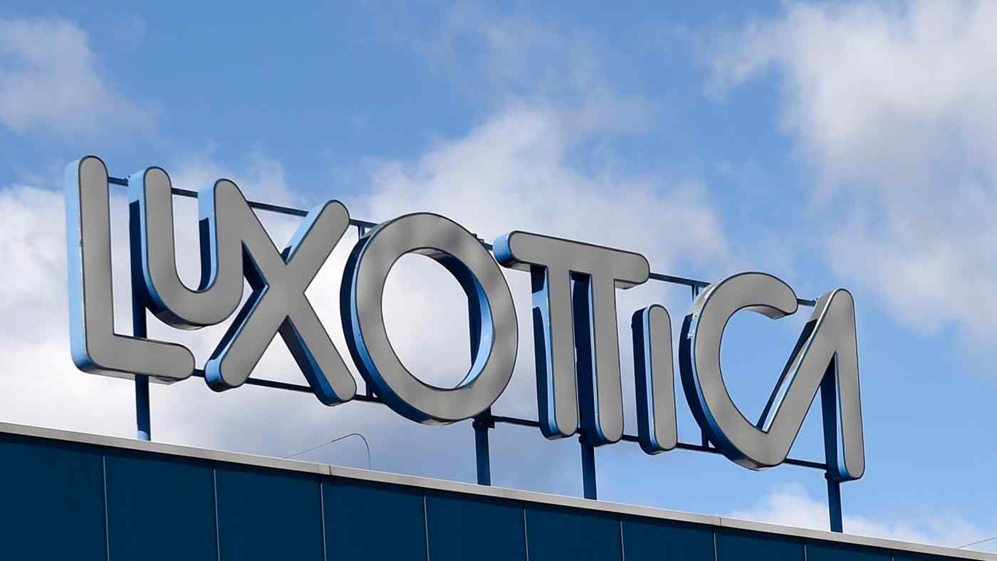
Description of the Poland market
Cambodia is located in the South Area in Asia
Luxottica is planning to expand its market in Cambodia market.
Cambodia is a developing country which is regarded as the 103th largest economy
Notes:
Cambodia market is the 103th largest market in the World. As Cambodia is located in the south Area of Asia,with coasts facing the Indian Ocean it tends to provide industries with business opportunities. Luxottica deals with eyewear products are planning to expand its market in Cambodia market. As Cambodia is a developing country which is regarded as the 103th largest economy, it offers various business opportunities for companies to enhance their business. Cambodia represents unique opportunities for global business as it continuous growth during 2019 has grabbed the attention of most international businesses.

Slide 6
Discussion:
As Cambodia is located in the south Area of Asia,with coasts facing the Indian Ocean it tends to provide industries with business opportunities. Luxottica deals with eyewear products are planning to expand its market in Cambodia market. As Cambodia is a developing country which is regarded as the 103th largest economy, it offers various business opportunities for companies to enhance their business. Cambodia represents unique opportunities for global business as it continuous growth during 2019 has grabbed the attention of most international businesses.

Slide 7

Key points/issues of the desired market
Key issues are the tax regulations, HR, local culture and credit sourcing.
Flexibility on Contract and HR Situation.
Luxottica must maintain a proper HR rule for its employees.
Notes:
The key points and issues regarding the expansion of the Luxottica brand in the Cambodian market are its tax regulations, HR, local culture and credit sourcing. Tax regulation in Poland is levied through both state and central governments. The tax revenue associated with the Poland government deals with the net revenue earned by the individual. As per the HR regulation, Luxottica could build and maintain a proper HR rule for its employees which deals with a light and newly proper contract, terms and remuneration along with compensation amount,attempting and open to new big Investor. In order to maintain its position in the market, Luxottica must consider its culture in its business operation, failing which could hinder the business operations.

Slide 8
Key opportunities of the desired market
key opportunity for Luxottica to expand its business in the Cambodia market is its geographical location.
Its constant economic growth would be the biggest reason for Luxottica.
Its upgrading imports and exports address both valued at 2.8 billion in 2022
Notes:
As it is located in the heart of the Golden Triangle,between Laos,Myanmar and Thailand, it tends to provide global business with ample business opportunities to enhance its business in the Cambodian market. The key opportunity for Luxottica to expand its business in the Cambodian market is its geographical location which tends to provide a strategic benefit along with a quite growing wide population and competitive and new of energy workforce. Its constant economic growth would be the biggest reason for Luxottica to enhance its business in the Cambodia market. Its upgrading imports and exports address both valued at 2.8 billion in 2022. It has a strong domestic labour market and the products and services in Cambodia could be manufactured in the lowest process which could be beneficial for Luxottica.

Slide 9
Discussion:
The key points and issues regarding the expansion of the Luxottica brand in the Cambodian market are its tax regulations, HR, local culture and credit sourcing. Tax regulation in Poland is levied through both state and central governments. The tax revenue associated with the Poland government deals with the net revenue earned by the individual. As per the HR regulation, Luxottica could build and maintain a proper HR rule for its employees which deals with a light and newly proper contract, terms and remuneration along with compensation amount,attempting and open to new big Investor. In order to maintain its position in the market, Luxottica must consider its culture in its business operation, failing which could hinder the business operations.

Slide 10

Key challenges in the desired country of operations
key challenges of Cambodia include rising inflation rates, interest rates and the government raised in the business
it is expected to get impacted by the Ukraine-Russia war
High regulation would impact the business of Luxottica
Notes:
The key challenges of Cambodia include rising inflation rates, interest rates and the government raised in the business as it is expected to get impacted by the Ukraine-Russia war and the world the whole economic situation now days. The rise in the rate of inflation would impact the business operation of Luxottica as it tends to hinder its pricing strategies. It takes a huge amount to expand the business in the global market as it is associated with the complete establishment of the operations (Kano, 2018). Due to the rise in inflation, Luxottica would get impacted as it could hamper its business operations along with its pricing strategy. The not High regulation would impact the business as it needs to consider various regulations related to employees and business which would replenish and acting as lenitive its company policy. Local culture, on the other hand, would be damaging as the people of Cambodia are proud of their culture which must be considered by Luxottica.

Slide 11
Discussion:
The key challenges of Cambodia include rising inflation rates, interest rates and the government raised in the business as it is expected to get impacted by the Ukraine-Russia war and the world the whole economic situation now days. The rise in the rate of inflation would impact the business operation of Luxottica as it tends to hinder its pricing strategies. It takes a huge amount to expand the business in the global market as it is associated with the complete establishment of the operations (Kano, 2018). Due to the rise in inflation, Luxottica would get impacted as it could hamper its business operations along with its pricing strategy. The not High regulation would impact the business as it needs to consider various regulations related to employees and business which would replenish and acting as lenitive its company policy. Local culture, on the other hand, would be damaging as the people of Cambodia are proud of their culture which must be considered by Luxottica.

Slide 12

Challenges and limitations of Luxottica
Key limitation and challenges include sustainable development and HR regulations.
Cambodian lacks sustainable practices.
The HR regulation could hamper the business of Luxottica.
Notes:
The challenges that would be faced by the Luxottica company while implementing the business in Cambodia include sustainable development and HR regulations. Sustainable development in the Cambodia market would be difficult as the country lacks the initiative regarding sustainable practices Most of the companies are adopting sustainability in their business operation as it is being widely accepted by their customers, .The next challenge that could be faced by Luxottica is that of HR regulations that deal with facilitating its employees with various aspects of the job which in turn could hamper the company policies. The overall HR regulation in Poland is associated with enhancing its employees' benefits along with providing them with proper contracts and remunerations which in turn could be costlier for Luxottica.

Slide 13
Discussion:
The challenges that would be faced by the Luxottica company while implementing the business in Cambodia include sustainable development and HR regulations. Sustainable development in the Cambodia market would be difficult as the country lacks the initiative regarding sustainable practices Most of the companies are adopting sustainability in their business operation as it is being widely accepted by their customers, .The next challenge that could be faced by Luxottica is that of HR regulations that deal with facilitating its employees with various aspects of the job which in turn could hamper the company policies. The overall HR regulation in Poland is associated with enhancing its employees' benefits along with providing them with proper contracts and remunerations which in turn could be costlier for Luxottica.

Slide 14

Recommendation
Luxottica could conduct thorough research
It must consider the culture of Poland to enhance its strategy
The company must build an effective strategy to deal with the HR regulations
Notes:
Luxottica could conduct thorough research on the Cambodia market to enhance its execution in the market. The company must consider the culture of Cambodian people to enhance its strategy to establish its market . The company must build an effective strategy to deal with the HR regulations of Cambodia and main Government affiliates and branches to deal with the HR issues. It could acquire local partners or local representatives to expand its business; they are more aware of the issues that would hamper the business operation along with the key challenges and issues. As and poor country the meeting and the bet of growing there their proper business could be an easy winning.After the Pol Pot Era The Country will be open to changes.” Abandon hope all ye who enter here”(Dante 1320)

Slide 15
Discussion:
Luxottica could conduct thorough research on the Cambodia market to enhance its execution in the market. The company must consider the culture of Cambodian people to enhance its strategy to establish its market . The company must build an effective strategy to deal with the HR regulations of Cambodia and main Government affiliates and branches to deal with the HR issues. It could acquire local partners or local representatives to expand its business; they are more aware of the issues that would hamper the business operation along with the key challenges and issues. As and poor country the meeting and the bet of growing there their proper business could be an easy winning.After the Pol Pot Era The Country will be open to changes.” Abandon hope all ye who enter here”(Dante 1320)

Slide 16

Conclusion
The presentation is associated with the overall strategies adopted by Luxottica.
The key issues has been analysed.
The key challenges has been evaluated.
Lastly recommendation has been provided.
Notes:
The presentation is associated with the overall strategies that would be adopted by Luxottica to establish its market in Poland. The key issues that are associated with the desired market have been explained which include tax regulation and HR regulations. The key opportunities that are present in the Cambodian have been explained. The key challenges in successfully expanding its market in Poland has been discusses along with the limitation associated with the market.

Slide 17
Discussion:
The presentation is associated with the overall strategies that would be adopted by Luxottica to establish its market in Poland. The key issues that are associated with the desired market have been explained which include tax regulation and HR regulations. The key opportunities that are present in the Cambodian have been explained. The key challenges in successfully expanding its market in Poland has been discusses along with the limitation associated with the market.

Slide 18
References
Kano, L., 2018. Global value chain governance: A relational perspective. Journal of International Business Studies, 49(6), pp.684-705.
Dante Alighieri,The Divine Commedy, 1320. XIV verse, 3rd Chant

Slide 19
QUESTIONS?

Slide 20
Thank you

