Slide 1




HYPNOTHERAPY
1810991 NAAZNEEN ARA
1809605 HARUN BOKSH
1810818 MUHAMMAD BELAL AHMED.
1810819 FERDOUS JESI.
1809620 RASHID KHAN
Lecturer : Dr Mark Gallagher Read

Slide 2

INTRODUCTION TO HYPNOTHERAPY
What is hypnotherapy?
Who uses it?
What happens in a hypnotherapy session?
(Hypnotherapy | Psychology Today UK, 2020)

Slide 3

A Brief History On Hypnotherapy
By Harun Boksh
z
Ancient Times-Sleep & Dream Temples
India
Egypt
Greece
Rome
(Hammond, 2013)

Slide 4

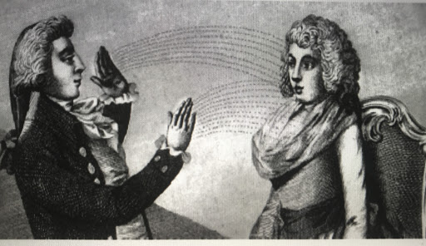
A Brief History On Hypnotherapy
By Harun Boksh
Early European Times
Hypnosis Gains credibility in the 19th century
Paracleus
Valentine Greatrakes
Dr. Franz Anton Mesmer
Dr. James Braid
(Hammond, 2013)

Slide 5

Benefits of Hypnotherapy
Help you to stop smoking
reduces Chronic pain
Reduces anxiety with relaxation techniques
promotes Weight loss
Helps with insomnia
(Top ten benefits of hypnotherapy - Hypnotherapy Directory, 2020)
This Photo by Unknown Author is licensed under CC BY-NC

Slide 6


Complications (cons) of Hypnotherapy
SHORT LIVED SIDE EFFECTS
Headaches
Drowsiness
Dizziness
Anxiety or distress
Creation of false memories
MORE SERIOUS EFFECTS
Creates false memories (confabulations)
People suffering from delusions, hallucinations or psychotic symptoms may not be the best candidate for this treatment.
(Possible Dangers and Complications, 2020)

Slide 7

Hypnotherapy compared to other therapies
COGNATIVE BEHAVIORAL THERAPY (CBT)
Smoking
Depression
Phobia
Anxiety
(Davis and Davis, 2020)

Slide 8

THE OVERALL EFFECTIVENESS OF HYPNOTHERAPY
Current literature on the hypnotherapy
(Lynn, S.J., Rhue J.W., & Kirsch, I. (Eds.) (20101).Handbook of Clinical Hypnosis (2nd ed.). Washington D.C.: American Psychological Association. Reviewed by Akira Otani, Ed.D., ABPH, Spectrum Behavioral Health, Annapolis MD, 2011)

Slide 9

References
American Journal of Clinical Hypnosis, 2011. Lynn, S.J., Rhue J.W., & Kirsch, I. (Eds.) (20101).Handbook of Clinical Hypnosis (2nd ed.). Washington D.C.: American Psychological Association. Reviewed by Akira Otani, Ed.D., ABPH, Spectrum Behavioral Health, Annapolis MD. 53(3), pp.231-234.
Brooksidecenter.com. 2020. Possible Dangers And Complications. [online] Available at: <https://www.brooksidecenter.com/possible_dangers_and_complicatio.htm> [Accessed 19 June 2020].
Davis, M. and Davis, M., 2020. Hypnosis And CBT - A Perfect Combination - The UK College Of Hypnosis And Hypnotherapy - Hypnotherapy Training Courses. [online] The UK College of Hypnosis and Hypnotherapy - Hypnotherapy Training Courses. Available at: <https://www.ukhypnosis.com/2019/02/18/hypnosis-and-cbt-a-perfect-combination/> [Accessed 19 June 2020].
Hammond, D (2013). A Review Of The History Of Hypnosis Through The Late 19Th Century. The American journal of clinical hypnosis.
Hypnotherapy-directory.org.uk. 2020. Top Ten Benefits Of Hypnotherapy - Hypnotherapy Directory. [online] Available at: <https://www.hypnotherapy-directory.org.uk/memberarticles/top-ten-benefits-of-hypnotherapy> [Accessed 19 June 2020].
Psychology Today. 2020. Hypnotherapy | Psychology Today UK. [online] Available at: <https://www.psychologytoday.com/gb/therapy-types/hypnotherapy> [Accessed 19 June 2020].

