Slide 1

Effective Teamwork
Presentation by SAM LLOYD

Slide 2
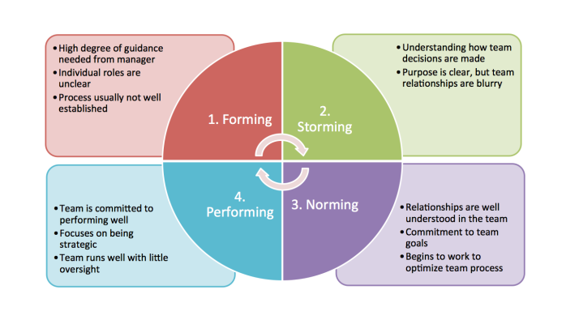
Tuckman’s Model of teamwork
(Carter, 2014)

Slide 3
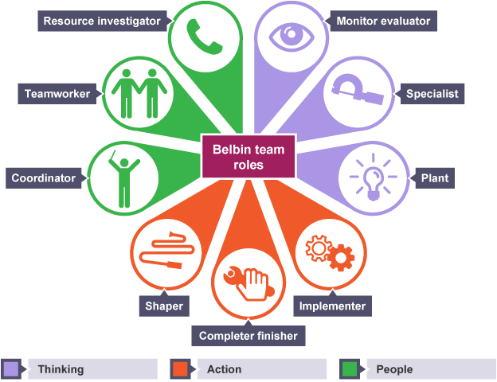
Belbin’s Team Roles
(Nguyen, 2017)

Slide 4
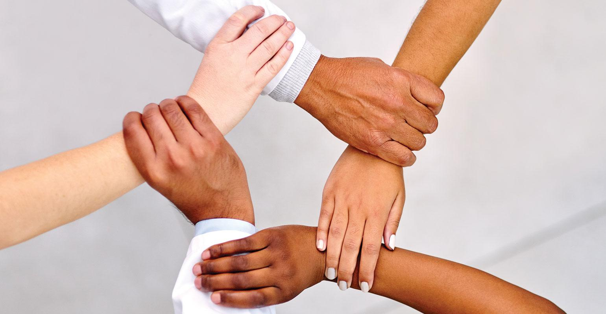
- Trust
Key behaviours in a team
- Conflict
- Commitment
- Accountability
- Results

Slide 5
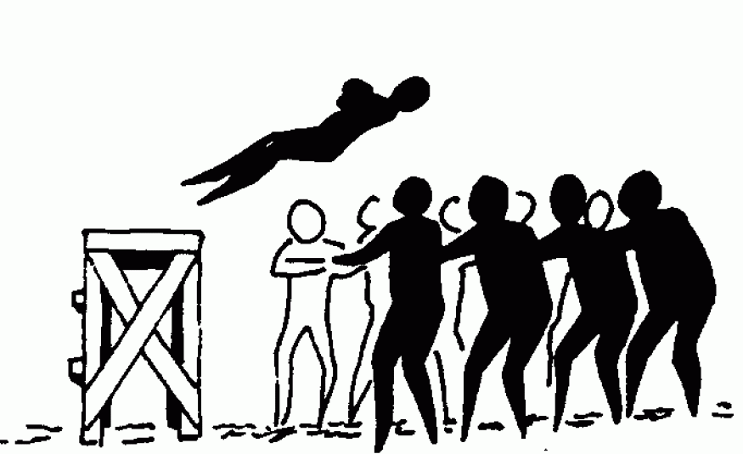
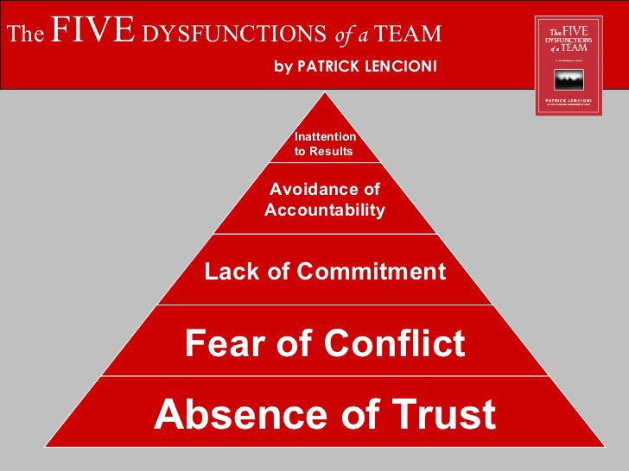
Trust: Why is trust important?
(Verandermanagement, 2013)
(Enwall, 2018)

Slide 6
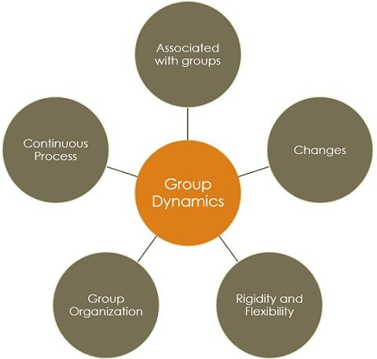
Group dynamics
(Business Jargons , 2021)

Slide 7
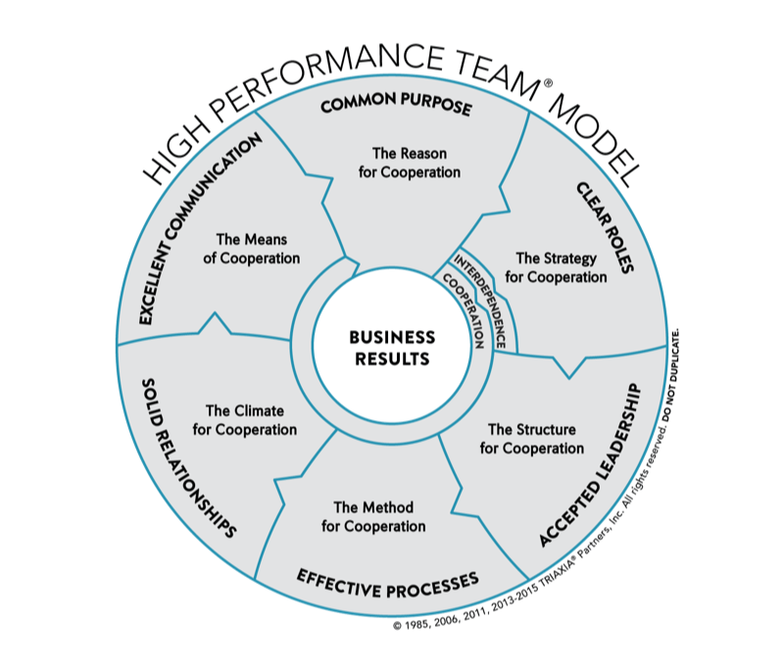
High performance teams
(Monga, 2017)

Slide 8
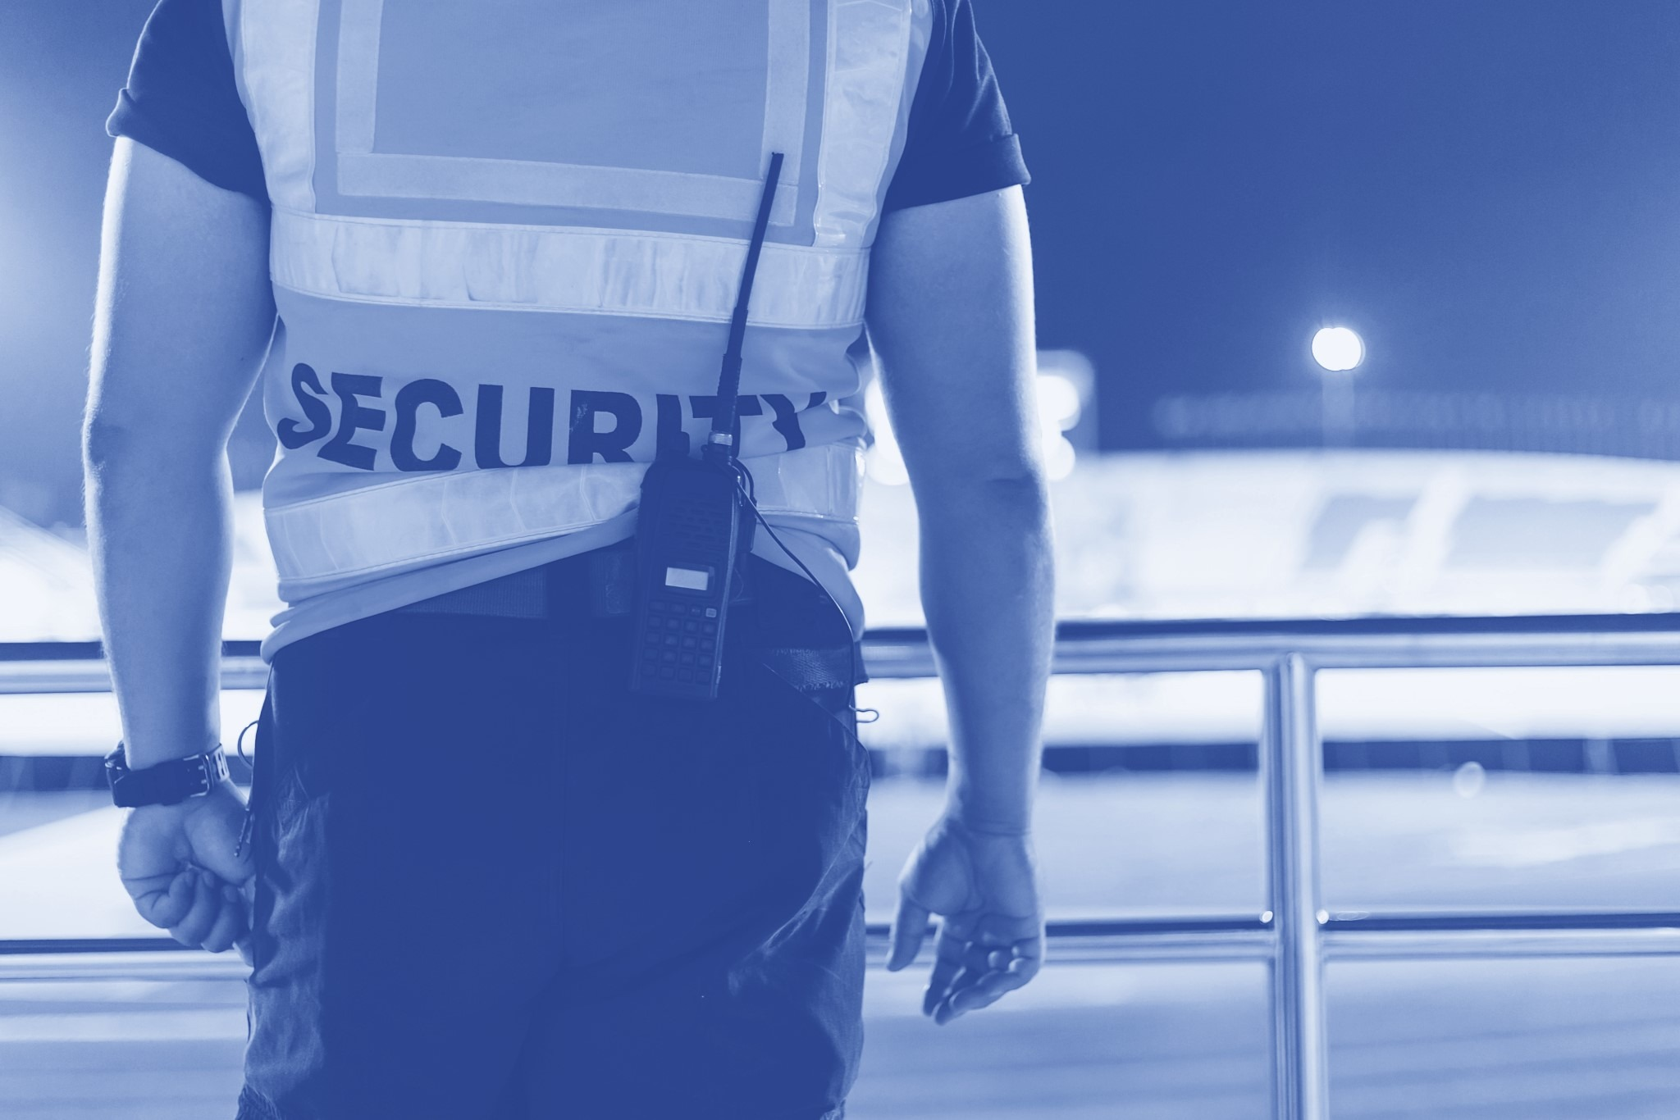
Teamwork in the security industry

Slide 9
References
Business Jargons , 2021. Business Jargons. [Online]
Available at: https://businessjargons.com/group-dynamics.html
[Accessed 16 05 2021].
Carter, J., 2014. Tuckman’s Model – Forming, Storming, Norming, Performing. [Online]
Available at: https://www.teambuildingactivity.com/tuckmans-model/
[Accessed 15 05 2021].
Enwall, T., 2018. On Leadership: Why building trust is the core of every successful team. [Online]
Available at: https://medium.com/@tenwall/on-leadership-why-building-trust-is-the-core-of-every-successful-team-a00573fca628
[Accessed 16 05 2021].
Monga, B., 2017. High Performing Teams: What Are They and How Do I Build One?. [Online]
Available at: https://activecollab.com/blog/collaboration/high-performing-teams
[Accessed 17 05 2021].
Nguyen, M., 2017. Learn Belbin Team Roles through Reflection. [Online]
Available at: https://dotnetsharing.wordpress.com/2017/09/19/learn-belbin-team-roles-through-reflection/
[Accessed 15 05 2021].
Verandermanagement, 2013. Teamwork and the Importance of Trust. [Online]
Available at: https://www.mudamasters.com/en/verandermanagement/teamwork-and-importance-trust
[Accessed 16 05 2021].

Slide 10
Any Questions?

