Slide 1



ECIE 6004. Global perspectives in education presentation.
By Jessica George (1804786)
Emma Freeman (1808580)
Richard Davies (1806173).

Slide 2
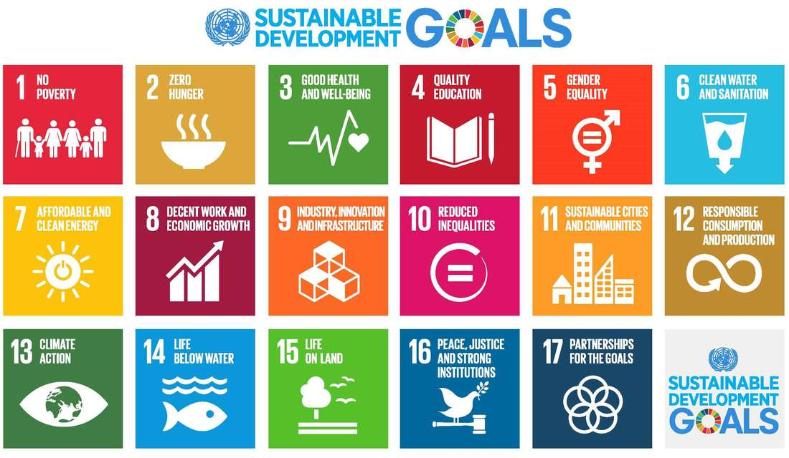
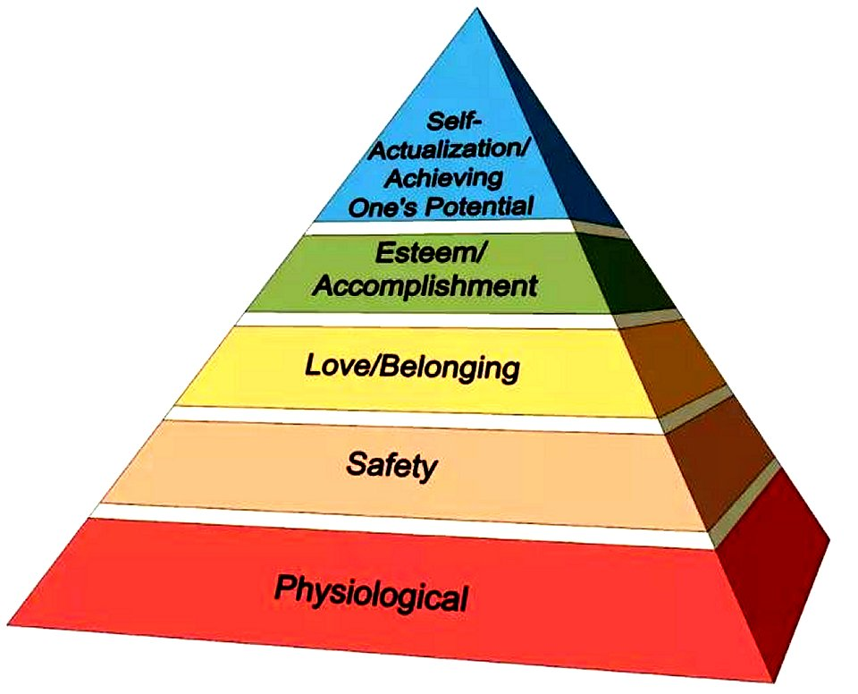
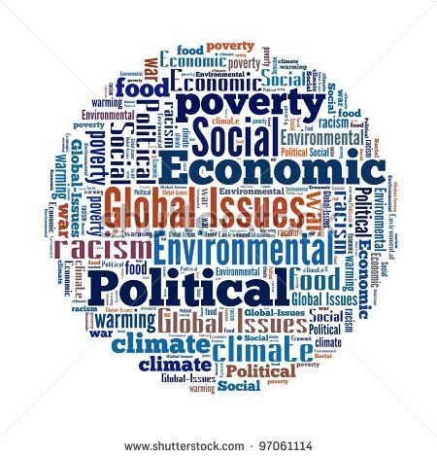
Global issues: Maslow's Hierarchy of Needs Theory show you need your physical and psychological needs met to reach your full potential such as food, safety and to be free from fear (Bates, 2019).
(Weebly, 2015).
Global issues include food insecurity, hunger, war, climate change, poverty reduction, and covid 19 response and recovery. Also, social injustice, child labour, child trafficking, child marriage, gender equality and the rights of girls and women are global issues (Brown, 2021).
(Pin Interest 2015).
(Shutterstock.com, 2015)

Slide 3
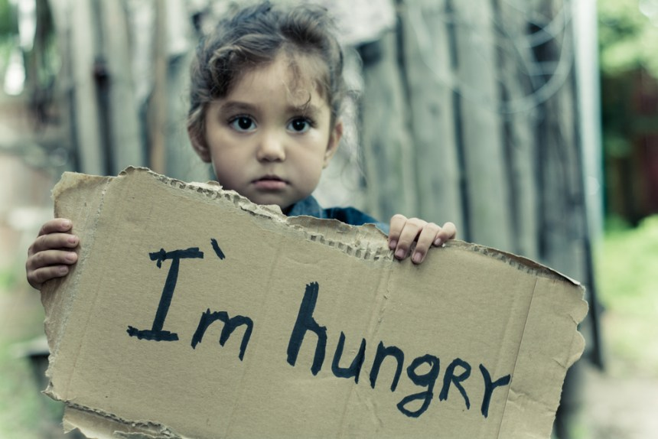
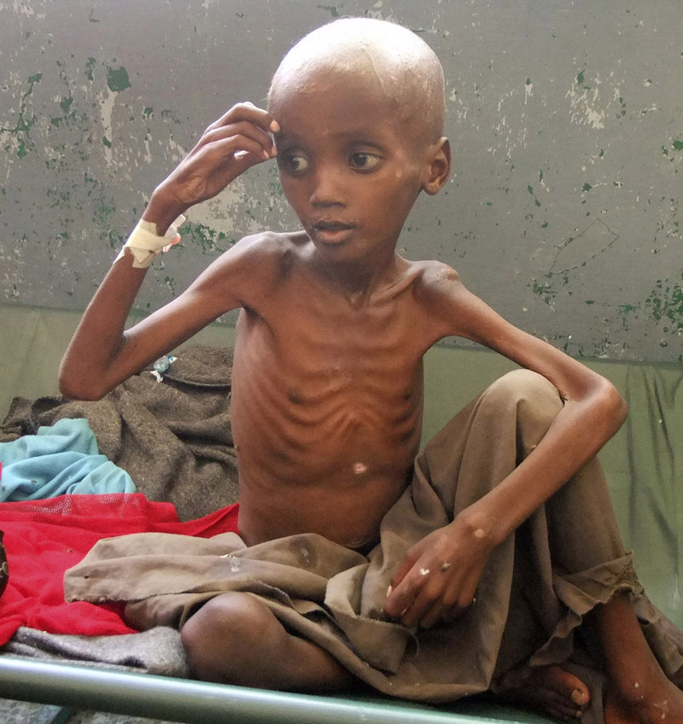
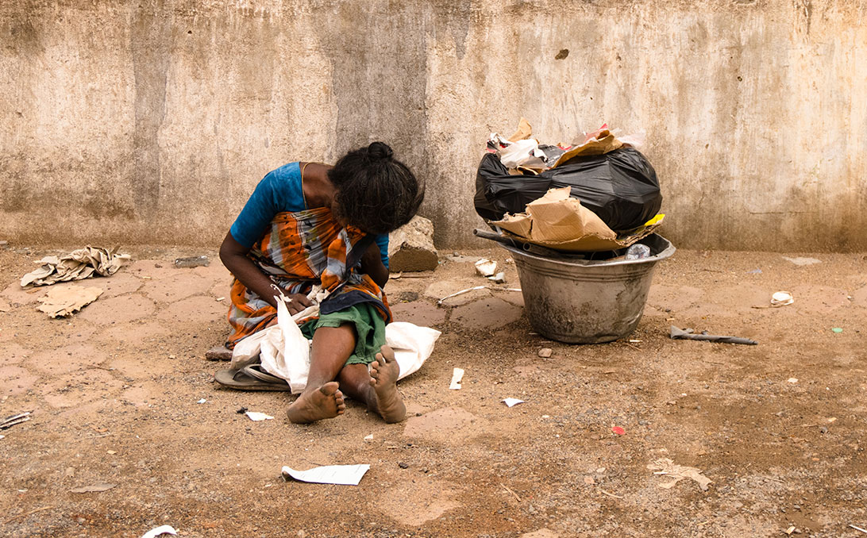
(Porras, 2020).
(Okafor, 2018).
(Unicef,2020).
Because of poverty and the pandemic there is conflict, loss of jobs, lack of food and people starving. Global hunger stands at 820 million (Mercy Corps, 2020)
"Countries bearing the greatest burdens and setbacks are the ones with the lowest budget, resources to respond and often have high debt" (Brown, 2021, p.1).
The Covid -19 pandemic has caused havoc to the effort to combat poverty.
Health service and education has been interrupted or completely disappeared, inequality has worsened (Brown, 2021).

Slide 4
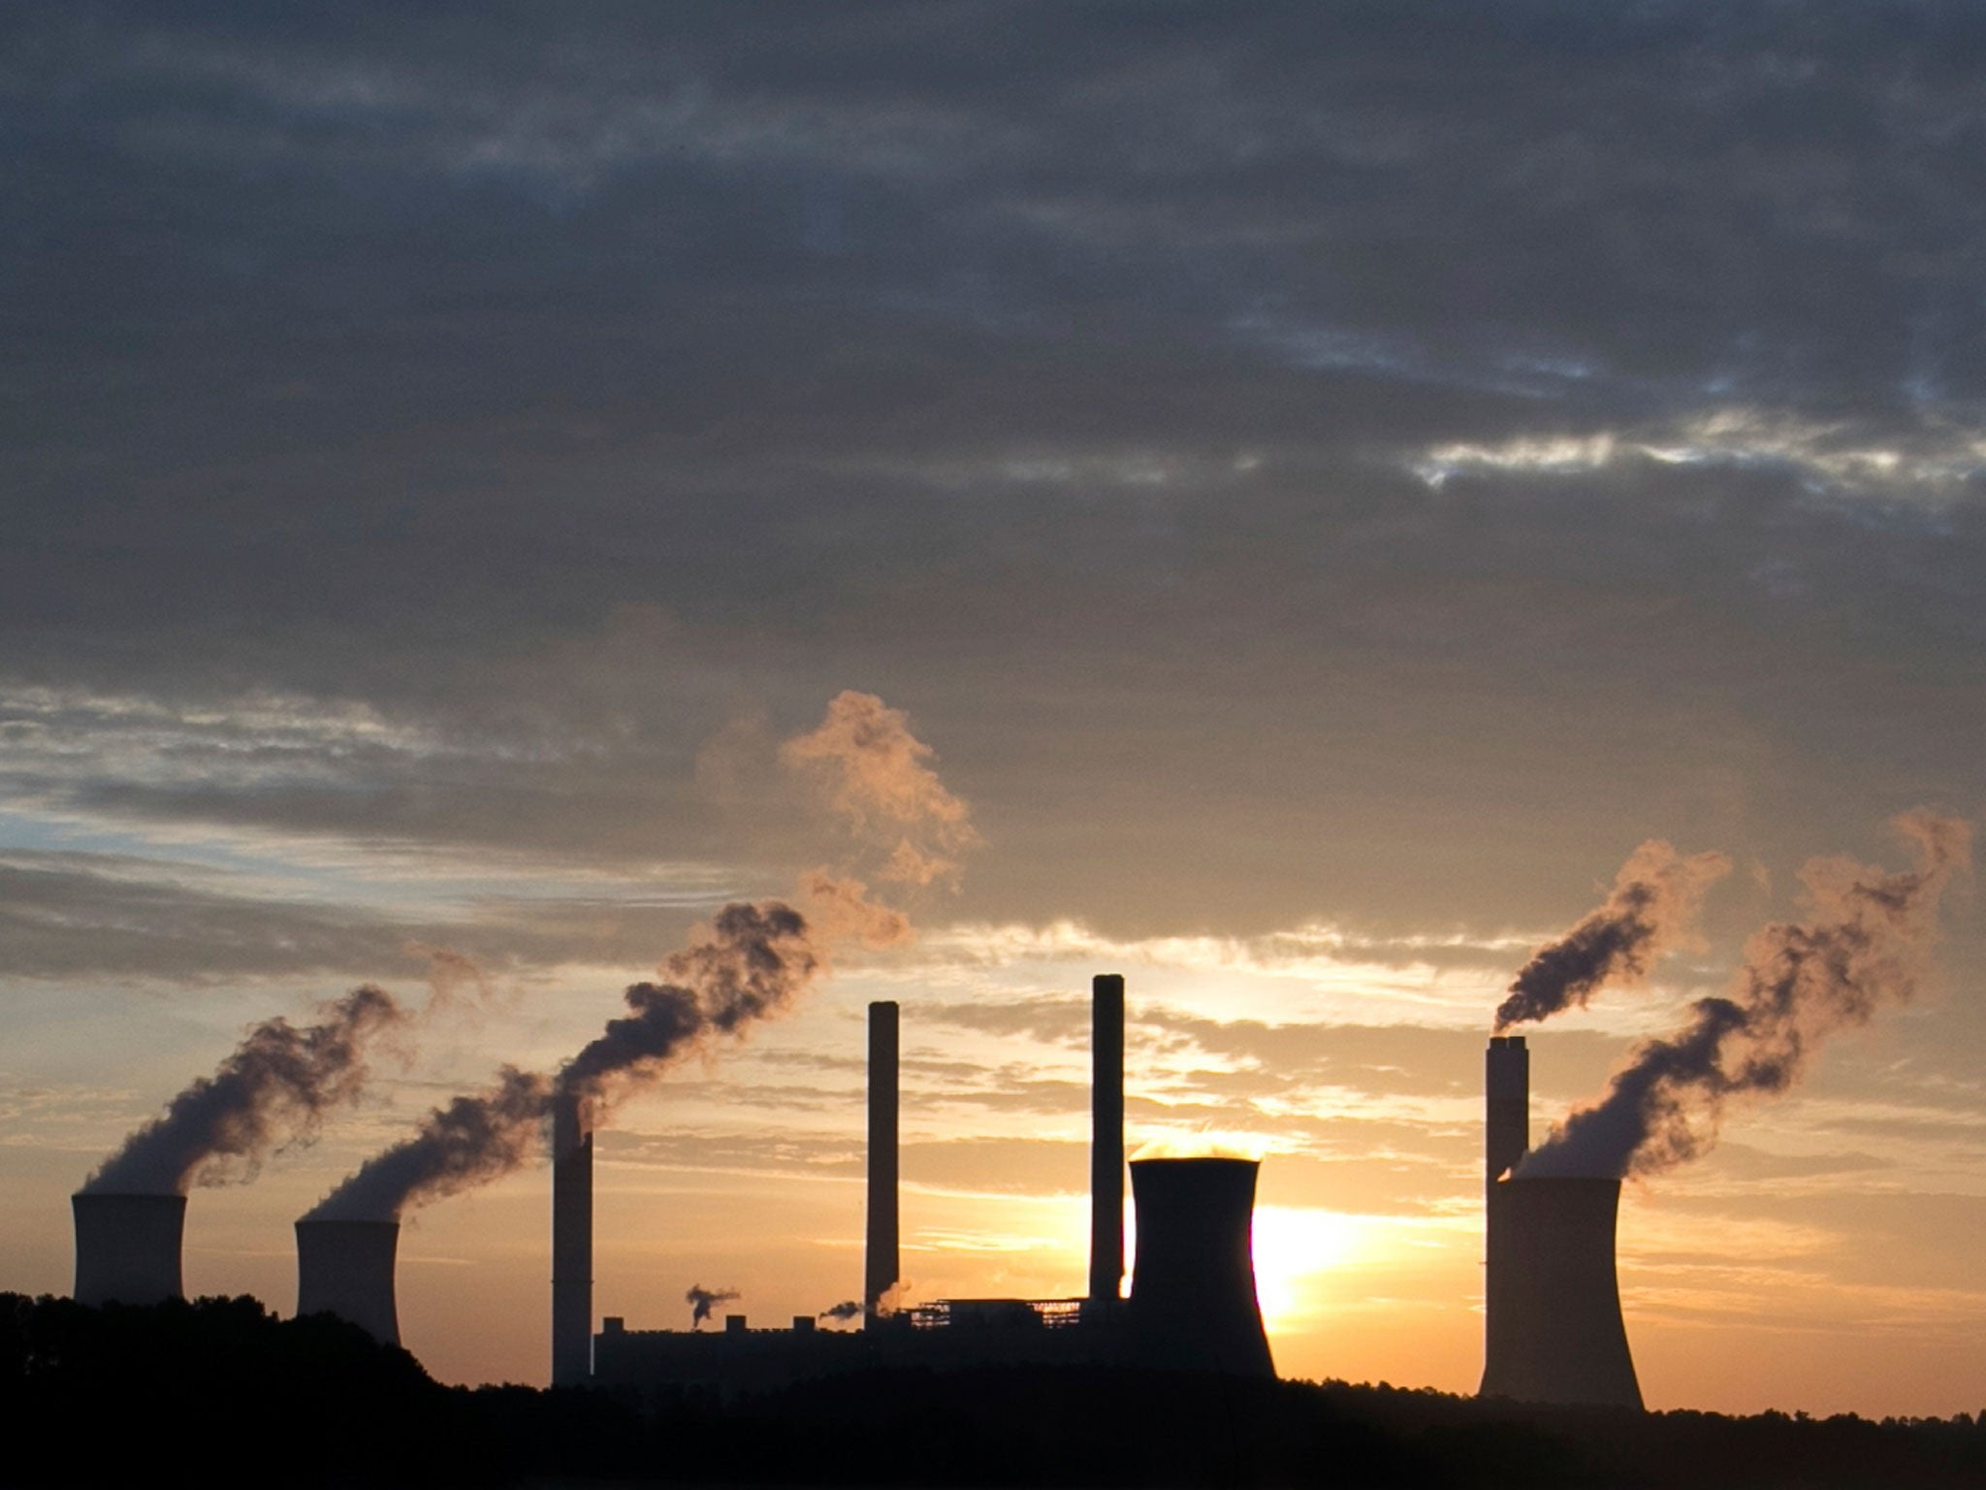
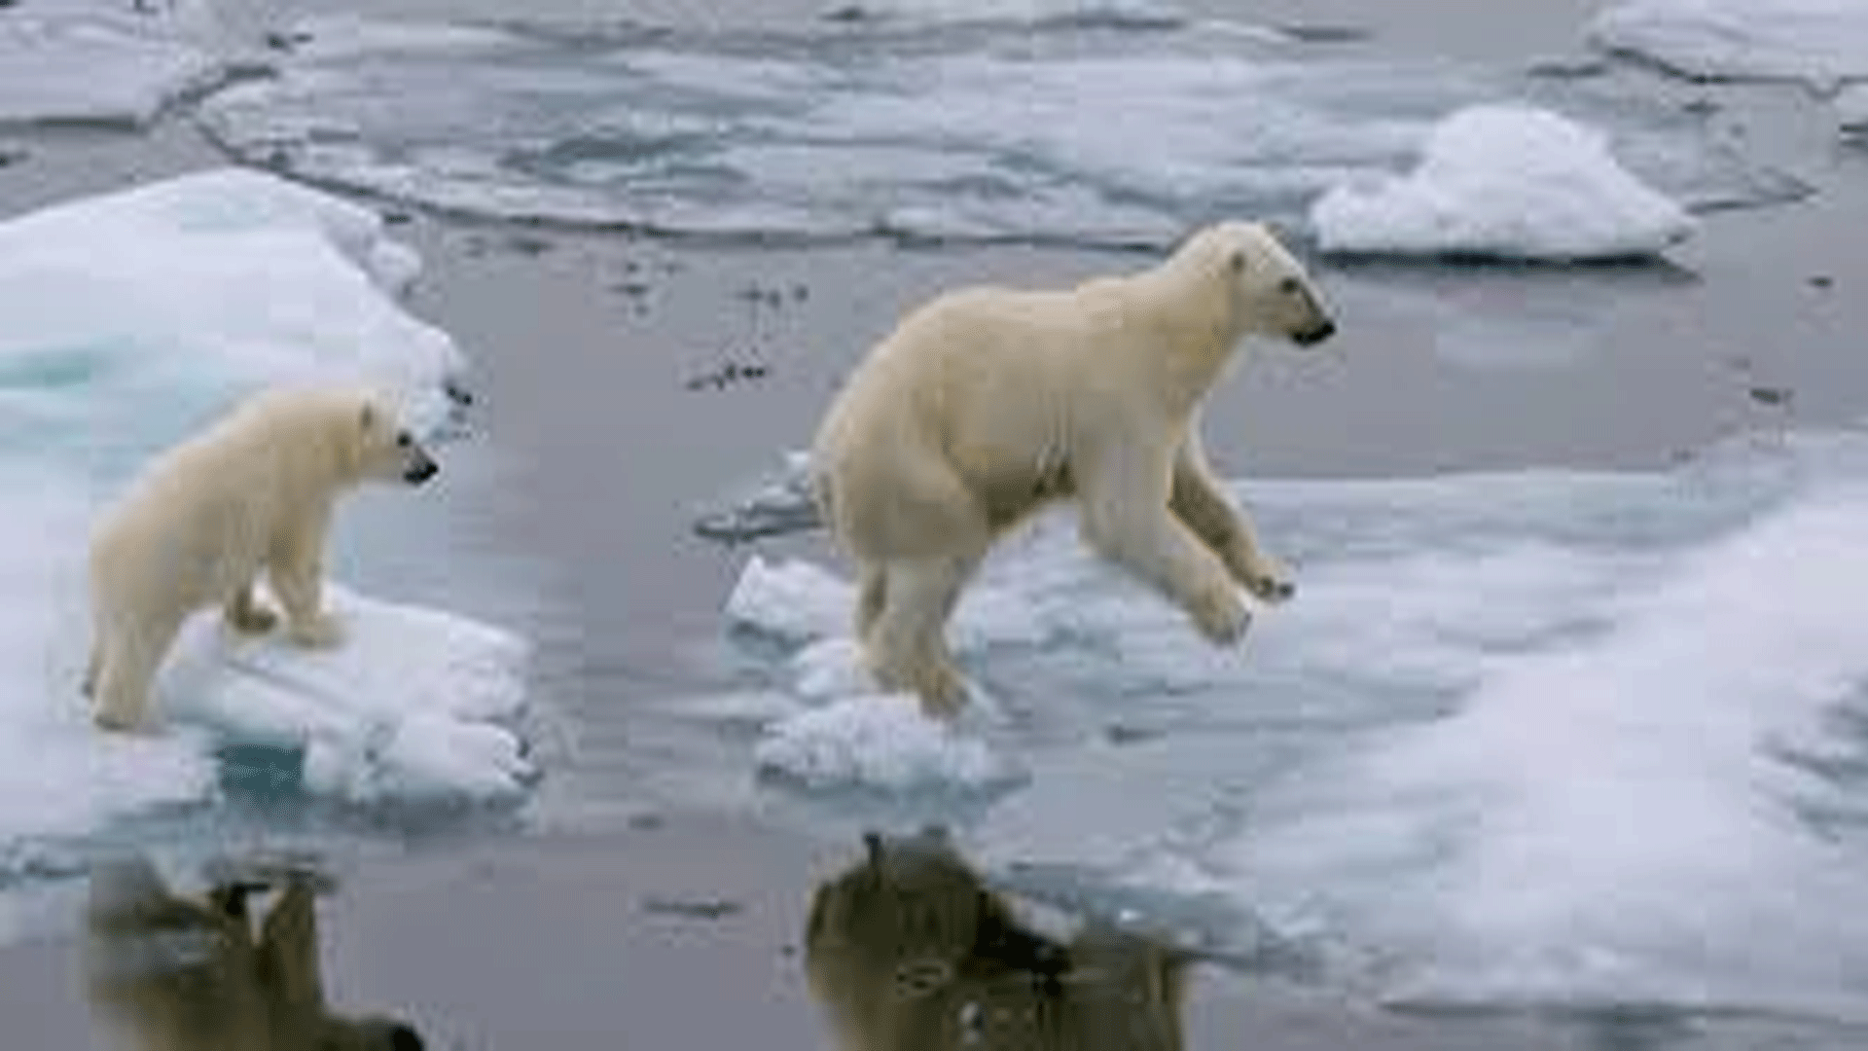
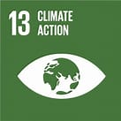
(Alternative Resources
Directory, 2018).
(Reddit, 2018)
Climate change is affecting every country; it affects lives. Weather patterns are changing, and sea levels are rising.
Land and ocean temperature has increased by 0.13°F per decade (Lindsey and Dahlman, 2021).
The travel ban has seen some improvements, but emissions are likely to return higher now travel has resumed (United Nations, 2020).
The 2015 climate change conference agreed to limit global temperature rise to 1.5°C and address: methylene gas, pollution, deforestation, coal financing, and shipping (United Nations Climate Change, 2018).
Investors continue to commit to reaching net-zero balancing greenhouse gas with equivalent emissions from the atmosphere (Brown 2021).
(United Nations,
2020).

Slide 5
References:
Alternative Resources Directory. (2018) Available at: www.alternativeresourcesdirectory.com. (Accessed: 4/2/22).
Bates, B. (2019) LEARNING THEORIES SIMPLIFIED. 2nd EDN. SAGE: London.
Brown, K. (2021) Global issues to watch in 2022. United Nation Foundation. Available at: www.unfoundation.org (Accessed: 26/1/2022).
Linsey, R and Dhalman, L. (2021) Climate Change: Global Temperature. Available at: www.climate.gov (Accessed: 10/2/2022).
Mercy Corps. (2020) The facts: What you need to know about global hunger. Available at: www.europe.mercycorps.org/en-gb/blog/quick-facts-global-hunger [Accessed 9 February 2022].
Okafor. (2018) Data shows child malnutrition “getting worse”. News Express Nigeria Global Voice. Available at: www.newsexpressngr.com. (Accessed: 1/2/2022.
Pin Interest (2015) These are the leading Global issues of our modern world. Available at: www.pininterest.com (Accessed: 28/1/2022).
Porras, B. (2020) Poverty and Covid-19. Available at: www.ie.edu/building-resilience/knowledge/poverty-covid-19/ (Accessed: 30th January 2022).
Reddit. (2018) World has THREE YEARS to prevent dangerous climate change. Available at: www.bing.com (Accessed: 30/1/2022).
Shutterstock.com (2015) available at: www.shutterstock.com (Accessed: 4/2/22).
Unicef. (2020) Un convention on the rights of the child - Article 27. Available at: www.unicef.org.uk (Accessed 5/2/22).
Unicef. (2020) Unicef food appeal – help deliver food to children. Available at: www.unicef.org.uk/nutrition/donate. (Accessed: 29/1/2022).
United Nations. (2020) Goal 13 take urgent action to combat climate change and its impacts. Available at: www.un.org/sustainabledevelopment/climate-change/ (Accessed: 31st of January 2022)
United Nations Climate Change. (2018) The Paris Agreement. Available at: www.unfccc.int (Accessed: 10/2/22).
Weebly. (2015) Global issues of the 21st Century – Global Leadership Seminar. Available at: www.globalseminar.weebly.com (Accessed 25/1/2022).

