Slide 1
A First Look At Views and Controllers
Lecture 3: Web Development: ASP.NET (WD DotNet)
Dr Kemi Ademoye

Slide 2
Today’s Lecture
Controllers
Views
  Razor View Engine
  HTML Helper Methods

Slide 3
Question
In a Web Application, what is the difference between a Post and Get HTTP Request?
Use Google to find out “What is a friendly URL?”

Slide 4
ASP.NET MVC Routing
Determines how .NET matches URL requests to controllers and actions in your application.
Routes are friendly URL patterns comprised of:
  Controller/Action/Id
  Controller
  Action Values
    Actions are methods in the controllers
You can also have an Area in the URL route.
  Areas are subsites within an MVC site

Slide 5
Routing in ASP.NET
For example, consider a request for:
  http://website.com/Product/Edit/5
The routing engine selects:
  The Product controller class
  The Edit action method in Product controller
  Passes the ID value, 5, to the Edit action.
Some more examples:
  http://localhost:49831/Employee/
  http://localhost:49831/Manager/List
  http://localhost:49831/Manager/Details/2

Slide 6
A Typical Data Model Controller
A typical data application controller will contain action methods for the four standard CRUD operations:
Create:
  GET: Create() – gets a blank data model to present in the view.
  POST: Create([Bind(model post data)]) – posts the new input data received from the view to data source.
Read:
  GET: Index() – gets all the items in the data model source to present in the view.
  GET: Details(int? id) – gets the details of the data item with the specified id to present in the view.

Slide 7
A Typical Data Model Controller
Update:
  GET: Edit(int? id) – gets the data item to edit, using the specified id, to present in the view.
  POST: Edit([Bind(model post data)]) – posts the edited data received from the view to the data source.
Delete:
  GET: Delete(int? id) – gets the data item to delete using the specified id to present for confirmation in the view.
  POST: DeleteConfirmed(int id) – posts the confirmed delete request of the data item to the data source.

Slide 8
Controller Action Method Results
Typically return an:
  IActionResult
  Task<IActionResult> (for asynchronous operations)
IActionResult is an interface that you can then encapsulate (enclose) the result type of interest.
The response from the controller method is typically:
  Normal HTTP Status Codes (Ok, Not Found, etc.)
  Data
You can also have redirect results: redirects user to another route.

Slide 9
Demo
Scaffolding a controller and a view

Slide 10
Exercise
Study the default views created.
What is wrong with them?
What marks do you think you will get in your assignment if this is all you do? ☺

Slide 11
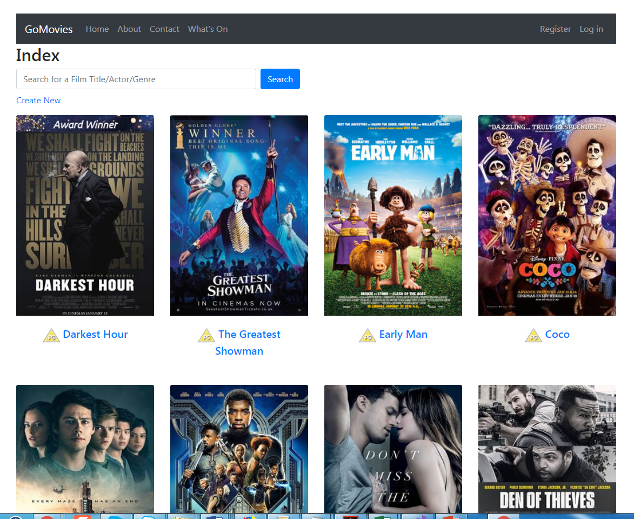
Is this better?

Slide 12
Views
Views are the actual output delivered to the user.
The View Engine is used to generate HTML code from your View and send it to the browser.
There are two main types of View Engines that come with ASP.NET:
  Razor View Engine – we will use this!
  Webforms View Engine
You can use other custom view engines too.

Slide 13
ASP.NET Razor
ASP.NET Razor is a markup language like HTML.
It is a markup syntax that lets you embed server-based code (e.g. C#) into web pages.
It consists of:
  Razor markup
  C#
  HTML
The server-based code generates dynamic web content on the fly, while the page is being written to the browser.
Notes:
Links:
https://docs.microsoft.com/en-us/aspnet/core/mvc/views/razor
http://www.w3schools.com/asp/razor_intro.asp

Slide 14
ASP.NET Razor
The default Razor language is HTML.
To switch to C# (server-side code), it uses the @ symbol.
  Remember C# code is case-sensitive ☺
For example:
  <p>@Username</p>
  <p>@DateTime.Now</p>
You can also have expressions – you have to enclose these in brackets:
  <p>Last week this time @(DateTime.Now –TimeSpan.FromDays(7))</p>

Slide 15
ASP.NET Razor
You can also have code blocks.
Code statements ends with semi-colons “;”
They start with the @ symbol and the code is enclosed within { … }
For example:
    @{
    var quote = "The future depends on what you do today. - Mahatma Gandhi";
    }
    <p>@quote</p>
In Razor, var (implicit type), is more commonly used to declare variables than explicit types e.g. int.

Slide 16
ASP.NET Razor
Another example of a code block using a server-side for loop to create a list of numbers.
  Standard HTML elements <ul> and <li> are used to generate a HTML list.
  Uses the @ symbol to switch to server-side code to execute the for loop and retrieve the current loop value.
    <ul>
    @for (int i = 1; i < 11; i++)
    {
    <li>@i</li>
    }
    </ul>

Slide 17
Razor Syntax: some more examples
<!-- Single statement block -->
@{ var myMessage = "Hello World"; }
<!-- Inline expression or variable -->
<p>The value of myMessage is: @myMessage</p>
<!-- Multi-statement block -->
@{
string greeting = "Welcome to our site!";
var weekDay = DateTime.Now.DayOfWeek;
var greetingMessage = greeting + " Today is: " + weekDay;
}
<p>The greeting is: @greetingMessage</p>
Notes:
https://www.w3schools.com/asp/razor_syntax.asp

Slide 18
ASP.NET Razor Syntax
Microsoft Docs Razor syntax
W3School’s ASP.NET Razor

Slide 19
Views @model Directive
The first thing you want to specify in a view that is displaying data from a model is:
  What model or viewmodel (later lecture) to use?
You do this using the @model directive.
If you are displaying a single model item (e.g. the details of a single model item), the syntax is:
    @model GoMovies.Data.Entities.Film
You access the current model item using the Model property of the view e.g. Model.Title, Model.Cast
Notes:
IEnumerable<T>: an interface that supports a simple iteration over a generic collection (a specified type – T is the type) of collection. Use if you do not need to modify the list items, you only need to iterate through them.
ICollection<T>: an interface that supports methods to manipulate (sorted, modified, etc.) generic collections.

Slide 20
Views @model Directive
If you are displaying a list of model items, you use the IEnumerable Interface:
    @model IEnumerable<GoMovies.Data.Entities.Film>
You will need to loop through each of the items using a loop. For example:
  @foreach (var item in Model)
  { … }
Note:
  Model refers to the current model the view is bound to.
  IEnumerable only supports traversing the items in the collection.
  You cannot access items using an index as you would do in an array, for example Model[0], so you use the loop variable, item.
Notes:
IEnumerable<T>: an interface that supports a simple iteration over a generic collection (a specified type – T is the type) of collection. Use if you do not need to modify the list items, you only need to iterate through them.
ICollection<T>: an interface that supports methods to manipulate (sorted, modified, etc.) generic collections.

Slide 21
Generating HTML for Views
ASP.NET provides two ways to help you quickly code and generate HTML elements in your view.
  HTML Helpers
    The more traditional approach, but readily available.
    Binds model data to HTML elements.
  Tag Helpers
    Newer approach, but limited set of predefined tags, but you can ‘easily’ create custom tags.
    Supposed to provide a more HTML-friendly development experience than the older, HTML Helpers.

Slide 22
HTML Helpers
HTML Helpers start with the @Html directive and the general syntax is:
    @Html.HelperName(string name, object value, object htmlAttributes)
The parameters are optional, but you will mostly likely need the value at the minimum
  Name: represents the name of the form element in the rendered HTML
  Value: the value of the element (e.g. a model property value)
  htmlAttributes: any additional HTML attributes you want to add to the element e.g. a specific CSS class.
The HelperName is the specific type of HtmlHelper you require e.g. TextBox, ActionLink, RadioButton, etc.
Notes:
http://www.tutorialsteacher.com/mvc/html-helpers
http://www.c-sharpcorner.com/article/html-helpers-in-Asp-Net-mvc/
https://msdn.microsoft.com/en-us/library/system.web.mvc.htmlhelper(v=vs.118).aspx
https://www.codeproject.com/Articles/787320/An-Absolute-Beginners-Tutorial-on-HTML-Helpers-and
https://docs.microsoft.com/en-us/aspnet/mvc/overview/older-versions-1/views/creating-custom-html-helpers-cs

Slide 23
HTML Helpers
There are two types:
Html Helper Methods
Strongly Typed Html Helper Methods
  They are for displaying model data.
  Requires the use of the Lambda expressions I have been avoiding telling you about ☺.

Slide 24
HTML Helper Example: Ordinary
The View specifies that it is using the Student model
  @model Student
Creating a textbox to edit the name using a TextBoxhelper:
@Html.TextBox("StudentName", null, new {@class = "form-control"})
  Binds to a property called StudentName in the model class
    The name and id of this HTML control will also be StudentName.
    If you had wanted to use a different name and id, then you bind the element to the model using the second currently “null” property.
  Defines an additional CSS class “form-control” to use for this element in the HTML.
Outputs the following HTML:
    <input class="form-control" id="StudentName" name="StudentName" type="text" value="" />

Slide 25
Lambda Expressions
A Lambda Expression is an anonymous function.
To create:
(input-parameters) => expression
  Input parameters for the function on the left
    Parameter names are usually in the form of single letters
    You can write longer names too
  Lambda operator =>
  Expression or statement block to execute on the right
An example: x => x * x
  Specifies a parameter called x
  Expression to execute and return is value of x squared, x²
Notes:
https://docs.microsoft.com/en-us/dotnet/csharp/programming-guide/statements-expressions-operators/lambda-expressions

Slide 26
Strongly Typed HTML Helper Methods
These methods typically end in For. For example:
  Html.DisplayFor
  Html.TextBoxFor
They are for displaying model data properties.
The syntax is:
  Html.TextBoxFor(ModelExpression, object htmlExpressions)
  Uses Lambda Expressions to specify the model expression representing the property to display.

Slide 27
Strongly Typed HTML Helper Methods
View Displaying Single Item
For example, in a view displaying a single model item (still using the Student model):
@Html.TextBoxFor(model => model.StudentName, new {@class = "form-control"});
  In the Lambda expression, the input parameter, model, maps to the current Student model item.
  The expression on the right-side of the lambda operator returns the current StudentName property value.
  new {@class...} is specifying an additional HTML class attribute to use.
Generates the same HTML on the earlier slide.

Slide 28
Strongly Typed HTML Helper Methods
View Displaying List of Items
In a view displaying a list of items, the model collection is defined as IEnumerable<Type>.
You loop through the collection and would use a strongly typed HTML Helper method as follows:
    @foreach (var item in Model) {
    @Html.DisplayFor(modelItem => item.Title)
    …
    }
  item is the looping variable containing the current model item in this example.
  Hmmm, do you notice anything?

Slide 29
Strongly Typed HTML Helper Methods
View Displaying List of Items
This was the loop and HTML helper method:
    @foreach (var item in Model) {
    @Html.DisplayFor(modelItem => item.Title)
    …
    }
In the Lambda expression:
  The input parameter on the left side, modelItem, is actually redundant.
  It actually uses the current looping variable, item, instead to select the property of interest.
  It is used in this way to conform to the syntax, otherwise you will get an error.

Slide 30
Tag Helpers
Tag Helpers were introduced in ASP.NET Core.
They provide a more HTML-friendly development experience than the older, HTML Helpers.
  Use attributes to specify server-side properties.
  The attributes start with asp-.
The predefined Tag Helpers are somewhat limited, but you can create custom tag helpers.
  Predefined Tag Helpers exist for most form controls
  For displaying data, you mostly have to either use HTML Helpers or create custom tag helpers.
Notes:
https://dannyvanderkraan.wordpress.com/2016/04/19/asp-net-core-1-0-goodbye-html-helpers-and-hello-taghelpers/

Slide 31
Example Tag Helpers
To create a text input field for the StudentName property.
    <input asp-for="StudentName" class="form-control" />
To create a corresponding label for the input field:
    <label asp-for="StudentName" class="control-label"></label>
To create a validation error message control:
    <span asp-validation-for="StudentName" class="text-danger"></span>

Slide 32
Lab Exercise
Download Instructions on Moodle

