Slide 2

Today’s Discussion
We will
  Understand the Active Directory Infrastructure
  Understand DHCP
  Understand the DNS
  Understand OUs and Containers
  Understand Accounts and Groups

Slide 3
I – Active Directory: Introduction
  A collection of one of more services including Server Roles, its features etc
  There are three main operations
    One is to manage identity of the resources on the network.
    Two is to facilitate access to and for the resources on a network.
    The Third is to Centrally manage the network.
  Active Directory is a directory service by Microsoft which maintains information centrally (in a database) regarding the network devices, users and their groups.

Slide 4
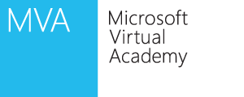
I – Active Directory: Introduction
Certificate Services
Federation Services
Rights Management Services
Identity
Non-Repudiation
  Maintain security of data
Network Access for External Resources
  Service,
  Client, Server
  User identification
Content Security and Control
Securely authenticate & prove the identity between users and servers on the network
  Resource access across traditional boundaries
Lightweight Directory Services
Domain Services
Active Directory
Internal Accounts
Authorization
Authentication
Application Templates
  Access the directory services data
Identity
Access
Centralized Management
Users, Computers, Policies

Slide 5
II – Active Directory: Domain Services
Active Directory Domain Services
  A directory service is the combination of
    the directory information source &
    the service that the information offers
    which in turn makes them available and usable
  Typical/ Old School Example:
    A phone book…
The Network Management (for managing user and group accounts) could be achieved
  in a Single location
  With a set of tools
Capable of
  assigning access to shared network resources
  Directory service for AD DS enabled applications
  Configuring security policies to all users and computers
  Group policies to manage user desktops and security settings

Slide 6
II – Active Directory: Domain Services
Centralized directory
Windows User
Windows Server
Mgmt Profile
Network Info
Printers
Shares
Applications
Single sign-on access
Server Config
SSO
App-Specific Directory Info
Integrated security
Account Information
Privileges
Profiles
Policies
Active Directory Domain Services
Manageability
Security
Interoperability
Windows Client
Email Servers
Network Devices
Config
QoS Policy
Security Policy
Mgmt Profile
Network Info
Policies
Mailbox Information
Address Book
Scalability
Common management interface

Slide 7
II – Active Directory: Domain Services
Scalable, secure, and manageable infrastructure for user and resource management
  stores and manages information about network resources
  provides support for directory-enabled applications such as Microsoft® Exchange Server
  allows for centralized management
LDAP is used to access the directory services data
Kerberos securely authenticates and proves the identity between users and servers on the network
DNS translates the Domain names into IP Addresses.

Slide 8
II – Active Directory: Domain Services
Physical Components
  Data store
  Domain controllers
  Global catalog server
  Read-Only Domain Controller (RODC)
Logical Components
  Partitions and Schema
  Domains and Domain trees
  Forests and Sites
  Organizational units (OUs)

Slide 9
II – Active Directory: Domain Services
Application
Server Config
SSO
App-Specific Directory Info
Windows User
Account Information
Privileges
Profiles
Policies
Active Directory LD Services
Manageability
Security
Interoperability
Network Devices
Config
QoS Policy
Security Policy
Email Servers
Mailbox Information
Address Book
AD LDS (Lightweight Directory Services) is a hierarchical file-based directory store
AD LDS is both the directory information source and the service that makes the information available and usable

Slide 10
II – Active Directory: Domain Services
Lightweight Directory Access Protocol (LDAP)
  Directory service that provides flexible support for directory-enabled applications, without the dependencies and domain-related restrictions of AD DS
  provide directory services for directory-enabled applications without incurring the overhead of domains and forests
  no requirement for a single schema throughout a forest
  X.500 Standard
  Based on TCP/IP
  A method for accessing, searching, and modifying a directory service
  A client-server model

Slide 11
II – Active Directory: Domain Services
Authentication: Verification – Local vs Network
Authorization: The authenticated user’s permission to execute the required task.
  SECURITY IDENTIFIER (SID)
  ACCESS CONTROL LIST (ACL)
    A discretionary access control list (DACL) identifies the security principals that are allowed or denied access to an object.
      When a person or process tries to access an object, the system checks the ACEs in the object's DACL to determine whether to grant access to it.
      If the object does not have a DACL, the system grants full access to everyone.
      If the object's DACL has no ACEs, the system denies all attempts to access the object because the DACL does not allow any access rights.
    A system access control list (SACL) enables administrators to log attempts to access a secured object.
      Each ACE specifies the types of access attempts by a specified principal that cause the system to generate a record in the security event log. An ACE in a SACL can generate audit records when an access attempt fails, when it succeeds, or both.

Slide 12


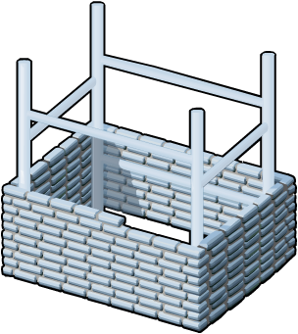




II – Active Directory: Domain Services
AD DS requires a DNS infrastructure
AD DS domain names must be DNS domain names
DNS Domain Name
DNS
AD DS domain controller records must be registered in DNS to enable other domain controllers and client computers to locate the domain controllers
DNS zones can be stored in AD DS as Active Directory integrated zones
DNS Zone

Slide 13
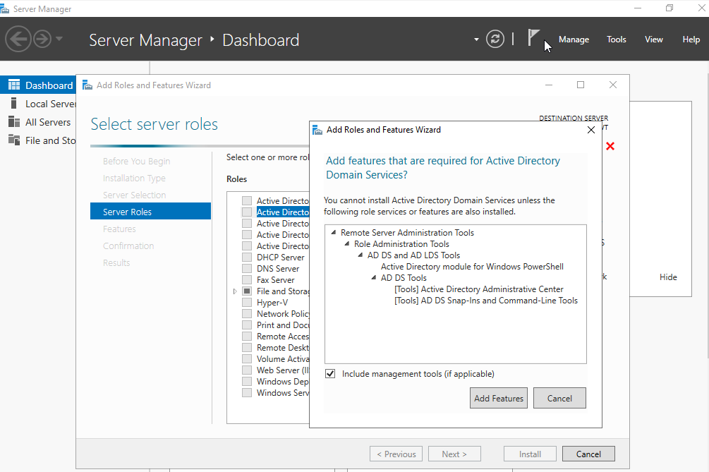
II – Active Directory: Domain Services
Domain Controller A domain controller is a server with the AD DS server role installed that has specifically been promoted to a domain controller
  Host a copy of the AD DS directory store
  Provide authentication and authorization services
  Replicate updates to other domain controllers in the domain and forest
  Allow administrative access to manage user accounts and network resources
  The AD DS data store contains the database files and processes that store and manage directory information for users, services, and applications

Slide 14
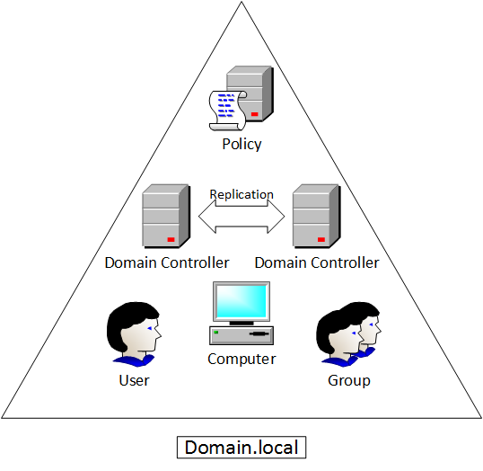
II – Active Directory: Domain Services
Domains are used to group and manage objects in an organization
  An administrative boundary for applying policies to groups of objects
  A replication boundary for replicating data between domain controllers
  An authentication and authorization boundary that provides a way to limit the scope of access to resources
DOMAIN

Slide 15
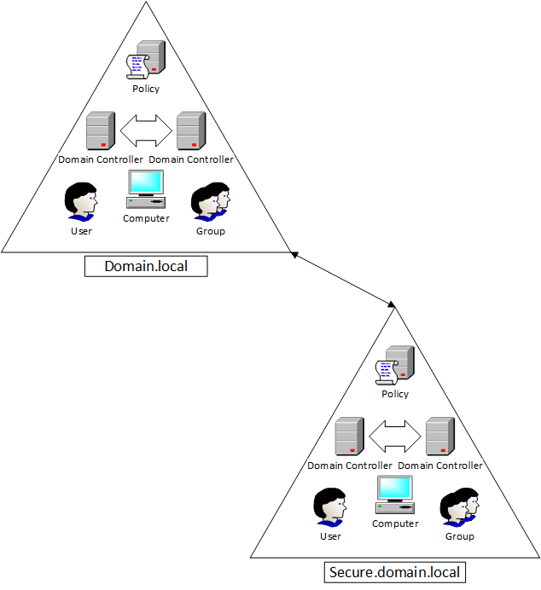
II – Active Directory: Domain Services
A domain tree is a hierarchy of domains in AD DS
  Share a contiguous namespace with the parent domain
  Can have additional child domains
  By default create a two-way transitive trust with other domains
A forest is a collection of one or more domain trees
  Share a common schema
  Share a common configuration partition
  Share a common global catalog to enable searching
  Enable trusts between all domains in the forest
  Share the Enterprise Admins and Schema Admins groups
TREE

Slide 16
II – Active Directory: Domain Services
OUs are Active Directory containers that can contain users, groups, computers, and other OU’s
  Represent your organization hierarchically and logically
  Manage a collection of objects in a consistent way
  Delegate permissions to administer groups of objects
  Apply policies
Active Directory is managed by the Microsoft Management Console (mmc.exe)
  Active Directory Administrative Center (dsac.exe)
  Active Directory Users and Computers (dsa.msc)
  Active Directory Domains and Trusts (domain.msc)
  Active Directory Sites and Services (dssite.msc)
  Active Directory module for Windows Powershell

Slide 17
III – Active Directory: Certificate Services
AD CS is the Microsoft implementation of Public Key Infrastructure (PKI)
PKI is a set of hardware, software, people, policies, and procedures needed to create, manage, distribute, use, store, and revoke digital certificates
AD CS provides customizable services for issuing and managing digital certificates
  Certification authorities (CAs) CAs issue certificates to users, computers, and services, and manage certificate validity
  CA Web enrollment Web enrollment allows users to connect to a CA by means of a Web browser in order to request certificates and retrieve certificate revocation lists (CRLs)
  Online Responder The Online Responder service sends a signed response containing requested certificate status information to clients
Certificate Signing Request
2
Enrollment
Certificate Repository
3
x.509 Certificate Chain
End-Entities (users or computers)
Certification Revocation Repository
Certificate Retrieval
4
1
CRL Retrieval
Certificate Revocation List
5
Revocation Request

Slide 18
III – Active Directory: Certificate Services
AD CS is the Microsoft implementation of Public Key Infrastructure (PKI)
PKI is a set of hardware, software, people, policies, and procedures needed to create, manage, distribute, use, store, and revoke digital certificates
AD CS provides customizable services for issuing and managing digital certificates
  Network Device Enrollment Service The Network Device Enrollment Service allows network devices to obtain certificates when they don’t have domain accounts
  Certificate Enrollment Web Service The Certificate Enrollment Web Service allows for certificate enrollment by users and computers using SSL to enables policy-based certificate enrollment for disconnected or non-domain-joined computers and users
  Certificate Enrollment Policy Web Service Delivers certificate enrollment policy information to computers and users to enable the Certificate Enrollment Web Service
Certificate Signing Request
2
Enrollment
Certificate Repository
3
x.509 Certificate Chain
End-Entities (users or computers)
Certification Revocation Repository
Certificate Retrieval
4
1
CRL Retrieval
Certificate Revocation List
5
Revocation Request

Slide 19

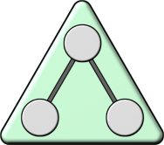




IV – Active Directory: Federation Services
Software Component that facilitates the cross-organizational access of systems and applications
The AD FS server role provides simplified, secured identity federation and Web single sign-on (SSO) capabilities.
  enables the creation of trust relationships between two organizations
  provides access to applications between organizations
  provides Single Sign-on (SSO) between two different directories for Web-based applications
AD DS
Web Server
Federation Trust
Account
Federation Server
Resource
Federation Server
Account Partner Organization
Resource Partner Organization

Slide 20
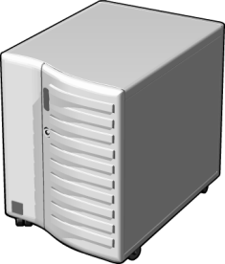











V – Active Directory: Rights Mgt Services
Active Directory Rights Management Services (AD RMS) is an information protection technology that works with applications to safeguard digital information
Allows individuals and administrators to specify access permissions to documents, workbooks, and presentations
  prevent sensitive information from being printed, forwarded, or copied by unauthorized people
  access and usage restrictions are enforced no matter where the information is located
RMS Server
Information Author
Recipient

Slide 21
Summary
Active Directory
  Rights Management Services, Certificate Services, Federation Services
  Lightweight Directory Services, Authentication & Authorization, DNS
  Domain Services
    Manageability
    Security
    Interoperability
    Physical and Logical Components
    Domain Controller
      DOMAINS
      TREE
      FOREST
      OUs are Active Directory containers that can contain users, groups, computers, and other Ous

Slide 22
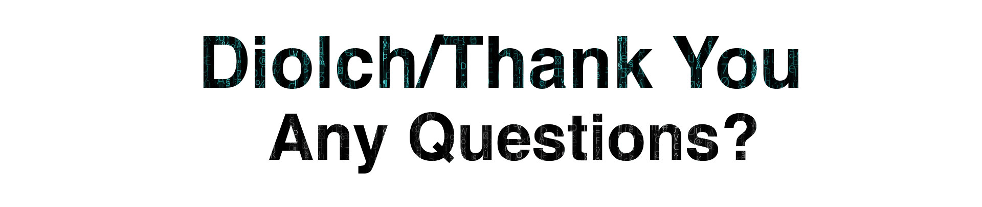
Books Referred: Dauti, Bekim. Windows Server 2019 Administration Fundamentals: A beginner's guide to managing and administering Windows Server environments, 2nd Edition . Packt Publishing.
SDN and NFV Simplified, Jim Doherty
Links referred in this presentation:
https://www.geeksforgeeks.org/difference-between-full-virtualization-and-paravirtualization/
https://docs.microsoft.com/en-us/virtualization/hyper-v-on-windows/about/
https://docs.microsoft.com/en-us/virtualization/hyper-v-on-windows/reference/hyper-v-requirements
https://docs.microsoft.com/en-us/virtualization/hyper-v-on-windows/quick-start/enable-hyper-v
https://docs.microsoft.com/en-us/virtualization/hyper-v-on-windows/quick-start/quick-create-virtual-machine
Disk2Vhd app: https://docs.microsoft.com/en-us/sysinternals/downloads/disk2vhd
V2P Tool: https://www.apricorn.com/upgrades/ezgig

Slide 23
Any Questions?
Enterprise Network Security
(ACCA7032)
Applied Computing - WISA

