Slide 1
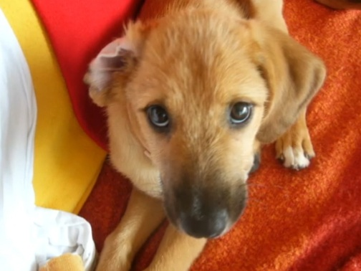

Reflective Practice

Slide 2
Introduction
I will briefly discuss reflective practice
I will use a case example of the death of our family dog
I will draw on the work of Gibbs’ (1988) Reflective cycle, Kolb’s reflective cycle (1984), Schons’ Reflective Model (1991), Wallace Black Elk (1990), Descartes (1628), Bassot (2016)
I will reflect on what was learned through our process of grief and loss and how this may be applied to my future practice.

Slide 3
What is Reflective Practice?
Self Reflexivity ‘is an active process of witnessing our own experience in order to examine it, give meaning to it and learn from it’ (Bager-Charleson, S., 2010, p89)
When we engage in self reflection we are ‘exploring our own meaning making processes’ (Bager-Charleson, S., 2010, p89)
Based on Gibbs’ Reflective Cycle, reflection involves 5 key aspects: Returning to experience, attending to feelings, evaluating experience, reaching conclusions and the actions that come from the learning (Gibbs, 1988)
According to Kolb, 1984, p38, “Learning is the process whereby knowledge is created through the transformation of experience”
Schon (1991, p8) coined the terms “Learning in action” (reflecting whilst doing) and “learning on action” (reflecting on past events)
Is it just us as individuals reflecting or do we need guidance to aid this process?

Slide 4
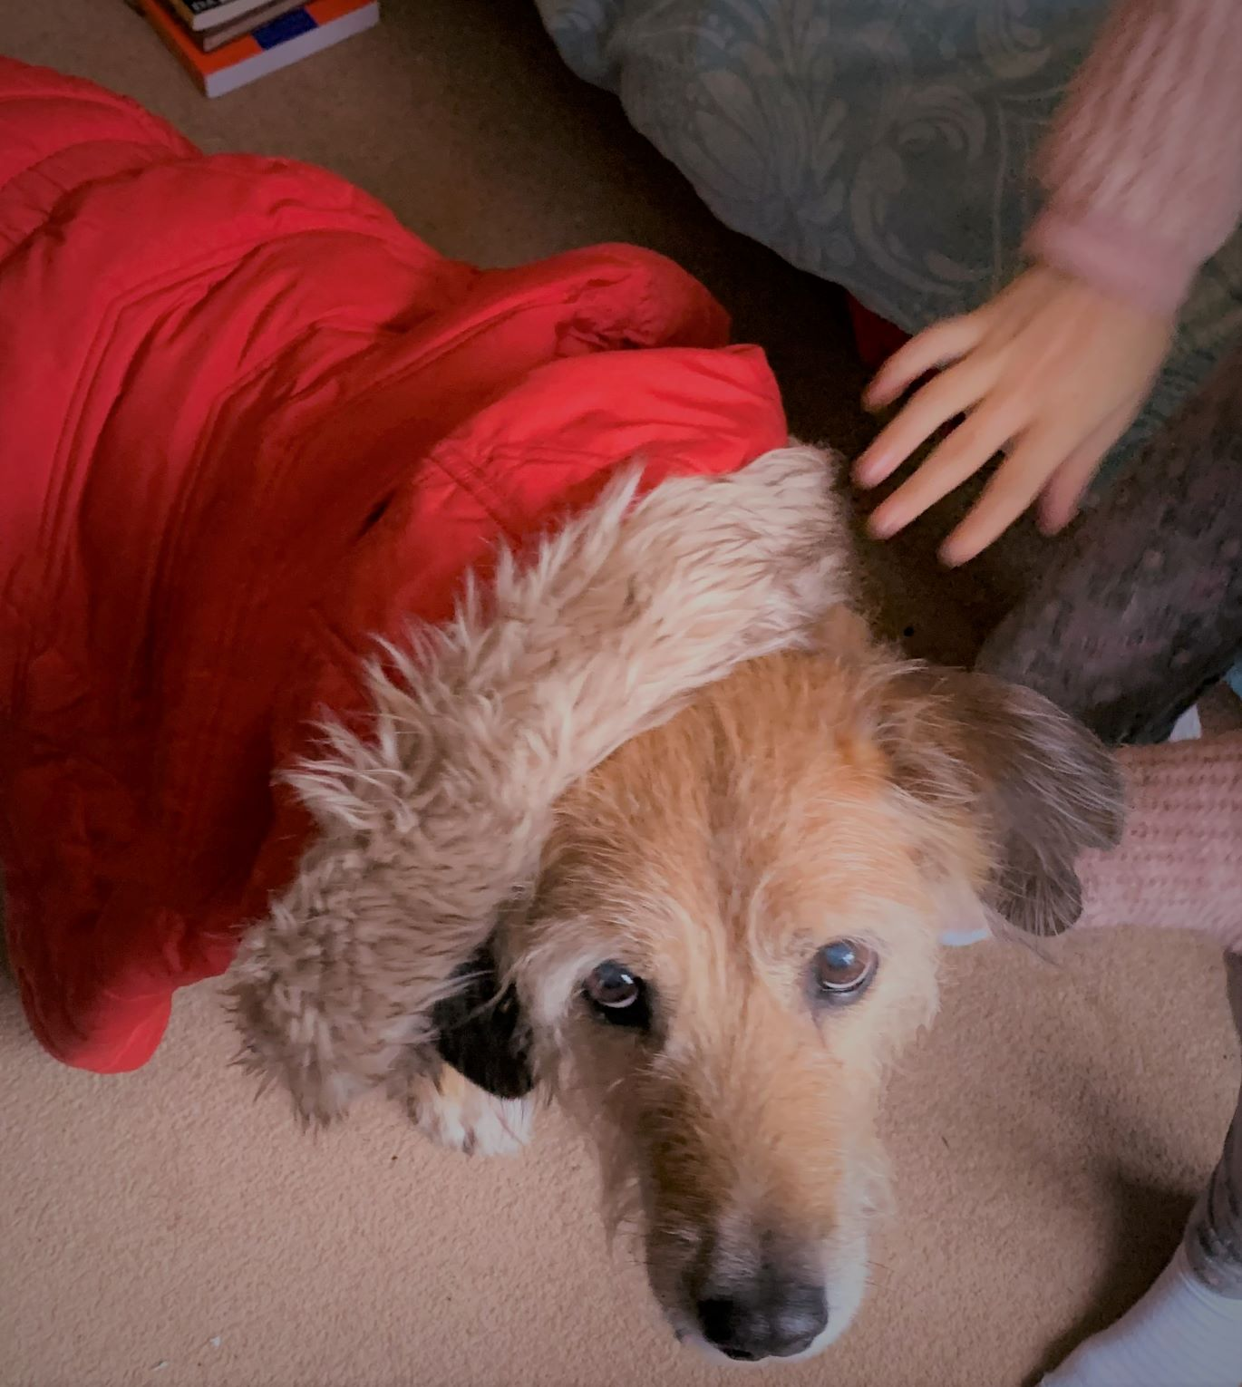
Personal Story
Bouba le petit orson (en Francais)

Slide 5
Le morte de Bouba
Returning to the experience (Gibbs, 1988)
We rescued our dog Bouba from a rural farm in the South of France near to where we are from
The post woman advertised on the internet as the farmer was going to drown him!
We had him for 16 years and had to put him down in July this year as he was suffering.
He had a lot of character and was known by many names as he used to take himself for a walk regularly, especially when I had my children as babies.
He was known in the South of France as ‘Chaussettes’ /Socks due to his white feet
He was known in Bristol by the homeless as ‘Red’ due to his colouring
He had a character that many people were drawn to and he is sorely missed in our family

Slide 6
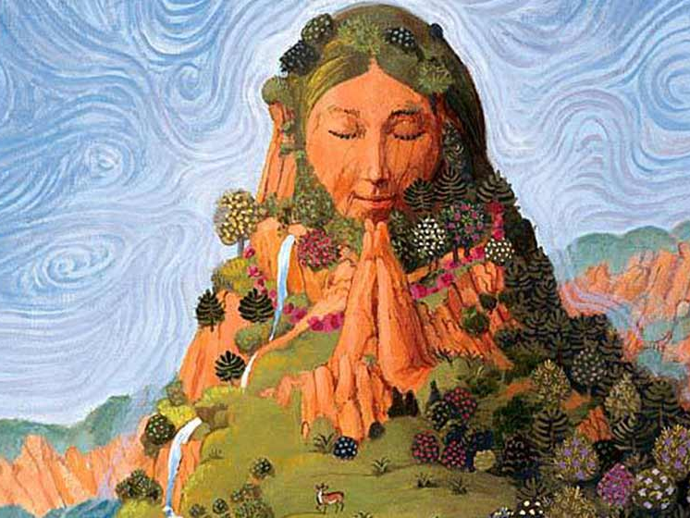
Pachamama – Amma Taye

Slide 7
Chant to the Divine Mother – Amma Taye
Attending to Feelings (Gibbs, 1988)
On the day we put Bouba down the chant to the Divine Mother came to me all day
I sang it to Bouba when he was dying
This supported me and my girls through his passing
Our grief and loss was very present
The receptionist at the vet was very uncomfortable, particularly with my youngest daughter’s display of grief and loss as she was wailing, holding our old dog, whilst I was chanting softly. She asked me to take my daughter into a another room to separate her from me and our dog. I felt shame when she asked this and did as she was asked.
However, chanting Amma Taye mantra, we were able to reflect on our grief and loss from a spiritual perspective, which provided meaning to us afterwards
In this way, we were able to be present with our grief in a more meaningful way
We took this experience back to our circle/community and sought feedback from them

Slide 8
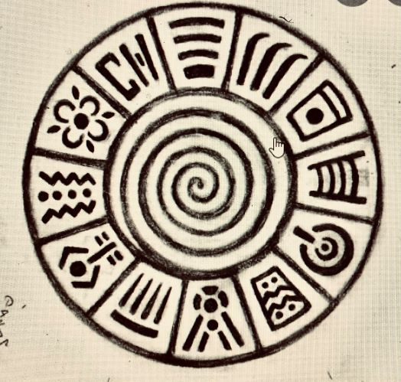
Red Path and my reflection on change

Slide 9
Evaluating the experience (Gibbs, 1988)
We had a method to support us in our grief and loss
Chanting to Amma Taye allowed us to experience our grief and loss in the moment (reflection in action, Schon, 1991)
This made the receptionist at the Vets feel uncomfortable and led me to reflect on socially and culturally appropriate ways to show grief and loss (Reflection on action, Schon, 1991)
I was not aware that I felt shame in the moment, when asked to remove my daughter from the room. I could have asked that she stay in the room with us to allow us continue experiencing the feelings in the moment.

Slide 10
Drawing conclusions (Gibbs, 1988)
If I had prepared before hand by having more open discussions about grief and loss, I could have attended to feelings that arose more effectively
If I had allowed my daughters and I to continue to be in the moment of grief by bringing awareness to my shame in the moment we could have more fully integrated this experience of loss
Reflecting on my shame afterwards, I shared with my daughters the Native American philosophy that people and animals do not die but instead “walk on” . This implies a continuation of a journey rather than an end point on a linear path (Wallace Black-Elk, 1990)
This was in order to bring some awareness to the fact that grief and loss are viewed differently in different cultures
I could have also had a discussion with them about the unease of the receptionist and the reasons that some people are uncomfortable about grief and loss. This could have better facilitated our own learning during and after this experience.

Slide 11
Action (Gibbs, 1988)
To allow time and space for reflection and learning
To be able to model this to my children for their learning
Using our learning to transform our experience of grief and loss (Kolb, 1984)

Slide 12
“Life is a circle”
Further personal learning and reflection has come from undertaking this presentation
The Native Americans believe life is a circle
If life is a circle, is there a centre?
If there is a centre, what or who might be at the centre?
What is the process for finding out?
If there is a necessity to take reference from outside of ourselves, where does that reference come from?
Have you participated in circle or community?
What was your experience of this if so, can you name feelings associated with the concept of circle/community?

Slide 13
Rationalism vs. Empiricism
Rationalism – Knowledge comes from intellectual and deductive ‘reasoning’
Empiricism – Knowledge comes from our sensory experience
To what extent are we dependant upon our experiences in our efforts to gain knowledge? (Cottingham et al., 1988)
How do we know if this knowledge has some objective criteria? (Descartes, 1628 cited in Cottingham et al., 1988)
Where does this knowledge come from and how do we integrate this knowledge into our practice?
Is there a case for bridging the gap between reasoning and our sensory experience, particularly in the task of Counselling?
Are rationalism and empiricism enough for our practice or do we need something/someone else to help inform us also?
Integrating feedback (from circle/family) to notice our ‘blind spots’ in practice using the ‘wing mirrors’ approach (Bassot, 2016) – without the help of circle I would not have been able to see how shame inhibited our process of grief and reflect on culturally and socially approprite ways to show grief and loss

Slide 14
Future Practice
How will my reflective process inform my future practice?
Use of reflective models (i.e. Gibbs, 1988, Kolb, 1984, Schon, 1983) to improve and enhance my own evidence based practice
Awareness of societal/cultural norms and how we respect them whilst maintaining our own integrity
Being aware of the stages of grief and loss and how we personally experience it, learn from it and can put that learning into practice
Awareness of different lenses we view our learning, knowledge and experience through and being able to effectively use these in practice and in our personal lives

Slide 15
References
Bager-Charleson, S. (2010) Reflective practice in counselling and psychotherapy, Exeter: Learning Matters. [ebook]. Chapter 1
Descartes, R. (1628), Rules for the Direction of our Native Intelligence, in Descartes: Selected Philosophical Writings, John Cottingham, Robert Stoothoff and Dugald Murdoch (trans.), Cambridge: Cambridge University Press, 1988
Gibbs, G. (1988), Learning by Doing. Published by Oxford Polytechnic
Margaret Keane, IT Tallaght 2016, adapted from Bassot, B. (2016). The Reflective Journal. 2nd Edition (p.6). London: Palgrave
Kolb, D (1984) Experiential learning: Experience as the source of learning and development (Vol. 1). Englewood Cliffs, NJ: Prentice-Hall
Schon, D. (1991). The reflective practitioner: How professionals think in action. Aldershot: Ashgate Publishing Ltd

