Slide 1

Space or Place: Different Views of Cyberspace
Frances Clynes
University of Wales Trinity Saint David

Slide 2
Space
The Space Debate
  Different Views of Space
  Space vs Place
  Monism vs Dualism
Cyberspace
  Is there a separate space or place called cyberspace?
  Cyberspace or cyberplace?
Notes:
In the literature, different authors have different approaches to space
Some of them see space as unitary but having different qualities depending on where you viewing it from or what it is being used for.
Others separate it into space and place, with some of them seeing space and place as polar opposites

Slide 3
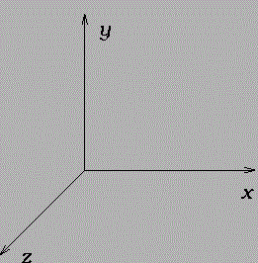
Space
Abstract
A conceptual and sometimes empty space
The homogenous space of Euclidean geometry
Empty, neutral, value-free
Notes:
Space is empty, neutral

Slide 4
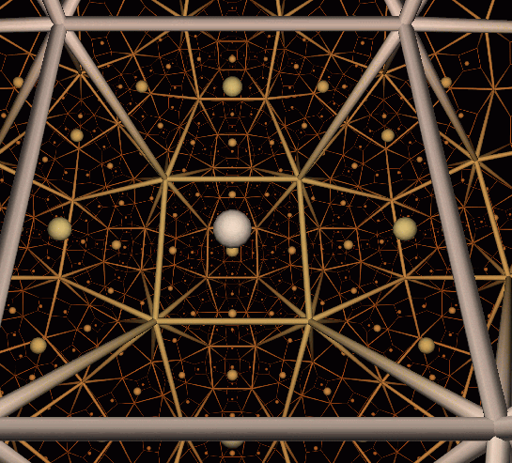
Space
Trubshaw (2005)
  An abstract analytical concept
Cassirer (1955)
  Mathematical space
  Three attributes
    Infinity, continuity and uniformity
Notes:
All mathematical spaces are alike
Cassirer says that the ultimate basis of the homogeneity of geometric space is that all its elements, the “points” which are joined in it, are mere determinations of position, possessing no independent content of their own outside of this relation, this position which they occupy in relation to each other.

Slide 5
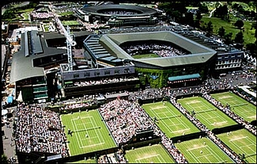
Place
A physical location where human activity takes place and which holds meaning for people
Identified by the activity and human experiences that take place there
A social construction
Wimbledon

Slide 6

Place
Trubshaw (2005)
  Somewhere specific and tangible
Tilly (1994)
  An ontological grounding of space in the differential structuring of human experience and action in the world
  A medium, a container for human action that cannot be divorced from the activities that take place in it
Tiananmen Square, Beijing

Slide 7
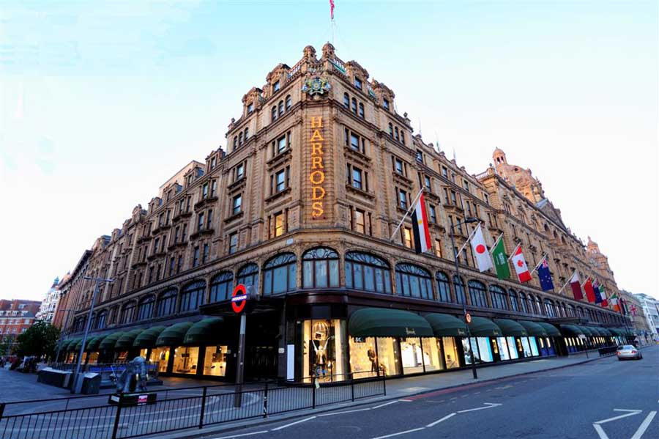
Place
Giddens (1991)
  A geographic location
  The physical settings of social activity
Massey (1994)
  It is the set of social relations that interact at a particular location that makes it a place, and give it its singularity and identity
Harrods, London

Slide 8

Space vs Place
Trubshaw (2005)
  ‘We relate to physical places in a way that we cannot to abstract notions of space. Whereas “space” is more about what is conceived and thought about, “place” is what is perceived and lived in.’
Tilly (1994)
  Idealistic and materialistic
Machu Picchu

Slide 9
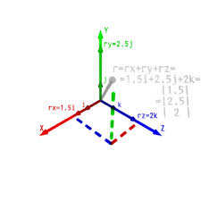
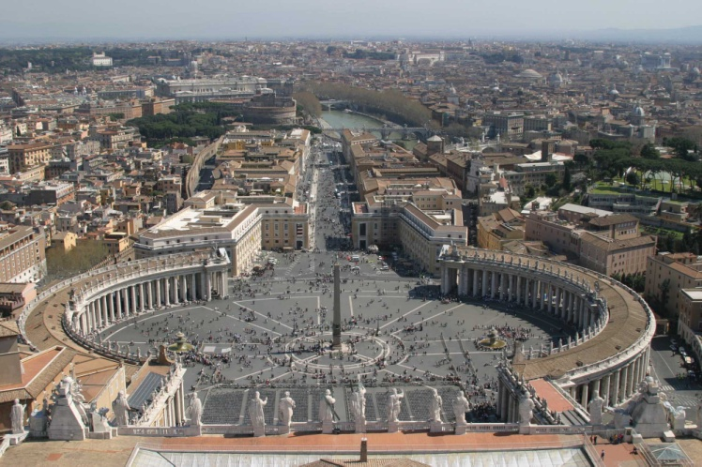
Space vs Place
Cassirer (1955)
  Two types of space that are polar opposites
    Space of pure cognition - Euclidean geometry
    Space of perception
    ‘It is self-evident that the space of perception, the space of vision and touch, does not coincide with the space of pure mathematics, that there is indeed a thoroughgoing divergence between the two.’
Notes:
Massey also discusses dualism in this context but she sees the space/place dualism as just another expression of what she calls the ‘radical polarization into two genders that is typically hegemonic in western societies’
Cassirer says, ‘ We require a peculiar reversal of perspective, a negation what seems immediately given in sensory perception, before we can arrive at the “logical space” of pure mathematics
He says there is an antithetical relationship between “physiological” space and “metric” space upon which Euclidean geometry bases its construction
Cassirer polarises it in the way that the others don’t
Cassirer - Mythical space
‘Occupies a kind of middle position between the space of sense perception and the space of pure cognition, that is, geometry.’
Closely related to the space of perception and strictly opposed to the logical space of geometry
Distinction between position and content cannot be made

Slide 10

Sacred and Profane
Durkheim (1915)
  Humans perceive the sacred and profane as two distinct worlds with nothing in common
  Sacred places are not inherently so
  The sacred quality is superimposed by society and repeatedly added to them
  Sacred identified with the ideal and transcendental
  Profane identified with the material world
Notes:
In the literature, the descriptions of the distinction between 'place' and 'space', frequently bears resemblance to the descriptions of the distinction between sacred and profane space. While Cassirer wrote of the 'thoroughgoing divergence' between the space of perception and space of pure cognition, both Durkheim and Eliade wrote of the polarity between sacred and profane space. In addition, Eliade's polarisation of sacred and profane space bears some resemblance to Trubshaw's differentiation between space and place. Trubshaw describes place as real, while Eliade uses the same term for the sacred. Similarly while Tilly described geometric space as 'universal, everywhere and anywhere the same', Eliade called profane space 'homogenous'. Like Tilly the importance of the individual's perception of space is key to Eliade.
Durkheim's polarisation of the sacred and profane has been challenged by Giddens who wrote,
Durkheim’s definition of religion depends upon the polarity of the sacred and profane, as discrete and opposed spheres. But although such a polarity can be clearly discerned in certain religious systems, particularly those of Judaeo-Christian origins, it is by no means universal. On the contrary, it seems that more often than not what Durkheim distinguished as the sacred and the profane intermingle in every day conduct.
Anthony Giddens, Durkheim, Fontana modern masters. (Glasgow: Fontana/Collins, 1978), p. 102.
The polarity has also been challenged by Lukes who argued that as Durkheim linked the sacred to society or the collective and the profane to individual life, the dichotomy is explained by the basic and multiple dichotomy between the social and the individual. The dichotomy between the social and the individual has played a significant role in Durkheim's other works, such as The Division of Labour in Society. According to Giddens, the conception of religion set out in The Elementary Forms of the Religious Life has to be understood within the context of the theory of social development which forms the general framework of Durkheim’s work. Thus, he stated, while the book can be treated for some purposes as an independent and self-contained study of primitive religion, its broad significance in Durkheim’s writings can only be adequately understood in this terms.
Steven Lukes, Emile Durkheim : his life and work; a historical and critical study (London: Allen Lane, 1973), pp. 26-27.
Emile Durkheim and Anthony Giddens, Selected writings (Cambridge,: University Press, 1972), p. 24.

Slide 11
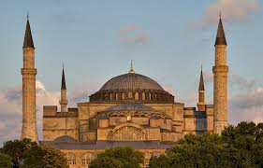
Sacred and Profane
Eliade (1959)
  Sacred and Profane
    Two distinct worlds with nothing in common
    Sacred space has a fixed point, a centre
    Profane space is homogenous
Notes:
Haiga Sophia has been a pagan temple, a Christian church and a mosque
Now it is a museum whose official website has several links to Dan Brown’s Inferno
Last year the Turkish prime minister called for it to become a mosque again.

Slide 12
More Space
Henri Lefevbre
Michel Foucault
Edward Soja
Rejected the dualistic view of space that Lefevbre claims has been part of the Western world view since Descartes

Slide 13

Descartes on Space
Res cogitans and res extensa
Res cogitans
  The space of the mind
Res Extensa
  The space taken up by the physical body
Rene Descartes (1596-1650)

Slide 14
Henri Lefebvre
'Philosophy has found it very difficult to get beyond such dualism as subject and object, Descartes's res cogitans and res extensa....‘
‘In this way of thinking, there is a ‘distance that separates 'ideal' space, which has to do with mental (logico-mathematical) categories, from 'real' space, which is the space of social practice. In actuality each of these two kinds of space involves, underpins and presupposes the other.'

Slide 15
Henri Lefebvre
He sought a unitary theory of space:
  Physical space
    Perceived space
    Space created by nature
  Mental space
    Conceived space
    Scientists and urban planners
  Social space
    Lived space
    Space of the imagination
    Artists
Notes:
Social space is composed of physical and mental space. It is all encompassing – it is all space
‘The fields we are concerned with are, first, the physical – nature, the Cosmos; secondly, the mental, including logical formal abstractions; and, thirdly the social. In order words, we are concerned with logico-epistemological space, the space of social practice, the space occupied by sensory phenomena, including products of the imagination such as projects and projections, symbols and utopias.’ (p. 11-12)
Social space is allocated according to class, and social planning reproduces the class structure. This is either on the basis of too much space for the rich and too little for the poor, or because of uneven development in the quality of places, or indeed both. Like all economies, the political economy of space is based on the idea of scarcity -

Slide 16
The Production of Space (1974)
Henri Lefebvre
  Space is a social product
    Every society produces its own space
    The space produced is a representation of the society
  Emphasised the importance of social space as a different way of thinking about space

Slide 17
Michel Foucault
‘Of Other Spaces’ (1967)
  Contemporary space is still not entirely desanctified
  ‘And perhaps our life is still governed by a certain number of oppositions that remain inviolable, that our institutions and practices have not yet dared to break down. These are oppositions that we regard as simple givens: for example between private space and public space, between family space and social space, between cultural space and useful space, between the space of leisure and that of work. All these are still nurtured by the hidden presence of the sacred. ‘
Notes:
One could say, by way of retracing this history of space very roughly, that in the Middle Ages there was a hierarchic ensemble of places: sacred places and profane places; protected places and open, exposed places; urban places and rural places (all these concern the real life of men). In cosmological theory, there were the super celestial places, as opposed to the celestial, and the celestial place was in its turn opposed to the terrestrial place. There were places where things had been put because they had been violently displaced, and then on the contrary places where things found their natural ground and stability. It was this complete hierarchy, this opposition, this intersection of places that constituted what could very roughly be called medieval space: the space of emplacement. (p. 22)
Now, despite all the techniques for appropriating space, despite the whole network of knowledge that enables us to delimit or to formalize it, contemporary space is perhaps still not entirely desanctified (apparently unlike time, it would seem, which was detached from the sacred in the nineteenth century). To be sure a certain theoretical desanctification of space (the one signalled by Galileo's work) has occurred, but we may still not have reached the point of a practical desanctification of space. And perhaps our life is still governed by a certain number of oppositions that remain inviolable, that our institutions and practices have not yet dared to break down. These are oppositions that we regard as simple givens: for example between private space and public space, between family space and social space, between cultural space and useful space, between the space of leisure and that of work. All these are still nurtured by the hidden presence of the sacred. (P. 23)

Slide 18
Foucault – Internal and External Space
Internal Space
  ‘The space of our primary perception, the space of our dreams and that of our passions hold within themselves qualities that seem intrinsic: there is a light, ethereal, transparent space, or again a dark, rough, encumbered space; a space from above, of summits, or on the contrary a space from below, of mud; or again a space that can be flowing like sparkling water, or a space that is fixed, congealed, like stone or crystal.’
External Space
  ‘The space in which we live, which draws us out of ourselves, in which the erosion of our lives, our time and our history occurs, the space that claws and knaws at us, is also, in itself, a heterogeneous space. ‘
Notes:
He says that space is heterogeneous – composed of sites which are irreducible to one another and absolutely not superimposable on one another
Lefebvre claimed the Foucault failed to bridge the gap between the theoretical realm of the philosopher and the space of people who deal with material things.

Slide 19
Foucault – Different Sites
‘I am interested in certain ones that have the curious property of being in relation with all the other sites, but in such a way as to suspect, neutralize, or invert the set of relations that they happen to designate, mirror, or reflect. These spaces, as it were, which are linked with all the others, which however contradict all the other sites, are of two main types.’
Utopias and Heterotopias

Slide 20
Foucault - Utopias
Different from the real space of society
Society in a perfected form or society turned upside down
Fundamentally unreal spaces
‘Utopias are sites with no real place ‘
Notes:
Spaces in the modern world

Slide 21
Foucault - Heterotopias
Real places that are ‘outside of all places’
Sites where:
  ‘All the other real sites that can be found within the culture, are simultaneously represented, contested, and inverted’
  ‘Absolutely different from all the sites that they reflect and speak about’
Notes:
There are also, probably in every culture, in every civilization, real places- places that do exist and that are formed in the very founding of society-which are something like counter-sites, a kind of effectively enacted utopia in which the real sites, all the other real sites that can be found within the culture, are simultaneously represented, contested, and inverted. Places of this kind are outside of all places, even though it may be possible to indicate their location in reality. Because these places are absolutely different from all the sites that they reflect and speak about, I shall call them, by way of contrast to utopias, heterotopias
Hetherington
‘Heterotopia are spaces in which an alternative social ordering is performed’
Can be opened and closed

Slide 22
Soja (1989)
'Foucault's heterogeneous and relational space of heterotopias is neither a substanceless void to be filled by cognitive intuition nor a repository of physical forms to be phenomenologically described in all its resplendent variability. It is another space, what Lefebvre would describe as I'espace vecu, actually lived and socially created spatiality, concrete and abstract at the same time, the habitus of social practices. It is a space rarely seen for it has been obscured by a bifocal vision that traditionally views space as either a mental construct or a physical form - a dual illusion'
Notes:
He states that Foucault’s heterotopia is neither a substanceless void to be filled by cognitive intuition nor a repository of physical forms to be phenomenologically described. It is another space, an actually lived and socially created spatiality, concrete and abstract at the same time, the habitus of social practices.

Slide 23
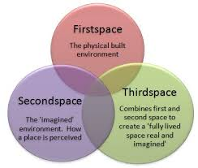
Soja - Thirdspace
A composite of all spaces
  First and second spaces
  Physical and mental spaces
Designed to break down a ‘rigid dichotomy’

Slide 24
Soja on Lefebvre and Foucault
‘The assertion of an alternative envisioning of spatiality (as illustrated in the heterotopologies of Foucault, the trialectics and thirdings of Lefebvre...) directly challenges (and is intended to challengingly deconstruct) all conventional modes of spatial thinking. They are not just “other spaces” to be added on to the geographical imagination, they are also “other than” the established ways of thinking spatially.’
  Thirdspace (1996)

Slide 25
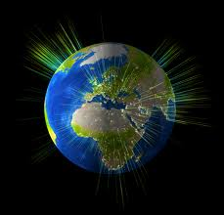
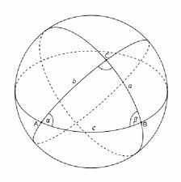
Modernity
Giddens (1991)
  Modernity tears space away from place
  'What structures the locale is not simply that which is present on the scene’
  Led to the development of space without reference to a privileged locale
Notes:
He wrote that in pre-modern societies space and place largely coincided since the spatial dimensions of social life were, for most people, dominated by what he terms 'presence', or localised activities. However in conditions of modernity, locales are thoroughly penetrated by and shaped in terms of social influences quite distant from them. He wrote, 'What structures the locale is not simply that which is present on the scene; the "visible form" of the locale conceals the distanciated relations which determine its nature.'

Slide 26
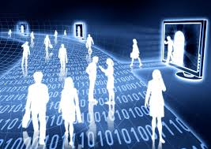
Technology
Meyrowitz (1997)
  A bond between physical place and social place in oral and print cultures
  Electronic media has led to a total dissociation between the two
  ‘When we communicate through telephone, radio, television, or computer, where we are physically no longer determines where and who we are socially’
Notes:
Because of electronic media there is a decrease in the importance of location’s role in the structuring of social life and the construction of meaningful human experiences
‘The Separation of Social Space from Physical Place’ in The Media Studies Reader ed. Tim O’Sullivan and Yvonne Jewkes (London: St. Martin’s Press, 1997), p. 42

Slide 27
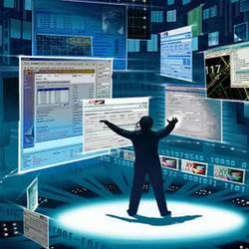
Technology
  ‘Electric circuitry has overthrown the regime of "time" and "space" and pours upon us instantly and continuously the concerns of all other men. It has re-constituted dialogue on a global scale. Its message is Total Change, ending psychic, social, economic, and political parochialism. The old civic, state, and national groupings have become un-workable. Nothing can be further from the spirit of the new technology than "a place for everything and everything in its place." You can't go home again.’
McLuhan, Fiore and Agel (2001)
  Electronic media has changed the nature of space
  Traditional meanings lost
Notes:
Marshall McLuhan, Quentin Fiore, and Jerome Agel, The medium is the massage : an inventory of effects (Corte Madera, CA: Gingko Press, 2001), p. 16.

Slide 28
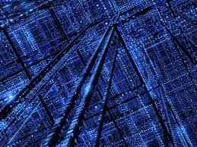
Cyberspace
‘Cyberspace. A consensual hallucination experienced daily by billions of legitimate operators, in every nation, by children being taught mathematical concepts…A graphic representation of data abstracted from the banks of every computer in the human system. Unthinkable complexity. Lines of light ranged in the nonspace of the mind, clusters and constellations of data. Like city lights, receding…’
William Gibson, Neuromancer (London: Harper Voyager, 1995 [1984]), p. 67,
Notes:
While the physical network we know as the Internet was being developed, this concept of cyberspace was born in a novel and quickly became the focus of study by academics. Although some of the work was about the use of networks, a lot of it was about our relationship with this thing called cyberspace.
The cyberspace described by Gibson bore little resemblance to the Internet in its early days which consisted mainly of plain hyper-linked text documents.
In Gibson's novels cyberspace was a place that was entered physically and could be experienced by all of the senses.
It was 1990 before the term cyberspace began to be used in connection with the Internet
Some of the early theorists believed that the Internet was in the process of becoming a Gibsonian three-D virtual reality
A lot of the theories about the human relationship with cyberspace were influenced by this

Slide 29

The Internet and Cyberspace
The Internet
  ‘The network of computers, modems, communication links, nodes and pathways that connect users into something (or some things) like the Internet, the World Wide Web, the information superhighway and so on’
  David Bell, ‘Cybercultures Reader: A User’s Guide’, in The Cybercultures Reader, eds. David Bell and Barbara M. Kennedy (London: Routledge, 2000)

Slide 30
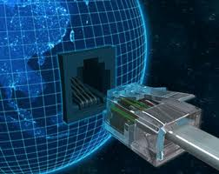
The Internet and Cyberspace
Cyberspace
  David Bell
    ‘We are simultaneously making ourselves over as data, as bits and bytes, as code, relocating ourselves in the space behind the screen, between screens, everywhere and nowhere’
  Anastasia Karaflogka
    ‘Where the act of connectivity and interactivity takes place’
Notes:
This differentiation assumes that there is a separate place called cyberspace

Slide 31
A Place Called Cyberspace
‘Where do we go when we are online? Where is the "place" in cyberspace? The relentless commercial and enthusiast discourses of the World Wide Web tell us that online activity is a journey, that it takes us somewhere other than where we are. We are "travelling" the Infobahn; we are "exploring" or "navigating" the Internet; we "go" to this site or that; we are "in" a world of "virtual reality." All these metaphors conspire to convince us that the "places" we "go" in cyberspace are somehow qualitatively different from the more mundane places from which we access the online world’
  Douglas Cowan (2005)

Slide 32
Early Literature
Used Gibson’s description
  Cyberspace was accessed with all five senses
1990
  It was believed that cyberspace would become a Gibsonian virtual world
  Benedikt called it a world ‘under construction’, a ‘technology very nearly achieved’
  John Perry Barlow first associated the physical network of the Internet with cyberspace
  Feelings were strong
Notes:
A lot of the early writers held either dystopian or utopian views on the subject
John Perry Barlow was one of the founding members of the Electronic Frontier Foundation and is currently its vice-chairman and a fellow at Harvard’s Centre for Internet and Society.

Slide 33
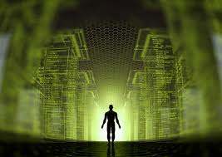
A Separate Place?
‘Cyberspace must be envisaged as a coherent and global virtual world independent of how it is accessed and navigated.’
  ^{Michael} ^{Benedikt 1991}
Notes:
In Neuromancer, William Gibson says that cyberspace looks like Los Angeles seen at night from 5000 feet in the air

Slide 34
A Separate Place
'The design of cyberspace is, after all, the design of another life-world, a parallel universe, offering the intoxicating prospect of actually fulfilling - with a technology very nearly achieved - a dream thousands of years old; the dream of transcending the physical world, fully alive, at will, to dwell in some Beyond - to be empowered or enlightened there, alone or with others, and to return.'
  Michael Benedikt (1991)
Notes:
The important word is transcending

Slide 35
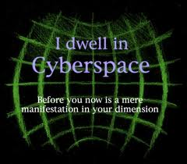
A Separate Place?
‘'Cyberspace is consensual delusion; there is only a consensual, arbitrary space (or spaces), in the mathematical sense of “space”’
  Tim McFadden (1991)

Slide 36
Technological Dystopia
‘The objects most purely embodying the ahrimanic presence are calculation and computing machines’
‘Their (computers’) basis appeared in the Garden as the serpent, established a foothold in our being, and now is building a new world of its own, a world with light not of the Sun and logic, not of the Word. Just as the Word offers each person the power to become a child of God, so each person is now offered the power to become a child of hell’
  David B. Black, The Computer and the Incarnation of Ahriman (1981)
Notes:
Ahriman opposes the forces of light

Slide 37
Dystopia
‘My quarrel is with a relatively small but disproportionately influential group of self-described “Net religionist” and “wannabe gods” who believe that the physical world can (and should) be “downloaded” into a computer, who believe that the future of mankind is not in RL (real life) but in some form of VR (virtual reality)’
  Mark Slouka, The War of the Worlds (1996)
Notes:
Even in the title of the book it is clear that he also sees it as a separate place
He is responding to the earlier beliefs that cyberspace would be come a Gibsonian virtual reality
His reaction is extreme but then so were some of the early utopian views
He takes the most extreme examples and exaggerates them and derides them. There is an example of this on almost every page. The whole book is a polemic. He is scaremongering and at no point examines cyberspace objectively
He refers to them as cyberists

Slide 38
Utopia
‘On the other side of our data gloves we become creatures of coloured light in motion, pulsing with golden particles. We will all become angels, and for eternity. Cyberspace will feel like Paradise, a space for collective restoration of the habit of perfection’
  Nicole Stenger (1991)
Notes:
Slouka’s Comments about this:
‘It came as something of a shock to me to realize that Stenger and Co., however much they might sometimes sound like Shirley MacLaine, were serious’
‘It was no coincidence, after all, that many of the most ardent theorists were academics. Cyberspace, I realized represented the marriage of deconstruction and computer technology – a mating of monsters if every there was one’
What Slouka is doing and his main argument assumes that cyberspace is destined to replace physical space – the substitution thesis
This extreme view was common particularly among the dystopians
It still exists to a certain extent with some people even though what has happened is that cyberspace has evolved alongside and in a lot of cases fused with offline space

Slide 39
Utopia
John Perry Barlow (1996)
  ‘We are creating a world that all may enter without privilege or prejudice accorded by race, economic power, military force, or station of birth’
  ‘We are creating a world where anyone, anywhere may express his or her beliefs, no matter how singular, without fear of being coerced into silence or conformity’
  ‘We will create a civilization of the Mind in Cyberspace. May it be more humane and fair than the world your governments have made before’

Slide 40
Utopia
June 1, 1993 – Notice from the White House
  ‘Today we are pleased to announce that for the first time in history, the White House will be connected to you via electronic mail. Electronic mail will bring the Presidency and this Administration closer and make it more accessible to the people. The White House will be connected to the Internet as well as several on-line commercial vendors, thus making us more accessible and more in touch with people across this country.’

Slide 41
Utopia
‘Cyberspace: Its corridors form wherever electricity runs with intelligence. Its chambers bloom wherever data gathers and is stored. Its depths increase with every image or word or number, with every addition, every contribution, of fact or thought. Its horizons recede in every direction; it breathes larger, it complexifies, it embraces and involves. Billowing, glittering, humming, coursing, a Borgesian library, a city; intimate, immense, firm, liquid, recognizable and unrecognizable at once.’
  Michael Benedict (1991)
Notes:
Jorge Luis Borges (24 August 1899 – 14 June 1986) – Argentian short-story writer
Magical realism – considered to be the first writer of the genre
“ I had always imagined paradise as a kind of library. ”
— Jorge Luis Borges
The Aleph – a book of short stories (1949) – with one story called ‘tThe Aleph’
The Aleph describes a point in space that contains all other spaces at once. People looking at it can see every place in the universe simultaneously
Soja claims that Borges’ magical realism resounds well with Lefebvre’s fascination with concrete abstractions, his paradoxically materialist idealism, and his adventurous exploration into the simultaneous worlds of the real-and-imagined. (p. 54 of Thirdspace)
He also says it is describes what he is trying to convey as Thirdspace: the space where all spaces are capable of being seen from every angle, each standing clear; but also a secret and conjectured object, filled with illusions and allusions, a space that is common to all of us yet never able to be completely seen and understand, an “unimaginable universe”, or as Lefebvre would put it “the most general of products”. (Thirdspace p. 56)
‘What eternity is to time, the Aleph is to space. In etrnity, all time – past, present, and future – coexists simultaneously. In the Aleph, the sum total of the spatial universe is to be found in a tiny shining sphere barely over an inch across. (Borges, 1971: 189)
Aleph, a super high capacity storage device, is a plot element in the cyberpunk novel Mona Lisa Overdrive by William Gibson
There is an information website about his work called the William Gibson Aleph

Slide 42
A Sacred Space
'In cultures thirsty for re-enchantment, it provides a doorway to digitized sacred space from a materialism that many people find increasingly unsatisfying’
  Christopher Partridge
'The attraction of cyberspace is that it is a re-packaging of the Christian Heaven in a secular and technologically sanctioned format‘
  Margaret Wertheim

Slide 43
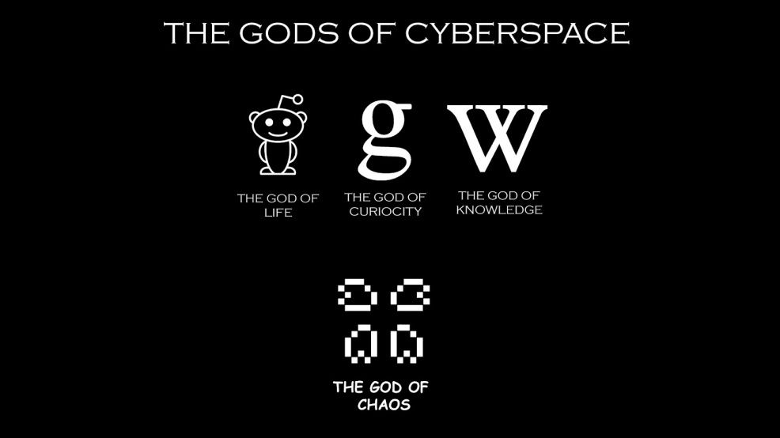
The Cyberspace Pantheon
‘At a time when the old gods were experienced as withdrawing and a sense of communication with them, difficult to achieve, the new cosmology introduced by Plato answered the question of where they had gone - to the sky.’
‘The world once more has a radical new cosmology and this time the question of where the gods are will be answered by cyberspace’
  David Ulansey
Notes:
He states that the Hellenistic age was one of intermingling of different cultures and the unification of previously separate and autonomous political and cultural entities – city-states, nations, tribes, in a single new imperial system.
He believes the same thing is happening today, this time on a planetary scale.
One of the effects of the Hellenisitic cultural unification was a fundamental shift in peoples’ sense of personal identity. Previously identity lay in the group, and there was a lack of concern for personal immortality
As smaller groups became absorbed in the large Hellenistic empire, they lost a significant degree of autonomy and were not longer able to provide a sense of collective identity for their members. This coincided with dramatic improvements in communication and transportation, and people became increasingly “detachable” from their local societies. They lost a sense of contact with their traditional gods, as the gods were seen a being related to the group rather than the individual.

Slide 44


Disillusionment
‘Cyberspace - that wonderful, phantasmagoric three-dimensional alternative reality imagined by William Gibson - was not actually shaping itself on-line as I and many others thought it surely would’.
  Michael Benedikt, "Towards a General Theory of Value: An Interview with Michael Benedikt," Gain(2003)

Slide 45
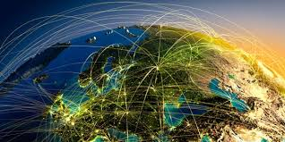
Limits of the Internet
‘The Internet’s impact is more limited than either the utopian or dystopian visions suggest’
  DiMaggio et al (2001)
Notes:
DiMaggio, Hargittai, Neuman, and Robinson – ‘Social Implications of the Internet’ (2001) Annual Review of Sociology
They point out that everyone examines the Internet through their own field, Marxists look at the impact on distribution of wealth, media people on the reach and effect of its broadcasts, management writers on its potential to change organisational structure.

Slide 46
Dystopia 2011
‘Internet-centrism is a highly disorienting drug; it ignores context and entraps policymakers into believing that they have a useful and powerful ally on their side. Pushed to its extreme, it leads to hubris, arrogance, and a false sense of confidence, all bolstered by the dangerous illusion of having established effective command of the Internet.’
  Evgeny Morozov, The Net Delusion
Notes:
Arguing against the concept that the Internet aids democracy. He argues that it aids dictators and tyrants equally and he makes frequent references to the Internet in China

Slide 47
Utopia 2011
‘SNS scholars suggest that technological tools such as SNSs may assist people in maintaining relationships with more individuals (as these sites simplify the process of communicating with and keeping updated on the lives of hundreds—even thousands— of “Friends.”‘
‘College students who use Facebook may reap the developmental benefits of this expanded social network (with more bridges to other networks) in the form of exposure to new and diverse ideas, information, and people.’
‘At the same time, SNSs may also supplement relationships between close friends by allowing for additional modes of communication, thus expanding bonding social capital’
  Nicole B. Ellison, Cliff Lampe, Charles Steinfield, and Jessica Vitak (2011)

Slide 48
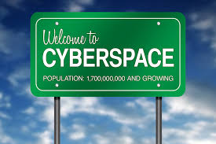
A Separate Place or Space
Cohen argues that the early utopian or dystopian theories were all dependent on seeing cyberspace as a separate place
She believes that it is seen that way because we cannot see it any other way
‘How can an assemblage of cables, routers, and servers be “a space”?’

Slide 49
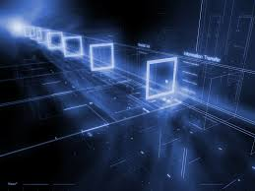
Cyberspace as Heterotopia
Cyberspace as fundamentally different to ‘real space’
Cyberspace as a third space
Heterotopia have a system of opening and closing that isolates them from ‘real space’
Notes:
Julie Cohen

Slide 50
Fundamentally Different
Declaration of the Independence of Cyberspace (1996)
Addressed to ‘Governments of the Industrial World’
  ‘I declare the global social space we are building to be naturally independent of the tyrannies you seek to impose on us. You have no moral right to rule us nor do you possess any methods of enforcement we have true reason to fear.’
  ‘Governments derive their just powers from the consent of the governed. You have neither solicited nor received ours. We did not invite you. You do not know us, nor do you know our world. Cyberspace does not lie within your borders. Do not think that you can build it, as though it were a public construction project. You cannot. It is an act of nature and it grows itself through our collective actions.’
Notes:
It was written primarily in response to the passing into law of the Telecommunications Act of 1996 in the United States which aimed to privatise the air waves and for the first time included the Internet.
The professed objective of the Act was to foster competition but in the case of the Internet 90% of the ISP market was won by 3 large companies
He is saying:
Cyberspace is a separate world – ‘the global social space we are building’, ‘our world’,
Different rules apply in cyberspace – ‘You have no moral right to rule us’, ‘Cyberspace does not lie within your boundaries’. He actually says later, ‘Our world is different’
Cyberspace has agency of itself – ‘It is an act of nature and grows itself’
He also says, Cyberspace consists of transactions, relationships, and thought itself, arrayed like a standing wave in the web of our communications. Ours is a world that is both everywhere and nowhere, but it is not where bodies live.

Slide 51
Spaces and Cyberspaces
‘There is no space, only spaces. These spaces, as social productions, are always centred in relation to human agency and are amenable to reproduction or change because their constitution takes place as part of the day-to-day praxis or practical activity of individuals and groups in the world.’
  Christopher Tilly
‘There is not one single, unified cyberspace; rather, there are multiple, heterogeneous networks, within which telecommunications and information technologies become closely enrolled with human actors, and with other technologies, into systems of sociotechnical relations across space...'.
  Stephen Graham
Notes:
Tilley, A Phenomenology of Landscape, p. 10.
Stephen Graham, "The End of Geography or the Explosion of Place? Conceptualising Space, Place and Information Technology," in The New Media and Cybercultures Anthology, ed. Pramod K. Nayar (Chichester: Wiley-Blackwell, 2010), p. 101.
Many of the writers state that we use spatial metaphors to describe and define cyberspace – eg highway, site, home
Graham states that we use spatial metaphor to define cyberspace and these metaphors have an important roles in shaping the ways in which technologies are socially constructed, just as those representing the material production of space and territory shape those. He refers to Lefevbre
He talks about co-evolution – the parallel social production of geographical space and electronic space rather than substitutes

Slide 52
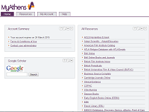
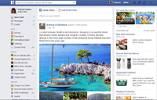

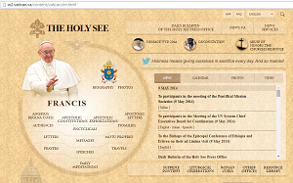
Is Cyberspace Heterogeneous?

Slide 53

Metaverse
Snow Crash, Neal Stephenson (1992)
An augmented reality
Reality merges with virtual reality

Slide 54
Quote from Snow Crash
‘Hiro has a house in a neighbourhood just off the busiest part of the Street.’
‘By getting in early, Hiro’s buddies got a head start on the whole business. Some of them even got very rich off it.’
That’s why Hiro has a ice big house in the Metaverse but has to share a 20-by-30 in Reality. Real estate acumen does not always extend across universes.’

Slide 55
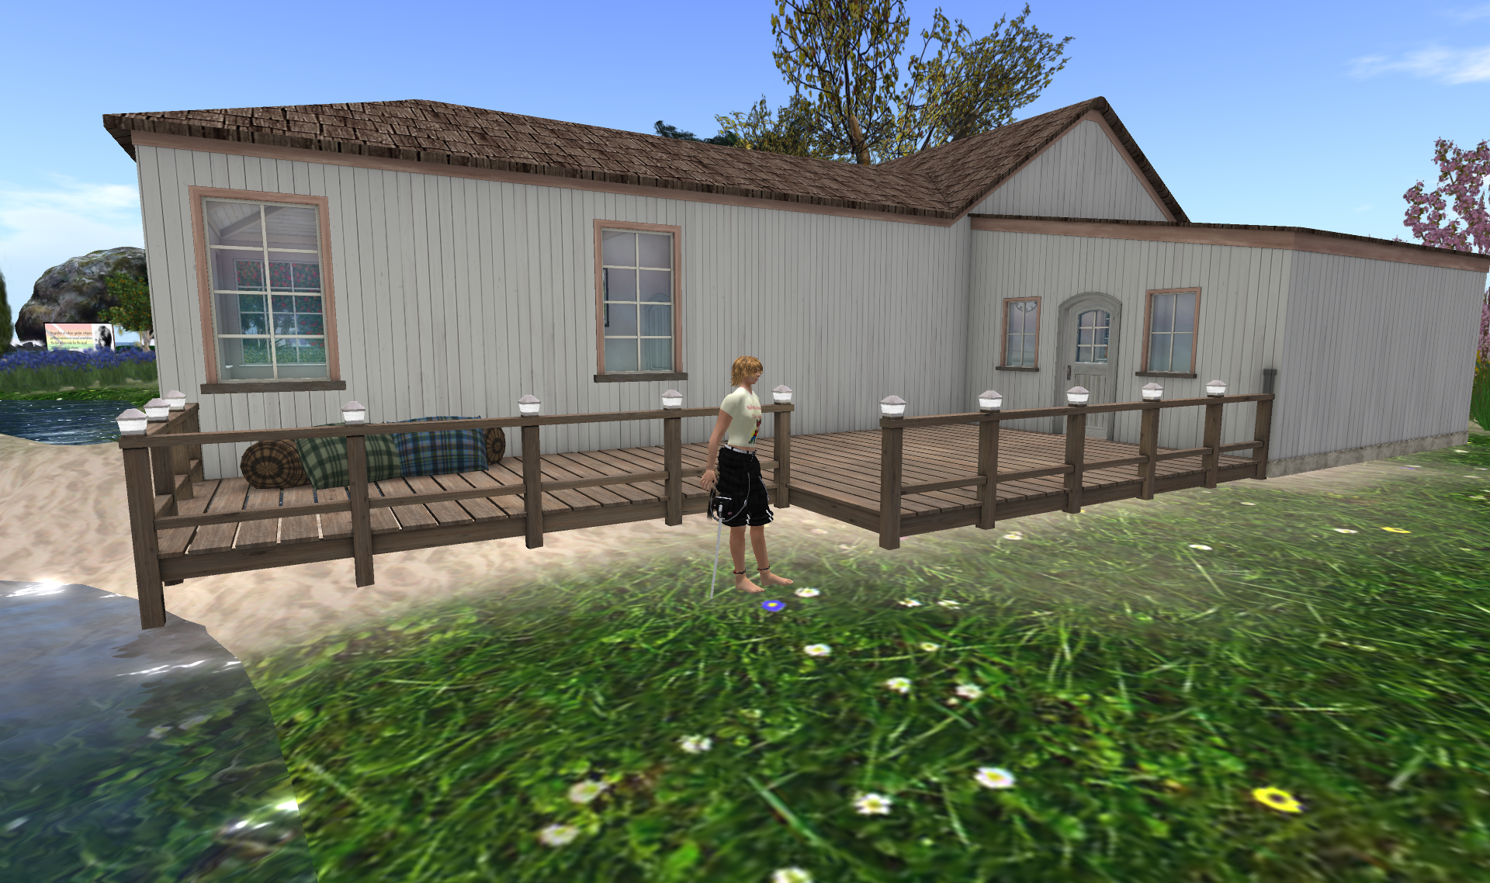
Second Life

Slide 56
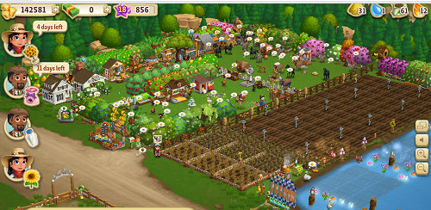
Farm on Facebook

Slide 57
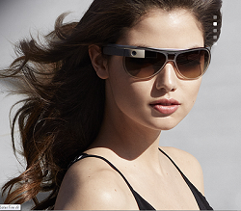

Augmented Reality
Google Glass
  ‘This is just the start’
  Became available this year
  A wearable computer
    Navigation
      Turn-by-turn navigation
    Strava Run
      Tracks run and performance
    GolfSight
      Accurate pin distance, course data and scoring information

Slide 58
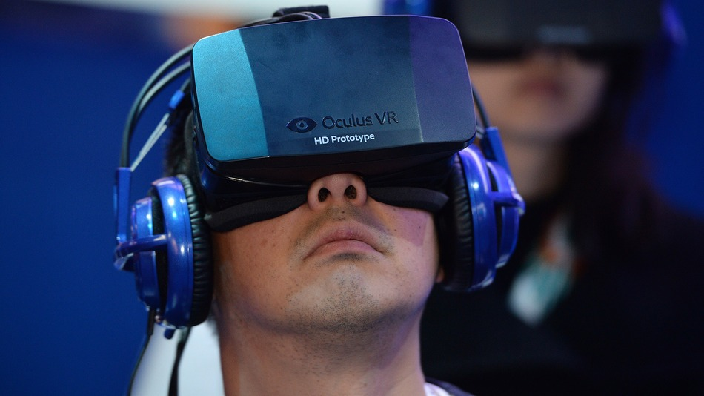
The Oculus Rift
‘Over the next 10 years, virtual reality will become ubiquitous, affordable, and transformative, and it begins with a truly next-generation gaming experience’
’We’ll see you in the Metaverse!’
  Oculus VR Website
Notes:
The Metaverse is a place in Snow Crash by Neal Stephenson
It’s a place where virtual reality and real life are more or less merged

Slide 59
25th March 2014
‘I'm excited to announce that we've agreed to acquire Oculus VR, the leader in virtual reality technology.
At this point we feel we're in a position where we can start focusing on what platforms will come next to enable even more useful, entertaining and personal experiences.
This is where Oculus comes in. They build virtual reality technology, like the Oculus Rift headset. When you put it on, you enter a completely immersive computer-generated environment, like a game or a movie scene or a place far away. The incredible thing about the technology is that you feel like you're actually present in another place with other people. People who try it say it's different from anything they've ever experienced in their lives.’

Slide 60
25th March 2014
‘Oculus's mission is to enable you to experience the impossible. Their technology opens up the possibility of completely new kinds of experiences.
Imagine enjoying a court side seat at a game, studying in a classroom of students and teachers all over the world or consulting with a doctor face-to-face -- just by putting on goggles in your home.
This is really a new communication platform. By feeling truly present, you can share unbounded spaces and experiences with the people in your life. Imagine sharing not just moments with your friends online, but entire experiences and adventures.
One day, we believe this kind of immersive, augmented reality will become a part of daily life for billions of people.’

Slide 61

25th March 2014
‘Virtual reality was once the dream of science fiction. But the internet was also once a dream, and so were computers and smartphones. The future is coming and we have a chance to build it together. I can't wait to start working with the whole team at Oculus to bring this future to the world, and to unlock new worlds for all of us.’
Mark Zukerberg, CEO, Facebook
$2 billion
Notes:
The Oculus Rift is expected to become available by next year
However there is a lawsuit pending with Zenimax Media
http://www.theguardian.com/technology/2014/may/22/oculus-rift-maker-sued-over-virtual-reality-technology
Virtual reality headset manufacturer Oculus is being sued by publisher, ZeniMax Media. The company claims that its intellectual property, as well as the expertise of several employees, was used to develop the Oculus Rift headset, which was successfully crowd-funded on the Kickstarer site in 2012
New worlds for us all – so there is still a separate place called cyberspace – or maybe the Metaverse

