Slide 1
Topic 11a - Java Collections Reference Documentation
Dr Stephen Hole

Slide 2
Collections Framework
The Collections Framework is a sophisticated hierarchy of interfaces and classes that provide state-of-the-art technology for managing groups of objects.
The Java Collections Framework standardises the way in which groups of objects are handled by Java programs.
The Collections Framework was designed to meet several goals.
  First, the framework had to be high-performance.
  Second, the framework had to allow different types of collections to work in a similar manner and with a high degree of interoperability.
  Third, extending and/or adapting a collection had to be easy.

Slide 3
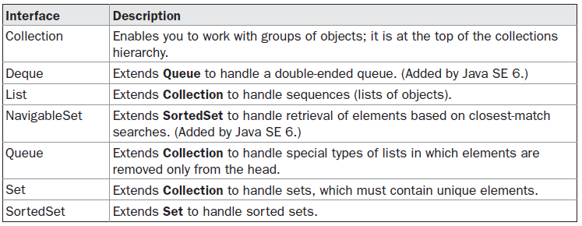
Collection Interfaces
The Collections Framework defines several interfaces.
The interfaces that underpin collections are summarized in the following table:

Slide 4
Collection Interfaces
In addition to the collection interfaces, collections also use the Comparator, RandomAccess, Iterator, and ListIterator interfaces.
Comparator defines how two objects are compared;
Iterator and ListIterator enumerate the objects within a collection.
By implementing RandomAccess, a list indicates that it supports efficient, random access to its elements.

Slide 5
Collections Interface
The Collection interface is the foundation upon which the Collections Framework is built because it must be implemented by any class that defines a collection.
Collection is a generic interface that has this declaration:
  interface Collection<E>
Objects are added to a collection by calling add( ).
Notice that add( ) takes an argument of type E, which means that objects added to a collection must be compatible with the type of data expected by the collection.
You can add the entire contents of one collection to another by calling addAll( ).

Slide 6
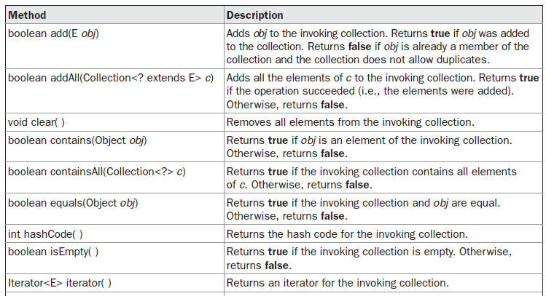
Methods Defined by Collection

Slide 7
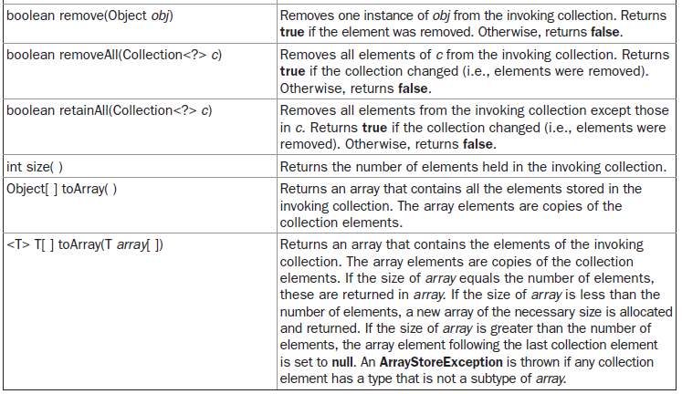
Methods Defined by Collection

Slide 8
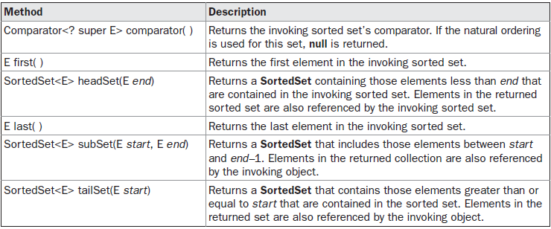
Methods Defined by SortedSet

Slide 9
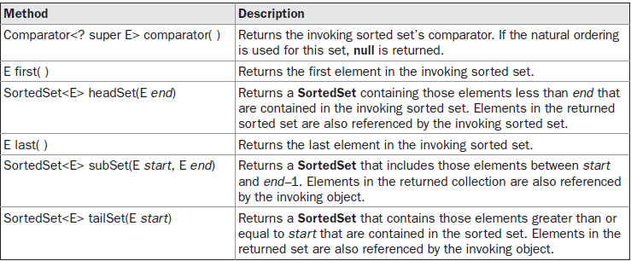
Methods Defined by the NavigableSet

Slide 10
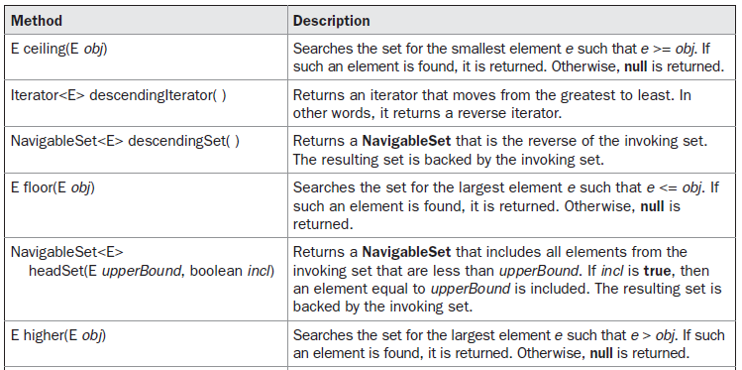
Methods Defined by the NavigableSet

Slide 11
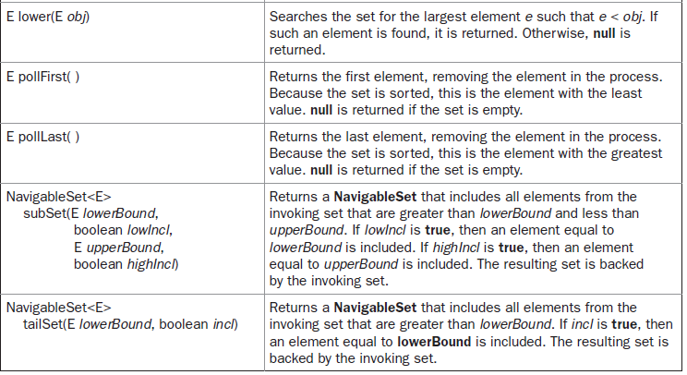
Methods Defined by the NavigableSet

Slide 12
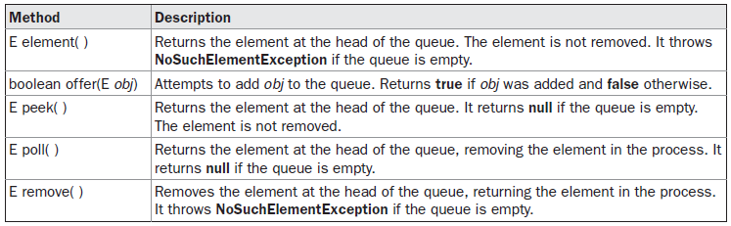
Methods Define by Queue

Slide 13
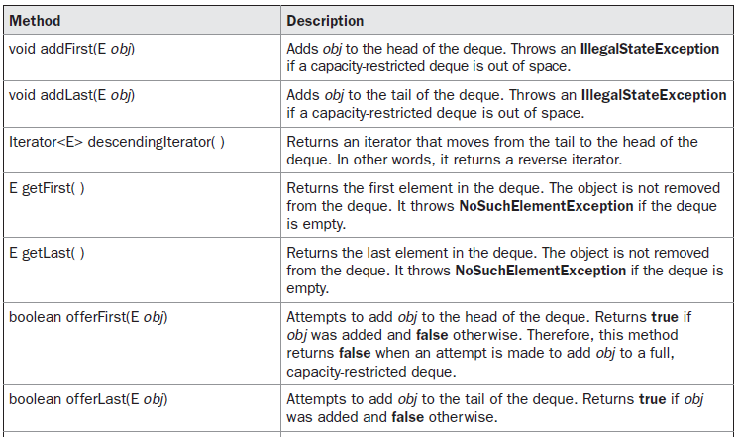
Methods Defined by Deque

Slide 14
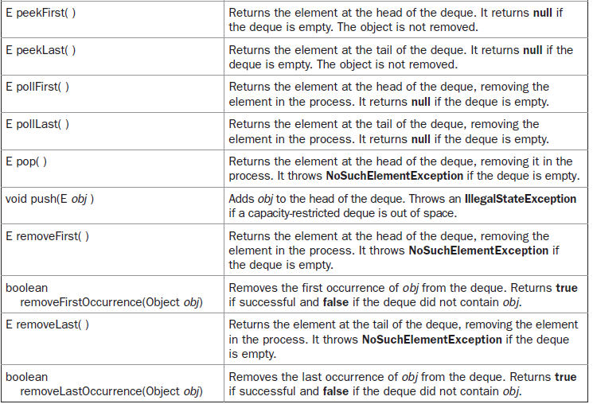

Slide 15
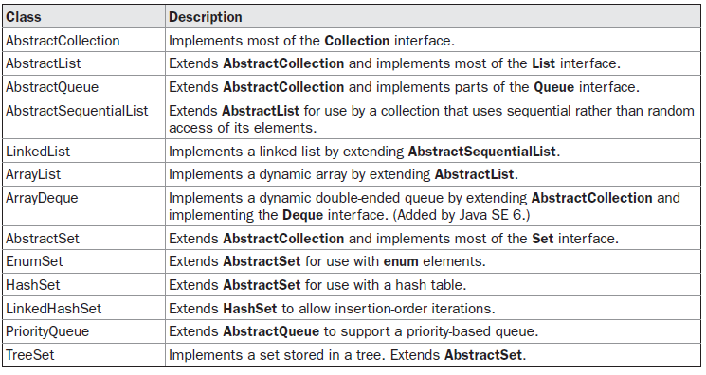
Collection Classes

