Slide 1
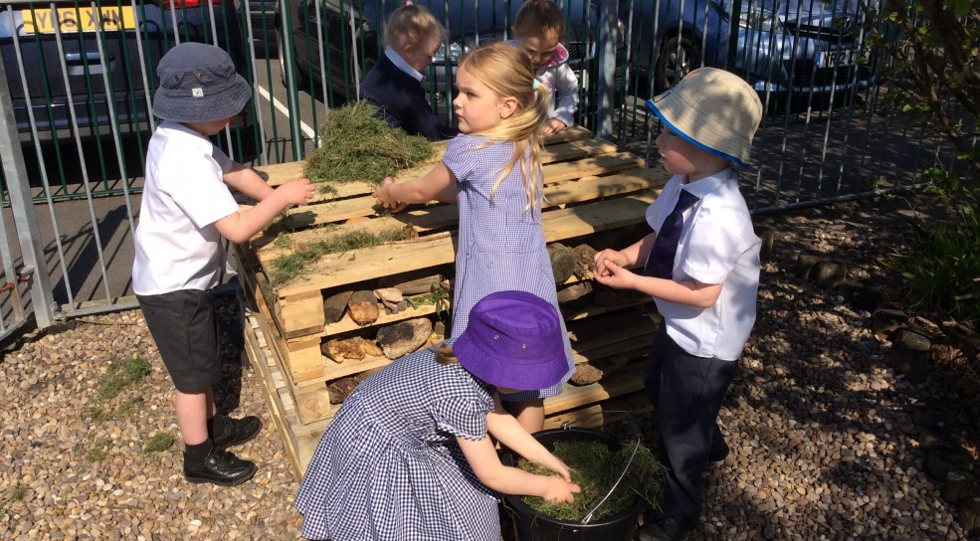

Slide 2
Observational study on the role of the adult in the environment in the foundation phase and early years in Wales
Joanna Coghlin

Slide 3
Intended Research
Observational study, with check list.
Questionnaires and Interviews.
Mixed Method of study including both quantitative and qualitive Data.
Primarily the research leads this study to an interpretivist paradigm.

Slide 4
Literature Review
The Foundation Phase in Wales: on using both indoor and outdoor environments to encourage early learning and development. (Welsh Assembly Government, 2009)
The Foundation Phase places great importance on using the outdoor environment to allow children to explore natural surroundings, experiment and take risks (Foundation Phase Framework, 2015).
As Steiner (cited in Nicol and Taplin, 2012) theory suggests the best form of assessment is for the adult to be able to observe and study the child, without the need to become involved and direct activities that are going on.
Donaldson (2018) Successful Futures – Independent capable learners. The new national curriculum (2022)

Slide 5
McClintic and Petty (2015) studying the roles of teachers during children’s outdoor play found that maintaining safety and directing children’s play were the most common roles played by teachers in the outdoor environment.
Waters and Maynard (2010)- Also observed interaction between the children and the adults and the initiation of interaction, questioning and conversation between the children and the adults
Maria Montessori (cited in Barbieru, 2016) - Child moving freely in the environment that the educator or pedagogy can see the child’s true potential and development. Montessori believed that children need to acquire independence in order to grow and learn.

Slide 6
Research question?
What is the adults understanding of their role when in the outdoor environment?
What is the adults understanding of child led learning when in the outdoors?
How confident and comfortable are the adults when in the outdoors?

Slide 7
Methodology
3 x 30 minute observations throughout the day over 5 days.
Take a check list with me to see
how many times the adult intervened in the play.
How many times the adult stopped the flow of play.
How often did the adult question the child?
Questionnaires are measurable data, the answers are measurable and analysed. Makherji and Albon(2012)
Interviews to accompany questionnaires.
Holmes (2012) Advised the best way to carry out an interview would be to tape record so that the interviewer can actively listen.
Additional person (Bell, 2005) keeping note of the interview, and the minutes of our conversation.

Slide 8
Exactly what I plan to do…
8 Children in every group. ( adults ratio 1:8 (Foundation Phase Framework, 2015).
1 Adult with 8 children in each observation.
4 Settings (2 large schools. 1 small school and a Day nursery)
Foundation Phase: Ages 3-6
Loose Parts (Nicholson, 1971)

Slide 9
Ethics
Written consent from Headteachers / Nursery Manager
Policy and procedures
Authorisation from the individuals (both adults and children) being involved in the observations.
Optional choice to complete a fully confidential questionnaire.
Possibility of interviews which stem from questionnaires.
When drawing up the questionnaires there will be particular awareness that some members of staff will consider this personal as it could be misconstrued as questioning their abilities to do their job, Therefore it’s important to keep the questions relevant to the research, non-intrusive and all questionnaires will remain anonymous for confidentiality reasons.
Data taken from observations will be kept completely anonymous and no names or identaties will be used when drawing up results, both adults and children with be given pseudo names or labelled with numbers or letters (Child A, Adult/Pedagogy 2) – Data protection and confidentiality.
Schools and Nursery will at no point be disclosed or names through the research.

Slide 10
Analysis
Observations: Qualitative Data
Non statistical research, Able to understand the area of study in greater depth, First hand experience of seeing the research being carried out (Bell, 2005)
Transcript
Questionnaires, check list: Quantative Data
Analysed and presented in graphs, charts or diagrams to show and compare the measurable data.
Numerical data and see if there are any trends within the findings. (Mukherji & Albon, 2012)

Slide 11
Reference
Barbieru, I. T. C. (2016). The Role of the Educator in a Montessori Classroom. Revista Romaneasca pentru Educatie Multidimensionala, 8(1), 107-123. doi: 10.18662/rrem/2016.0801.07
Bell, J. (2005) Doing your research project: A guide for first time researchers in Education, health and social science. 4th edn. Maidenhead: Open University Press.
Donaldson, G. (2018) Successful Futures Looking at the Curriculum and Assessment Arrangements in Wales. Available at: https://gov.wales/sites/default/files/publications/2018-03/succesful-futures-a-summary-of-professor-graham-donaldsons-report.pdf
Flannigan, C. and Dietze, B., (2017). Children, Outdoor Play, and Loose Parts. Journal of Childhood Studies, 42(4), pp. 53-60.
Foundation Phase Framework (2015). Foundation Phase Framework (Resvised 2015). Available at: https://gov.wales/sites/default/files/publications/2018-02/foundation-phase-framework-revised-2015.pdf
Holmes, G Robert. (2012).Doing your early years Research Project: a step by step guide. 2nd edn. London. Sage
McClintic, S. & Petty, K. (2015) Exploring Early Childhood Teachers’ Beliefs and Practices About Preschool Outdoor Play: A Qualitative Study, Journal of Early Childhood Teacher Education, 36:1, 24-43, DOI: 10.1080/10901027.2014.997844

Slide 12
Mukherji, P and Albon, D. (2012) Research methods in early childhood. London. Sage
Nicol, J and Taplin, J. (2012) Understanding the Steiner Waldorf Approach. Early years education in practice. New York. Routledge
Waters, J & Maynard, T (2010) What's so interesting outside? A study of child‐initiated interaction with teachers in the natural outdoor environment, European Early Childhood Education Research Journal, 18:4, 473-483, DOI: 10.1080/1350293X.2010.525939
Welsh Assembly Government. (2009) Foundation Phase Outdoor Learning Handbook. Available at : https://s3-eu-west-1.amazonaws.com/hwb-live-storage/98/b6/32/ac/655c427189581dd0cab40bf0/foundation-phase-outdoor-learning-handbook.pdf

Slide 13

Any Questions?

