Slide 1
DEVELOPING RELATIONSHIPs and workplace achievements
TRAINING
TEODORA IFTIME LECTURER: BRYNACH HEFFERNAN

Slide 2

Training
According to Jack Holloran “training is an activity leading to skilled behaviour, teaching employees the basic skills they need to perform their job. The heart of a continuous effort designed to improve employee competency and organisational performance.”
Dale S. Beack on the other hand, defines training as “the organised procedure by witch people learn knowledge and improve skills for a definite purpose”.

Slide 3
To improve the performance of employees, short-term training is a process of acquiring knowledge, shaping skills concepts, rules, or altering attitudes and behaviours.
Training must be provided to employees after they have been selected, placed and introduced to their new workplace.

Slide 4
According to Douglas McGregor there are 3 diffrent purposes for training:
Acquiring intellectual knowledge
Acquiring manual skills
Acquiring problem solving skills

Slide 5

This skill knowledge is the result of extensive practise, which results in the storing of skill information. The ability to ride a bicycle is a common illustration of skill knowledge.
Acquiring a manual skill involves practise or experience accompanied by positive reinforcement approach based exclusively upon trial and error. While mentoring can accelerate learning, the individual cannot learn until he participates and receives cues indicating the success of his efforts.

Slide 6

Much of the work of a manager is devoted to finding solutions to problems. His responsibilities include directing the actions of both himself and those of his subordinates, planning, and a wide variety of other decision-making duties.
A chinesse proverb says:”Give a man a fish and you will feed him for a day. Teach a man to fish, and you will feed him for a life time.

Slide 7

Teaching a person a useful skill can be more beneficial in the long run than filling a need for them temporarily, that’s basically the meaning of this proverb. So, for example, if you give a hungry man a fish then his hunger will be satisfied, but only for a short time. If, instead, the man were taught how to fish, then he could eat whenever he got hungry. Well, assuming he is able to catch a fish whenever he wanted to right?

Slide 8
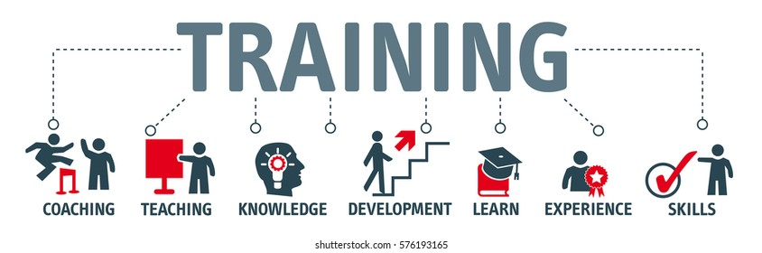
There are 5 steps to follow when it comes to a training:
Decide if the training is needed
Determine what type of training is needed
Identifying goals and objectives
Implementing training
Evaluation of the training programme

Slide 9
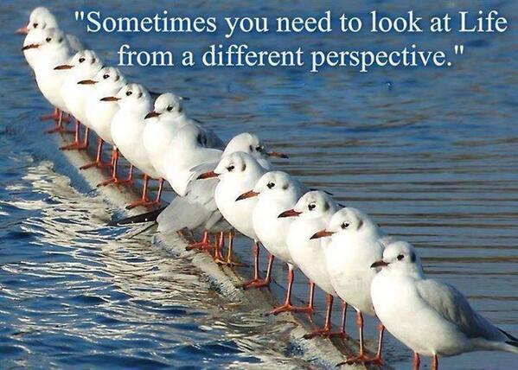
In order to assess whether or not an employee's performance has improved as a result of the training programme, companies should conduct an evaluation of the training session.
Henry Ford said “ if you always do what you have always done, you will always get what you always got.

Slide 10
A. On the job training B. Off the job training
Job instruction training
Planned progression
Job rotation
Temporary promotions
Comitee and junior boards
On-the-job coaching accounts for 80% of all training, as has been previously stated. Aside from the fact that it is topical and relevant to the real-world experience of everyday life, it also offers the distinct advantage of meeting the unique requirements of each individual subordinate.
Discussion method
Demonstrations
Role-playing
Computer modelling
Experimental exercise
Off-the-job training is a type of education in which employees gain knowledge about their job or the latest developments in their area at a location other than their place of employment.

Slide 11
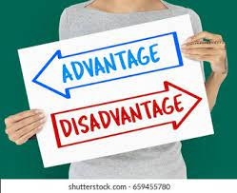
Both methods of training have advantages and disadvantages
Advantages On-the-job training are:
It does no disrupt the normal operation
It is systematically organised
Efficiently created programs may add a lot of value
On the other hand has disadvantages such as:
It is not directly in the context of the job
It is often formal and expensive
Trainers may not be motivated
It is artificial in nature

Slide 12

Also On-the-job training has advantages but disadvantages too
Advantages:
Simple method of lerning
Has expert supervision
Improved productivity
Quicker learning
Is more effective
Disadvantages:
Productivity can be lowered
Team disturbances
It can be rushed
Higher risk of accidents

Slide 13
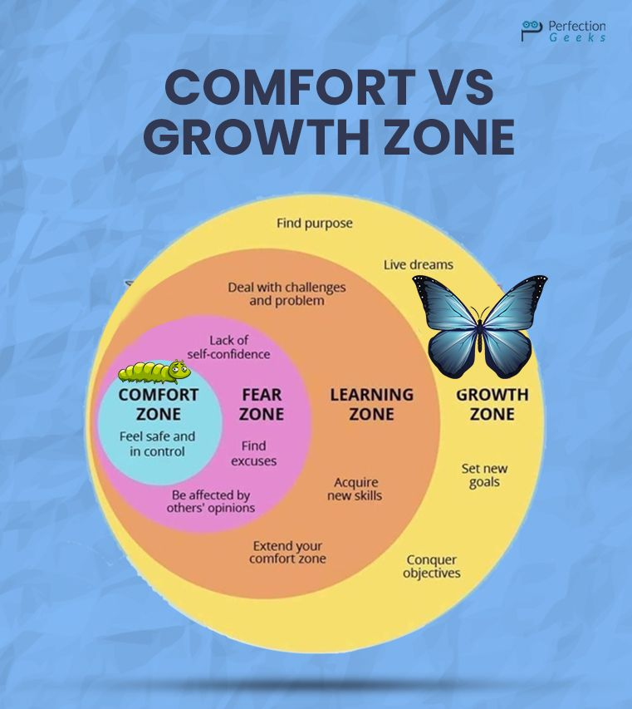
We complain about things that are actually in our control. And, sometimes we stay in a situation, even if we don’t like it, just because it’s what’s comfortable. It’s what we are used to, it doesn’t require learning, it doesn’t require stepping out of our comfort zone.
This quote symbolizes stepping out of our comfort zone. Do something different and obtain something different. Do something uncomfortable, taking a new leap of faith, experimenting with risk.

Slide 14
Training process benefits both, the Organisation and the Employee.
Advantages for the Organisation:
Goldstein and Gillian presented six reasons why businesses believe that training investments might help them achieve a significant advantage.
Increased staff efficiency- Through training, individuals can develop confidence, which manifests itself in their production and results.
Reduce supervision- When an employee works, he or she must be overseen.When an employee receives enough training, the quantity of monitoring necessary is reduced, and errors are reduced.

Slide 15

Less wastage: Training has a significant impact on reducing an employee's wastage, resulting in significant financial savings for the company.

Slide 16

Employees are happier and more likely to stay with the company if they are given the opportunity to advance through effective training. As a result of this, the company's workforce turnover will be reduced.
Aid in the smooth running of the business- New hires may not be familiar with how the company operates, but training can help them develop a better understanding of how it works for everyone in the firm, new or old.

Slide 17

Advantages to the employee:
Mc Namara (2008) cited various benefits in his contribution to the argument over the general benefits of staff training and development.
Self-confidence- Employee self-confidence increases as a result of training. The individual is able to adapt his work environment and is not embarrassed in front of his superiors. This confidence translates into opportunities for employees to make more effective efforts in the future.

Slide 18

Boost motivational levels-Training instils a positive attitude in employees and boosts their motivation levels inside the organisation, ultimately boosting the organization's performance.

Slide 19

High rewards:
A well-designed training program enables employees to take advantage of the company's reward structure and incentives. Thus, the employee receives these benefits, which boosts his motivation levels.

Slide 20

Promotions:
Effective training programmes improve performance and raise the likelihood of promotion. Many employees even enrol in a specific programme designed to increase their chances of promotion and advancement inside the organisation.

Slide 21
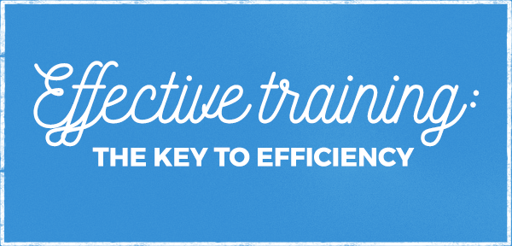
Principles of training
To achieve the desired effects, training must be ongoing, methodical, and result in positive outcomes for both employers and employees (Planty, McCord and Efferson 1948)
According to Littlefield, C.I. and Rachel, R., the following concepts must guide training programmes in order for them to be effective.
The most successful training occurs when the learning experience is replicated as closely as possible to the work environment.

Slide 22
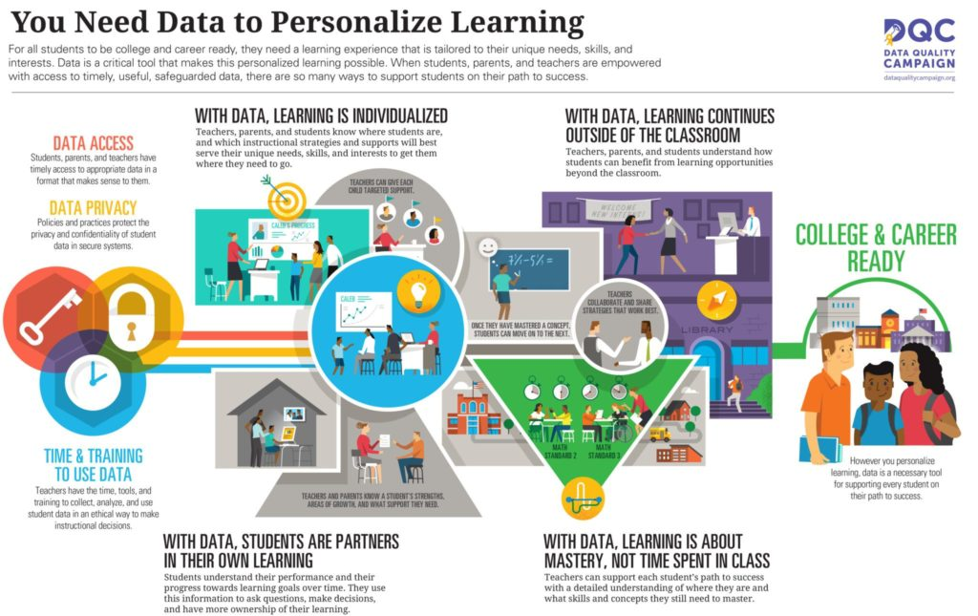
Employees learn best when they are given personalised education and assistance that is helpful, polite, and mindful of their needs.

Slide 23
An evaluation of training requirements must take into account two factors:
Job requirements
Personal requirements
However, Robbins and Decenzo claim that managers can identify an employee's specific training needs by answering four simple questions:
What are the Organisation’s goals?
What steps must be taken, in order to achieve these objectives?
What actions are required by each job holder to accomplish his or her allocated responsibilities?
Whether or not an employee is capable of doing the required behaviours depends on what abilities, knowledge, and attitudes he or she has.

Slide 24


It is clear from these questions that human resources planning and training demands are inextricably linked.
When an organisation determines what type of labour is needed and what type of skills and knowledge are required, a training programme should automatically follow.

Slide 25

Conclusion
During the age of globalisation, knowledge is becoming a fundamental capital and a driving force for growth as a source of long-term competitive advantage.
An employee's training is designed to help them perform their duties more efficiently .Employee training isn't ongoing, but it's scheduled and offered at a predetermined time.

Slide 26
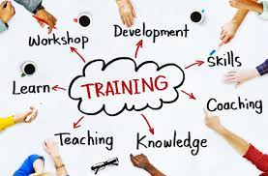
Even if training can be time consuming, expensive, it can higher the risk of accidents and and can also lower the productivity, training is necessary at every stage of the work process and for every employee and is also essential in keeping people up to date with the fact that new technology, concepts, values, and environments are constantly evolving.

Slide 27


Slide 28
References
1. Hannah Skentelbery (2018)The Main Pros and Cons of On the Job Training. Available at: https://www.warrington-worldwide.co.uk/2018/04/25/the-main-pros-and-cons-of-on-the-job-training/
2. Quotes (2021) B.B. King quotes. Available at: https://www.brainyquote.com/quotes/b_b_king_102588
3. Coventry University (2020) Of the job training. Available at: https://www.futurelearn.com/info/courses/training-development-work/0/steps/88531
4. Training (2018) Train the trainer. Available at: https://www.sos.state.co.us/pubs/elections/VotingSystems/systemsDocumentation/HartIntercivic/COApplicationDocs/F-GeneralDocumentation/03-TrainingMaterials/PollingPlaceOperations/TrainTheTrainer/6661-008-A-Verity-1-0-TTT-Handbook.pdf
5. Rolf P. Lynton, Uday Pareek (2011) Training for development, SAGE Publishing, India. 400 pg

Slide 29
6. Tracey Williams R . (1992) Designing Training and Development Systems. Third Edition. 503 p
7. Shula, Don, (2001) The Little book of coaching : motivating people to be winners. 117 p
8. Blanchard, K. H., & Sargent, A. G. (1984). The one minute manager is an androgynous manager. Training & Development Journal.
9. Kenneth H. Blanchard, Don Schula (2001) The little book of coaching: Motivating people to be winners. 128 p
10. Kenneth H. Blanchard, Spencer Johnson (2011) The One Minute Manager - Increase Productivity, Profits And Your Own Prosperity . 112 p

