Slide 1
Apps to support your studies
John apps/ rhian pole/ jamie tavender

Slide 2
MOBILE DEVICES
Many of the activities that have been discussed as part of the module so far, can be performed/accessed via a mobile device.
Mobile devices are adapting quickly to offer a broader range of ways of accessing and interacting with academic learning materials.

Slide 3
MOBILE DEVICES
Pros
cons
Access the VLE
Keep up to date with course emails
Stay organised
Read online content
Record lectures (with permission!)
Take photographs/video
Use social networking tools
Access podcasts
Participate in online quizzes, sms voting, video conferencing, etc.
Not suitable for;
writing lengthy and complex assignments
Reading journals, online books or extensive course materials
Tasks that require lots of switching between applications

Slide 4
Apps to support your studies
Mobile devices allow you to download ‘apps’.
Many of these apps are free and useful for study!
Apps can be accessed through;
App Store
https://market.android.com/apps
http://appworld.blackberry.com

Slide 5










Apps
 | Apple | Android | Blackberry
Storing Your files | Dropbox SkyDrive
Reference Management | Mendeley | Referey
Study Aids | Soundnote MaxJournal Coursenotes Dictionary iTunesU | Springpad Evernote | Study Buddy Dictionary
Time management | iCal | Business Calendar Free | Get It Done Tasks

Slide 6
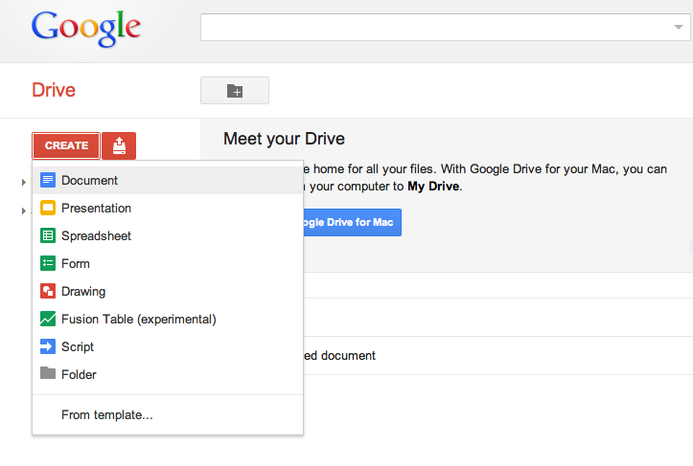
Google drive

Slide 7
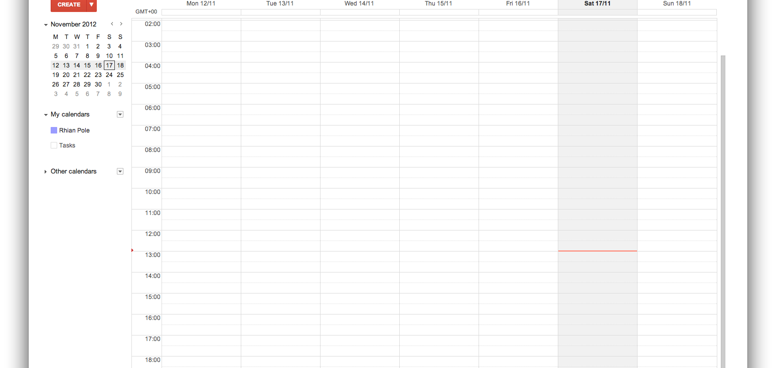
Google calendar

