Slide 1

The Impact of Social Isolation
“Perceived social isolation represents a mismatch between an individual's social needs and the provisions the social environment offers or is perceived to offer” (Hawkley and Capitanio, 2015).
(Conti, 2018)
SJSS4002: The Caring Society Student I.D. – 1603130

Slide 2
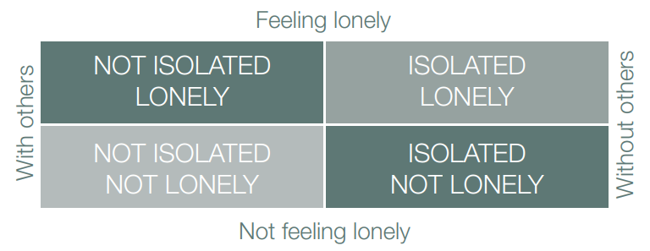
Defining Isolation
Isolated or Lonely?
Isolation as a Choice (Age UK, 2018).
A Lack of Belonging (Larson, 2019).
Poor Attachment (Bogaerts, Vanheule and Desmet, 2006).
(British Red Cross, 2016)

Slide 3
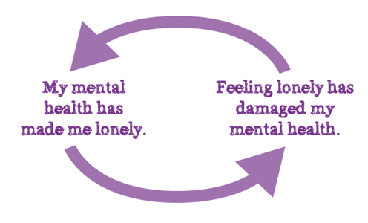
The Effects of Isolation
Impact on Systolic Blood Pressure (Hawkley et al., 2010), (NHS, 2010).
Cardiovascular Disease and Morbidity Rates (Valtorta et al. 2016).
Altzeimer’s, Cholesterol and Stress (Hawkley and Cacioppo, 2010).
(Mind, 2013)

Slide 4
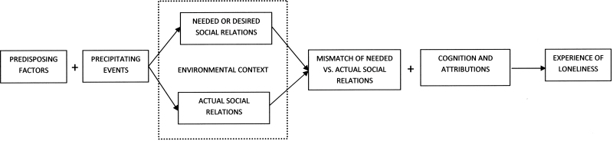
Theories of Isolation
Interactionalism (Peplau and Perlman, 1982).
Therapeutic Intervention (Hart, 2009).
Bowlby and Attachment (Holmes, 1993).
Maternal Deprivation Hypotheses (Bowlby, 1953).
(Open-i, no date)

Slide 5

Looked After Children
Looked After Children (Action for Children, 2017).
Social Media – Cause or Cure?
Adverse Childhood Experiences (Hughes, 2017).
(Childline, no date)

Slide 6
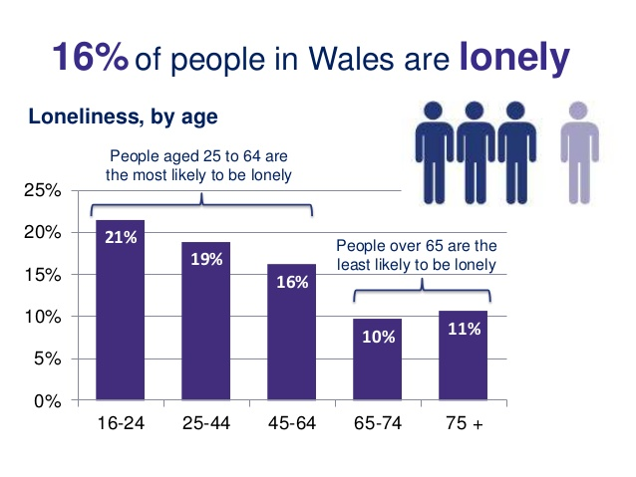
Isolation in Wales
Well-being Initiatives (Irranca-Davies, 2018a).
National Survey for Wales (Irranca-Davies, 2018a).
(Slideshare, 2018)

Slide 7

Conclusion
“Young or old, loneliness doesn’t discriminate.”
(Action for Children, 2017, p2).
(Slikker, 2018)

Slide 8
References
Action for Children (2017) It Starts With Hello: A report looking into the impact of loneliness in children, young people and families. [online] Available at: https://www.actionforchildren.org.uk/media/9724/action_for_children_it_starts_with_hello_report__november_2017_lowres.pdf [Accessed 16 Jan. 2019].
Age UK (2018) Loneliness and isolation – understanding the difference and why it matters. [online] Available at: https://www.ageuk.org.uk/our-impact/policy-research/loneliness-research-and-resources/loneliness-isolation-understanding-the-difference-why-it-matters/ [Accessed 14 Jan. 2019].
Bogaerts, S., Vanheule, S. and Desmet, M. (2006) ‘Feelings of Subjective Emotional Loneliness: An Exploration of Attachment’. Social Behavior and Personality: an international journal, 34(7), pp.797-812.
Bowlby, J. (1953) Child care and the growth of love. London: Penguin Books.
Childline (no date) Loneliness and isolation. [online] Available at: https://www.childline.org.uk/info-advice/your-feelings/feelings-emotions/loneliness-isolation/ [Accessed 18 Jan. 2019].
Conti, C. (2018) alone woman sitting next to her lover's empty chair. [online] Adobe Stock. Available at: https://stock.adobe.com/images/alone-woman-sitting-next-to-her-lover-s-empty-chair/181951973 [Accessed 11 Dec. 2018].
Hart, R. (2009) ‘Child refugees, trauma and education: interactionist considerations on social and emotional needs and development’. Educational Psychology in Practice, 25(4), pp.351-368.
Hawkley, L. and Cacioppo, J. (2010) ‘Loneliness Matters: A Theoretical and Empirical Review of Consequences and Mechanisms’. Annals of Behavioral Medicine, 40(2), pp.218-227.
Hawkley, L. and Capitanio, J. (2015) ‘Perceived social isolation, evolutionary fitness and health outcomes: a lifespan approach’. Philosophical Transactions of the Royal Society B: Biological Sciences, 370(1669).
Hawkley, L. et al. (2010) ‘Loneliness predicts increased blood pressure: 5-year cross-lagged analyses in middle-aged and older adults’. Psychology and Aging, 25(1), pp.132-141.

Slide 9
Holmes, J. (1993) John Bowlby and Attachment Theory. London: Routledge.
Irranca-Davies, H. (2018a) Tackling loneliness and isolation in Wales is a national priority. [online] Welsh Government. Available at: https://gov.wales/newsroom/health-and-social-services/2018/isolation/?lang=en [Accessed 17 Jan. 2019].
Irrana-Davies, H. (2018b) Loneliness and social isolation is a growing threat to public health: We must tackle it together. [online] Welsh Government. Available at: https://gov.wales/newsroom/health-and-social-services/2018/loneliness/?lang=en [Accessed 17 Jan. 2019].
Larsen, P. (2019) Lubkin's Chronic Illness: Impact and Intervention. 10th ed. Burlington: Jones & Bartlett Learning.
Mind (2013) Loneliness | Mind, the mental health charity - help for mental health problems. [online] Available at: https://www.mind.org.uk/information-support/tips-for-everyday-living/loneliness/#.XEGjx_Z2tPY [Accessed 18 Jan. 2019].
NHS (2010) Loneliness and high blood pressure. [online] Available at: https://www.nhs.uk/news/heart-and-lungs/loneliness-and-high-blood-pressure/ [Accessed 16 Jan. 2019].
Open-i (no date) A discrepancy model of loneliness adapted from Perlman | Open-i. [online] Available at: https://openi.nlm.nih.gov/detailedresult.php?img=PMC3968864_geronb_gbt121_f0001&req=4 [Accessed 18 Jan. 2019].
Peplau, L. and Perlman, D. (1982) Loneliness: A Sourcebook of Current Theory, Research and Therapy. New York: Wiley.
Slideshare (2018) National Survey for Wales, 2017-18: Headline results. [online] Available at: https://www.slideshare.net/StatisticsWales/national-survey-for-wales-201718-headline-results [Accessed 18 Jan. 2019].
Slikker, D. (2018) Social Isolation is the Absence of Social Relationships. [online] Dorothy Slikker. Available at: http://www.authordorothyslikker.com/social-isolation-absence-social-relationships/ [Accessed 18 Jan. 2019].
Valtorta, N. et al. (2016) ‘Loneliness and social isolation as risk factors for coronary heart disease and stroke: systematic review and meta-analysis of longitudinal observational studies’. BMJ Journals, 102(13), pp.1009-1016.

