Slide 1

Course: BSc (Hons) Health and Social Care
Module: BMHP6030-Health, Wellbeing and Sustainable Development
Student name: Florence Mirembe
Student number: 2313074
Lecturer’s name: Dr Itse Olaoye
Submission Date: 24/07/2026
Recognition of AI Tool Usage
I certify that neither the creation of this assignment nor any of my research involved the use of AI tools. I certify that none of the content I have presented was produced using artificial intelligence. I certify that I have kept all the notes, drafts, and other materials I used; I might be requested to present these as proof.

Slide 2
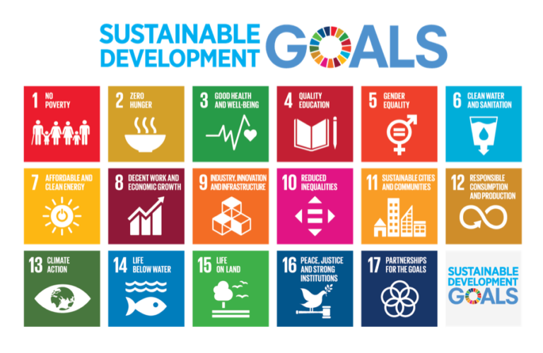
INTRODUCTION
Modern health and care practices are centered on sustainable development, well-being, and health, with an increasing emphasis on prevention, person- centered care, and addressing the social determinants of health.
This presentation explores the methods, challenges, and strategies that can be used to promote sustainability, improve health outcomes, and reduce inequalities across health and care systems.
This Photo by Unknown Author is licensed under CC BY

Slide 3
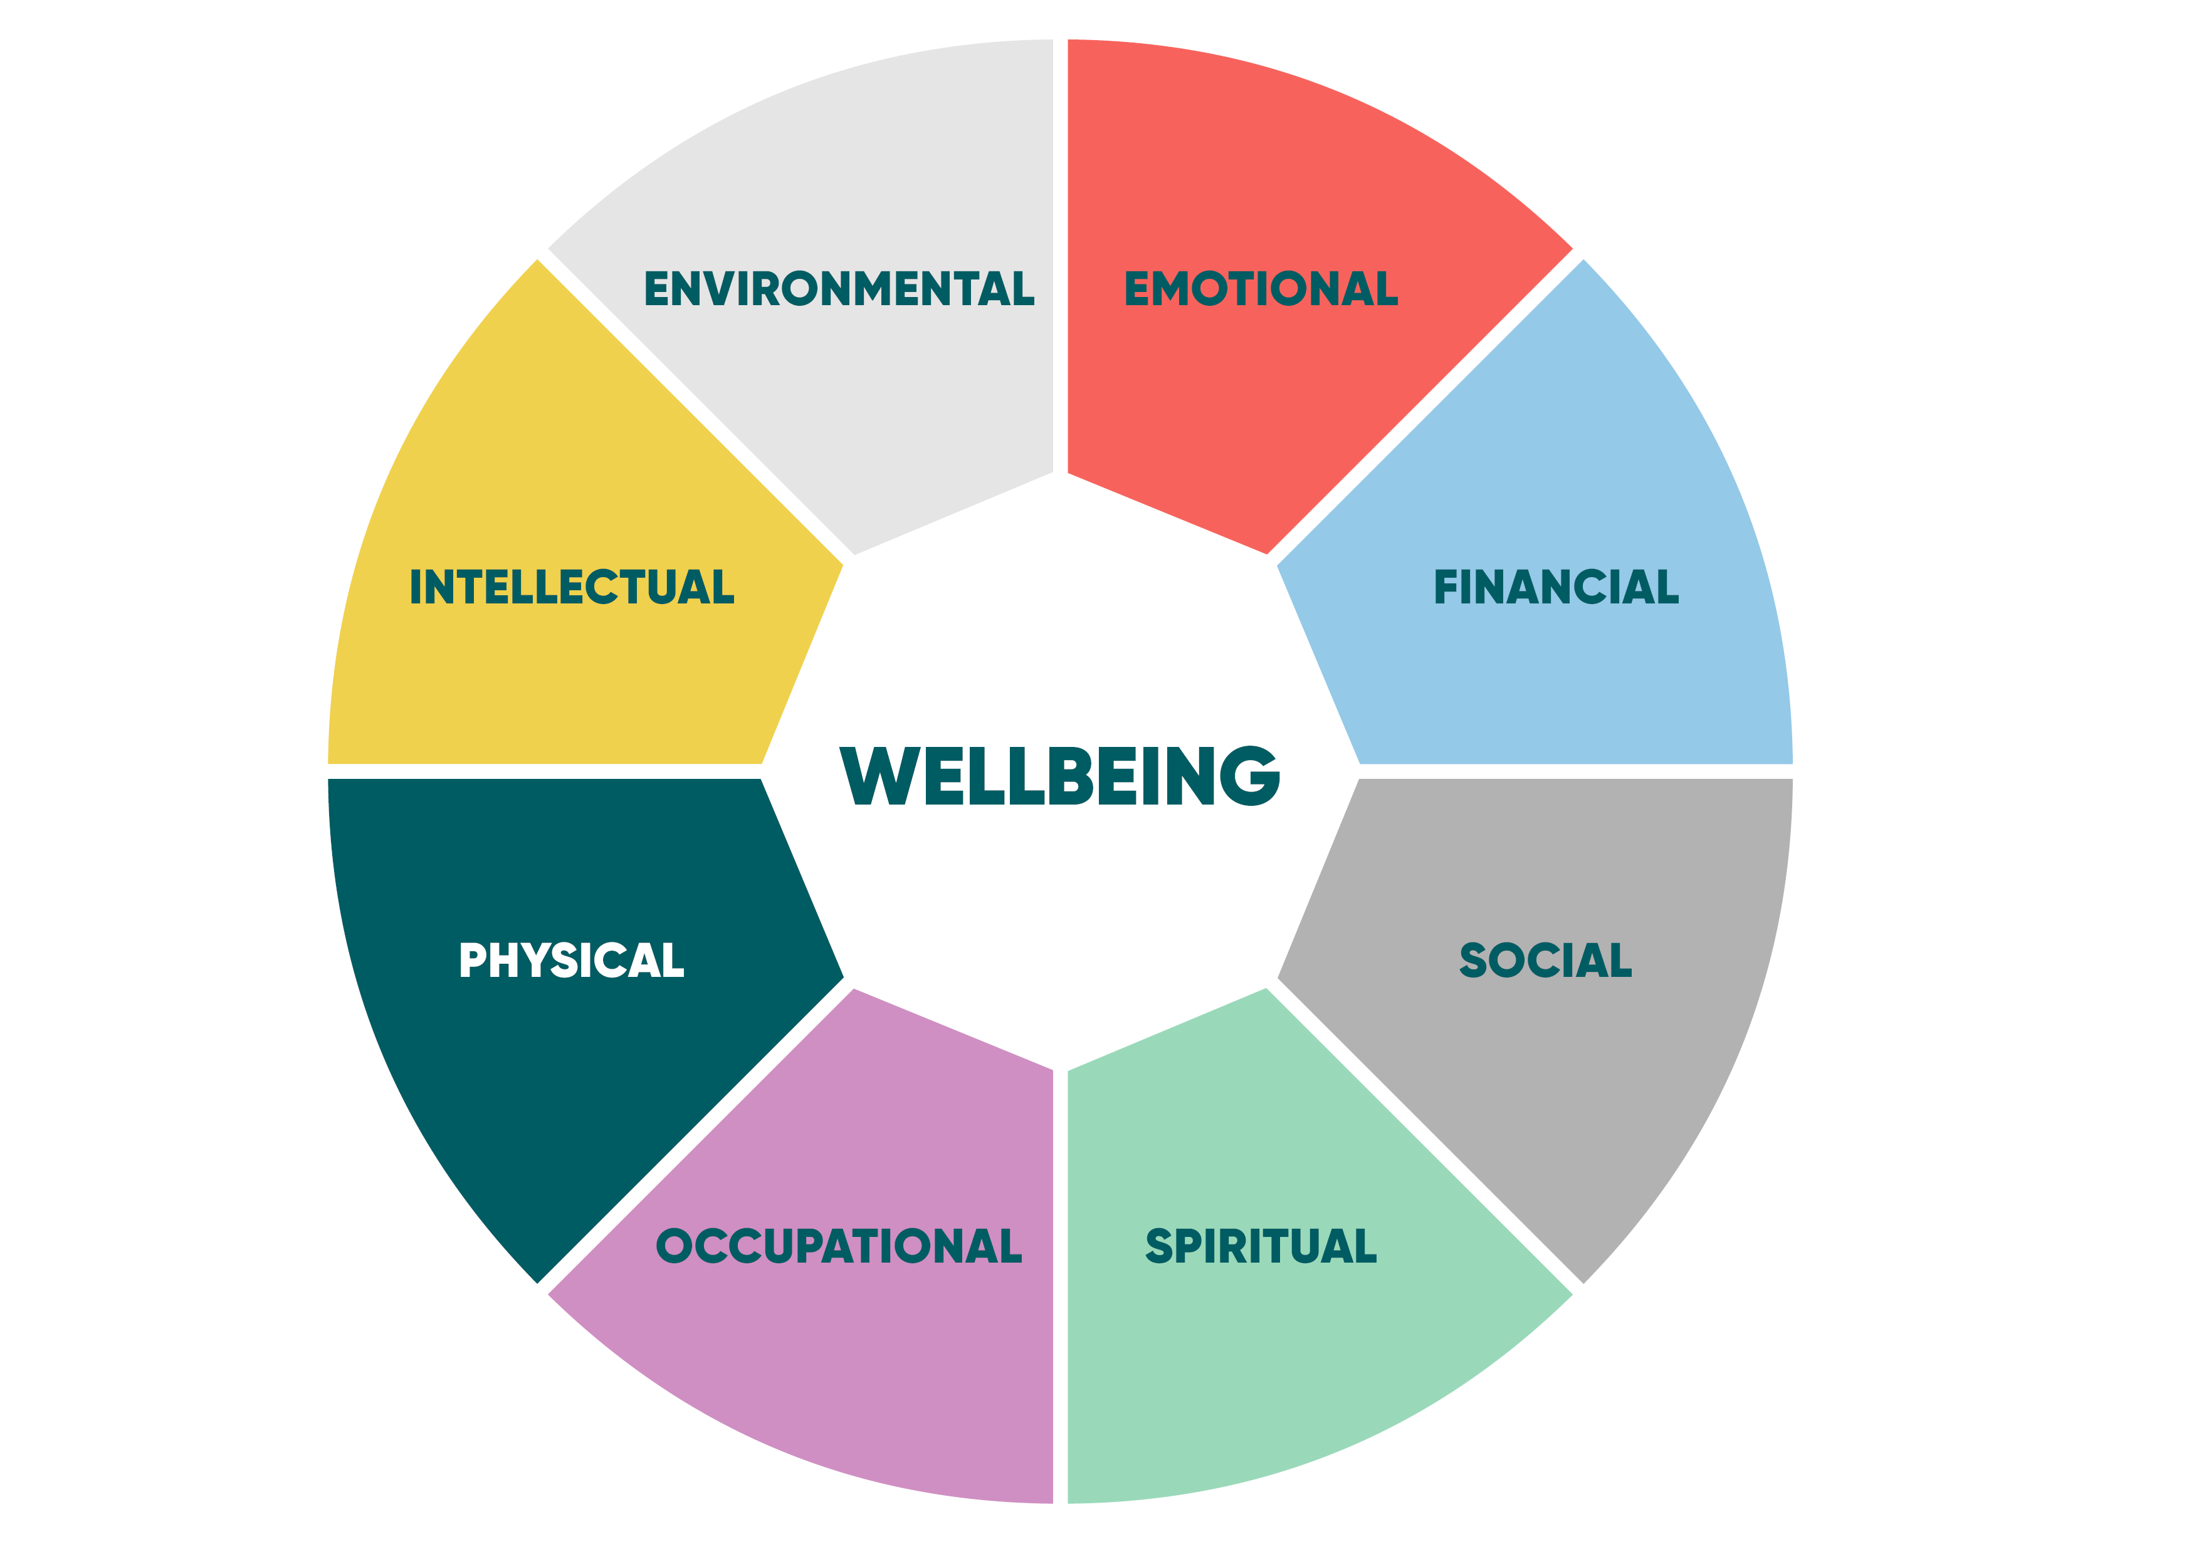
Key Concepts
Health: Social, emotional, and physical well-being in addition to the absence of illness (World Health Organisation, 2025).
Wellbeing: Physical, emotional, mental and social health. (World Health Organisation, 2025).
Sustainable Development: Meeting current needs without damaging future generations (United Nations, 2025).
(DHD, 2024).

Slide 4

Why These Concepts Matter
Health systems face ageing populations, chronic illness and workforce pressures (McKee et al., 2021).
WHO links health to Sustainable Development Goal 3 (WHO, 2022).
Good wellbeing improves productivity and quality of life (Jennifer Jane Newson, Oleksii Sukhoi and Thiagarajan, 2024).
Prevention reduces long-term healthcare costs (Health, 2025).
(The Global Goals, 2025).

Slide 5
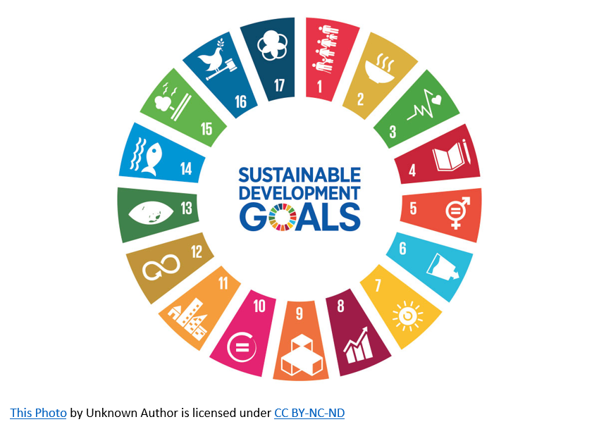
Relevance to Modern Healthcare
A worldwide framework for sustainable development and better health and welfare is offered by the 17 Sustainable Development Goals (SDGs) (GOV.UK, 2021).
Joined-up support: Combines physical, mental and social care.
Improved results: Strengthens health and wellbeing.
Better experience: Reduces hospital admissions and improves care.
(Allen Scott et al., 2025).
Person-centered care: Treats the individual, not just the condition.
(The Global Goals, 2025).

Slide 6
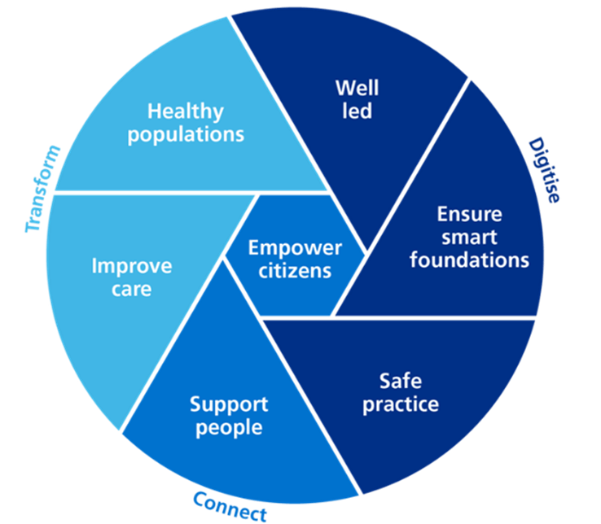
Examples of Integrated Care
Integrated Care Boards (ICBs): To address community requirements, local NHS health services are planned and coordinated (Coulter and Oldham, 2016).
:
Multidisciplinary teams (MDTs): Deliver organised health, social care, and community support (Pacho et al., 2025).
Upper-tier local authorities: Offer public health, social care, broader wellness services such as housing and education (CDC, 2024).
Community connections: Social prescribing links people to local support (e.g. walking groups, befriending services (Office for Health Improvement & Disparities, 2022).
(Williams , 2021).

Slide 7
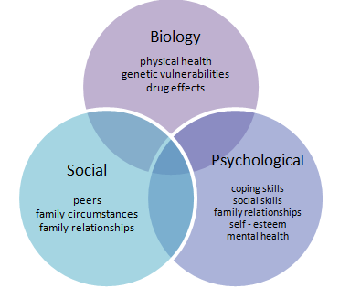
Theoretical Perspectives
Biopsychosocial Model
Biological influences: Include genetics, physical health, and disease processes.
Psychological factors: Include thoughts, emotions, behaviors, and mental health.
Social factors: Include relationships, culture, and socioeconomic conditions.
Holistic Care Models
Integrates physical and mental health.
Multidisciplinary teams (doctors, nurses, psychologists, social workers).
Promotes coordinated, person-centered care through services.
Improves patient satisfaction and continuity of care.
(Morgan et al., 2026).
A comprehensive approach to health that takes social, psychological, and biological aspects into account. The model supports person-centered care and prevention (Bolton, 2023).
This Photo by Unknown Author is licensed under CC BY

Slide 8
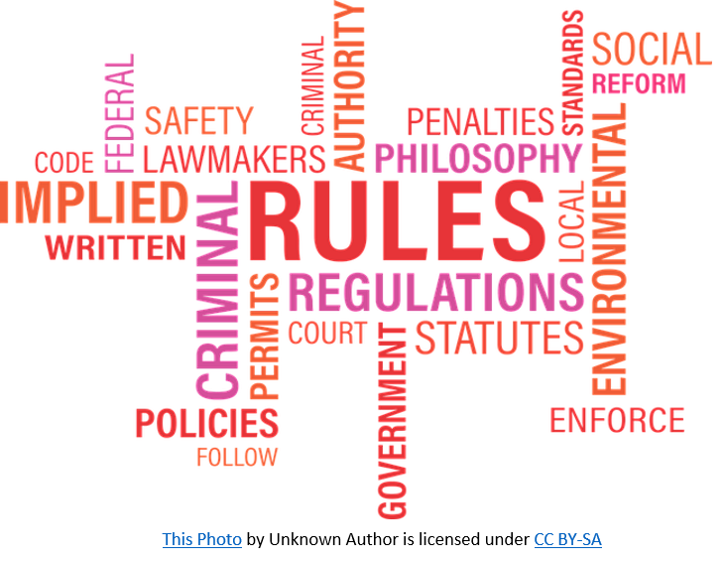
Policy and Governance
Policies
Safeguarding Policy (Care Act 2014).
Prevents abuse and neglect of individuals while promoting long-term wellbeing and safety. (Johnson and Boland, 2019).
Equality, Diversity and Inclusion Policy (Equality Act 2010).
Encourages fairness and reduces health disparities while promoting inclusivity and social wellbeing (Hussain, Rizvi and Sheikh, 2021).
Mental Health and Wellbeing Policy (Supported by Health and Safety Executive guidance).
Encourages early intervention in mental health and promotes positive health outcomes while reducing stress (Alsamiri et al., 2024).

Slide 9
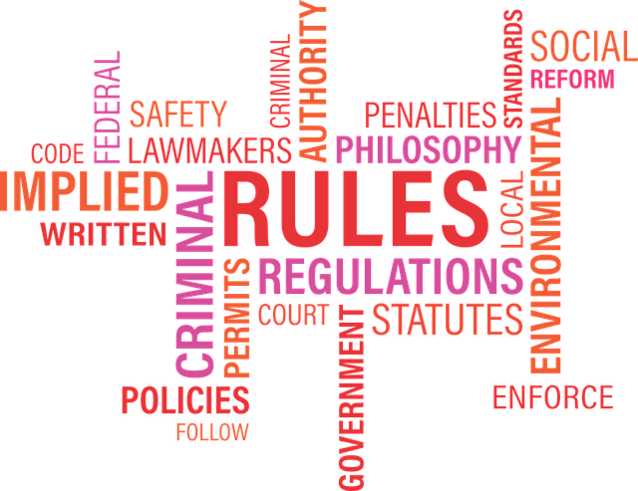
Policy and Governance
Governance Measures
Leadership and Accountable: Ensures accountability for carrying out and monitoring policies.
Staff Training and Development: Ensures staff understand and apply policies accurately.
Monitoring and Evaluation: Measures effectiveness and supports continuous improvement.
(Clarke et al., 2023).
Regular Policy Review: Ensures policies remain effective and up to date.
:
This Photo by Unknown Author is licensed under CC BY-SA

Slide 10
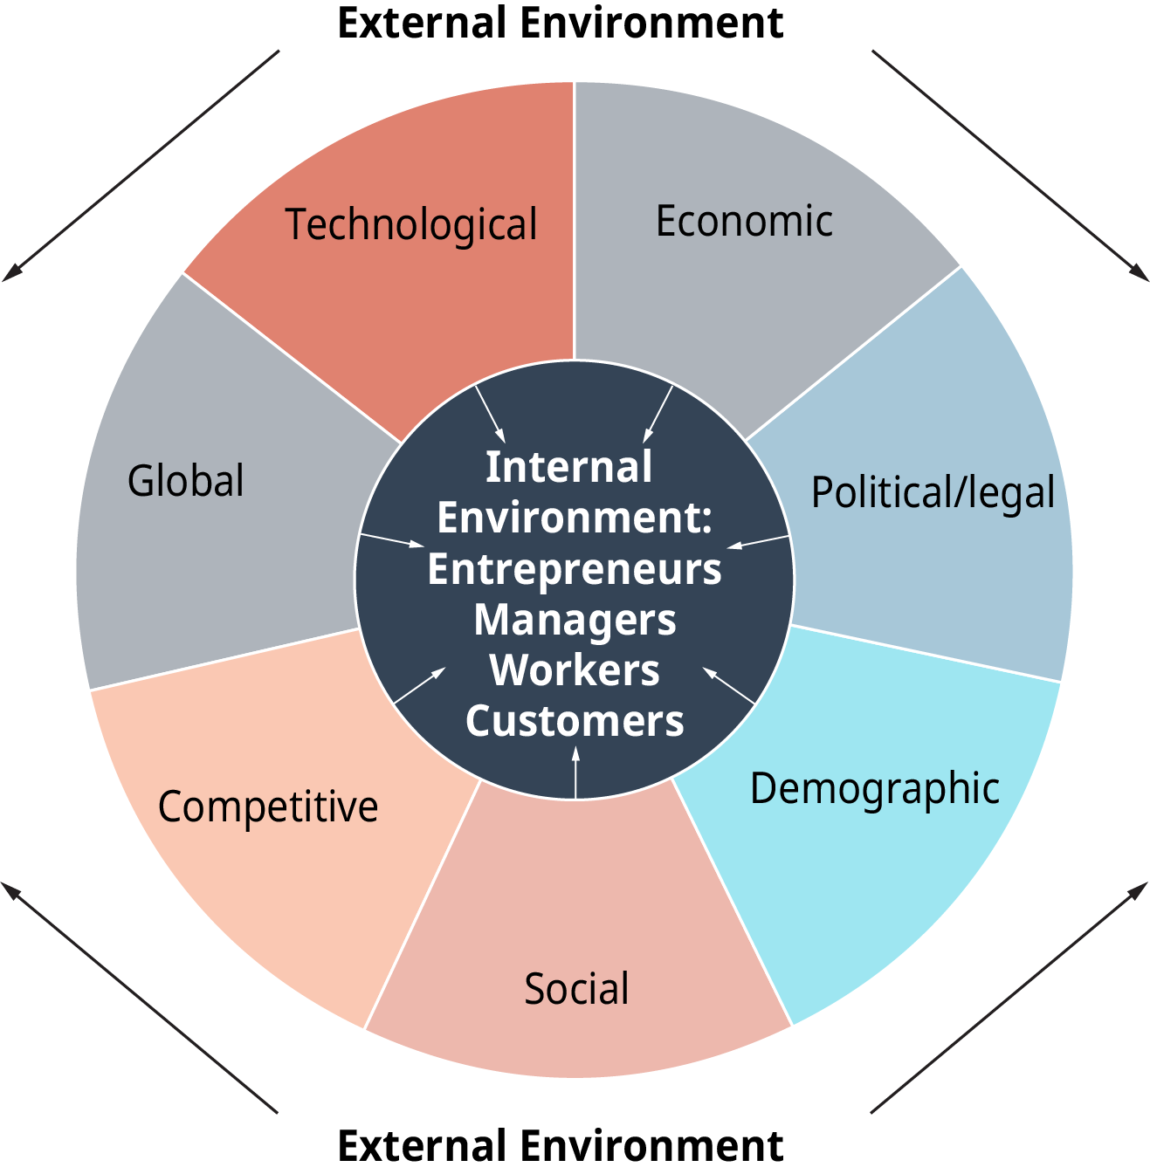
Challenges to Implementation Policy
Funding pressures limit service development
Workforce shortages affect delivery
Regulatory complexities slow innovation
Digital exclusion limits access to some groups
These barriers reduce policy impact (Kshatriya et al., 2026).
This Photo by Unknown Author is licensed under CC BY

Slide 11
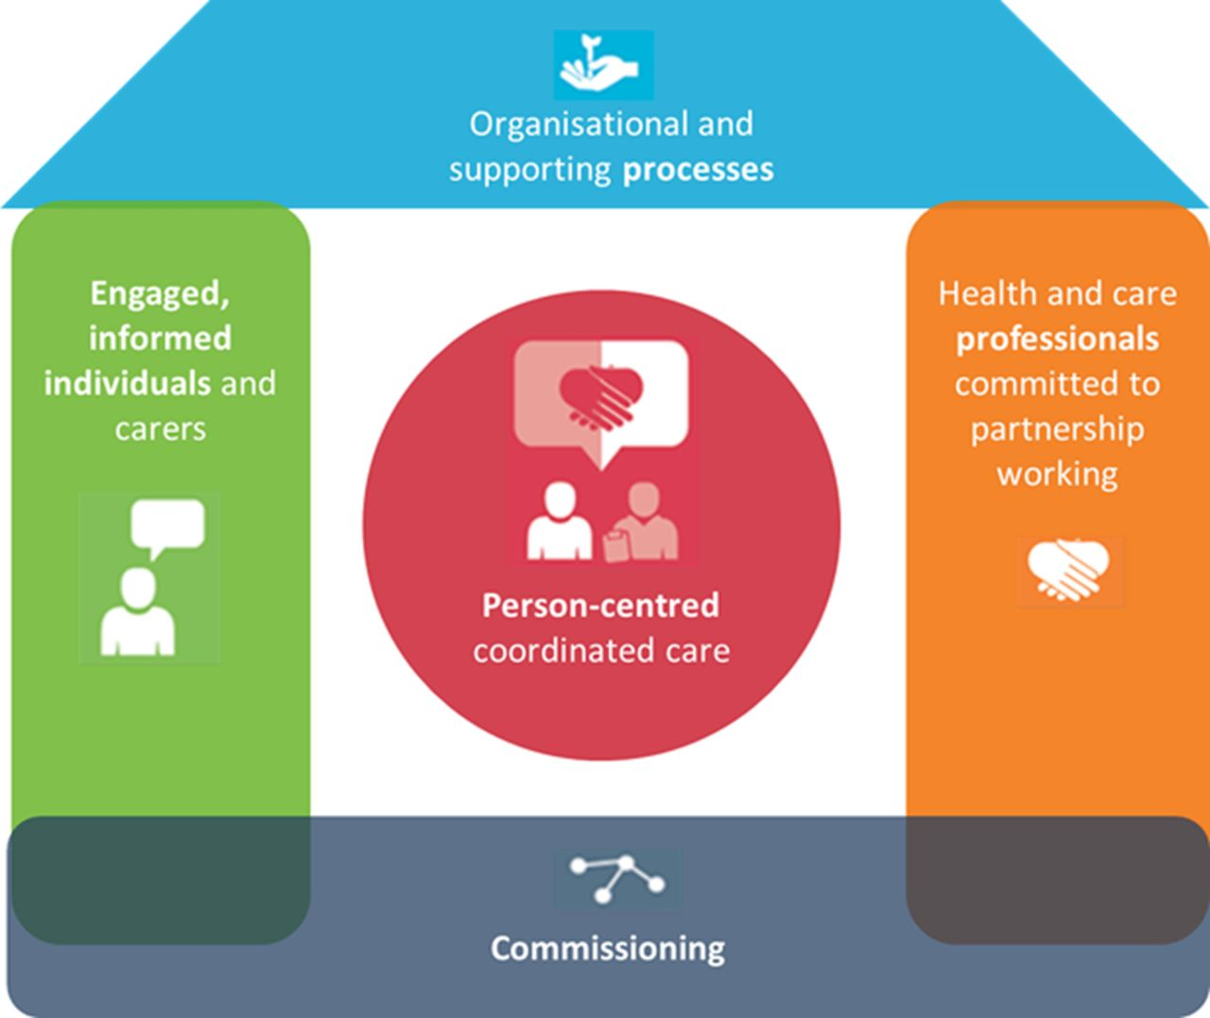
Service Delivery and Innovation
Telehealth and virtual care increased after COVID-19 pandemic.
Community health programmes improve local access.(e.g. Social prescribing and health Hubs).
Wellness programmes support prevention(e.g. Preventive Mental Health Platforms).
Practical example: remote monitoring for long-term conditions (Hidalgo-Padilla et al., 2025).
This Photo by Unknown Author is licensed under CC BY

Slide 12

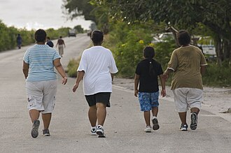
Case Examples: Improving Healthcare Delivery
Public Health Initiatives:
The NHS Quit Smoking App: ( Initiative to raise awareness and prevent smoking in the community).
Better Health: (Supports programs for preventing obesity in the community).
Walking Groups/ Green Gyms: (Guided walks to enhance cardiovascular health and wellness).
Promotes health living through community-based programs and prevention
(Talbot and Branley-Bell, 2021).
Physical Activities to reduce obesity
This Photo by Unknown Author is licensed under CC BY-SA

Slide 13
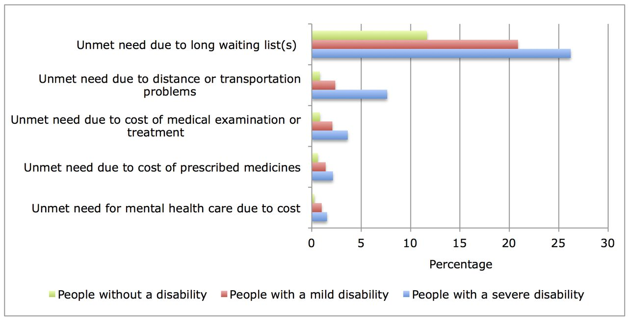
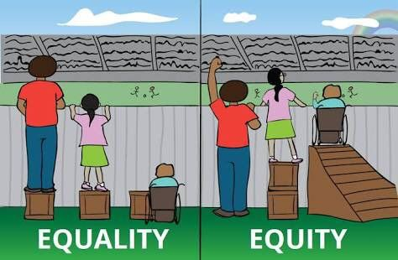
Equity and ACCESS
Health inequalities persist, driven by social determinants of health
Deprived communities experience poorer health outcomes
Unequal access contributes to disparities in health outcomes
Targeted interventions can reduce health inequities
(Hayre et al., 2026).
This Photo by Unknown Author is licensed under CC BY-NC
This Photo by Unknown Author is licensed under CC BY-SA-NC

Slide 14
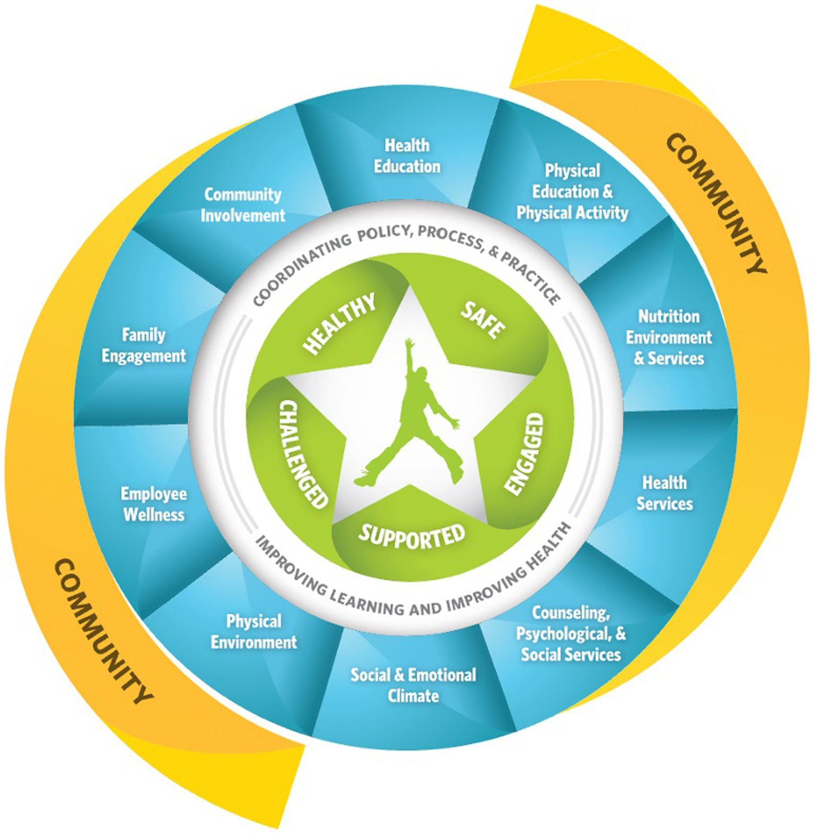
Recommendations for Improvement
Local level:
Expand social prescribing services
Improve digital inclusion and access
Increase community mental health support
National level:
Increase investment prevention funding
Strengthen workforce planning and capacity
Implement health impact assessments across all policies
Direct changes in governance that bring the public and private sectors together (Lakioti et al., 2025).
This Photo by Unknown Author is licensed under CC BY

Slide 15
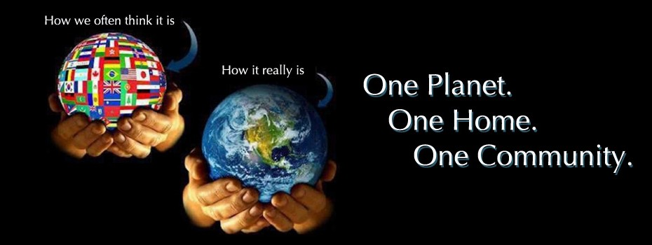
Conclusion
Health, wellbeing, and sustainable development are now at the core of present health care systems, driving the need for integrated, equitable, and preventive approaches that improve population health outcomes.
As health systems face increasing pressures from rising rates of chronic disease and an ageing population, they must adapt by prioritising coordinated, person-centered care. Achieving these goals also requires strong cross-sector collaboration to address the broader causes of health, reduce inequalities, and improve health outcomes for all communities.
This Photo by Unknown Author is licensed under CC BY

Slide 16
References
Allen Scott, L., Cabaj, J., Devolin, M., Henderson, I., Lewanczuk, R., McDougall, L., Patterson, S., Wayne, J., Lee, K., Malkin, J., Rehmani, M., Toohey, A., Habibullah Pulok, M. and Teare, G. (2025) ‘Healthier Together: Strengthening collaboration, Social Value and Getting to Health and Wellbeing outcomes; International Journal of Integrated Care, 25(S2), p.083. Available at https://doi.org/10.5334/ijic.nacic24083.
Alsamiri, Y.A., Hussain, M.A., Alsamani, O.A. and Al (2024) ‘Promoting Mental Health and Wellbeing as Means to Prevent disability: a Review; Frontiers in Public Health, 12. Available at https://doi.org/10.3389/fpubh.2024.1425535.
Bolton, D. (2023) ‘A Revitalized Biopsychosocial model: Core theory, Research paradigms, and Clinical Implications; Psychological Medicine, 53(16), pp.1–8. Available at https://doi.org/10.1017/s0033291723002660.
Card, A.J. (2022) ‘The Biopsychosociotechnical model: a systems-based Framework for human-centered Health Improvement; Health Systems, 12(4), pp.1–21. Available at https://doi.org/10.1080/20476965.2022.2029584.
CDC (2024) Social Connection. Social Connection. Available at: https://www.cdc.gov/social-connectedness/about/index.html (Accessed 23 June 2026).
Clarke, D., Appleford, G., Cocozza, A., Thabet, A. and Bloom, G. (2023) ‘The Governance behaviours: a Proposed Approach for the Alignment of the Public and Private Sectors for Better Health Outcomes, BMJ Global Health, 8(Suppl 5), pp.e012528–e012528. Available at https://doi.org/10.1136/bmjgh-2023-012528.

Slide 17
References
Coulter, A. and Oldham, J. (2016) ‘Person-centred care: What Is It and How Do We Get there;? Future Hospital Journal, 3(2), pp.114–116. Available at https://doi.org/10.7861/futurehosp.3-2-114.
DHD (2024) Wellbeing | YouMatter. Available at: https://youmatter.co/wellbeing/ (Accessed 23 June 2026).
GOV.UK (2021). Implementing the Sustainable Development Goals. Available at: https://www.gov.uk/government/publications/implementing-the-sustainable-development-goals/implementing-the-sustainable-development-goals--2 (Accessed 29 June 2026).
Hayre, J., Canning, E., Pearce, H., Khera, R. and Ford, J. (2026) ‘Public Health Policies and Interventions to Address Health Inequities in high-income countries: an Umbrella Review; BMC Public Health, 26(1). Available at https://doi.org/10.1186/s12889-025-25876-2.
Health (2025) Chapter 6: the 3 Shifts - Sickness to Prevention. GOV.UK. Available at: https://www.gov.uk/government/publications/engagement-insight-report-10-year-health-plan-for-england/chapter-6-the-3-shifts-sickness-to-prevention (Accessed 23 June 2026).
Health and safety Executive (2024) Health and Safety at Work Act 1974. Available at: https://www.hse.gov.uk/legislation/hswa.htm (Accessed 25 June 2026).
Hidalgo-Padilla, L., Dabbous, M., Halvorsrud, K., Beaney, T., Gideon, G., Gogarty, E., Greenfield, G., Hayhoe, B., Kerr, G., Raine, R., Rehill, N., Stewart, R., Gaughran, F. and Pinto da Costa, M. (2025) ‘Remote Consultations in England during COVID-19: Challenges in Data Quality, Linkage, and Research Validity; Online Journal of Public Health Informatics, 17, pp.e66672–e66672. Available at https://doi.org/10.2196/66672.

Slide 18
References
Hussain, Z., Rizvi, L.J. and Sheikh, H. (2021) ‘The Equality Act (2010)-pre- and post-pandemic Historic Development on Equality and Discrimination Issues for employers: Review of Literature; International Journal of Law and Management, 64(2). Available at https://doi.org/10.1108/ijlma-03-2021-0067.
Jennifer Jane Newson, Oleksii Sukhoi and Thiagarajan, T.C. (2024) ‘MHQ: Constructing an Aggregate Metric of Population Mental Wellbeing; Population health metrics, 22(1). Available at https://doi.org/10.1186/s12963-024-00336-y.
Johnson, K. and Boland, B. (2019) ‘Adult Safeguarding under the Care Act 2014; BJPsych Bulletin, 43(1), pp.38–42. Available at https://doi.org/10.1192/bjb.2018.71.
Kshatriya, M., Syal, R., Als, D., Muralidharan, O., Akindole, B., Padhani, Z.A., Das, J. and Bhutta, Z.A. (2026) ‘Implementation of Health and health-related Sustainable Development goals: progress, Challenges and Opportunities—a Systematic Literature Review Update; BMJ Global Health, 11(2), p.e021623. Available at https://doi.org/10.1136/bmjgh-2025-021623.
McKee, M., Dunnell, K., Anderson, M., Brayne, C., Charlesworth, A., Johnston-Webber, C., Knapp, M., McGuire, A., Newton, J.N., Taylor, D. and Watt, R.G. (2021) ‘The Changing Health Needs of the UK Population; The Lancet, 397(10288), pp.1979–1991.
Lakioti, E., Pagonis, N., Flegkas, D., Itziou, A., Moustakas, K. and Karayannis, V. (2025) ‘Social Factors and Policies Promoting Good Health and Well-Being as a Sustainable Development Goal: Current Achievements and Future Pathways; Sustainability, 17(11), p.5063. Available at https://doi.org/10.3390/su17115063.

Slide 19
Reference
Morgan, T., Pilimatalawwe, D., Mannes, J., Morse, I., Folwell, J., Hain, P., Walsh, C.M., O’Curry, S. and Duschinsky, R. (2026) ‘Integrating Care in a Children’s hospital: a Qualitative Interview Study with Mental and Physical Health Professionals in England; BMJ Open, 16(3), p.e113196. Available at https://doi.org/10.1136/bmjopen-2025-113196.
Office for Health Improvement & Disparities (2022) Social prescribing: Applying All Our Health. Available at: https://www.gov.uk/government/publications/social-prescribing-applying-all-our-health/social-prescribing-applying-all-our-health (Accessed 23 June 2026).
Pacho, A., Wistow, G., Mays, N., Thana, L., Rehackova, L., Douglas, N., Al-Haboubi, M. and Durand, M.A. (2025) ‘The Role and Functions of community-based Multidisciplinary Teams in Two Integrated Care and Support Pioneers: Perspectives from Local System Leaders; Journal of Health Services Research & Policy, 30(1_suppl). Available at https://doi.org/10.1177/13558196251349353.

Slide 20
References
Talbot, C.V. and Branley-Bell, D. (2021) BetterHealth: a Qualitative Analysis of Reactions to the UK Government’s Better Health Campaign. Journal of Health Psychology, 27(5), p.135910532098557. Available at: https://journals.sagepub.com/doi/full/10.1177/1359105320985576 (Accessed 28 June 2026).
The Global Goals (2025) Goal 3: Good Health and well-being. The Global Goals. Available at: https://globalgoals.org/goals/3-good-health-and-well-being/ (Accessed 23 June 2026).
United Nations (2025) The Sustainable Development Goals - United Nations Sustainable Development. United Nations Sustainable Development. Available at: https://www.un.org/sustainabledevelopment/development-goals/ (Accessed 23 June 2026).
WHO (2022) Targets of Sustainable Development Goal 3. World Health Organisation. Available at: https://www.who.int/europe/about-us/our-work/sustainable-development-goals/targets-of-sustainable-development-goal-3 (Accessed 23 June 2026).
Williams, D. (2021) Ideal Health Consultants. Ideal Health. Available at: https://www.ideal-health.co.uk/insights/integrated-care-systems-navigating-ics-organisational-maturity/ (Accessed 23 June 2026).
World Health Organization (2025) Health and Well-Being. World Health Organization. Available at: https://www.who.int/data/gho/data/major-themes/health-and-well-being (Accessed 23 June 2026).

