Slide 1
Data Warehousing & Data Mining
ACCA6026
Lecture 3 – Pre-processing Data
Prof. Nik Whitehead

Slide 2
Garbage In, Garbage Out
Data quality is one of the most important factors to any data analyst
Data needs to be
  Appropriate – don’t analyse 10 years where 5 will do
  Clean – impossible* and missing data needs to be fixed
Even after data has been cleaned it may need to have new columns generated to allow a wider range of analyses to be performed upon it
This is all done at the preprocessing stage
* Bhatia (p56) includes a controversial example of ‘impossible’ data. Be aware that cultural differences may lead to different ways of coding data.

Slide 3
Preprocessing in CRISP-DM
Business
Understanding
Data
Understanding
Data
Preparation
Modelling
Evaluation
Deployment
Determine
Business
Objectives
Collect
Initial
Data
Select
Data
Select
Modelling
Technique
Evaluate
Results
Plan
Deployment
Assess
Situation
Describe
Data
Clean
Data
Generate
Test Design
Review
Process
Plan Monitoring
&
Maintenance
Determine
Data Mining
Goals
Explore
Data
Construct
Data
Build
Model
Determine
Next Steps
Produce
Final
Report
Produce
Project Plan
Verify
Data
Quality
Integrate
Data
Assess
Model
Review
Project
Format
Data

Slide 4
Data Understanding
Before cleaning the data you need to understand the data
  What do each of the attributes represent?
  What are the descriptive statistics for each attribute?
  What does the attribute look like graphically?
  Is the data skewed?
  What counts as an outlier?
  What kinds of errors exist within the data?
  Are there any obvious relationships between attributes that might be useful in your analyses?
  Is the data formatted sensibly?
These can be viewed in Weka, but Tableau is a good alternative for exploring data
  More of Tableau in a few weeks

Slide 5
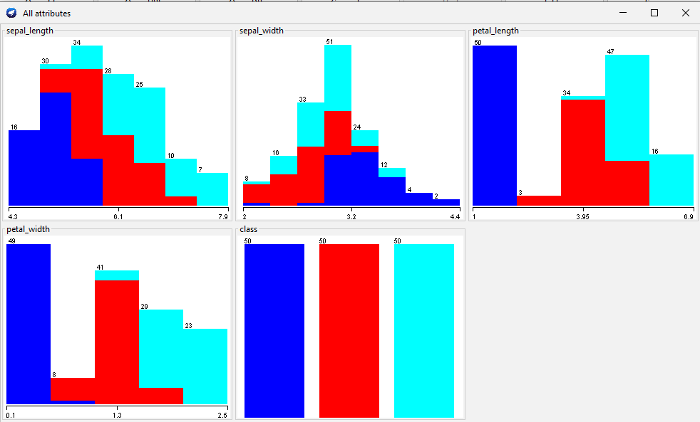
Weka’s ‘Visualize All’
The Weka attribute visualizer has a ‘Visualize All’ option

Slide 6
Preprocessing in CRISP-DM
Business
Understanding
Data
Understanding
Data
Preparation
Modelling
Evaluation
Deployment
Determine
Business
Objectives
Collect
Initial
Data
Select
Data
Select
Modelling
Technique
Evaluate
Results
Plan
Deployment
Assess
Situation
Describe
Data
Clean
Data
Generate
Test Design
Review
Process
Plan Monitoring
&
Maintenance
Determine
Data Mining
Goals
Explore
Data
Construct
Data
Build
Model
Determine
Next Steps
Produce
Final
Report
Produce
Project Plan
Verify
Data
Quality
Integrate
Data
Assess
Model
Review
Project
Format
Data

Slide 7
Data Preparation
Selecting Data
  Try to select/filter the data before you clean it – cleaning can take a lot of time so minimize how much you need to do
Cleaning data
  Handling missing values
  Detecting (and possibly removing) outliers
Data transformation
  Normalisation
  Encoding categorical variables
Data reduction
  Dimensionality reduction

Slide 8
Handling Missing Values
In a large dataset you can often just delete rows with missing values
Non-deletion alternatives
  Fill in the missing value manually
    Can take a lot of work
  Use a global constant such as “Unknown” or “-999”
    Use with caution as data mining may identify patterns based upon this
  Use the attribute mean value
  Use some other calculated value with a high probability of being close to the actual value
    Even better than the mean, but calculation time can be high

Slide 9
Binning Data
It is often useful to convert continuous data into categorical data in order to
  See frequency patterns more clearly
  Increase the type and number of mining algorithms that can be applied to the data
Equal interval binning
  Each bin is the same width (range)
  0-9, 10-19, 20-29…
Equal interval binning
  Each bin contains the same number of data points
  Bin widths can vary widely

Slide 10
One Hot Encoding
For some analyses it is useful to convert categorical attributes into binary attributes
  1 category with 3 members (small, medium large) becomes 3 new attributes that show if the category value is present or not
Avoids accidental ranking of numerical categorical data
Size | Small | Medium | Large
Large | 0 | 0 | 1
Small | 1 | 0 | 0
Medium | 0 | 1 | 0
Small | 1 | 0 | 0
Large | 0 | 0 | 1
Large | 0 | 0 | 1

Slide 11
Exercise
You are preparing a dataset for analysis that includes special category data
  What key ethical issues must be considered during the preprocessing stage?
  How might choices such as removing outliers or inputting missing values affect the fairness and transparency of the final analysis
  Propose guidelines for ensuring ethical data handling during the preprocessing stage of a data mining project

Slide 12
Data Integration
If data comes from multiple sources then there may be differences in how the same data is stored in each dataset
  Which one should be the single source of truth (SSOT)?
  Is the SSOT the same for every attribute?
Beware redundancy!
  Check that the same data does not exist twice with different titles
Text normalisation
  Text values may exist in different combinations of upper and lower case, so converting everything to upper case ensures that the mining algorithms treat all text equally

Slide 13
Data Transformation
It is good practice to have all numerical data of a similar scale
Normalisation
  All attributes are converted to a standard scale, normally a (0,1) range
  Should only be done after outlier removal or the values can be very skewed
Standardisation
  If the data contains outliers or is otherwise very skewed convert to the Z-score instead
  Z-score (aka standard score): shows how many standard deviations away from the mean a data point lies

Slide 14
Data Formatting
Data pre-processing and data mining may occur in different tools
  E.g. pre-process in Excel, mine in Weka
This may require data to be reformatted to move between one and the other
  Generative AI is your friend for this ☺
If the same tool is used for both, e.g. R or Weka, then no further formatting is needed

Slide 15
Dimension Reduction
Curse of Dimensionality – the more attributes you have, the longer it will take to process and the more likely it will generate overfitted models
Not all data in a dataset is equally useful
  There are often many attributes that are correlated to each other
Principal Component Analysis (PCA) identifies the most useful attributes within a dataset
  Identifies how much of the variance in the dataset is due to variance in each attribute
  Any attributes with low variance can be ignored (removed)

Slide 16
Preprocessing in R and Weka

Slide 17
The Preprocessing Process
Do NOT just load your data and do stuff at random!!!
PLAN the operations you need to apply
Select the required data
Clean data
  Handle missing values, remove duplicates, identify and manage outliers, correct other errors
Integrate data from multiple sources (optional)
  Solve inconsistencies and redundancies
Transform data
  Scale, normalise, encode, bin
Reduce data
  Principle component analysis

Slide 18
Useful R Functions for Preprocessing
Data loading
  read.csv(), head(), summary()
Data cleaning
  is.na(), complete.cases(), as.numeric(), as.factor()
Handling missing values
  data$age[is.na(data$age)]<- median(data$age, na.rm=T)
Normalisation
  data$age <- (data$age-min(data$age))/(max(data$age)-min(data$age))
Standardisation
  scale()
One-hot encoding
  model.matrix()
Also: tidyverse package (includes dplyr and tidyr)

Slide 19
Worked Example
Preprocessing sequence
Identify missing values
Inputting the medial to replace any missing values
Normalisation
Binning data into equal interval bins
One-hot encoding
Principal Component Analysis
Download the 3-StudentData.arff file and we will work through these together
Feel free to ask questions as we go
@relation students_data
@attribute age numeric
@attribute test_score numeric
@attribute study_hours numeric
@attribute gender {male, female, nonbinary}
@attribute grade {A, B, C, D, F}
@data
20, 85, 10, male, B
22, 90, 12, female, A
19, 78, 8, female, C
21, 92, 15, male, A
20, 88, 11, nonbinary, B
23, 95, 16, female, A
…

Slide 20
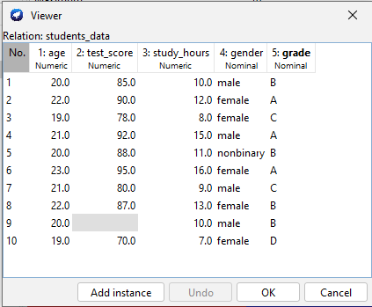
Missing Values
Weka will not allow blank values in an ARFF file
  All missing values need to be replaced with ? before the file will load
Any missing values will be highlighted in the data viewer
  Preprocess ¦ Edit…

Slide 21
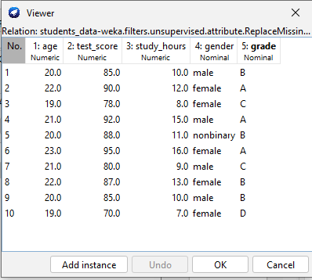
Inputting the Median
Use Weka’s ReplaceMissingValues filter
  Filters -> Unsupervised -> attribute -> ReplaceMissingValues
After selecting the filter you must click on the Apply button to the right of the filter to run it
Weka uses mean or median as appropriate

Slide 22
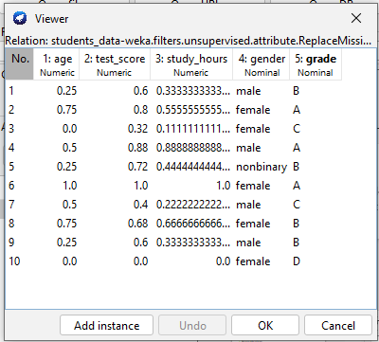
Normalising Numerical Data
Use Weka’s Normalize filter
  Filters -> Unsupervised -> attribute -> Normalize
NB: This will normalise ALL numerical attributes
Can normalise to intervals other than (0,1) by clicking the filter space and changing the scale and translation values

Slide 23
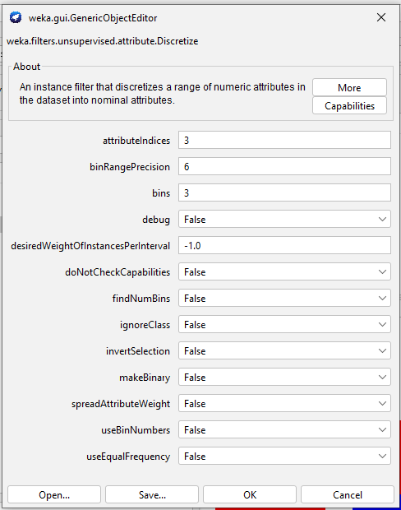
Generating Equal Interval Bins
Use Weka’s Normalize filter
  Filters -> Unsupervised -> attribute -> Normalize
Identify the index of the attribute you want to bin
Choose the number of bins
Click on OK -> Apply

Slide 24
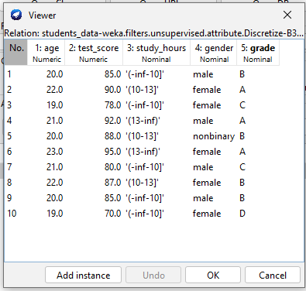
Generating Equal Interval Bins
Notice that the values have been replaced with strings describing the bins
You can then use RenameNominalValues to change the bin names but I find search and replace in Notepad++ easier ☺

Slide 25
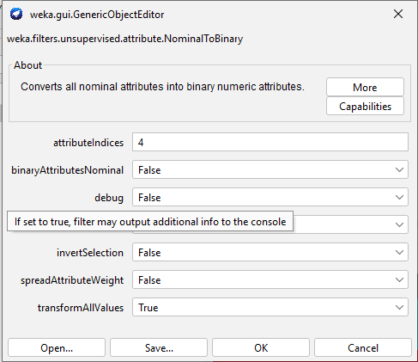
One-Hot Encoding
Use NominalToBinary
Filters -> Unsupervised -> attribute -> NominalToBinary
Set the attribute index
Set transformAllValues to True
Click on OK -> Apply

Slide 26
Principal Component Analysis
Use PrincipalComponents
  Filters -> Unsupervised -> attribute -> PrincipalComponents
NB: This will replace the original attributes with the principal components in the Attributes area
Examine the first few components and note which attributes they include
  These are the most important attributes in your dataset
  If an attribute doesn’t appear in the first three principal components then consider removing it

Slide 27
Exercise/Homework
Download 3-health_check_data.arff and load into Weka
Identify any missing values
Use a filter to replace the missing value in bmi with the median value
Normalise all numerical attributes to (0,1)
Bin the cholesterol attribute into 3 equal-width bins (low, medium, high) and rename them
Apply one-hot encoding to exercise_level
Use PCA to identify which of the original attributes contribute most to the first principal compnent

Slide 28
Looking ahead
Next session: Classification Analysis

