Slide 1
Module recap

Slide 2

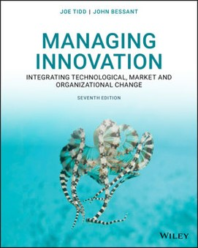
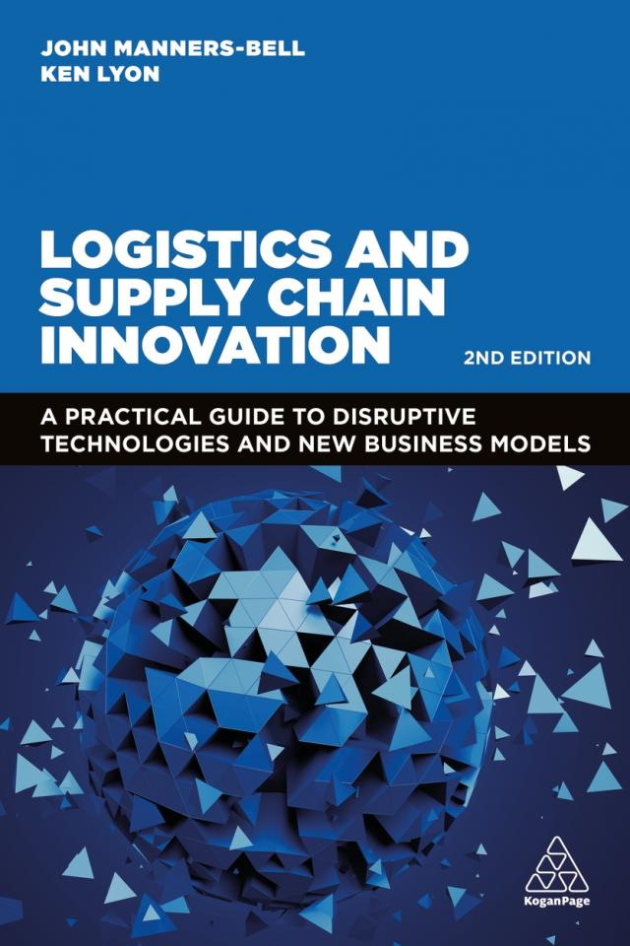
Core Textbooks
Managing Innovation by Tidd and Bessant (2020)
Logistics and Supply Chain Innovation by Manners-Bell and Lyon (2023)
Details are on the Leganto Reading List on Moodle

Slide 3

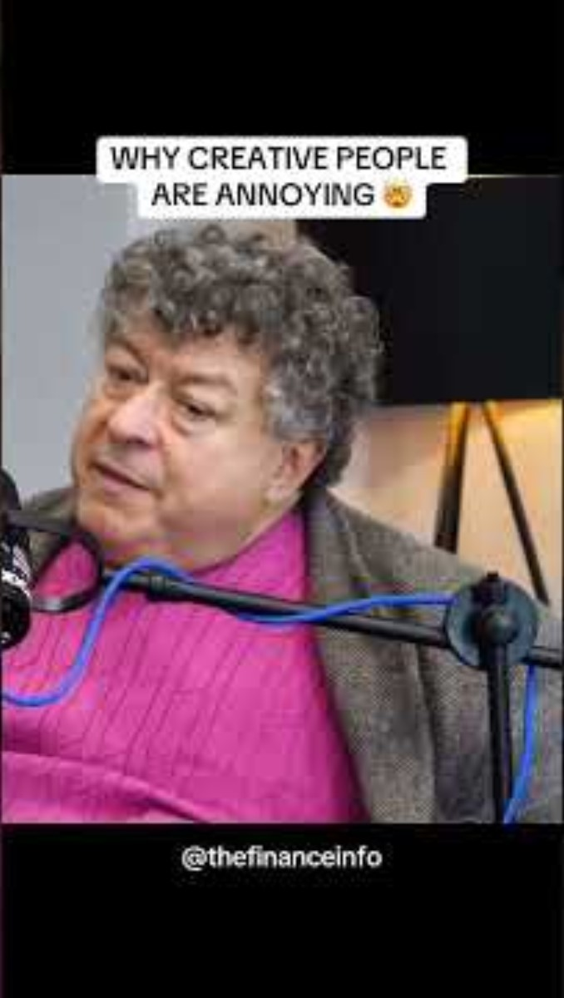
What is Creativity?
Creativity can be a process, as well as a flash of inspiration. Ideas are often solutions to problems or to address needs.
Creative people are adept at identifying the root causes of a problem and are imaginative in solving them
They are not constrained by the need to follow standard approaches
They desire originality, non-conformity and the opportunity to experiment and express new ideas

Slide 4

The Creative Process
Preparation
Incubation
Illumination
Verification
Notes:
Creativity isn’t just about lightbulb moments – it’s a process.
As it’s a process, anyone can learn to be more creative.
Preparation – user research, empathise with users in order to define problem and users’ needs.
Incubation – let your mind wander, contemplate the problem. Go for a walk, sleep on it! Be open to all ideas.
Illumination – the eureka moment. But this often takes time.
Verification/Implementation – build on your idea, evaluate it, make sure it meets needs – Dyson came up with thousands of prototypes before settling on the bagless vacuum we all know today.

Slide 5
Technology Push and Market Pull
Technology Push
  A new technology manifests in a new product launched into the marketplace
Market Pull
  A gap in the market exists for a solution to a problem
Notes:
MOUSE CLICK – ONCE – NEXT SLIDE

Slide 6
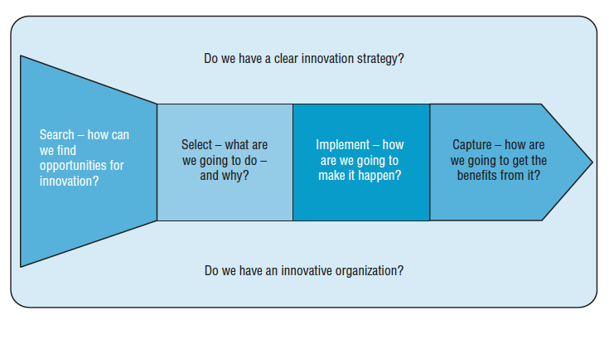
A process model for innovation
Notes:
Research suggests that if we want to succeed at managing innovation, we need to manage it as a process.

Slide 7
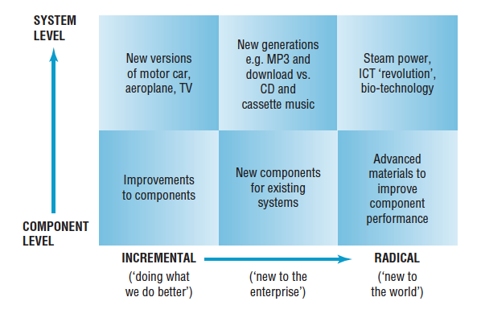
Traditional types of Innovation

Slide 8
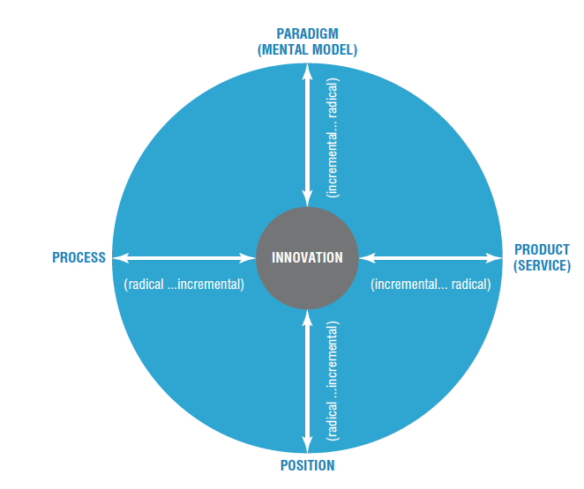
Scope for innovation
The 4 P’s Model

Slide 9
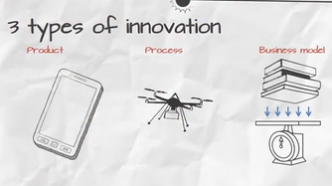
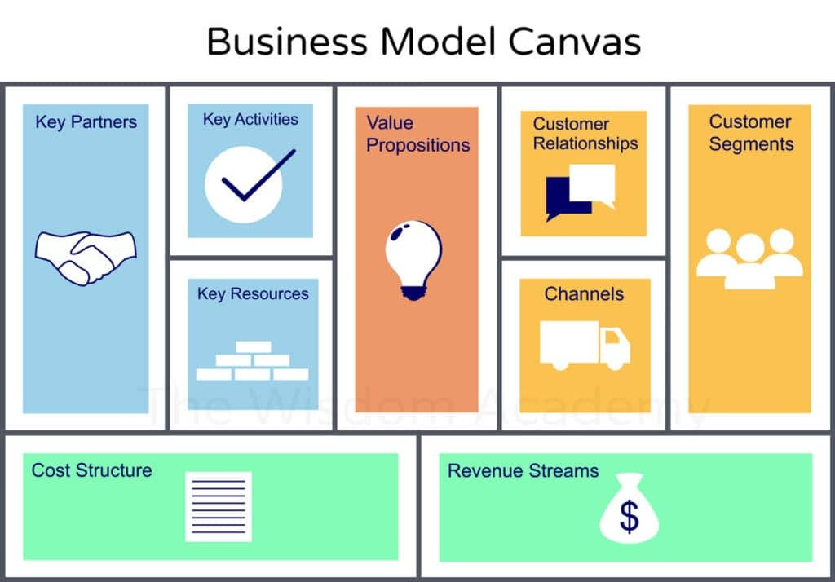
Notes:
How an organisation is structured to support innovation

Slide 10
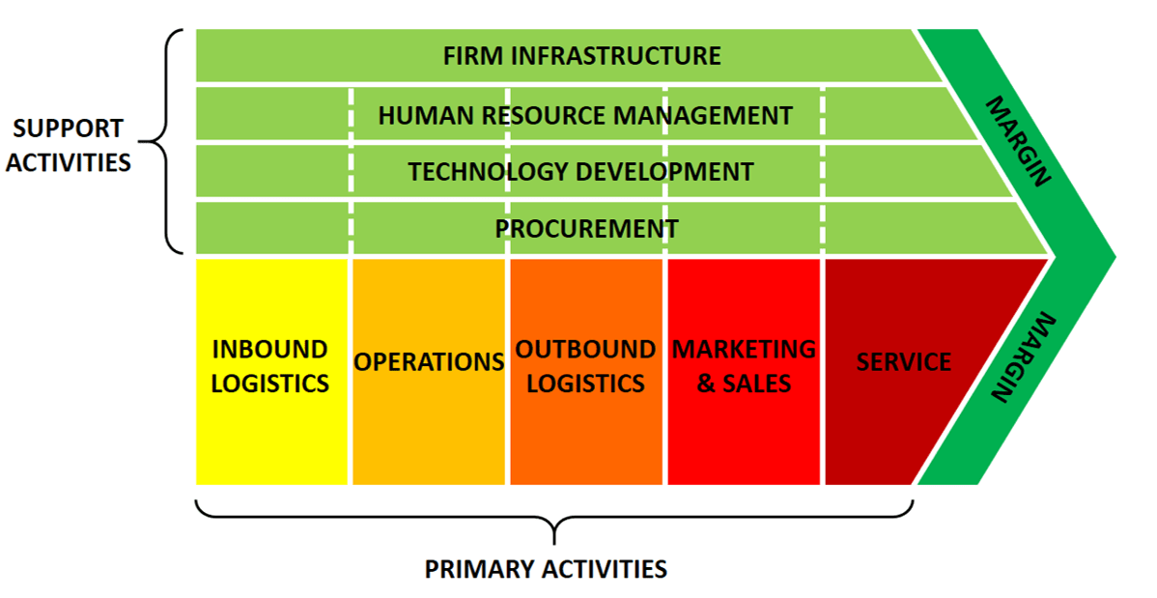
Porters Value chain

Slide 11
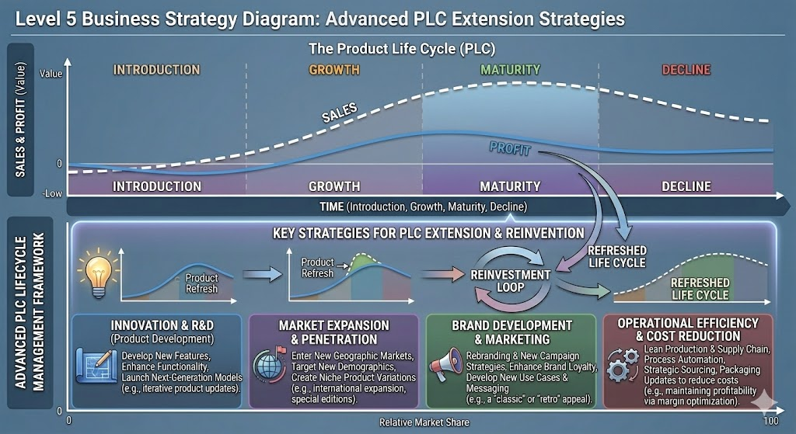
Notes:
Not all products reach this final stage. Some continue to grow and the maturity phases of the life cycle is extended to delay the decline phase.

Slide 12
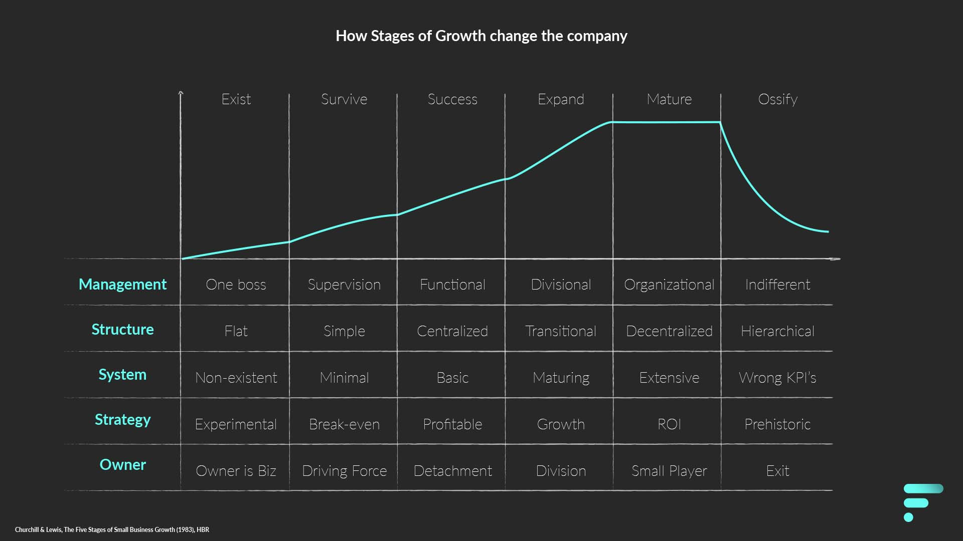

Slide 13
Greiner’s five stage growth model
STAGE 1
STAGE 2
STAGE 3
STAGE 4
STAGE 5
Large
Evolution stages
Revolution stages
5: ?
4: Red Tape
Crisis of:
3: Control
5: Collaboration
Size
2: Autonomy
4: Co-ordination
1: Leadership
3: Delegation
2: Direction
Growth through:
Small
1: Creativity
Young
Mature
Age
Notes:
Notes
Grant Thornton
Managing People

Slide 14
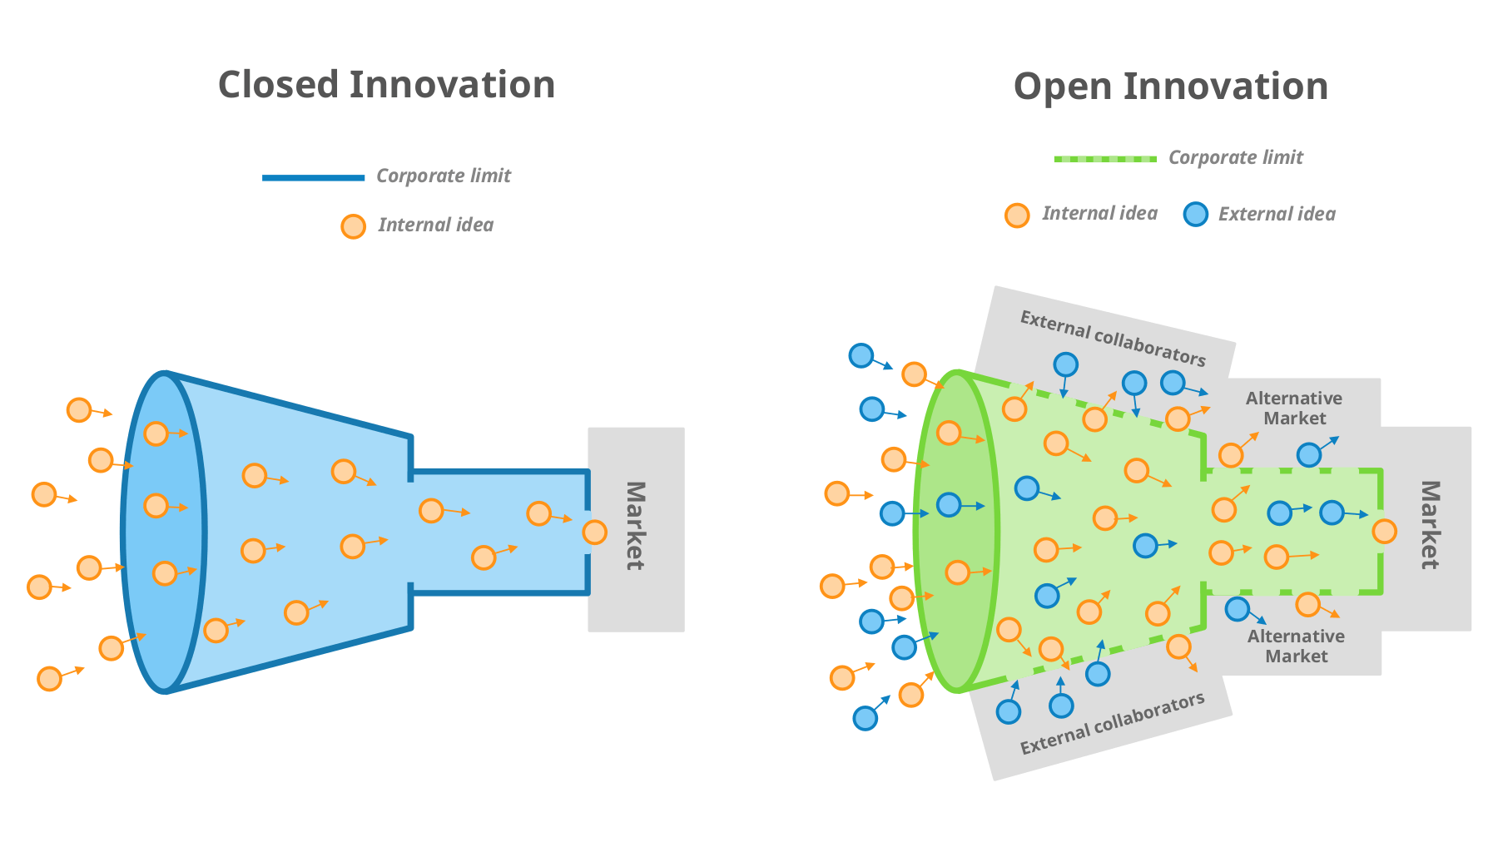
Innovation Funnels
These models focus on generating and evaluating ideas from either within the organization or from other collaborative sources combined with internal ideas before selecting the most promising ones for further development to either new or existing markets.
Notes:
Some innovative organisations use this model – generate as many ideas as possible and then select most promising ones.

Slide 15
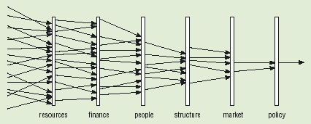
Idea Screening
A good idea is not enough; it needs some degree of fit with the organisation in terms of resources, capabilities, finances, structure and values. It must also fit with the external environment – the market, the needs of customers, relevant regulations and sundry other stakeholders.
Ideas need screening to ensure resources, finance, people structure, market demand and policies exist

Slide 16
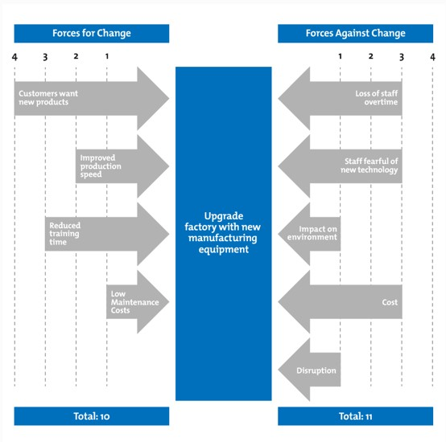
Force-Field Analysis
Stage 1: Define the Innovation Opportunity in the box in the middle
Stage 2: Identify the Forces For the Opportunity
Stage 3: Identify the Forces Against the Opportunity
Stage 4: Assign a score for each Force identified in stages 2 & 3. The scoring system should range from 1 (weak) to 5 (strong), and then total each side.
Stage 5: Analyse the outcome to decide whether or not to move forward with the Innovative Opportunity.
Notes:
Time to try this out.
Work individually and then discuss your analysis in groups.

