Slide 1
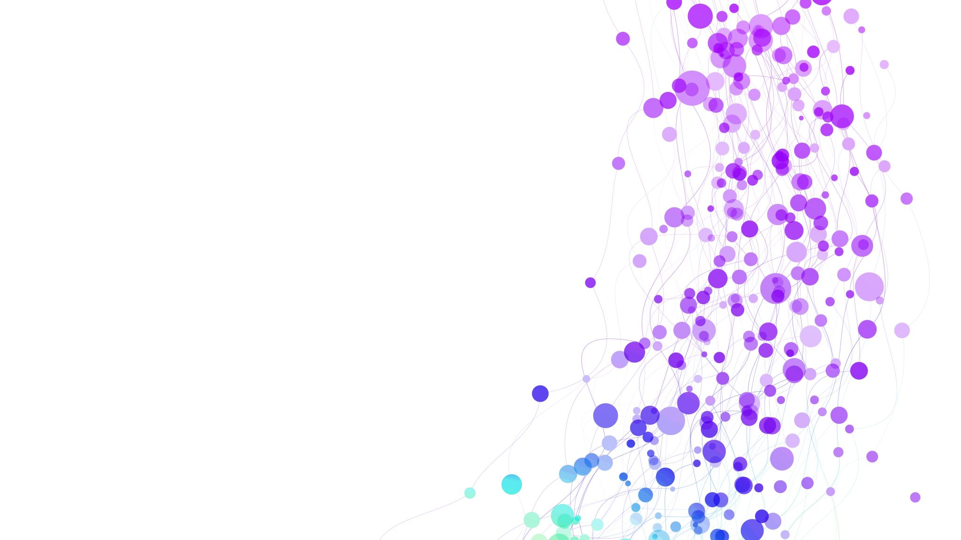
Digital Transformation in Hospitality and Tourism
Conference Research Presentation
Valentina Somnik - 2020147

Slide 2

Introduction

Slide 3
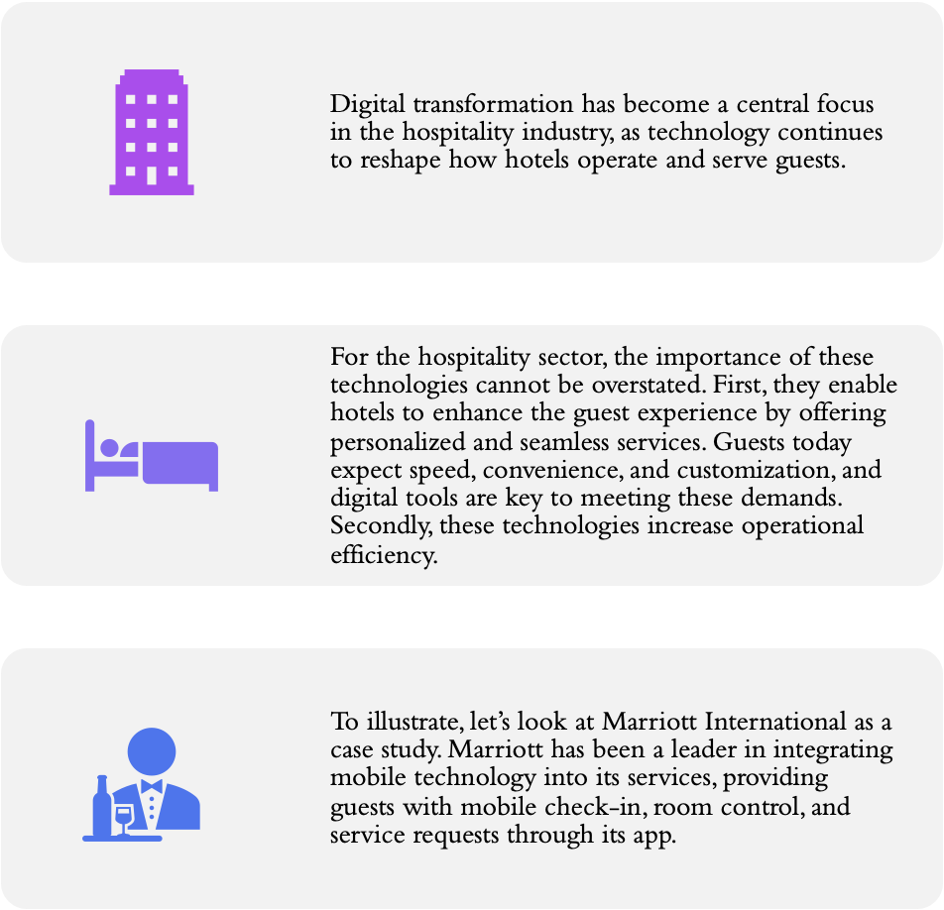
Digital Transformation - Introduction

Slide 4
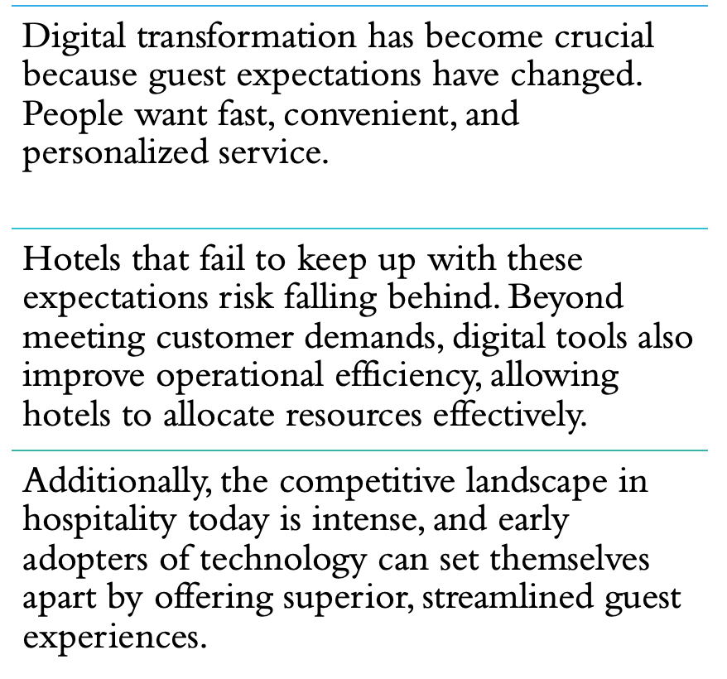
Importance of Digital Transformation

Slide 5
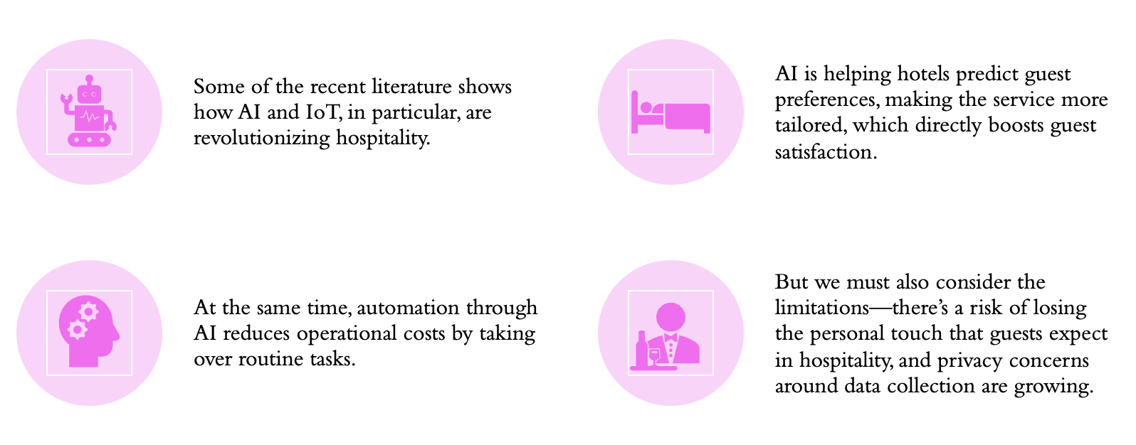
Literature Findings – Main Points

Slide 6

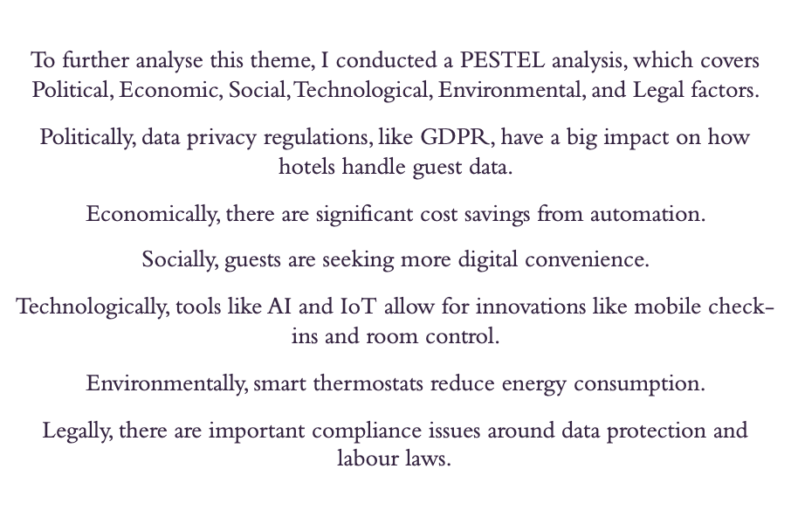
Hotel & Hospitality Industry - APPLICATION

Slide 7
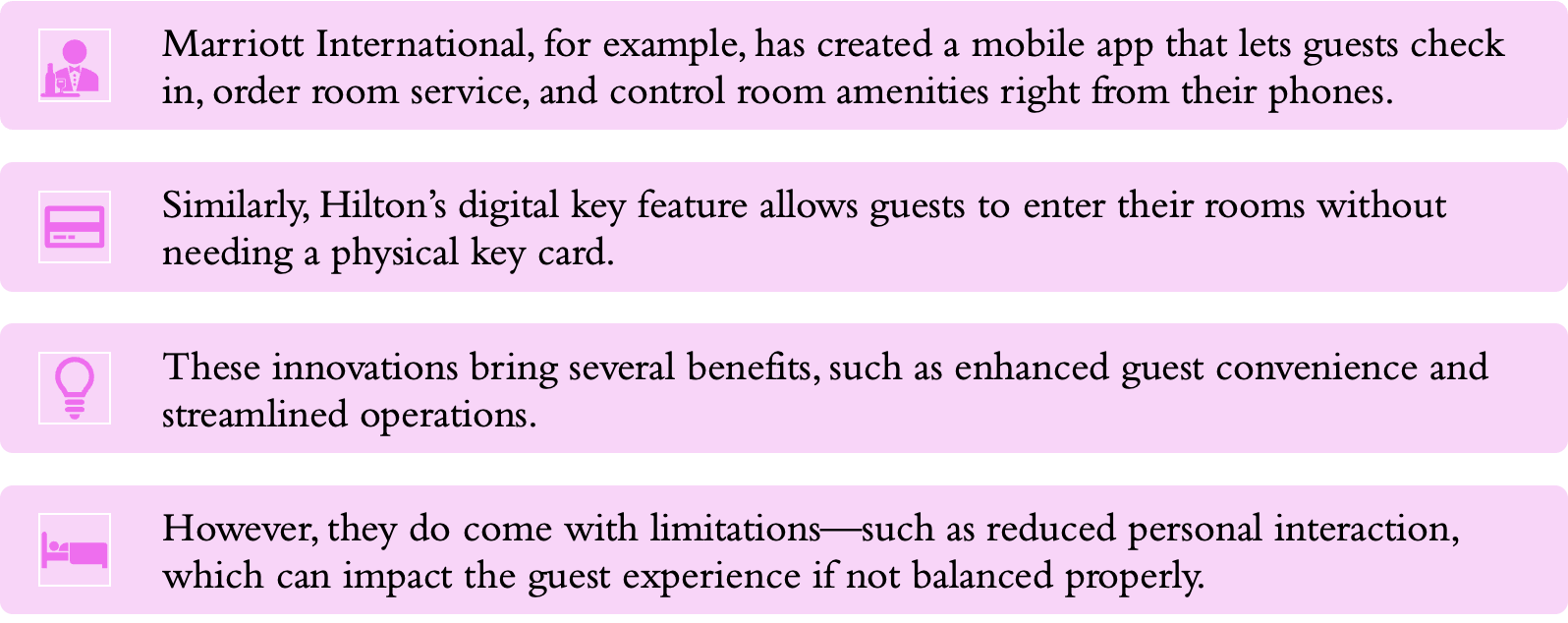
Responses of the Industry

Slide 8
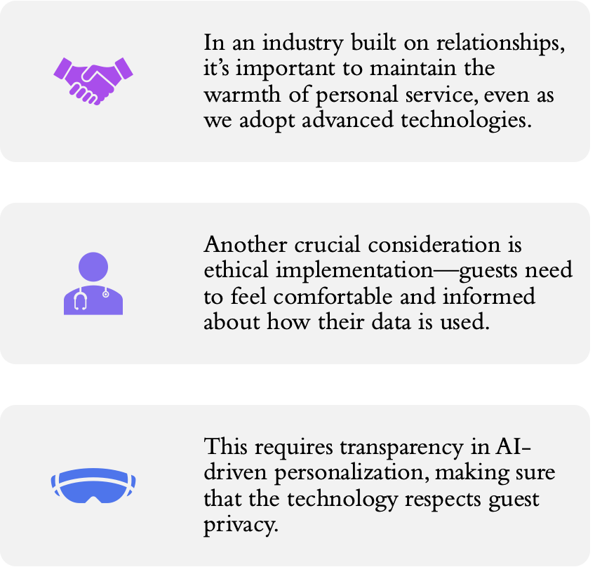
Digital Transformation – Critical Reflection

Slide 9
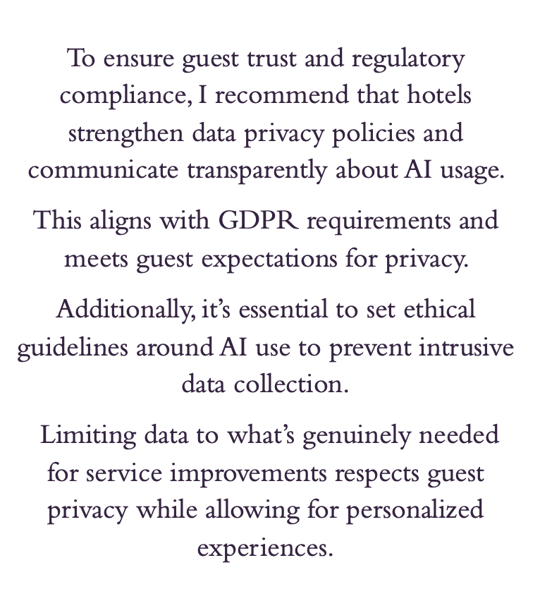
Future Policy Recommendations

Slide 10
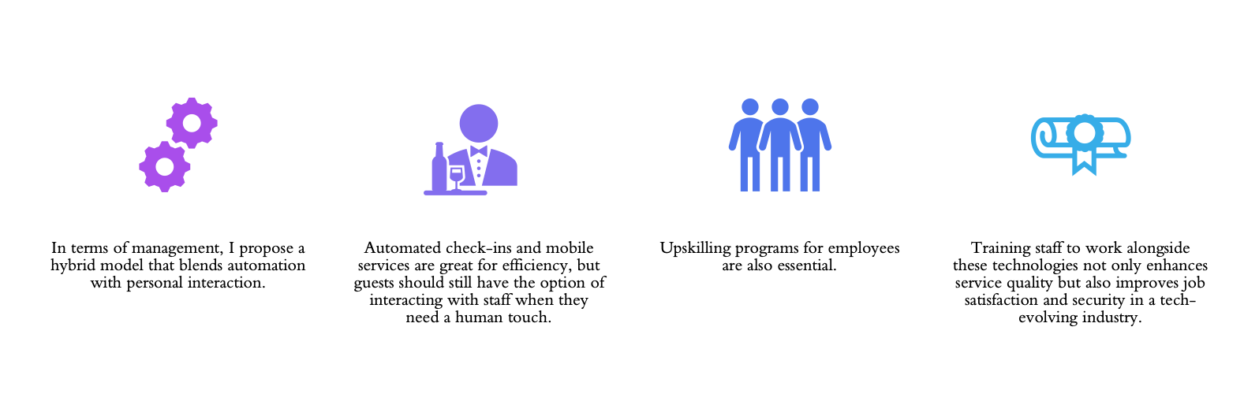
Management Strategies for Digital Transformation

Slide 11

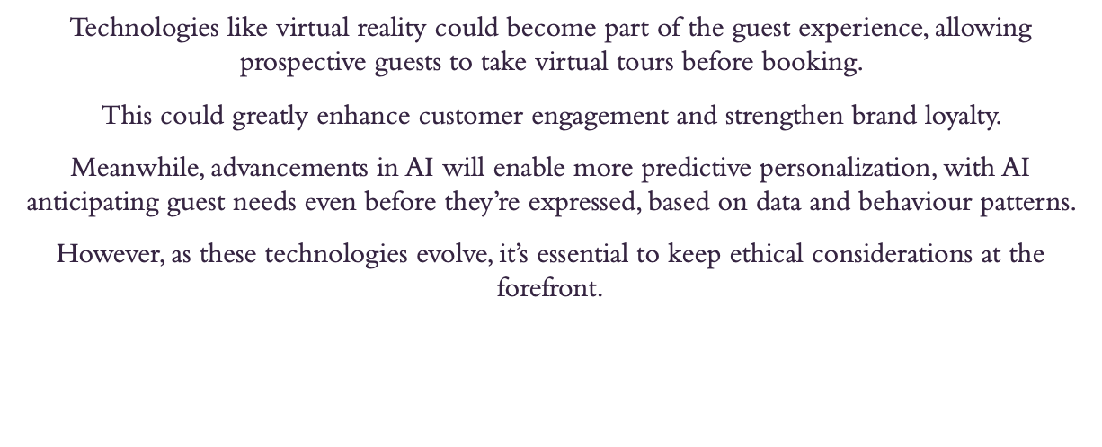
Hospitality Industry – Future Trends

Slide 12
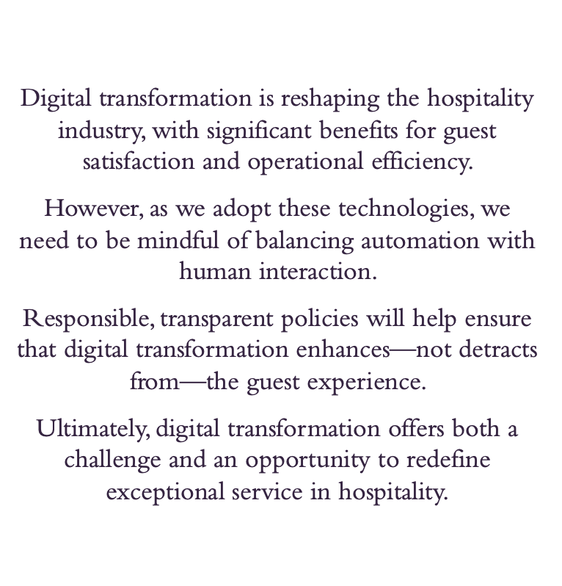
Conclusion

Slide 13
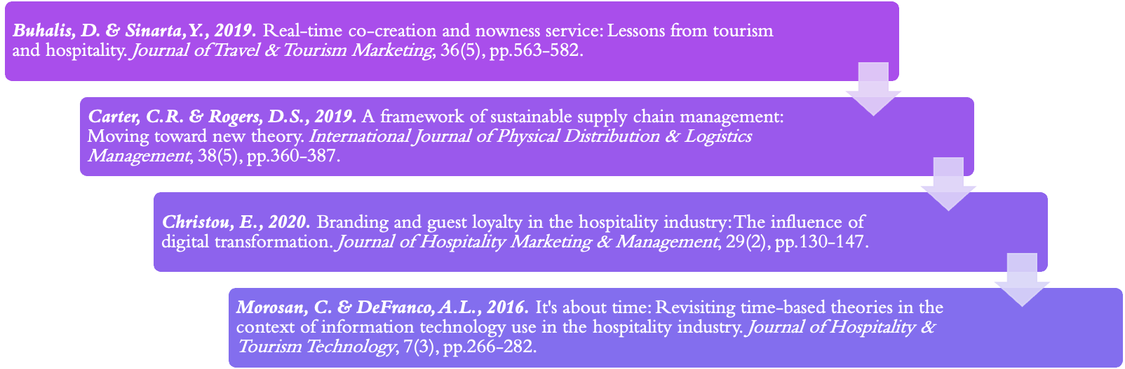
List of References

