Slide 1
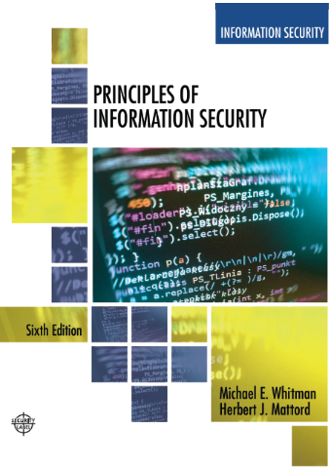
Identity, Access Control & Zero Trust Security
Week 3
Adapted Text
Lecturer: Munya
Email: m.murira@uwtsd.ac.uk

Slide 2
Learning Objectives
Understand modern access risks in cloud/hybrid environments
Apply governance thinking to identity and access management (IAM)

Slide 3
Recall: Identity and security
“Identity is now the new security perimeter.”
TRADITIONAL FOCUS
MODERN ORGANISATIONS RELY ON
Firewalls
Cloud computing
Remote working
Network protection
Mobile access
Perimeter security
SaaS applications
Digital identities
Protecting identities has become critical.
Verify who is accessing resources and control what they can access.
Recall question: Why are firewalls alone no longer enough?

Slide 4
Why Access Security Matters
Compromised accounts or sessions can lead to:
Ransomware
Attackers deploy malware and encrypt files.
Data breaches
Attackers access or steal sensitive information.
Cloud compromise
Attackers take control of cloud resources.
Financial fraud
Attackers misuse accounts to authorise fraudulent payments.
Discussion: What could happen if an attacker accessed
a university administrator’s account?

Slide 5
Modern Access Threats
Modern access-related threats include:
phishing
credential stuffing
password spraying
session hijacking
MFA fatigue attacks
Why do phishing attacks continue to succeed?
Threat | Description
Phishing | Trick users into revealing credentials(Impersonation,fake links e.t.c)
Credential stuffing | Reuse stolen passwords (Trying stolen credentials on other services)
Password Spraying | Attempt common passwords – across many accounts
Session Hijacking | Steal active sessions- to bypass the login process
MFA Fatigue | Repeated MFA requests- to pressurise you to approving access

Slide 6
Interactive Case Study
“The Compromised Employee Account”
Scenario
An employee:
clicks phishing email
attacker steals credentials
VPN account compromised
attacker accesses cloud systems
sensitive data downloaded
Discussion Questions
What failed first?
Was MFA enough?
Should VPN access have been restricted?
How could Zero Trust reduce impact?
What governance weaknesses exist?
What should happen immediately after detection?

Slide 7
Group Workshop Activity
“You Are the Security Governance Team”
Scenario
A company:
supports hybrid working
uses VPNs
has BYOD devices
expanding cloud adoption
BUT:
increasing phishing attacks
weak identity governance
poor access reviews
Task
Develop:
Top identity/access risks
Governance improvements
Technical improvements
Staff awareness recommendations

Slide 8
Come Prepared (Questions)- Ready to form Part of Week 4
  Can organisations realistically prevent every attack?
  If you could choose only one, would you use IDS or IPS to protect a hospital network, and why?
  “Which is more dangerous: false positives or false negatives?”
  Why are traditional antivirus products no longer enough?
  Can small organisations realistically operate a SOC?
  Can organisations realistically monitor every security alert?
  Should organisations assume attackers are already inside?
  Is threat hunting only useful for large organisations?
  Can AI replace security analysts?
  Will future cyber defence become fully automated?”

Slide 9
Reference Links
NIST Cybersecurity Framework
NIST Cybersecurity Framework
NIST Zero Trust Architecture
NIST SP 800-207 Zero Trust
Microsoft Zero Trust Overview
Microsoft Zero Trust Overview
Cisco Firewall Overview
Cisco Firewall Overview
Cisco VPN Overview
Cisco VPN Overview
OWASP Credential Stuffing
OWASP Credential Stuffing
IBM Cost of a Data Breach Report
IBM Cost of a Data Breach Report

