Slide 1

Common Developmental Disabilities:

Slide 2

Consolidation of learning from this module so far…
The following case studies will help us reflect upon the topics of child development and disability, and give us a chance to consider the impact that these conditions can have on children and their families.
In your presentation groups you have around 40 minutes to prepare a 5 minute feedback to the main classroom regarding your case study and be prepared to answer a few questions at the end of your feedback.
How you wish to present your case study is up to you.
I will be offering assistance between the groups.

Slide 3
Other things to consider is how their developmental disability might impact on their lives. Try commenting on the impact of their disability on three or four key life areas from the list below:
Child development
General health
Quality of life
Access to healthcare
Access to education
Social inclusion
The lives of their carers
The lives of their siblings
Remember to think about the background of each of the case studies.
How might their lives be different had they been born in a different country or socio-economic background?
Draw on your learning so far… be bold and reference…

Slide 4


Case Study A. Justin:
Justin is six years old. He lives in a suburb of Chicago in the United States (high-income country) with his parents and two older siblings. When he was a baby, he contracted rubella, causing moderate hearing loss in both ears. Justin’s family have healthcare insurance and Justin received hearing aids soon after his diagnosis. In recent years, he has been able to receive consistent speech and language therapy. He loves pizza and dancing.

Slide 5
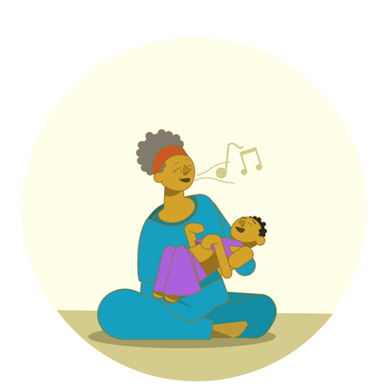
Case Study B. Thandi
Thandi is three years old. She lives in rural Malawi (low-income country) with her mother, aunt, uncle and three cousins. Thandi’s mother noticed early on that she did not develop in the same way as other children, and Thandi has recently been diagnosed with cerebral palsy. Thandi’s mother stays at home and does not work. They are supported by Thandi’s aunt and uncle. Thandi’s mother was distressed when told of her daughter’s condition and when doctors explained that it could not be cured. She has been paying traditional healers to try to cure Thandi’s condition. Thandi likes music and listening to her aunt sing.

Slide 6
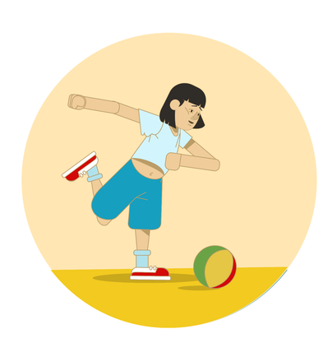
Case Study C. Mai
Mai is nine years old. She was born with Down Syndrome. She lives in northern Vietnam (lower-middle income country) with her mother, father and younger sister. She lives an active life within her community and enjoys playing football. Mai’s mother and father have recently started attending a parent support group where they receive advice and support from other parents. As well as football, Mai enjoys drawing with her sister.

Slide 7
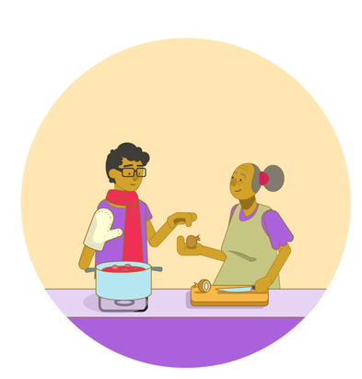
Case Study D. Lucas
Lucas is seventeen years old. He was diagnosed with autism as a young child after his parents noticed that he behaved differently to other children. He currently lives in Rio de Janeiro in Brazil (upper-middle income country) with his grandmother. He is a shy and quiet young man, but is prone to bouts of hyperactivity and aggression. His grandmother has relied heavily on a local None Governmental Organisation (NGO) to help support Lucas. The NGO provides a number of services for children with autism, including peer-support groups and life skills training. Lucas loves to help his grandmother knit and cook.

Slide 8
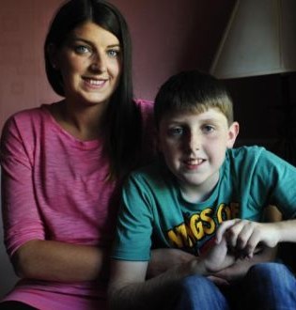
Case study E: Dylan
‘He’s a 10-year-old child with disabilities . . . I can’t see how isolating helps’
https://www.irishtimes.com/news/education/case-study-he-s-a-10-year-old-child-with-disabilities-i-can-t-see-how-isolating-helps-1.2331166

Slide 9

Feedback time!

Slide 10


