Slide 1


The Benefits of
Collaborative
Learning
By Kirsty Truslove
Student ID – 0902265
BMSP4015

Slide 2
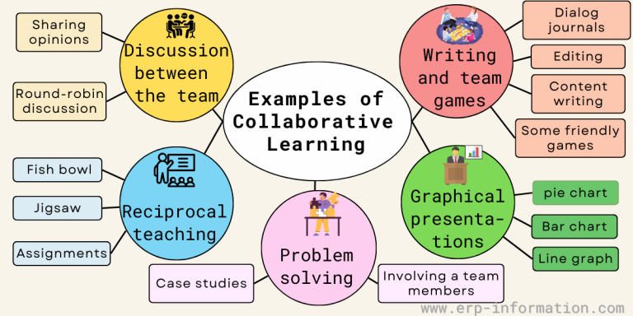
Introduction
An educational tactic where students work in groups to accomplish a common goal by enhancing skills through social communications
Improve learning
Problem Solving
Complete tasks
Learn new ideas
Share ideas
(Hedge, 2023)

Slide 3

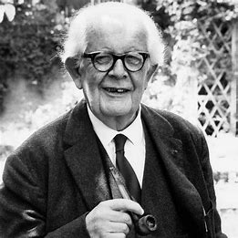

Collaborative Learning Theorists
Vygotsky Theory of Learning Collaboration –
“He believed that community was an important factor in the process of creating meaning and knowledge.” (Andreev, 2022)
Social Interaction
Zone of Proximal Development
More Knowledgeable Other (MKO)
Scaffolding
(McLeod, 2024 & Cherry, 2024)
Jean Piaget’s Theory –
Jean Piaget had a theory that concentrated on how people gained knowledge via independent interaction with their surroundings.
Piaget’s theory is well known for its phases of cognitive development, that meaning that as children get older, they go through a number of common stages.
(Simply Psychology, 2024)

Slide 4
Advantages
Disadvantages
Higher level of thinking
Promotes student - peer interaction
Forming more supportive networks
Shared responsibility
Active engagement
Enhanced communication skills
Learning from peers
Introverts may struggle
Learning together is slower
Unequal participation
Group conflicts
(Drew, 2024)

Slide 5

1) All businesses will benefit from having an enthusiastic workplace
2) Growth of higher-level thinking
3) Training for real life social and employment situations
4) Clear Objectives
5)Supportive leadership
6)Diverse teams
7)Training and Development
(Andreev, 2022 & Laal & Ghodsi, 2012)
Business, Collaborative Learning and the Benefits…

Slide 6

Conclusion
Collaborative learning change the way we teach and learn. It helps students with many things, including - helping to develop critical thinking, learning and sharing of new ideas, problem solving, creativity and communication to be able understand their subject better. (Hedge, 2023)
Collaborative learning increases students' communication skills and builds a sense of community which prepares them for real world challenges while making learning more enjoyable.

Slide 7


Thank-you
For
Your
Time!
Any Questions?

Slide 8
/
References
Andreev, I. (2022, March 2). What is collaborative learning? Valamis. https://www.valamis.com/hub/collaborative-learning#:~:text=Jean%20Piagetset%20out%20to%20understand%20how%20infants
Cherry, K. (2024). What is Sociocultural Theory? Developmental Psychology. https://www.verywellmind.com/what-is-sociocultural-theory-2795088
Drew, C. (2024, May 29). Collaborative Learning: Pros & Cons. Helpful Professor. https://helpfulprofessor.com/collaborative -learning/
Hedge, A. (2023, May 18). What is Collaborative Learning? (Benefits, Strategies, Theories, and Examples). Erp-Information. https://www.erp-information.com/collaborative-learning
Laal, M., & Ghodsi, S. (2012). Benefits of collaborative learning. Procedia - Social and Behavioural Challenges, (31), 486-490. https://doi.org/10.1016/j.sbspro.2011.12.091
Mcleod, S. (2024). Vygotsky’s Theory of Cognitive Development. Simply Psychology, (31), 486-490. https://www.simplypsychology.org/vygotsky.html
Simply Psychology. (2024, March 13). Vygotsky vs. Piaget: A Paradigm Shift. https://www.simplypsychology.org/piaget-vs-vygotsky.html

