Slide 1
Introduction to Marketing
Day three

Slide 2
Programme for the day
The marketing mix
The four “P’s” – product, price, place, promotion
Product life-cycle
Multi-media marketing

Slide 3
The marketing mix – the 4 “P’s”
Product (and/or service)
Price
Place
Promotion

Slide 4
Product - factors
Features
Benefits
Design
Quality
Packaging
Guarantee
Support or back up services

Slide 5
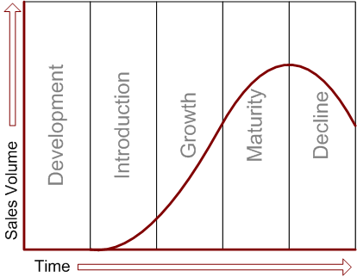
Product life-cycle

Slide 6
Price - factors
Costs and overheads
Quality
Competitors’ pricing
Discounts
Bulk purchasing
Special offers
Credit terms

Slide 7
Place - factors
Location
Accessibility
Opening times
Flexibility
Internet/telephone ordering
Distribution channels

Slide 8
Distribution channels
The path through which goods and services travel from the vendor to the consumer or payments for those products travel from the consumer to the vendor. A distribution channel can be as short as a direct transaction from the vendor to the consumer, or may include several interconnected intermediaries along the way such as wholesalers, distributers, agents and retailers. Each intermediary receives the item at one pricing point and moves it to the next higher pricing point until it reaches the final buyer. Coffee does not reach the consumer before first going through a channel involving the farmer, exporter, importer, distributor and the retailer.
The business dictionary

Slide 9
AIDA
Get the customers’ Attention, arouse their Interest, stimulate their Desire to buy, turn desire into Action to purchase

Slide 10
Promotion - factors
Advertising
Sales promotion
Public relations
Selling

