Slide 1
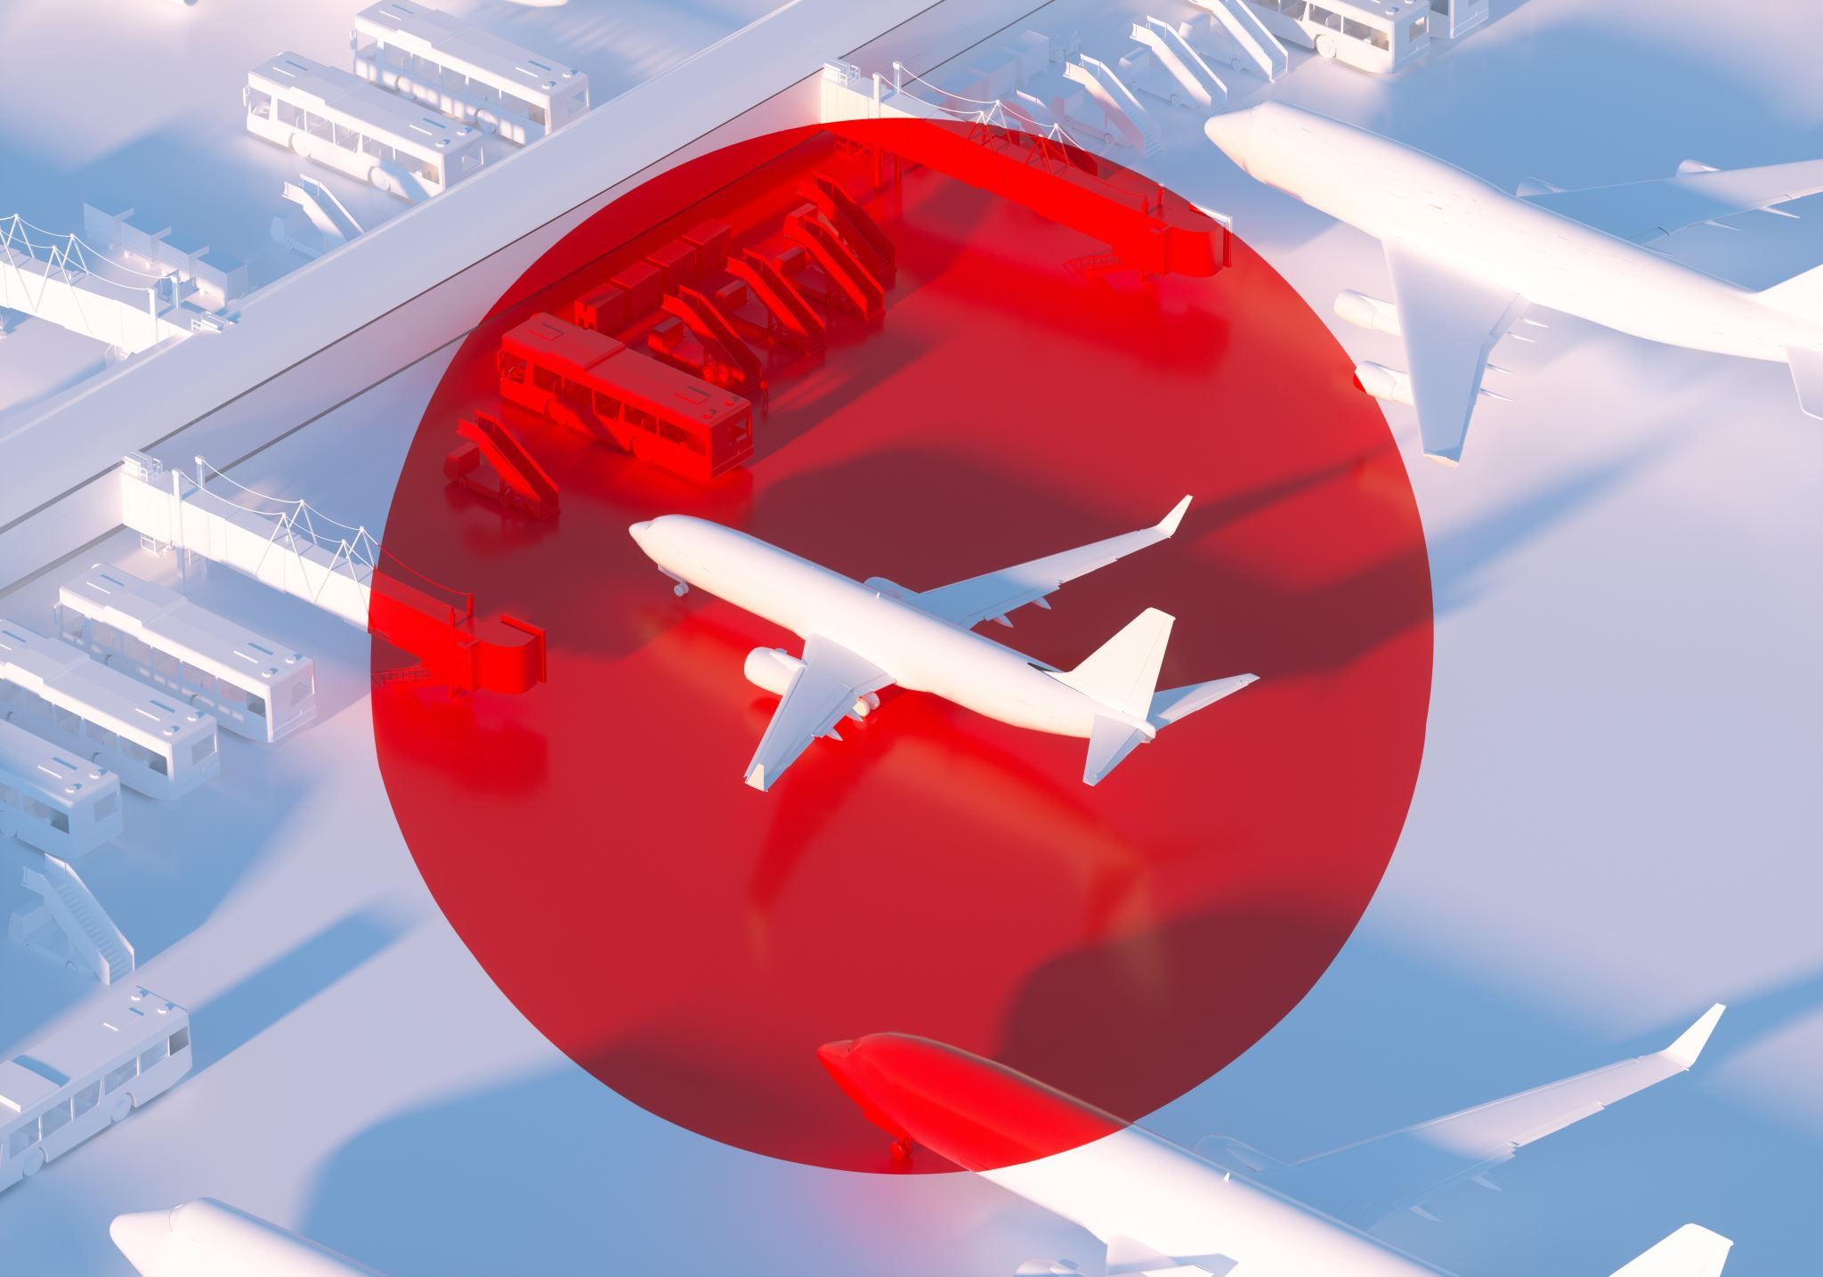
Communication Barriers in Flight Foods Ltd.
• Module: Communication Skills
• Case Study Presentation
• Student Name : Tahmina Aktar Haque
• Student ID : 2528850

Slide 2
Presentation Overview
Company background
Problems identified
Five communication barriers
Communication theories
Recommendations
Conclusion
References

Slide 3
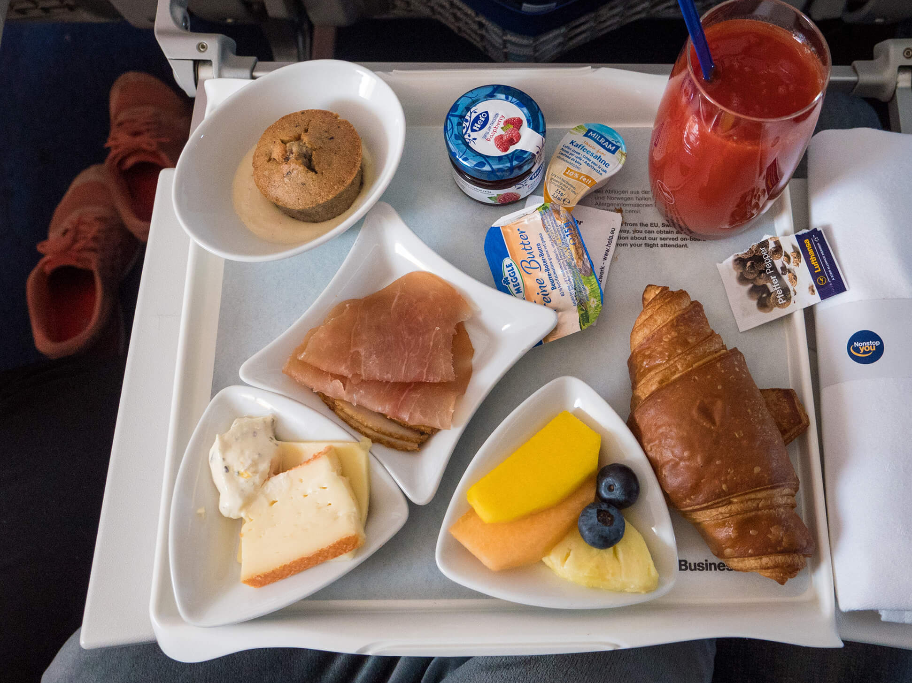
Company Background
Medium-sized ready meal manufacturer
Supplies ready meals to airlines
Workforce of 40 employees
Five different cultural groups.
Old, noisy machinery

Slide 4
Main Problems
Losing market share
Undercooked food
Poor packaging
Meat found in vegetarian meals
Poor food hygiene practices

Slide 5
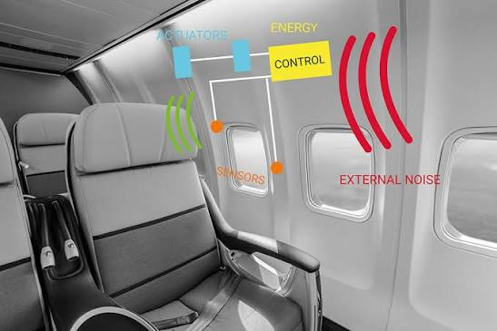
Environmental Noise Barrier
Old machines create excessive noise
Staff cannot hear instructions clearly
Increases mistakes
Shannon & Weaver: Noise interrupts communication
Solution:
A, Reduce machine noise – Service old machines or run them one at a time.
B, Use hand signals or written notes – For orders during noisy time.
C, Move important talk to a quite area - Do briefings away from machines.

Slide 6
Language & Communication Barrier
Limited English among workers
English-only safety signs
Misunderstood instructions
Schramm: Shared understanding is essential

Slide 7
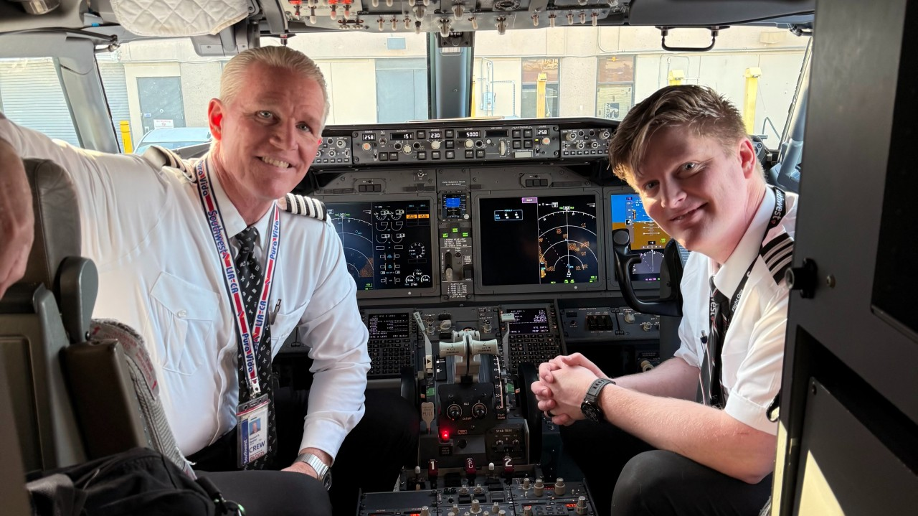
Age / Generational Barrier
Employees aged 16–60
Younger staff struggle to follow instructions
Different learning styles
Berlo SMCR: Receiver influences communication

Slide 8
Cultural Barrier
Five different cultural groups
Different communication styles
Workers speak their own languages
Misunderstanding food hygiene standards

Slide 9

Emotional Barrier
Gary becomes stressed and frustrated
Calls staff 'Idiots'
Poor morale and teamwork
Emotions reduce effective communication

Slide 10
Recommendations
Food hygiene training before work
Multilingual signs
Visual instructions
Replace noisy machinery
Team meetings
Cultural awareness training

Slide 11
Conclusion
Communication barriers caused quality issues
Better communication improves food safety
Staff training improves performance
Better teamwork restores customer trust

Slide 12
References
Berlo, D.K. (1960). The process of communication: An introduction to theory and practice. New York, NY: Holt, Rinehart Winston.
* Used for: Berlo’s SMCR model of communication – Sender, Message, Channel, Receiver.
Schramm, W. (1954). How communication work. In W. Schramm(Ed), The process and effects of mass communication(pp.3-26).Urbana, IL: University of Illinois Press.
* Used For: Schramm’s model communication as a two-way process with feedback.
Shannon & Weaver (1949) The mathematical theory of communication. Urbana, IL: University of Illinois Press.
* Used For: Noise in communication and how it interrupts the message.
Food Standards Agency (2024) Food hygiene: A guide for business.Retrieved August 8,2026,from food.gov.uk
* Used for: Food safety standards and communication barriers in food businesses
Health and Safety Executive (2024). Managing noise at work. Retrieved August 8,2026,from hse.gov.uk
* Used for: Environmental noise risks, PPE, and workplace communication issues

