Slide 1

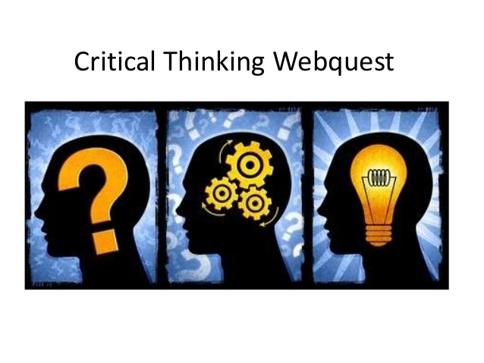

Critical Thinking
Critical Reading
Introduction
Critical Thinking when Writing
Critical reading enhances critical thinking in psychology as it requires you to analyse, evaluate, reflect and make judgements on the text in your mind at the same time as reading it, (Cottrell, 2011). Critical reading requires attention to be focused closely on parts of a text.
Basic preparation when reading can enhance critical thinking skills, (Cottrell, 2011).
Cottrell, (2011) considers the following factors highly Important when critically reading books for psychology:
Preliminary skim
Scan the introduction of the book
Scan the final chapter
Scan the beginnings and ends of the chapter
Important factors to consider when reading articles critically for psychology:
Firstly, browse the abstract of the article to see if it relates.
Secondly, read the abstract slowly if it does relate and pinpoint the main argument.
Lastly, use the abstract to identify the most relevant information which relates to you, (Cottrell, 2011).
Quite often, when the phrase Critical thinking is heard, it is common to think it means to analyse something negatively, (Cottrell, 2011).
However, critical thinking is much more then that, it is a cognitive process which takes all aspects into account, (Cottrell, 2011).
It is reflective thinking, (Bensley, 2008). Which requires attention, judgement, categorisation and selection, (Cottrell, 2011).
Critical thinking consists of taking in information and thoughts from an neutral point of view, and analysing this information while taking into account your own, thoughts, outlooks, feelings and experiences, (McCreery, et al., 2013).
For good critical thinking skills to be developed, they must be practiced. Academic writing is a good way to do this as it explores the understanding you have of the subject being studied, (McCreery, et al., 2013). It brings together the other features of critical thinking, (Cottrell, 2011).
An important factor of academic writing is re-drafting and editing. This encourages critical writing as the final draft should include the features related with critical thinking, (Cottrell, 2011).
Making Notes to Support Critical Thinking
Personnal
Qualities which Enhance Critical Thinking Skills
Time Management
Independent Reading
Independent Learning
Avoid making lots of notes, make sure notes are relevant. Notes should support the main purpose. Make a conscious effort to for your notes to reflect what you have just read. Avoid making unnecessary un-thought through notes by reading through the text without a pen in your hand, (Cottrell, 2001).
Cottrell, (2011) believes the following points are important to keep in mind when making notes to support critical thinking in psychology:
What does the information you are reading actually mean?
Is the argument supported by the reasons?
Is there evidence to support what is being stated?
Does the information match what you already know about the subject?
Does the information match the evidence already available?
Does this information show any faults?

Slide 2
Reference List
All images sourced from google images
Cottrell, S. (2011). Critical thinking skills : Developing effective analysis and argument (2nd ed., Palgrave study skills). Basingstoke: Palgrave Macmillan.
Cottrell, S. (2013). The study skills handbook (4th ed., Palgrave study skills). Basingstoke ; New York: Palgrave Macmillan.
Latto, J., & Latto, Richard. (2009). Study skills for psychology students (Skills for successful study series). Maidenhead, England : New York: Open University Press ; McGraw-Hill.
McCreery, Eales-Reynolds, Judge, Jones, McCreery, Elaine, Eales-Reynolds, Lesley-Jane, . . . Jones, Patrick. (2013). Critical thinking skills for education students (Second edition / Brenda Judge and Elaine McCreery, both at Manchester Metropolitan University (Manchester). ed., Study skills in education).

