Slide 1
BSc Health & Social Care
Changemakers – Creativity and Value Creation (BMHP 5014)
WEEK 5

Slide 2
Today we will…
Share with each other what your idea’s are and which two artefacts you have chosen.
Discuss the assessment draft for the first assignment e-portfolio artefact tasks.
The assessment for the second assignment.
Submission and conduct.
Referencing requirements.
Work on your e-learning activities.

Slide 3
Module Learning Outcomes
  Demonstrate knowledge and critically understanding of innovation, creativity and enterprising mindset, recognising the values and the contributions creativity makes to the common good.
  Conceive, articulate and apply creative thinking within a work-based or academic context to develop novel solutions and/or value creation.
Notes:
A discussion on why the LO are important for their overall learning and how they demonstrate these in their work and by completing the online activities.

Slide 4
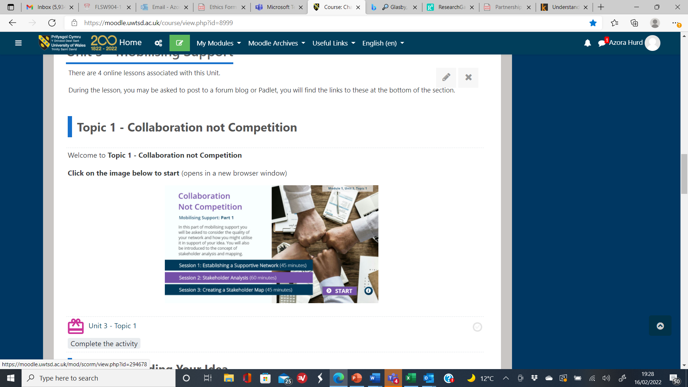
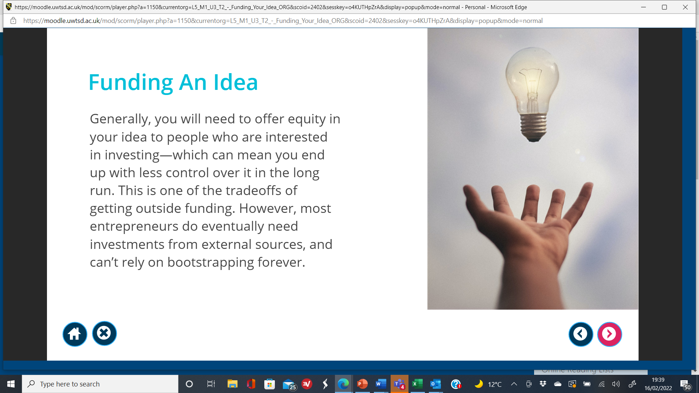
Mobilising Support
TOPIC 1 COLLABORATION NOT COMPETITION
Establishing a supportive network
Stakeholders analysis
Creating a stakeholder map
Notes:
One of the topics from the online e-learning material takes the students through working in collaboration with others and not in competition with others.
This is the opportunity to help students work collaboratively to share their ideas and to support members of the cohort to generate ideas on their e-portfolio artefacts.
It is important to aid students to see a link to the e-learning materials and the production of the e-portfolio as it links to the health and social care sector.

Slide 5
Your Cohort’s E-portfolio
Sharing Ideas
As part of a learning circle for the class it is important to share ideas and help everyone to complete the assessment task for the first submission. This links to the topic area covered in Unit 3 around mobilising support – collaboration not competition.
You will be expected to confirm which two artefacts you will be including in your e-portfolio and your topic area so be prepared to share.
Everyone in class will be able to support you with ideas to include in your topic area as peer support.
Notes:
To encourage engagement and sharing of their ideas via the concept of mobilising support which is one of the topic areas covered within the online material.
This activity should include all the students to share their ideas with each other for a period of 3 minutes each to present their idea and then ask the collective to provide some feedback to the student on what they might like to include.
To help springboard ideas and generate discussion.
To enable them to confirm their ideas and to work on them for submission in week 8.
To help support each other to think of wider things.
To stimulate collective creativity.

Slide 6


Module overview
Module Title – Changemakers: Creativity and Value Creation
Module Code – BMHP5014
Credits - 20 (Level 5)
Assessments
Assessment 1 – E-Portfolio consisting of 2 artefacts tasks
Assessment 2 – 2,000 (-/+ 10%) written assignment

Slide 7

Assessment 1

Slide 8
Assessment 1
Assignment 1 – E-Portfolio Evidence of Learning – 50% weighting - 2,000 word equivalent consisting of 2 different artefact tasks
Submission to Turnitin link.
Notes:
Assessment 1
Produce an e-portfolio that addresses the following four tasks:
This mark will be awarded based on your tutor’s assessment of your active participation in, and contributions to, the learning activities throughout the module.
Tutors will award marks for completing specified tasks and for the output you produce and submit (e.g., completion of activities, messages posted in discussion threads, active participation in discussions). This mark relates to both participation and contribution, so simply completing all module study activities is not a guarantee that you will receive the full 10 marks. If your tutor does not feel you have participated in these activities, the 10 marks will be lost.
Task 1. Create a mind map that demonstrates how the ideas and concepts covered in Unit One of the module are interconnected and how they contributed to the development of your project idea.
Task 2. Using a medium of your choice, create a summary that outlines how you came up with your idea and how it adds value, based on the concepts introduced in Unit Two of the module.
Task 3. Create a 2-minute elevator style pitch of your idea and a supporting flyer. The pitch should be recorded, and a link included with the Turnitin submission. A flyer can be produced using PowerPoint, though you could also try applications such as Canva, available for free at https://www.canva.com/en_gb/.
Task 4. Create an A3 digital conference poster showcasing your project. Your poster should make reference to the learning covered in Unit Four of the module. A list of references should be included with the poster.
Assessment 2
Identify the key learning points which you have gained because of completing the Changemakers: Creativity and Value Creation module. Draw upon aspects from each of the four units of the module e.g., ideas and values, creative solutions, mobilising support and evaluation to identify your knowledge and critical understanding of innovation, creativity and enterprising mindset recognising the values and contribution, which creativity makes to the common good.
General Submission Guidance
All of your submissions must include a title page that clearly states your name, your student number, the module code and title, your lecturer’s name, and your assignment title.
2. All of your submissions should be typed in Arial font, size 11/12.
3. All of your submissions should be typed with 1.5 line spacing.
4. All of your submissions should have an appropriate structure, include page numbers, and have a reference list (using Harvard Referencing)

Slide 9
ASSESSMENT CRITERIA E-PORTFOLIO
Generic Assessment Criteria
1. Engagement with Literature Skills 10%
2. Knowledge and Understanding Skills 20%
3. Cognitive and Intellectual Skills 20%
4. Practical Application Skills 20%
5. Transferable Skills for Life and Professional Practice (including 10 marks for e-learning participation in the online material) 30%
Notes:
Reinforce the assessment criteria and especially criteria 5 which has the 10 extra marks they can gain for completing the online activities.

Slide 10
E-Portfolio Options
Choose two from the following tasks to evidence your e-portfolio - both of your artefacts have to be linked to each other.
Task 1 Option – Mind-map plus 500 words explanation.
Task 2 Option – A Blog which is 500 words must include at least 1 website link.
Task 3 Option – Elevated Pitch which is 500 words.
Task 4 Option – A flyer/leaflet plus 500 words explanation.
Task 5 Option – Conference Poster plus 500 words explanation.
Notes:
Reminding the students briefly what is expected in the assessment task.
The word count is an indication of what they need to do for each artefact.
Remind students that it is 2,000 works equivalent as notional time and effort is taken into consideration for supporting their creativity in the production of the e-portfolio.

Slide 11
Assignment layout – E-Portfolio
Cover page – your name, student number, module reference details, the lecturers name.
Contents page – add page numbers.
Introduction – must contain which two artefacts you have chosen, what your idea or approach is for your portfolio, and why these artefacts can be useful in practice in health and social care for this idea or approach.
Artefact 1 – name which one (500 words).
Artefact 2 – name which one (500 words).
Conclusion – summarise the main points of your assignment.
Reference page – references list for both artefacts (in Harvard Referencing style).

Slide 12
General Information
You are expected to create an e-portfolio which comprises of 2 items from a list of 5 artefact task options. The e-portfolio items should follow through an idea or an approach to either:
Develop a new project plan that is unique and which you have identified a gap in a service, or
You are advocating in support for an existing national or local project, which you will demonstrate your active role of leadership to support the project to a potential new audience within your local area; or
You will develop a campaign of your own that will promote, or advocate a given cause, or mission for which you are passionate about.
The expectation is that you will confirm which aspect in your approach to your given option in a clear introduction to your two artefact items which you have chosen to showcase.
Notes:
Students must evidence from which perspective they are going to be taking when designing their two artefacts. This must be one of the three approaches and they must clearly confirm this in a short introduction at the beginning of the e-portfolio.
The portfolio will have a cover page, a contents page, a short introduction and then each artefact task and finally the reference list.

Slide 13
Task 1 Option – Mind-map
ARTEFACT TASK 1
Create a mind map of your choice with no more than 6 interconnecting links that demonstrates how the ideas and concepts are formulated from one of the approaches you have chosen to take.
Alongside your mind-map you should provide a written explanation of your mind-map of no more than 500 words.
You can use supporting imagery, and it can be hand drawn or produced using MS Word, or PowerPoint using Office 365 or an appropriate technology such as Mind Meister available at: www.mindmeister.com/
The mind map should be referenced appropriately for all the images uses.
The mind-map explanation should include references sources around your idea/approach on the topic area and it can include governmental legalisation and national policy.

Slide 14
Task 2 Option – A Blog
ARTEFACT TASK 2.
Create a blog that outlines how you came up with your idea/approach. You should discuss your idea by explaining what it is clearly which will encourage other bloggers to engage with you.
This blog should be no more than 500 words and should use supporting visualisation imagery e.g., graphs, tables and pictures and should include website links to entice your potential audience to seek further information.
It should have one website link included around your idea/approach.
A list of sources used to inform your blog should be included in a reference list, using the appropriate referencing standard.

Slide 15
Task 3 Option – Elevated Pitch
ARTEFACT TASK 3.
Create an elevator style pitch (a written piece which you could present to a fictitious audience) about your idea/approach.
The pitch should be written in a format that will enable you to present it to a new potential audience and should be no more than 500 words.
In your pitch you are promoting your idea to engage with the audience, so that they will offer support to you in a proactive way either by being actively involved or by offering support such as crowdfunding.

Slide 16
Task 4 Option – A flyer/leaflet
ARTEFACT TASK 4.
Create a single-sided flyer which supports your idea and approach. Your flyer can be produced in PowerPoint using Office 365 or cover an A4 MS Word sheet.
It should be designed to engage your potential audience or contributors and should benefit your idea. For example, if you have an awareness raising idea, your flyer should concisely portray the issue and how you would like people to get involved.
You will need to explain the contents of your flyer in no more than 500 words about how you came up with the flyers design and why you think it is effective at advertising your idea.
A list of references should be included outlining both the images you use and the academic source material you have include.

Slide 17
Task 5 Option – Conference Poster
ARTEFACT TASK 5.
Create a conference poster showcasing your idea and approach. Your poster should showcase your idea in such a way that it encourages your potential audience to find out more and to attend your conference.
Think of a strapline for your conference poster and use images to portray your idea and concepts.
You will need to explain the contents of the poster in no more than 500 words of how you came up with the poster design and why you think your potential audience would get involved.
A list of references should be included with the poster. Consider your potential audience when designing the poster and the kind of messages you wish to portray to promote your idea to encourage individuals to attend.

Slide 18
Be creative, innovative and show an enterprising mind-set
Whichever two artefact tasks you chose for your e-portfolio, please be as creative as possible in the design of your work.
You can use MS Word and PowerPoint slides to produce your e-portfolio as long as it can be read in the Turnitin portal.
Ensure you use images, colours, boxes and written text to make your work eye-catching and visually appealing.
Notes:
Reminding the students to be as creative as possible in the production of the e-portfolio.
Must remind students that they have to either produce their work in PowerPoint 365 or MS Word. Only one document can be uploaded and it is essential that they have both their artefacts linked and to follow one of the bullet points outlined on slide 10 in red.

Slide 19
PARTICIPATION AND CONTRIBUTION IN THE ONLINE ACTIVITIES
In the final assessment criteria Transferable Skills for Life and Professional Practice you will be able to attract up to 10 marks for demonstrating that you have been proactive with the online e-learning material.
The lecturer for the module will be monitoring your involvement and the achievement of the activities and postings of material in the Forum, blogs and Padlet.
These 10 marks will be awarded based on your lecturer’s assessment of your active participation in, and contributions to, the learning activities throughout the module.
Notes:
Monitoring of online activities.
Lecturer monitoring of undertaking the activities and postings.
Blogs are their way of capturing what they have learnt as a aid towards helping them write the 2nd assignment.
The Padlet is for all the cohort to contribute to and comment on.
The cohort notice board is for all the group to comment on the postings.
Each posting relates to which unit they are working on when they undertake the posting which comes up at the top of the email. These emails goes out to everyone undertaking the module this term.

Slide 20
IMPORTANT INFORMATION
It is important that you create one document for that covers only two of your chosen artefact tasks and submit it into Turnitin.
You must indicate which task number you are covering in your work.
It is essential that you provide one reference list at the end of producing both your chosen tasks and that you use the University’s Harvard referencing guidance.
Ensure that you spell check your work, that you have correctly referenced the websites used for the images in your work and that you have used paragraphs (where appropriate) to break up your narrative.
Notes:
Whichever two artefact tasks you chose for your e-portfolio, please be as creative as possible in the design of your work.
You can use PowerPoint Office 365 format or MS Word to produce your e-portfolio as long as it can be read in the Turnitin portal.
Ensure you use images, colours, boxes and written text to make your work eye-catching and visually appealing.

Slide 21
IMPORTANT INFORMATION
Your work should have flow and be logically presented. You can add relevant images, website links, blogs, YouTube videos, governmental website links, or other documentary information to help enhance your idea and concepts that formulates either your new project, or advocates support of, or the development of a campaign.
Please be as creative as possible in the design of your work. Ensure you include any pictures, graphs, tables, colours, boxes and written text to make it visually appealing.
Notes:
Whichever two artefact tasks you chose for your e-portfolio, please be as creative as possible in the design of your work.
You can use PowerPoint Office 365 format or MS Word to produce your e-portfolio as long as it can be read in the Turnitin portal.
Ensure you use images, colours, boxes and written text to make your work eye-catching and visually appealing.

Slide 22
Assessment 2

Slide 23
Assessment 2
Assignment 2 – Written Assignment – 50% weighting, 2,000 words (-/+10%)
Submission to Turnitin link.
Notes:
Assessment 1
Produce an e-portfolio that addresses the following four tasks:
This mark will be awarded based on your tutor’s assessment of your active participation in, and contributions to, the learning activities throughout the module.
Tutors will award marks for completing specified tasks and for the output you produce and submit (e.g., completion of activities, messages posted in discussion threads, active participation in discussions). This mark relates to both participation and contribution, so simply completing all module study activities is not a guarantee that you will receive the full 10 marks. If your tutor does not feel you have participated in these activities, the 10 marks will be lost.
Task 1. Create a mind map that demonstrates how the ideas and concepts covered in Unit One of the module are interconnected and how they contributed to the development of your project idea.
Task 2. Using a medium of your choice, create a summary that outlines how you came up with your idea and how it adds value, based on the concepts introduced in Unit Two of the module.
Task 3. Create a 2-minute elevator style pitch of your idea and a supporting flyer. The pitch should be recorded, and a link included with the Turnitin submission. A flyer can be produced using PowerPoint, though you could also try applications such as Canva, available for free at https://www.canva.com/en_gb/.
Task 4. Create an A3 digital conference poster showcasing your project. Your poster should make reference to the learning covered in Unit Four of the module. A list of references should be included with the poster.
Assessment 2
Identify the key learning points which you have gained because of completing the Changemakers: Creativity and Value Creation module. Draw upon aspects from each of the four units of the module e.g., ideas and values, creative solutions, mobilising support and evaluation to identify your knowledge and critical understanding of innovation, creativity and enterprising mindset recognising the values and contribution, which creativity makes to the common good.
General Submission Guidance
All of your submissions must include a title page that clearly states your name, your student number, the module code and title, your lecturer’s name, and your assignment title.
2. All of your submissions should be typed in Arial font, size 11/12.
3. All of your submissions should be typed with 1.5 line spacing.
4. All of your submissions should have an appropriate structure, include page numbers, and have a reference list (using Harvard Referencing)

Slide 24
Respond to the following question
"Identify the key learning points from the online e-learning material which you have gained because of completing the Changemakers: Creativity and Value Creation module.
Draw upon one topic area from each of the four units of the e-learning material from the module e.g.,
Unit 1 - ideas and values,
Unit 2 - creative solutions,
Unit 3 - mobilising support and
Unit 4 – evaluation”.

Slide 25
Expectations
You are expected to write in the first person to reflect on your learning and personal journey which has helped you to identify your knowledge and critical understanding of innovation, creativity and enterprising mindset recognising the values and contribution, which creativity makes to the common good within the health and social care profession.

Slide 26
Self-reflection
Remember that with Assignment 2 you are doing a self-reflection of your journey through completing each of the four units in the e-learning online activities.
You write in the first person, so that you can bring in your experiences.
You are drawing on the e-learning material by evidencing from the material itself in a meaningful and engaging way and linking it to health and social care.

Slide 27
Identify a topic in each of the units
Reflect upon a topic in each of the online units i.e. four topic areas.
Draw on the key topic material in each area so that you have e-learning reference sources.
Keep within the word count of 2,000 words +/- 10%
Remember to research around the topic area and draw on other sources.
Ensure you include also a reflection on how innovation, creativity and having an enterprising mindset can be used toward the common good within the health and social care profession.

Slide 28
2nd Assessment - Assignment Structure
Cover page – student number, your name, the module number and title (not part of the word count).
Sub-heading suggestions for writing the assignment as follows:
Introduction – setting an outline about what you are going to cover in the assignment, which is linked to the assignment question (approximately 100 words).
Unit 1 – choose one topic area from the unit and confirm it in your introduction to this section of your reflection (400 words).
Unit 2 – choose one topic area from the unit and confirm it in your introduction to this section of your reflection (400 words).
Unit 3 – choose one topic area from the unit and confirm it in your introduction to this section of your reflection (400 words).
Unit 4 – choose one topic area from the unit and confirm it in your introduction to this section of your reflection (400 words).
What is important in each unit’s reflection is that you are being specific so that it is evident which topic area you have chosen.
Notes:
The assessment structure is for guidance to enable to student to manage the wordcount effectively.
Remind the students to be brief in their reflection drawing out the saliant points and how this links to their journey and lining it to the health and social care sector for the common good.
Help the student to understand it is about self-reflection.

Slide 29
2nd Assessment - Assignment Structure
  Conclusion – your overall learning from the e-learning material which you have gained linking it to recognising the values and contribution, which creativity makes to the common good (in health and social care) (300 words).
  References list – follow the Harvard guidance and requirements. It is essential that you have 8 creditable reference sources.

Slide 30
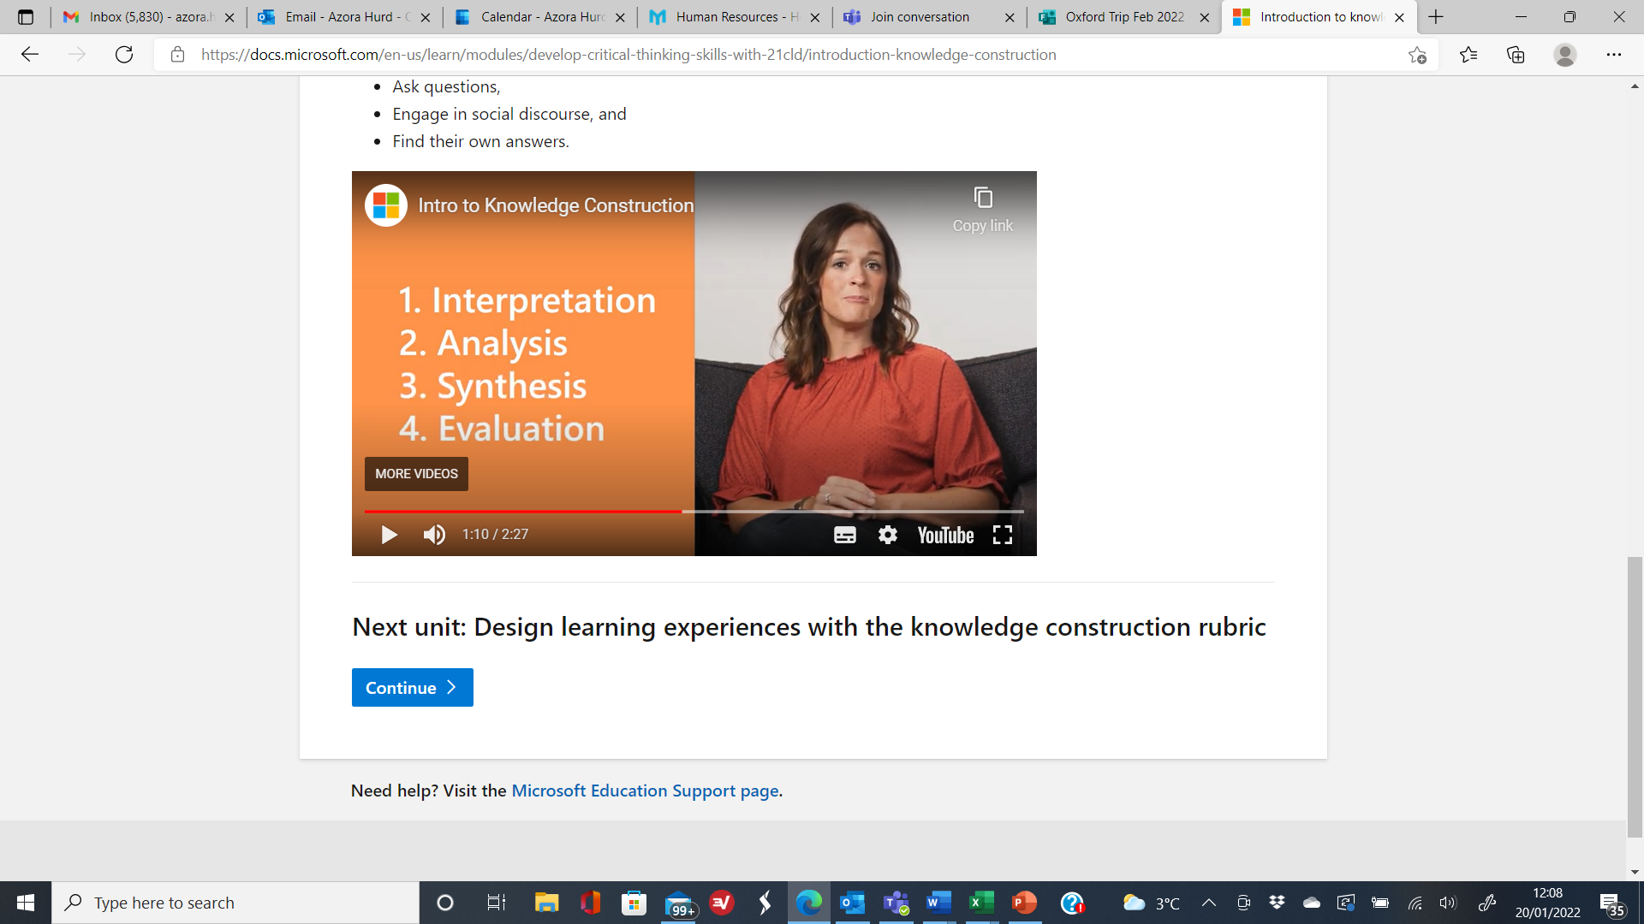
Reflection relates to…
Notes:
To develop core module concepts and enhance your ideas around change makers insights around demonstrating your knowledge and critically understanding of innovation, creativity and enterprising mindset.
I want to prepare you to learn more and challenge yourself to learn more that what you are learning from the online activities. You need to see a link to the social care and health profession.
I would like you to construct your own understanding of the online material and link it to your lived experiences, personally, professionally and socially.
Think of the online e-learning as helping aid your purposeful knowledge construction around innovation, creativity and having an enterprising mindset.
You should be willing to share your insights, and experiences with the cohort through the notice board and Padlet posting and you can add your own development through your blog postings.
This module forces you to generate ideas and developed understandings, which are new to you in your lived experiences.
This is done through higher level thinking skills and how you do the four core elements, whilst undertaking the online activities. The learning therefore takes place by undertaking and completing the online activities.
I want you to learn things from a new perspective and incorporating your learning within health and social care context.

Slide 31
Assessment Criteria 2nd Assignment
Generic Assessment Criteria
1. Engagement with Literature Skills 20%
2. Knowledge and Understanding Skills 20%
3. Cognitive and Intellectual Skills 20%
4. Practical Application Skills 20%
5. Transferable Skills for Life and Professional Practice 20%

Slide 32
SUBMISSION AND CONDUCT
Your submission should be your own work.
You should not share or circulate your assignment with others, who could copy your work into their assignment submission.
You should not purchase assignments written by others on your behalf.
You should note that there is an Academic Misconduct Policy and process around academic practice and unfair practice within the University, which will be followed if it is suspected that you have breeched the policy.

Slide 33
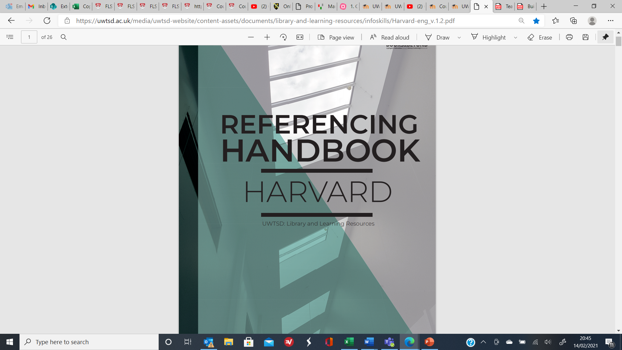
REFERENCING REQUIREMENTS
Ensure that you follow the UWTSD Harvard referencing requirements.

Slide 34
Units for the on line tasks – Unit 1
TOPIC 1 HOW INNOVATION CHANGES THE WORLD
Introducing innovation
Innovation and society
Creating the future
Creativity and society
TOPIC 2 WHO AM I? MY SENSE OF SELF
The idea of self
Social influences
Developing creative confidence
TOPIC 3 ADDRESSING SUSTAINABILITY
What is the problem?
Sustainability changemakers
Be the changemaker.
Additional resources
TOPIC 4 MAKING STATEMENTS
Big (traditional) values
Designing tool recipes
Small (personal) values
Additional resources

Slide 35
Units for the on line tasks – Unit 2
TOPIC 1 CHANGE MARKING – THE ACT OF CREATING VALUE
Who and what are changemakers?
Value creation pedagogy
The practice of changemaking
TOPIC 2 STORYTELLING
Stories and why we tell them.
Spotting competences in stories
Creating our own competency story
TOPIC 3 IDENTIFYING NEW IDEAS
Scoping
Finding meanings
Identifying attributes
TOPIC 4 SEEKING SOLUTIONS
Creative solutions tool cards
Tool Kits
Making your own tool kit

Slide 36
Units for the on line tasks – Unit 3
TOPIC 1 COLLABORATION NOT COMPETITION
Establishing a supportive network
Stakeholders analysis
Creating a stakeholder map
TOPIC 2 FUNDING YOUR IDEA
Sources of funding
Creating a crowdfunding campaign
Understanding social enterprise
TOPIC 3 TELLING YOUR STORY
Storytelling as a persuasive communication tool
Self-confidence and authenticity
Preparing a strong presentation
TOPIC 4 BE IN IT TO WIN IT
Navigating social media
Developing your professional persona
Linkedin the professional network

Slide 37
Units for the on line tasks – Unit 4
TOPIC 1 MEASURING SUCCESS
What is success?
The Pygmalion effects
Success and wellbeing
TOPIC 2 PERSONAL EVALUATION
Your project success
You, your project and others
Success through teamwork
TOPIC 3 MOVING FORWARD
Building up from the project
The power of failure
Looking forward
TOPIC 4 CLOSING THE LOOP
Skills and attributes
Showcasing your work

Slide 38
Any questions?

