Slide 1
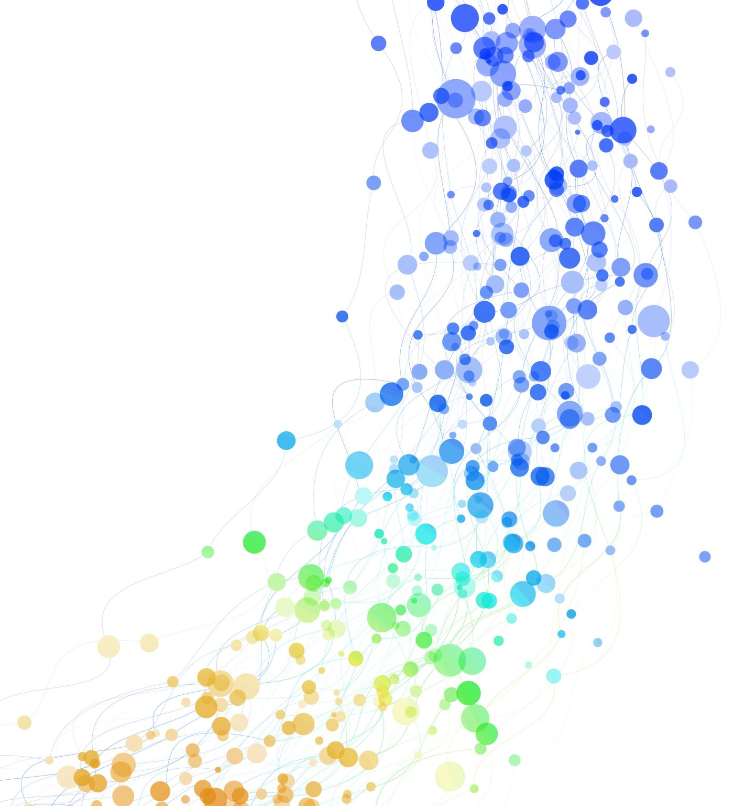
measles
Communicable Disease
Samantha Smale
2006544

Slide 2
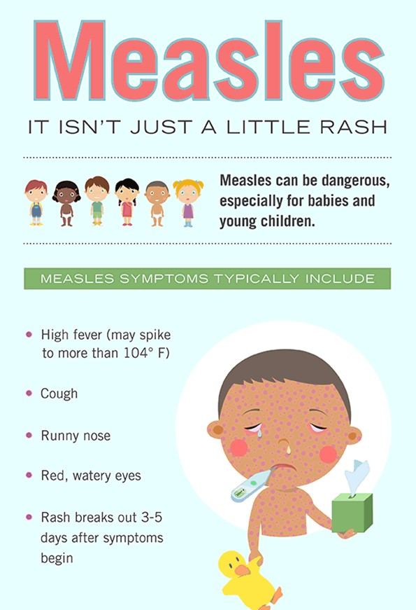
(Measles: guidance, data and analysis - GOV.UK, 2021)
Measles is a very contagious infection caused by a virus. It usually gets better on its own, but it can make some people very ill. Measles is an acute viral respiratory illness. It is characterized by a prodrome of fever. Measles symptoms appear 7 to 14 days after contact with the virus and typically include high fever, cough, runny nose, and watery eyes. Measles rash appears 3 to 5 days after the first symptoms.

Slide 3
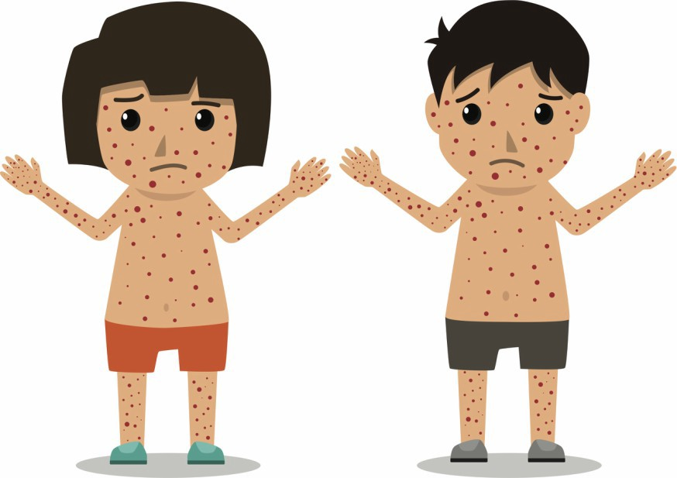
The main symptom of measles is a red-brown blotchy rash This usually starts on the head or upper neck before spreading outwards to the rest of the body.. You may have cold-like symptoms for a few days before the rash appears. There's no specific treatment for measles. Rest, take painkillers and drink plenty of fluids to help ease the symptoms until it has run its course. Measles is spread through coughs and sneezes. A person is most contagious from when symptoms develop until about 4 days after the rash first appears. The MMR vaccine can prevent measles. The vaccine is given as part of the routine NHS childhood vaccination programme.
(Confirmed cases of measles, mumps and rubella in England and Wales: 1996 to 2020 - GOV.UK, no date; Moss, 2017)
(World Health Organization, 2019)

Slide 4
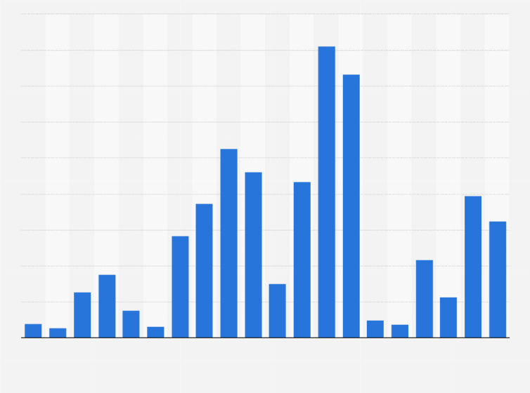
Research and analysis.
Confirmed cases of measles in Wales and England: 2017-2020
Year | Measles
2017 | 283
2018 | 989
2019 | 808
2020 | 79
(Confirmed cases of measles, mumps and rubella in England and Wales: 1996 to 2020 - GOV.UK, 2021)

Slide 5
History of measles- vaccine
Measles vaccine was introduced in the UK in 1968 and uptake was good from 1980s. An MR (measles/rubella vaccine) campaign in schools in 1994, followed up using a second dose (MMR) in 1996 makes it likely that people in school between these dates have had at least one dose of measles vaccine. The MMR vaccine is offered to all children in the uk. The measles mumps and rubella (MMR) vaccine is given as part of the routine NHS childhood vaccination programme. The vaccine is generally safe, Most children do not experience any side effects, if side affect do occur they are usually a mild fever or rash. Measles is highly infectious and can lead to serious complications, on rare occasions it can be fatal. With two doses of the Measles Mumps and Rubella (MMR) vaccine is necessary to eliminate it. It is now uncommon in the UK because of the effectiveness of vaccination. Anyone can get measles if they have not been vaccinated or have not had it before, although it's most common in young children.
(Nicholson and Leask, 2012)
(Moss and Griffin, 2012)

Slide 6
References.
Confirmed cases of measles, mumps and rubella in England and Wales: 1996 to 2020 - GOV.UK (no date). Available at: https://www.gov.uk/government/publications/measles-confirmed-cases/confirmed-cases-of-measles-mumps-and-rubella-in-england-and-wales-2012-to-2013 (Accessed: 14 November 2021).
Measles: guidance, data and analysis - GOV.UK (no date). Available at: https://www.gov.uk/government/collections/measles-guidance-data-and-analysis (Accessed: 14 November 2021).
Moss, W. J. (2017) ‘Measles’, The Lancet, 390(10111), pp. 2490–2502. doi: 10.1016/S0140-6736(17)31463-0.
Moss, W. J. and Griffin, D. E. (2012) ‘Measles’, The Lancet, 379(9811), pp. 153–164. doi: 10.1016/S0140-6736(10)62352-5.
Nicholson, M. S. and Leask, J. (2012) ‘Lessons from an online debate about measles–mumps–rubella (MMR) immunization’, Vaccine, 30(25), pp. 3806–3812. doi: 10.1016/J.VACCINE.2011.10.072.
World Health Organization (2019) ‘Measles vaccines: WHO position paper, April 2017 – Recommendations’, Vaccine, 37(2), pp. 219–222. doi: 10.1016/J.VACCINE.2017.07.066.

