Slide 1

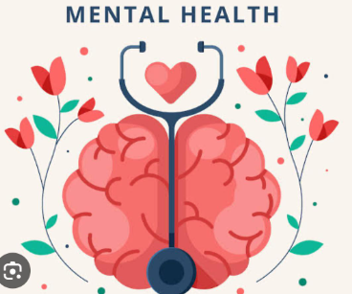
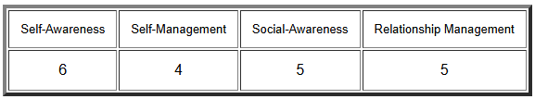
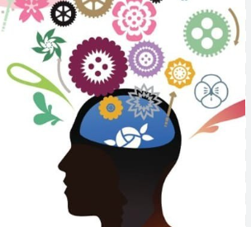
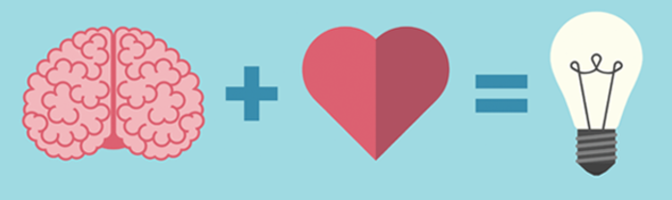
Emotional Intelligence (EI): Key Aspects and Personal Reflection
2. Self-Management: Self-management entails controlling feelings, cognitions, and behaviour in various contexts (Erhard et al., 2022). It’s primarily about self-control, flexibility, and optimism. I have learnt to control stress and avoid being distracted by it while handling tasks. I use mindfulness and specific types of breathing that have allowed me to control my temper in situations that require it.
Benefits:
helps in staying composed and making decisions under stress
Promotes efficiency and concentration.
Promotes changed thinking patterns and self-comforting behaviours
3. Mental Health: Mental health can be regarded as closely related to emotional intelligence because the aspect involves handling emotions (Kubala and Williams, 2022). I have come to know that having emotional intelligence affects mental health. Thus, by having a schedule for assessing when I want to run away from work or have anxiety or stress, I can act to take care of my mental health or engage in activities that may help, such as practising yoga or going for a run.
Benefits:
Eliminate stress and avoid cases of burnout
Improves emotional resilience
Reinforces a proper and positive way of thinking.
1. Social Intelligence: Social intelligence may be defined as the ability to comprehend and act appropriately in the complexity of social situations, interact favourably with other people, and express oneself in meaningful and compassionate manners (Krishnan and Rogers, 2014). I was able to observe positive changes in my ability to identify and react to the emotions of others, improving interpersonal relations. This makes me sensitive to the feelings of people I relate with daily.
Benefits:
Promotes better relations at the workplace and home
Accomplishes develop conflict resolution competencies
It opens people up to learning about others' experiences and makes them more understanding.
The Global EI Test Results
How I Plan to Improve My EI: I want to improve my EI and will do everything needed to achieve that objective. For the next three months, I will keep working on self-focus and awareness, which will assist me in regulating stress and recognising emotions. Besides, I will enhance my level of social intelligence by practising listening actively and being empathetic. My relaxed mental health issues are hitherto a work in progress, and alongside furthering other mental health activities such as writing and exercising, I will work hard and train myself to become stress-resistant and resilient to stress.

