Slide 1
How do we use Technology to collaborate at UWTSD?
2123160 SIDI MOHAMED ATHMANI
2120355 SHABANA AKHTAR
2118505 AMINA BEGUM
2123156 JAMEEL MUHIMIN
Module Title: Digital Skills and Research Methods
Module Code:BMSW4003
Tutor: Ngozi Ibeji

Slide 2
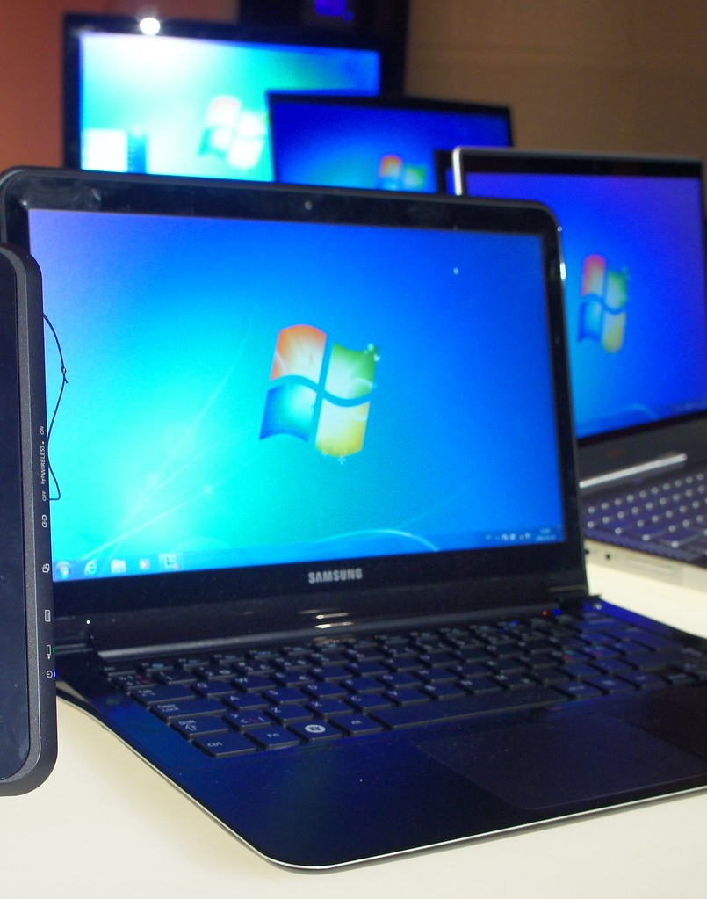
What we will present
Introduction
Rationale
Method
Questions
Ethical Considerations
Research Timeline
Hypothesis
Reference List
Sample of Questions
Jameel Muhimin

Slide 3
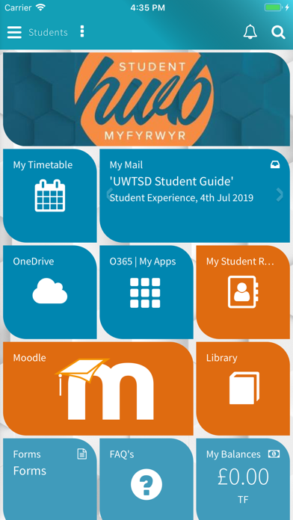

1.Introduction
Technology is constantly changing
Using technology confidently is crucial
Microsoft Teams, Moodle, and One Drive
Many students are new to education or returning after many years
Question: Is there a need to provide training on how to use technology to collaborate at UWTSD?
Jameel Muhimin
Notes:
At UWTSD, we are using technology like Microsoft Teams, Moodle, and One Drive to collaborate as we enter this new digital world.
Technology is evolving at a rapid pace and understanding how to use technology is critical to a student's ability to complete a course at UWTSD.
Many students at UWTSD are new to education or coming back after many years and even so tech has changed so drastically over the years even so it should not alter student way of learning, we would like to conduct a research to find out whether these students feel confident in using the technology systems for their course and if they could benefit with further training.
In this presentation, we will explore the question of whether there is a need for training on the use of technology for collaboration at UWTSD.
We chose to address this question because we can relate with the it , and we feel that there is not enough research on this topic here at Birmingham. We will only be foucising on the students in this study
We will explain the research we have selected on this topic and explain our research methodology and ethical considerations.
The study will provide a clear answer to the question of students currently enrolled in a course at UWSTD.

Slide 4





Rationale
Shabana Akhtar
Notes:
Working from home- work/school- Real life challenges New student myself
At UWTSD students can access Student HWB which provides many technological tools and information to fully support their studies. Students have access to Moodle, Teams, Outlook, One drive and many other supportive apps and resources. The benefits of this vast pool of support can only be unlocked if the student has sufficient skills to utilize what has been provided. The reason for conducting this research is to understand how confident students feel accessing and using HWB and any other technology required to be used during the course. Identifying what the students needs and digital capabilities are will aid students and UWTSD to plan a course of action if required. This will put students in a better position to succesfully complete the course.

Slide 5
Literature Review
It is necessary to design appropriate trainings for students. (Kopp1 et al 2019)
The focus on digital competence continues to grow in popularity in higher education,(Zhao, 2021)
Pandemic of covid has given rise to online learning which has continued in UWTSD. Effective integration of technology by staff required (Ali, 2020).
Study found a significant need for training to develop more in-depth knowledge of applications (Kvavik, 2022).
Shabana Akhtar
Notes:
We have looked through existing research and found articles to support the fact students could benefit from extra training in HE to support them digitally.
Speak about my sources
Ali (2020) studying has been hybrid last 2 years and theres still uncertainty out there in terms of teaching
Kvavik (2022) Although students possess general knowledge of using everyday tech, they don’t have the in depth knowledge to use it to its full potential.

Slide 6
Method
Quantitative Research
Males and Females over 18
MS Forms
Email to students
Analyze
Jameel Muhimin
Notes:
We will conduct research using a quantitative method to ascertain if students feel confident using technology to collaborate at UWTSD.
The study will involve both male and female students aged 18 over.
We will be using MS Forms to create our questionnaire
Which will then be sent out via email to level 4 students.
They will be asked to submit the form after answering and we will then analyse the results using graphs.

Slide 7

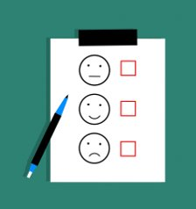
Questions
What questions?
Why?
Amina Begum

Slide 8




Closed
Consent
Confident in using MS Teams
Confident in using one drive applications
Rank order
How do you feel in navigating moodle
Likert
I feel confident using Outlook
Amina Begum
Notes:
These questions will help us to identify whether students need training to collaborate at uni.
Q1 – Will include the consent and permissions to use info
Q2 + 3 – closed question Y/N; identify a comparison between how many students report y/n.
Q4 – Rank order so we get idea how they feel; create a link between students feelings and their use of technology
Q5 – Likert scale on confidence of using outlook

Slide 9


What are Ethical considerations?
Confidentiality of data
Accuracy in analysing and reporting data
Safety of researcher
Privacy of participants
Treated fairly with openmindedness
Saunders et al 2019
Amina Begum
Notes:
Confidentiality; focus is on data collected and not on individuals so we shouldn’t expose who we collect the information from. Also there is more reliability of data when assurance of confidentiality is given.
Treated fairly; be open minded of peoples answers and treat all participants fairly, do not misrepresent findings if there is a conflict of interest and be truthful.
Accuracy in analysing data; results should not be falsified, all data must be reported even if they contradict what your supposed outcome was meant to be.
Safety of researcher; ensuring safety of the researcher so they are not harmed from social interactions with participants.

Slide 10


Ethical considerations we will follow
Purpose of the research
Permission
Consent
Right to withdraw
Private and confidential
Over 18
Amina Begum
Notes:
The reason for research will be communicated to the people taking part through the email
Permission will be asked to use info for review and conclusion and to be used in our written report
It is voluntary and do not have to take part and if they want they can withdraw
No personal questions asked, name address etc
Everyone attending UWTSD are over 18 so no underage persons

Slide 11
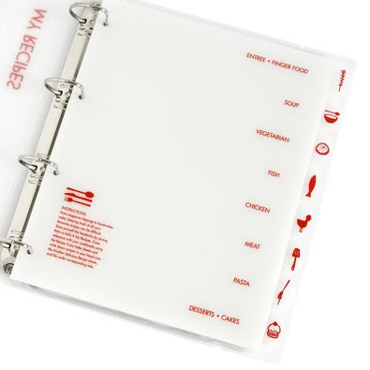
Research Timeline
Week 6-Create Microsoft Forms Questionnaire and send to participants.
Week 7-Analyse the returned results.
Week 8-Start writing the final report.
Week 9- Complete report and review.
Week 10- Submit Report
Week 3- Identify research question
Week 4- Plan how research will be conducted, look and review existing literature
Week 5-Plan our proposal
SIDI MOHAMED ATHMANI
This Photo by Unknown author is licensed under CC BY-SA-NC.
Notes:
Week 3 – To look at a selection of question and choose 'How do we use Technology to collaborate at UWTSD?' As we could relate to this question and saw learners in our group struggling with some of the technology tools used for the course.
Week 4- Look at a few different methods of research and decided to use Microsoft forms. We looked at some previous studies/research and literature to find out what had been discovered.
Week 5-To plan the proposal and work on the Powerpoint Presentation.
Week 6- To create the forms Questionaire, identify participants and send it to them.
Week 7 – Look at the results
Week 8- Use the results to start putting a report together
Week 9 –Time to review the completed report
Week 10- Submit Report!!!

Slide 12
Hypothesis
The development of digital competence needs to be perceived as part of lifelong learning,
(Zhao, 2021)
We think the study will find students need training with the technology tools they will use for their course.
Staff and student readiness needs to be fathomed and supported accordingly.
(Zhao, 2021)
undergraduate students need more training in digital technologies to integrate them into their educational experiences, (Kim, 2018)
Shabana Akhtar
Notes:
Many factors could contribute to the need for extra training including the student using technology for personal reasons, but the confidence or competence is not there to collaborate using tools necessary for the course. Training could be required on how to navigate the student HWB and finding all the resources available on Moodle or specific to using certain applications like powerpoint, teams, outlook etc. The studies, literature and reports we have looked at support what we think our findings will be. Talk about how sources are relevant.

Slide 13
Reference List
UWTSD(2022) Student HWB. Available at: https://www.uwtsd.ac.uk/hwb/#:~:text=Student%20Hwb%20%7C%20University%20of%20Wales%20Trinity%20Saint%20David (Accessed: 15 February 2022)
Zhao, Y., Llorente, A.M.P. and Gómez, M.C.S., 2021. Digital competence in higher education research: A systematic literature review. Computers & Education, 168, p.104212.
Kopp, M., Gröblinger, O. and Adams, S., 2019. Five common assumptions that prevent digital transformation at higher education institutions. INTED2019 Proceedings, 1, pp.1448-1457.
Kvavik, R.B., 2005. Convenience, communications, and control: How students use technology. Educating the net generation, 1(2005), pp.7-1.
Ali, W., 2020. Online and remote learning in higher education institutes: A necessity in light of COVID-19 pandemic. Higher education studies, 10(3), pp.16-25.
Kim, Hye J., Ah J. Hong, and Hae-Deok Song. 2018. "The Relationships of Family, Perceived Digital Competence and Attitude, and Learning Agility in Sustainable Student Engagement in Higher Education" Sustainability 10, no. 12: 4635. https://doi.org/10.3390/su10124635
Saunders, M.N.K., Lewis, P. and Thornhill, A. (2019) Research methods for Business students. 8th edition. Harlow: Pearson

Slide 14
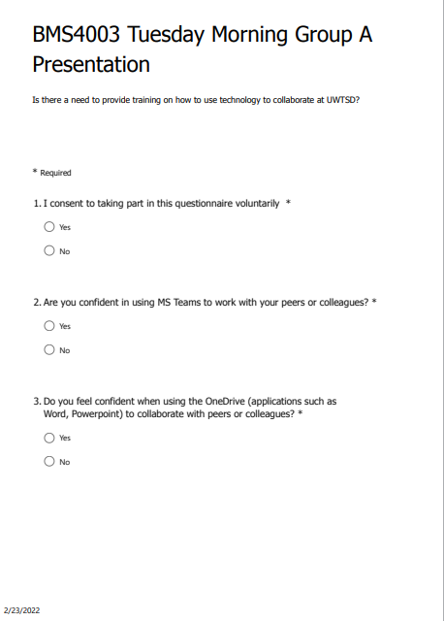
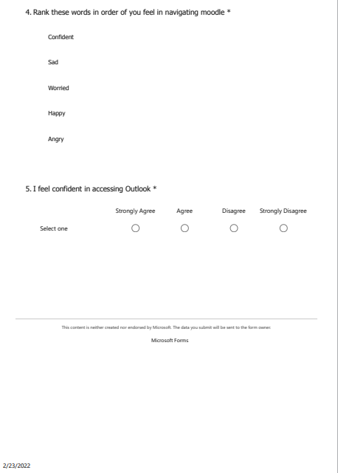
Questionnaire

