Slide 1
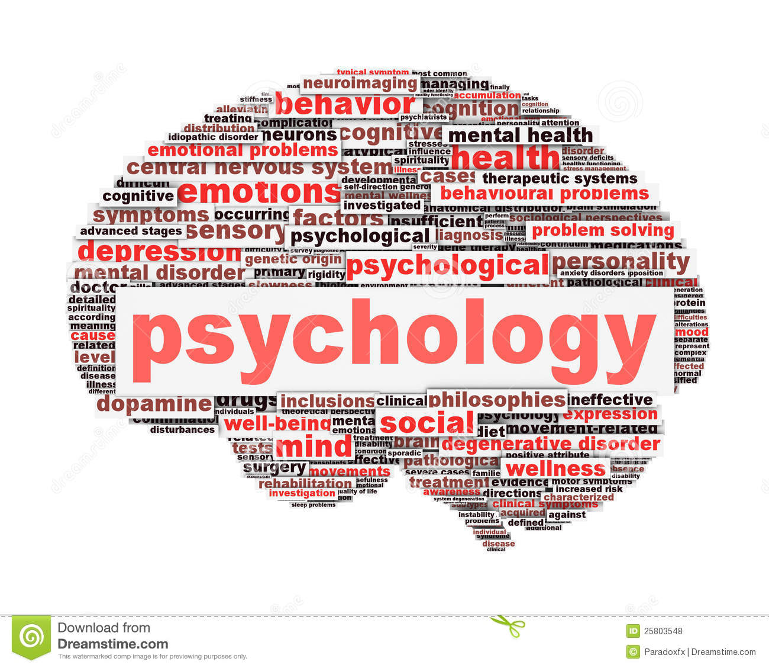
Name: Andreea Mirea
AD Student: 2523016
Module Code : LCHS4010 BIRM
Module: Psychology in Health and Social Care
Lecturer: Dr Rizwan Nadim

Slide 2

Contents
Introduction: Lifespan Development and Shona Case
Jean Piaget’s Attachment Theory
Application to Shona’s situation
Practical strategies and interventions
Nature and nurture
Critical evaluation
Conclusion
Reference

Slide 3
Introduction
Lifespan Development in Early Childhood
Early childhood is an important period of lifespan development in which children experience significant physical, cognitive, emotional and social changes. During this stage, children develop greater independence, communication abilities, social relationships and emotional understanding. Their development is influenced by interactions with caregivers, peers and the environment. Understanding these developmental changes enables early years practitioners to provide appropriate support and learning opportunities that meet each child’s individual needs (Berk, 2018).
Role of Psychology in Health and Social Care
Psychology contributes to health and social care by enabling practitioners to understand human behaviour, emotions, cognition and development. This knowledge supports person-centred care, helping professionals identify individual needs and promote physical, emotional and social wellbeing. In early years settings, psychological knowledge can help practitioners understand children’s beha viour and provide appropriate support for their developmental needs (Berk, 2018).
Case Scene Shona (Age 3)
In Shona’s case, psychology helps practitioners understand her anxiety, limited communication and difficulties with social interaction. Applying psychological knowledge enables practitioners to identify her developmental needs and provide person-centred support, such as reassurance, play-based activities and opportunities for positive peer interaction. This can promote Shona’s emotional, social and cognitive wellbeing within the nursery environment (Berk, 2018).

Slide 4
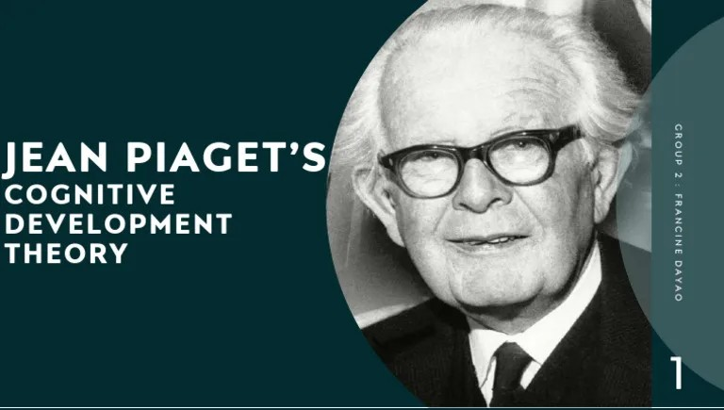
​
Piaget’s theory explains that children actively construct knowledge by interacting with their environment. The key concepts are schemas, assimilation and accommodation. Schemas are mental frameworks used to organise knowledge. Assimilation occurs when children incorporate new experiences into existing schemas, while accommodation involves modifying schemas when new information does not fit their existing understanding.
(Piaget, 1952).
Early childhood is a significant period of lifespan development, during which children experience rapid physical, cognitive, emotional and social growth. According to Piaget’s Cognitive Development Theory, children aged 2–7 years are in the preoperational stage. At this stage, children develop language, imagination, symbolic thinking and communication skills, although their logical reasoning is still developing (Piaget, 1952).

Slide 5
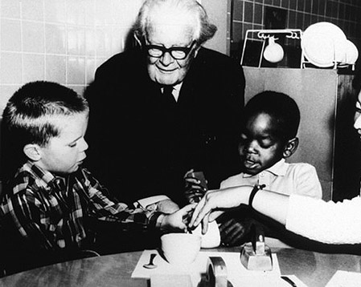
Applying Piaget’s Theory to Shona
Piaget’s theory helps explain Shona’s development by recognising that, at three years old, she is in the preoperational stage, where language, symbolic thinking and social understanding are developing. Her limited communication and difficulty engaging in group play may indicate a need for additional opportunities to learn through active, play-based experiences. Practitioners can therefore provide visual resources, simple activities, repetition and small-group play to support her cognitive, communication and social development at an appropriate pace (Piaget, 1952).
At three years old, Shona is in Piaget’s preoperational stage, where language and social understanding are developing. Her anxiety, limited communication and difficulty with group play may reflect challenges in adapting to new experiences. Piaget’s theory suggests that children learn through interaction with their environment. Therefore, routines, play and repetition can support Shona’s cognitive and social development (Piaget, 1952).

Slide 6

Application to Shona’s development
Shona’s transition into nursery involves unfamiliar experiences that may require time and repetition to understand. Piaget’s theory supports practical learning opportunities, although it does not fully explain her separation anxiety or communication difficulties (Piaget, 1952; Flavell, 1963).
- Emotional development: Predictable routines and visual timetables may increase familiarity and reduce uncertainty. Consistent reassurance from practitioners can also support Shona’s emotional wellbeing (Department for Education, 2024).
Cognitive development: Providing Shona with puzzles, picture books and sensory activities can encourage exploration, language development and problem-solving. These activities are appropriate for Piaget’s preoperational stage because they allow Shona to learn through active interaction and play (Piaget, 1964; Berk, 2013).
Physical development: Outdoor play, drawing and construction activities can strengthen Shona’s fine and gross motor skills, coordination and independence. These experiences provide opportunities for active learning while supporting her overall physical development (Department for Education, 2024; Whitebread etal., 2012).
Social and emotional development: Small-group activities, role-play and supported peer play can provide Shona with opportunities to communicate, develop confidence and establish positive relationships. Consistent encouragement can help her feel more secure and willing to participate.(Wood, Bruner and Ross, 1976).

Slide 7
Nature and nurture
Practical Strategies for Shona
Practitioners should provide structured, play-based activities that meetbased activities that respond to Shona’s individual developmental needs. Using visual aids, clear instructions and repetition can enhance her understanding, while small-group activities can gradually develop her social participation and confidence. Ongoing observation and collaboration with her carers can help practitioners evaluate and adapt her support plan appropriately (Department for Education, 2024; Wood, Bruner and Ross, 1976).
In Shona’s case, both nature and nurture may contribute to her psychological development. Nature refers to biological influences, such as inherited characteristics, temperament and individual developmental patterns, which may affect her communication and emotional responses.
Nurture includes environmental influences such as relationships with carers, previous experiences and the transition into nursery. Shona’s separation anxiety and limited communication may therefore be influenced by the interaction between her individual characteristics and environmental experiences (Berk, 2018).

Slide 8

Critical evaluation Strengths and Limitation.
Piaget’s theory is useful because it encourages practitioners to provide practical, play-based learning appropriate to children’s developmental abilities. It supports exploration, curiosity and independent problem-solving.
Child-centred: Piaget views children as active learners who develop knowledge through exploring their environment (Piaget, 1952).
Clear framework: His developmental stages provide practitioners with a structured way to understand children’s cognitive abilities. (Piaget, 1952).
Practical application: The theory supports play-based learning, exploration and problem-solving, which can benefit Shona’s cognitive development.(Piaget, 1952).
Limitation
Rigid stages: Children develop at different rates, so Piaget’s stages may not apply equally to Shona.
Limited social emphasis: The theory gives less attention to social interaction and adult guidance, which are important for Shona’s communication. (Piaget, 1952; Berk, 2013).
Cognitive focus: It focuses mainly on cognitive development and may overlook emotional and environmental influences.

Slide 9
Therefore, Vygotsky may be more applicable than Piaget because it focuses strongly on Shona’s social and communication needs.
Social interaction: Vygotsky emphasises that children develop knowledge and skills through interaction with adults and peers. This is relevant to Shona because supportive group activities can improve her communication and social participation (Vygotsky, 1978). ​
Zone of Proximal Development (ZPD): Vygotsky suggests that children can achieve more when they receive appropriate guidance from a knowledgeable adult. Practitioners can therefore use scaffolding, such as modelling language and providing simple instructions, to support Shona’s development (Vygotsky, 1978; Wood, Bruner and Ross, 1976). ​
Conclusion
Piaget’s theory provides a useful framework for supporting Shona through exploration and play. Predictable routines, practical activities and gradual social interaction can promote her development. However, her individual characteristics and environmental experiences must also inform the support plan (Piaget, 1952; Berk, 2013).

Slide 10

Reference:
Reference
psycnet.apa.org. (n.d.). APA PsycNet. [online] Available at: https://psycnet.apa.org/record/2009-05801-000
Google Books(2025) The Origins of Intelligence in Children. [online] Available at: https://books.google.com/books?id=H7MkAQAAMAAJ
flavell, h (1966) the developmental psychology of jean piaget. [online] d. van nostrand company, inc. Available at: https://archive.org/details/developmentalpsy0000john
Early years foundation stage statutory framework For group and school-based providers Setting the standards for learning, development and care for children from birth to five. (n.d.). [online] Available at: https://dera.ioe.ac.uk/id/eprint/40850/1/EYFS_statutory_framework_for_group_and_school_-_based_providers.pdf
Toy Industries of Europe (2024) Championing Play | Policy Guide for EU Decision-Makers. [online] Available at: https://www.toyindustries.eu/championing-play/
Piaget, J (1964) Piaget, J (1964) Cognitive Development in Children Development and Learning. Journal of Research in Science Teaching, 2, 176-186. - References - Scientific Research Publishing. [online] www.scirp.org. Available at: https://www.scirp.org/reference/ReferencesPapers?ReferenceID=1386216
Wood, D.W., Bruner, J.S.B. and Ross, G.R. (1976). The Role of Tutoring in Problem Solving. In: Journal of Child Psychology and Psychiatry. [online] Great Britain: Pergamon Press, pp.89–100. Available at: https://w.pauldowling.me/tmr/readings/Wood,%20Bruner%20&%20Ross.pdf
Piaget, J. (1952) The Origins Of Intelligence In Children. [online] Available at: https://archive.org/details/in.ernet.dli.2015.188455
sejemol487 (2024) Child Development 9th Edition pdf. [online] Scribd. Available at: https://www.scribd.com/document/791018265/Child-Development-9th-Edition-pdf
Vygotsky, L. (1978) Mind in Society: The Development of Higher Psychological Processes. [online] Harvard University Press. Available at: https://pauldowling.me/tmr/readings/LSVygotsky_1978_MindinSocietyDevelopmentofHigherPsycholo.pdf

