Slide 1
LCBB5002
Management Accounting
Assessment 2 Support

Slide 2
LEARNING OUTCOMES
﻿Prepare control reports which show original, flexed and actual budgets
Calculate key variances.
Evaluate decisions using relevant costing
Demonstrate decision making abilities under risk.

Slide 3
Key Information
70% of the final Grade
2500 words with calculations: Part A: 1500 words for budgeting and variance analysis, Part B: 1000 for relevant costing in decision making
In-depth critical analysis
Must practice week 8 mock question
Application to the scenario and any real-world examples
Evidence of wide reading

Slide 4
Sample Contents Page
1 -Introduction
2-Main body
2.1- Part A: Question 1
Question 2
Question 3
2.2 –Part B: Question 1
4- Conclusion
5- References

Slide 5
Question
Amana Ltd is a family-owned tourist business located in England which sells souvenirs to tourists. They have several locations in tourist hotspots across England namely Brighton, London bridge, Westminster bridge, Buckingham Palace, Birmingham city centre and Manchester city centre. Souvenirs are produced by a Chinese manufacturer specifically according to designs made by the Amana team.
The complete scenario is on the Assessment 2 brief which can be found on Moodle.

Slide 6
Part A
Prepare the monthly control report showing original budget, flexed budget, and variances. (25 marks)
Using your control report prepared in (i) above, prepare a report on Amana’s performance during the year 2020. (20 marks)
Provide recommendations to Amana’s CEO on areas of improvement. (15 marks)
(1500 words, TOTAL = 60 marks)

Slide 7
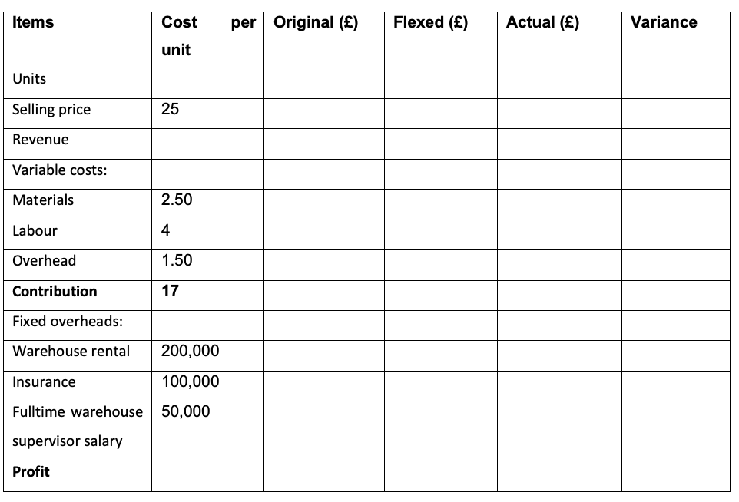
Part A: Things to consider - show your workings clearly by using the right proforma
Show direction of variances – favourable or unfavorable

Slide 8
Part A contd: Things to consider
ii) Using your control report from question i, prepare a report on Amana’s performance during the year 2020. Here you should make some reference to the scenario such as:
Selling price was reduced in order to increase revenue – is this a sustainable strategy?
iii) Provide recommendations to Amana’s CEO on areas of improvement.
They may need to consider switching suppliers as cost of materials have gone up.

Slide 9
Critical Analysis Methodology
Using the PER methodology, we shall look at Amana’s performance
Point – Reduction in selling price
Explain – The selling price and quantity sold determine revenue generated by any business.
Relate back to the scenario: Amana Ltd has reduced their selling price in 2020 which may have been done in other to increase sales and remain competitive (Alegre and Sard, 2017). However, reducing prices to stimulate sales is not a sustainable strategy , thus prices should be reviewed to ensure they generate long term profitability.

Slide 10
Critical Analysis Methodology
Using the PER methodology, we shall look at recommendations for Amana ltd.
Point – Increase in cost of materials
Explain – As this is a product-based business, cost of materials will be a significant part of their cost structure and must be monitored efficiently.
Relate back to the scenario: The cost of Amana’s materials has increased in 2020. Given that souvenirs are their core products, they must ensure that material costs are kept under control without compromising on quality (Weustink et al., 2000). It is advisable for Amana ltd to consider switching to a cheaper supplier with good track records.

Slide 11
Part B
Mr Amana has noticed that a lot of his competitors now sell online to customers in the UK, Europe and US. He has been considering closing the Brighton, Birmingham city centre and Manchester city centre branches in order to streamline the business activities and move 50% of their sales online. Several factors have to be taken into consideration when making this decision. The complete scenario is on the Assessment 2 brief which can be found on Moodle.
Requirement: In your report, provide an analysis of Mr Amana’s decision to go online and advise if they should set up their own online shop or sell on Amazon. You should take into consideration all the relevant costs. (1000 words, TOTAL = 40 marks)

Slide 12
Part B: Things to consider
Which business option is better and why
You need provide the pro and cons of the option chosen
Take into consideration all relevant costs provided
Use headings to separate your points.

Slide 13
Materials to use
Textbooks for basic understanding
Research Articles
Financial news such as financial times, morning star or Reuters

Slide 14
References
Alegre, J. and Sard, M., 2017. Price strategies by German and British tour operators in Mallorca. Journal of Hospitality and Tourism Management, 33, pp.93-102.
Rhode, S. and Garrison, N. (2019) Management Accounting. Sixth edition. London, England: McGraw Hill
Weustink, I.F., Ten Brinke, E., Streppel, A.H. and Kals, H.J.J., 2000. A generic framework for cost estimation and cost control in product design. Journal of Materials Processing Technology, 103(1), pp.141-148.

Slide 15


